Slide 1
Uni Compartmental Knee Arthroplasty
Indications & Rehab
Jeff Silverstein, MD, FAAOS
360 Orthopedics

Slide 2
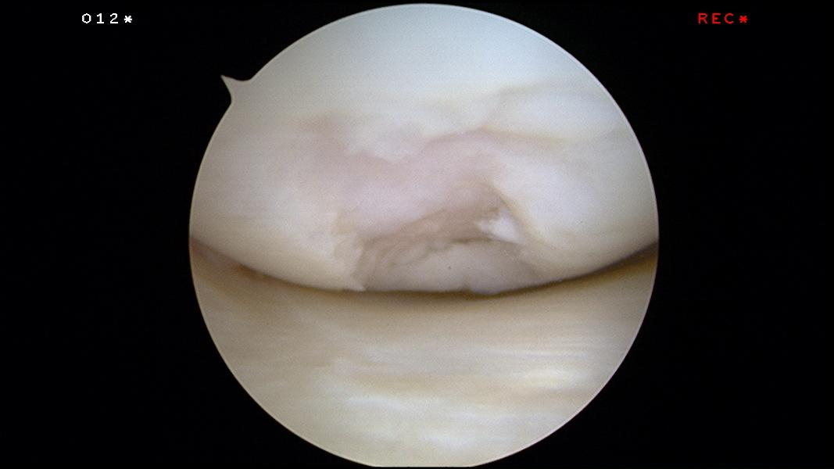
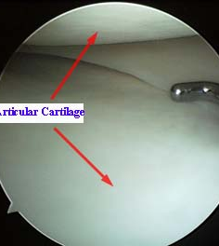
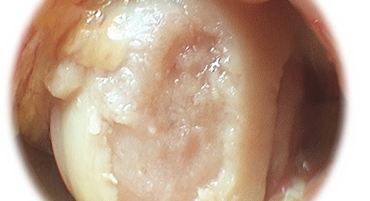
Arthritis = loss of cartilage

Slide 3
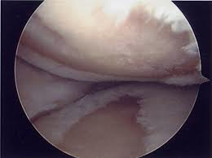
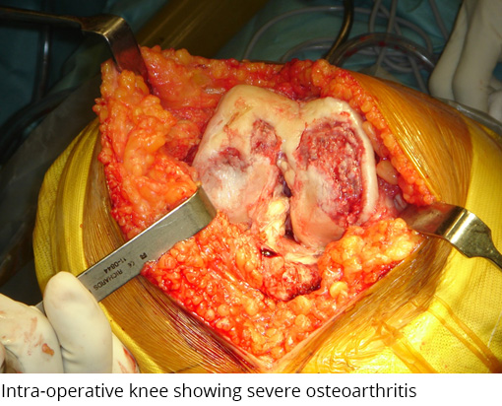
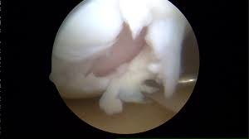

Slide 4
What is the goal of Knee Replacements
Pain relief / cover the exposed bone
Restore motion
Correct alignment

Slide 5
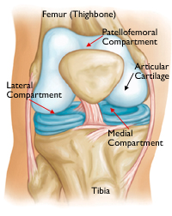
3 Compartments

Slide 6
So why bother with a “Uni/Partial”
Do we need to replace the non-arthritic parts of the knee?

Slide 7
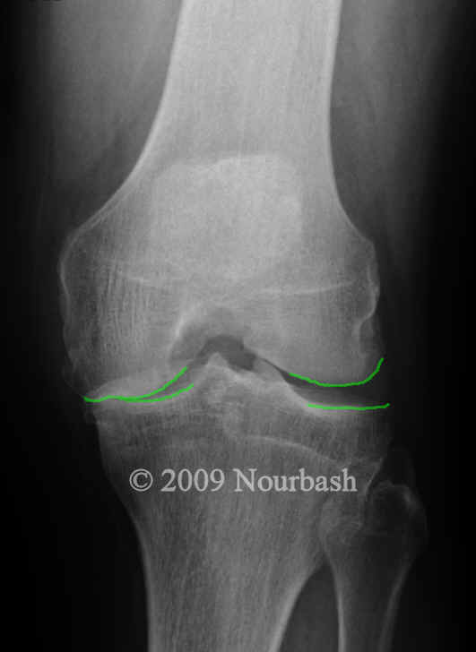
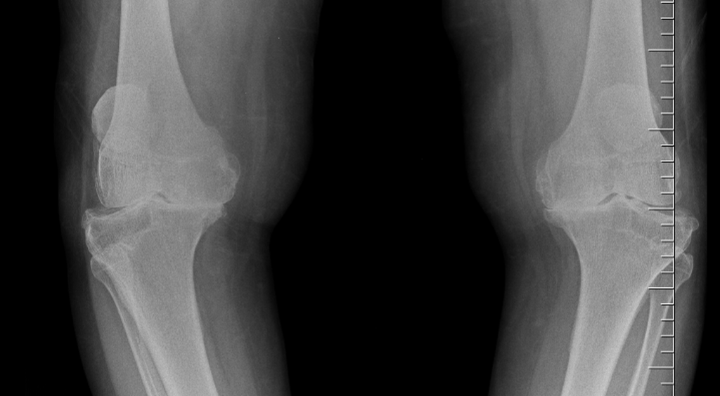
Same operation for both knees?
Isolated Medial DJD
Severe Tri-Compartmental DJD

Slide 8
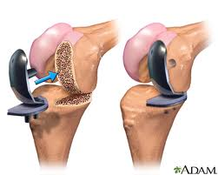
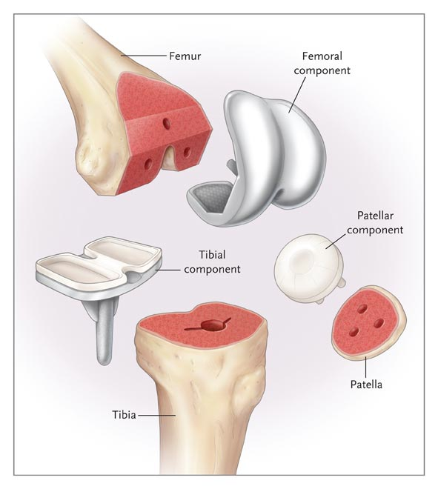
Uni vs Total

Slide 9
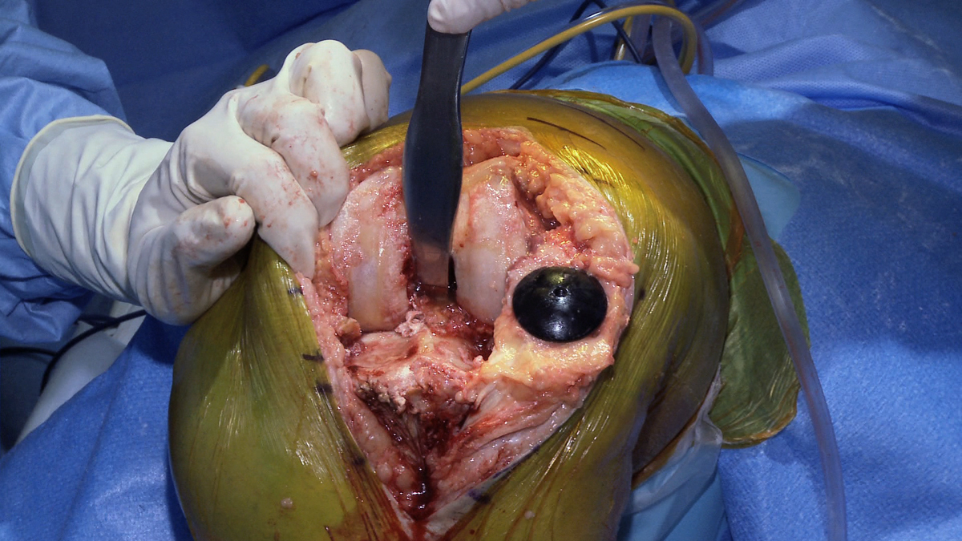
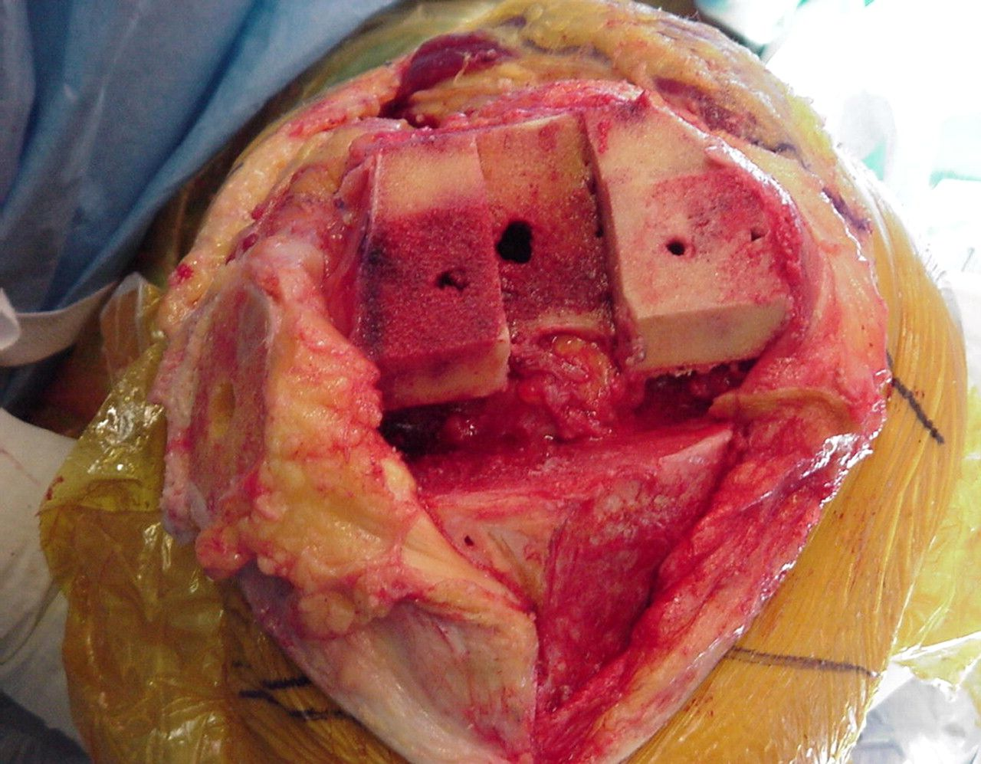
TKA Exposure = Dislocating Knee Joint

Slide 10
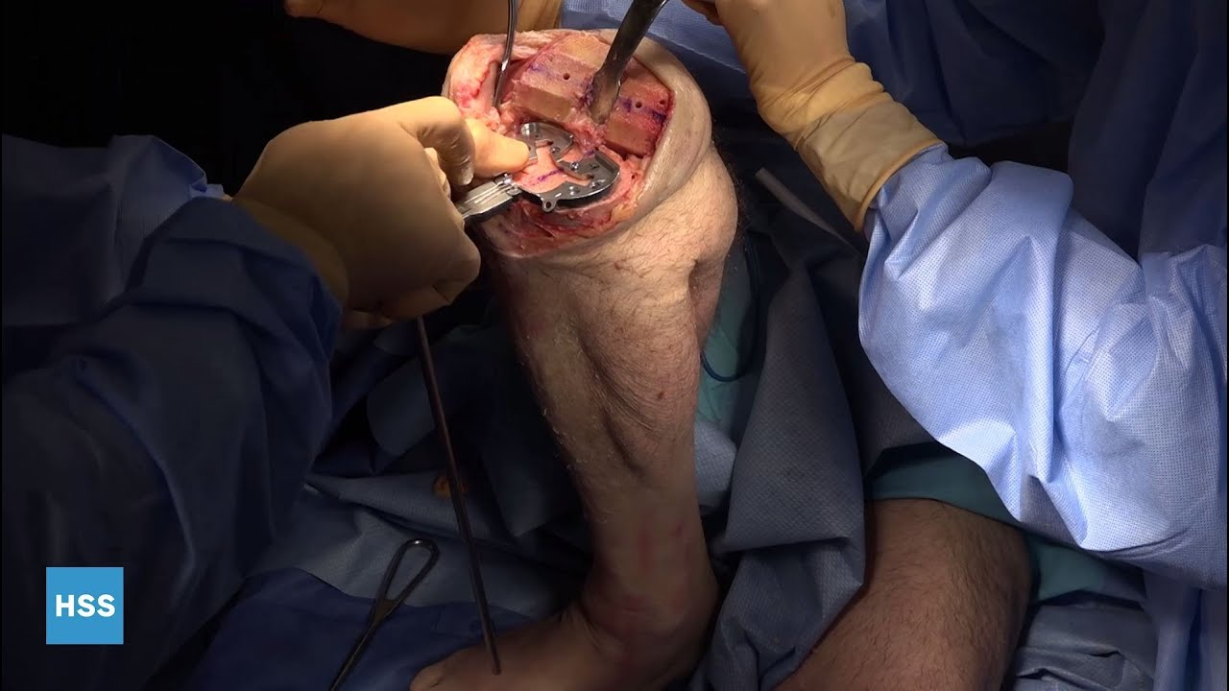
Soft Tissue/Dislocation

Slide 11
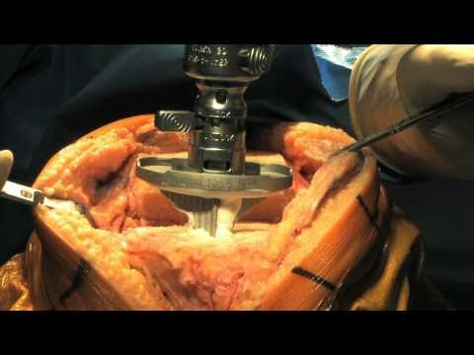
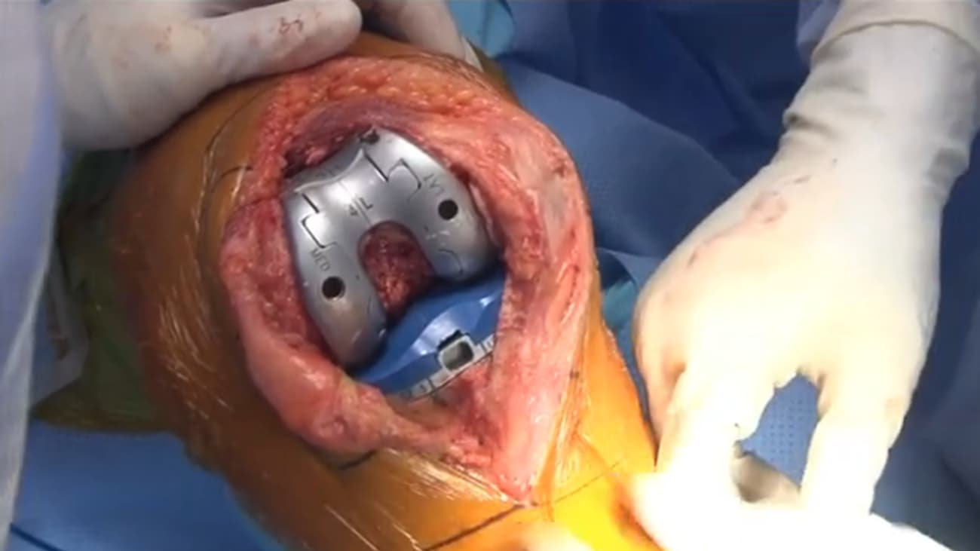

Slide 12
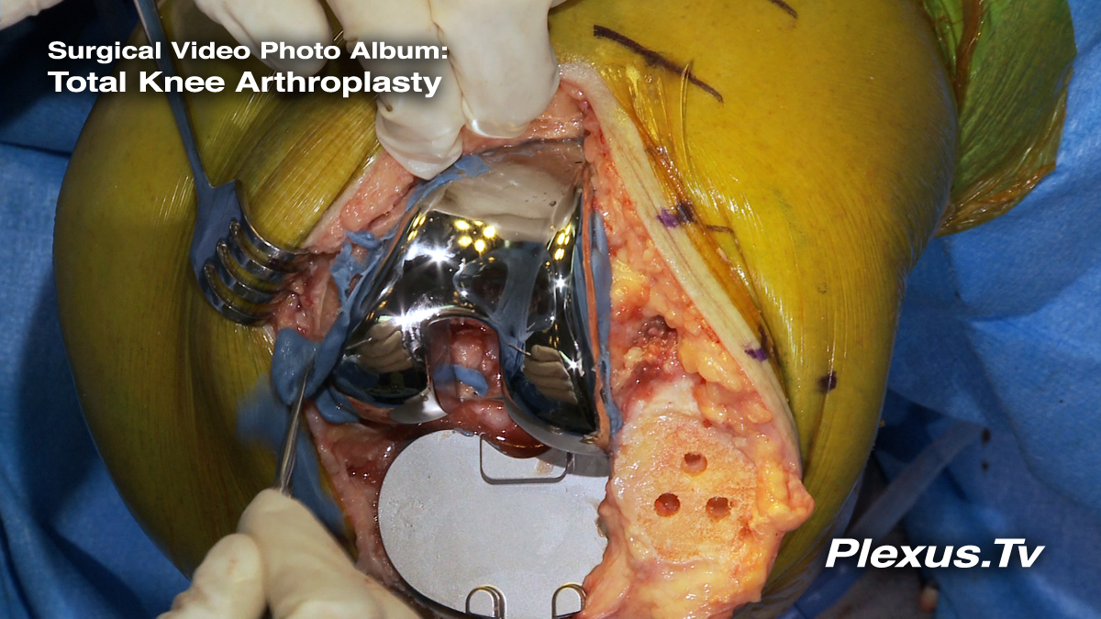
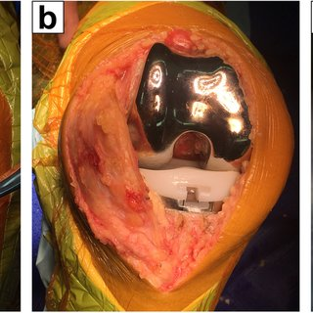

Slide 13
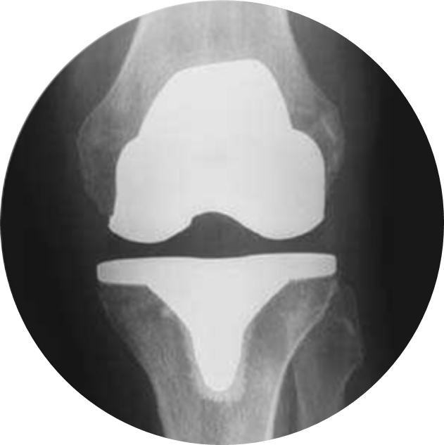
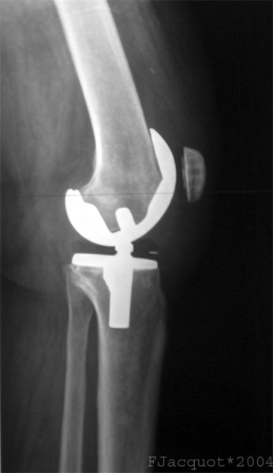
Total Knee Arthroplasty

Slide 14
TKA
TKA accomplishes the goals above and “Resurfaces” or “Replaces” all three areas ; WHEN NEEDED

Slide 15
So Why bother with a “Uni”
Do we need to replace the non-arthritic parts?
  Uni can feel more natural
  Retain ACL/PCL
  Less invasive/Quicker recovery
10-15% patients say with a TKA expectations were not met ---- “discomfort”

Slide 16
“Uni” Arthroplasty
  Replaces only the affected knee compartment
  Medial, Lateral or Patella Femoral
  Retain ACL/PCL and meniscus in other area

Slide 17
Uni Knee
Historically
  5-10% of TKA arthroplasty patients could be candidates for a “uni” arthroplasty statistically
Newer Data
  Suggestive up to 30% - 40% could be a candidate

Slide 18
American Joint Replacement Registry
2012 to 2021
  1.5 million TKA
  131,000 Uni’s ( 8%)

Slide 19
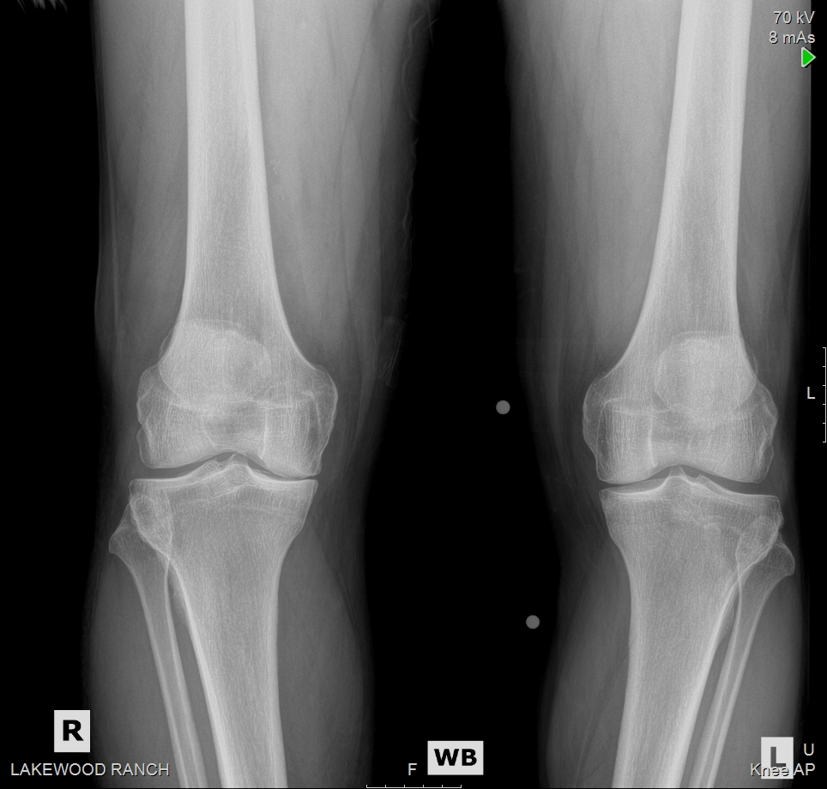
Varus/Medial DJD
Does this patient need a TKA?

Slide 20
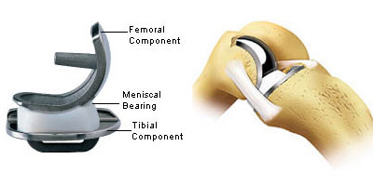
Uni Knee

Slide 21
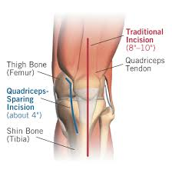
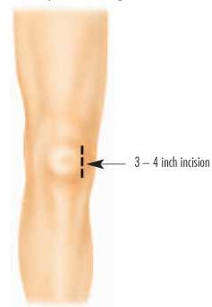
Uni Incision Quad Sparing

Slide 22
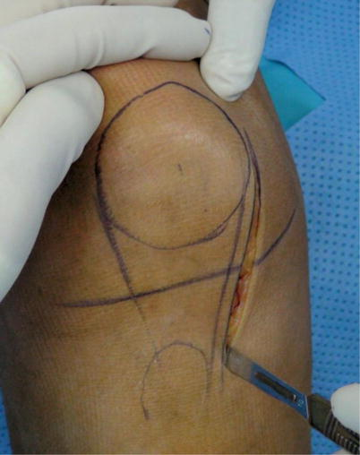
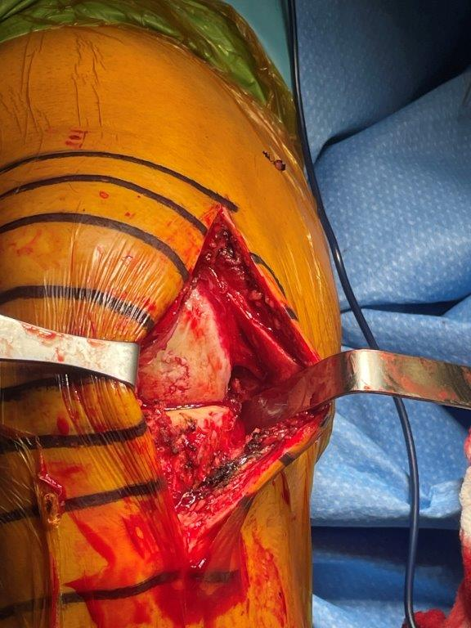
Medial Uni Incision
Working “In-situ” with uni medial/lateral
Quad sparring typically
Don’t “dislocate” the knee
4 inch incision along side of patella

Slide 23
Uni Medial Exposure

Slide 24
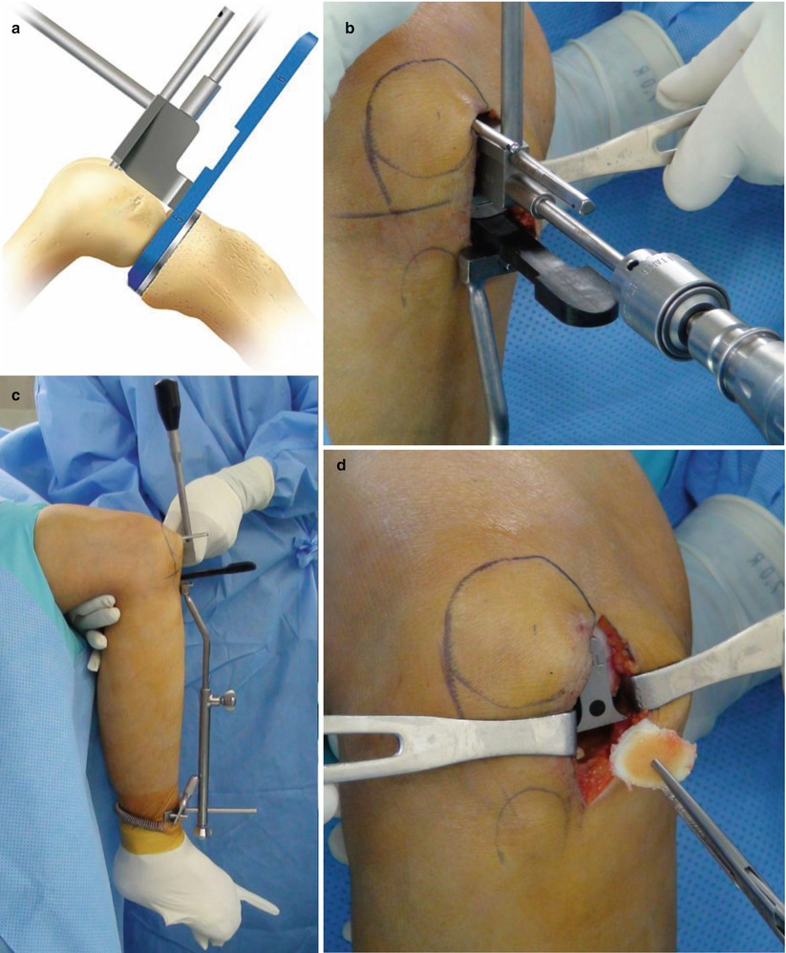

Slide 25
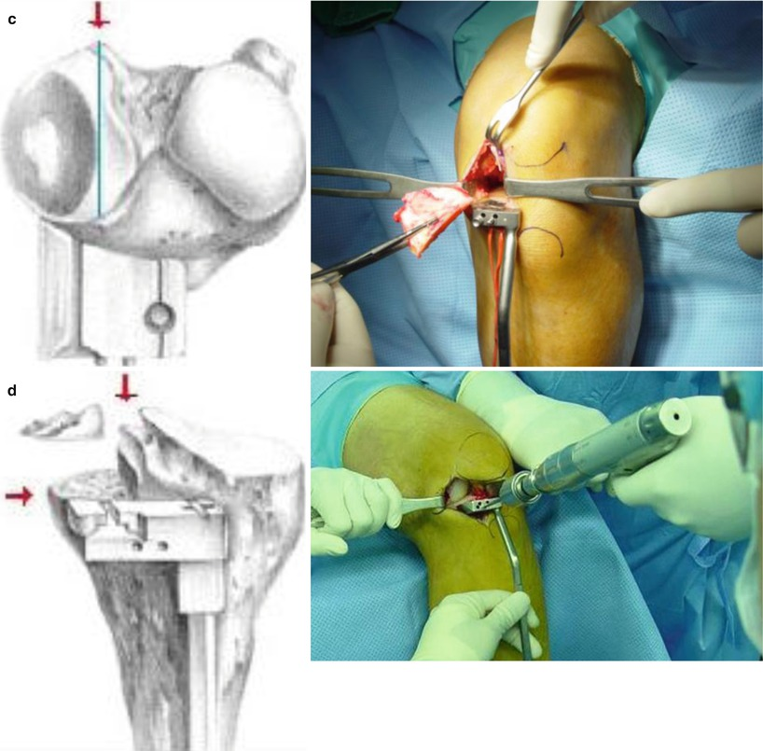

Slide 26
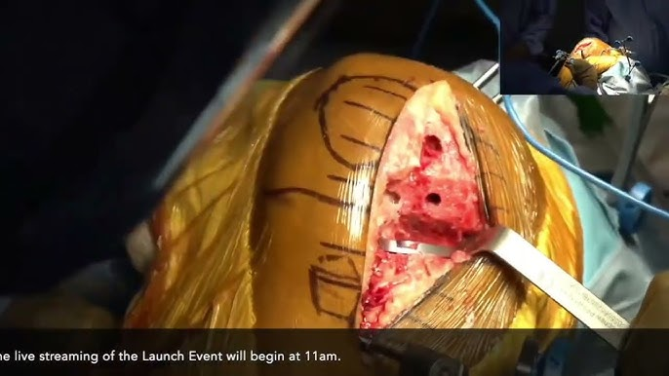

Slide 27
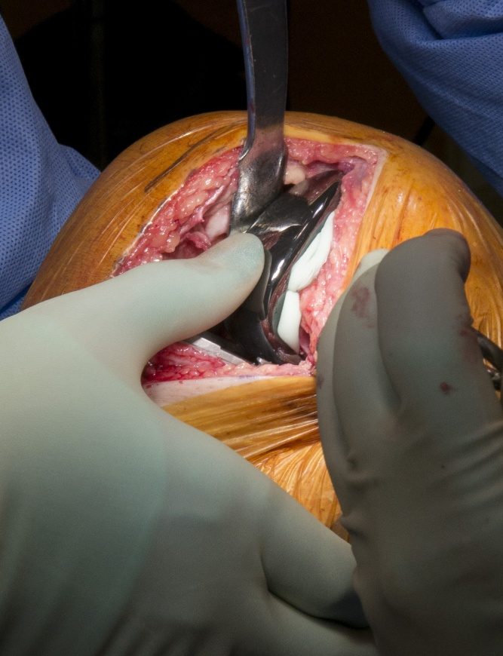
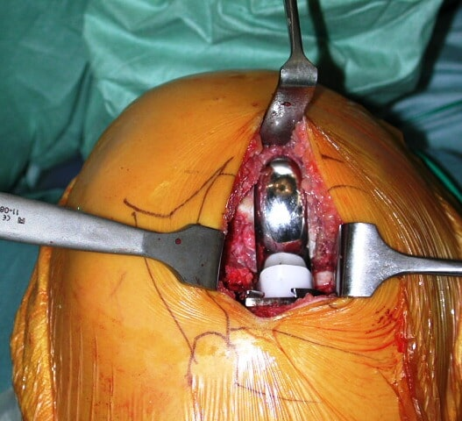

Slide 28
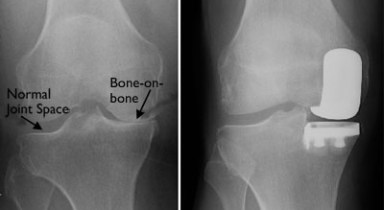
Medial Knee DJD and Uni

Slide 29
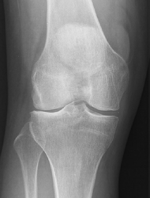
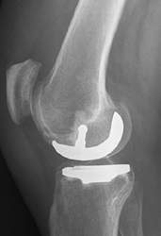
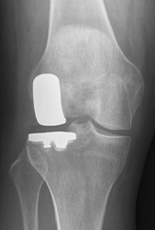
Lateral Uni Arthroplasty

Slide 30
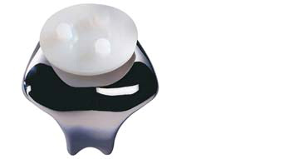
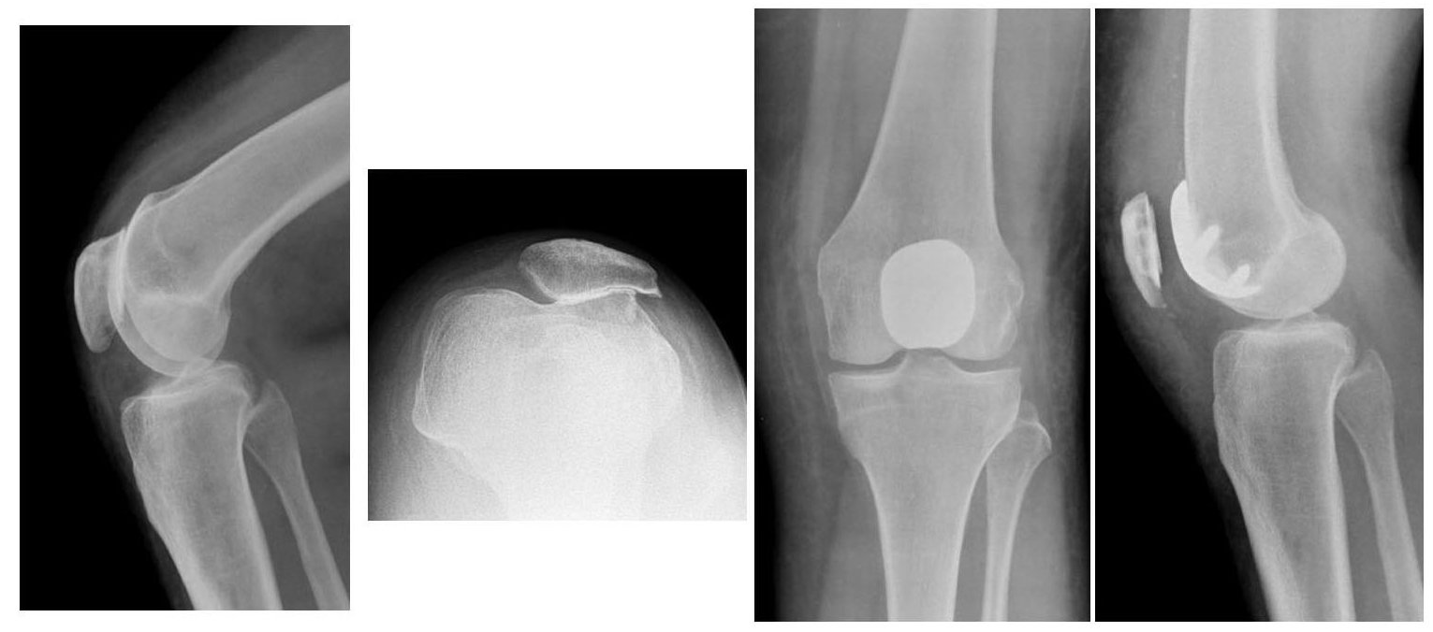
Patella Femoral Joint “Uni”

Slide 31
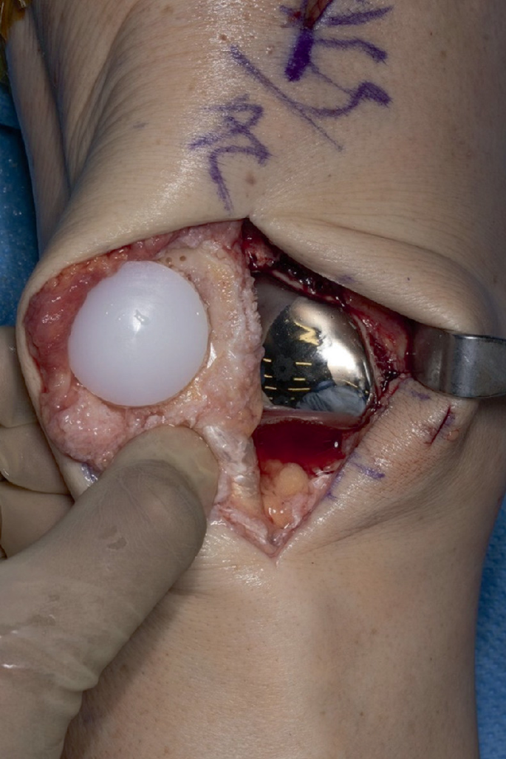
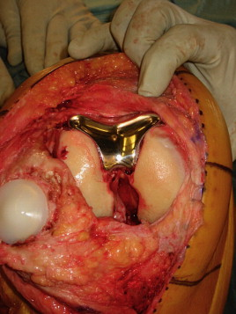

Slide 32
Uni Knee Indications
Isolated uni/single compartment disease
  No signs of arthritis in other areas

Slide 33
Uni Knee Indications
Non-inflammatory arthritis only: osteoarthritis
  Avoid Rheumatoid
  Lupus
  other “inflammatory” arthritis
  Otherwise will develop DJD in other areas

Slide 34
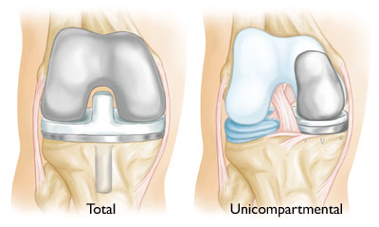
Uni Knee Indications
ACL intact b/c not built into uni knee design
  It is built into the TKA design
  Some will do combined uni and ACL reconstructions

Slide 35
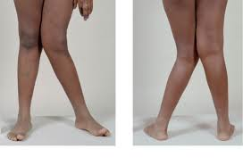
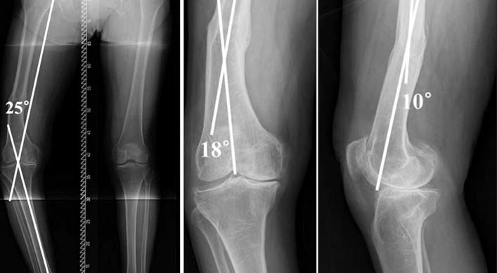
Uni Knee Indications
Pre op fixed varus/valgus deformity < 10 deg
  Balancing soft tissues difficult to get stable knee

Slide 36
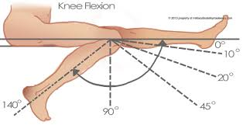
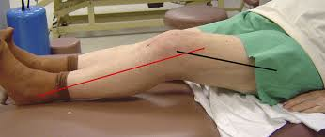
Uni Knee Indications
Limited Flexion Contractures < 10 Degrees
Pre-op ROM > 90 degrees
Difficult to “balance” knee, will need releases; posterior capsule, MCL/LCL, ITB, Popliteus

Slide 37
Uni Knee Indications
No prior meniscal surgeries on opposite side
  Will lead to early adjacent compartment arthritis

Slide 38
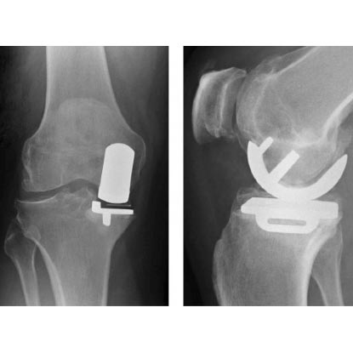
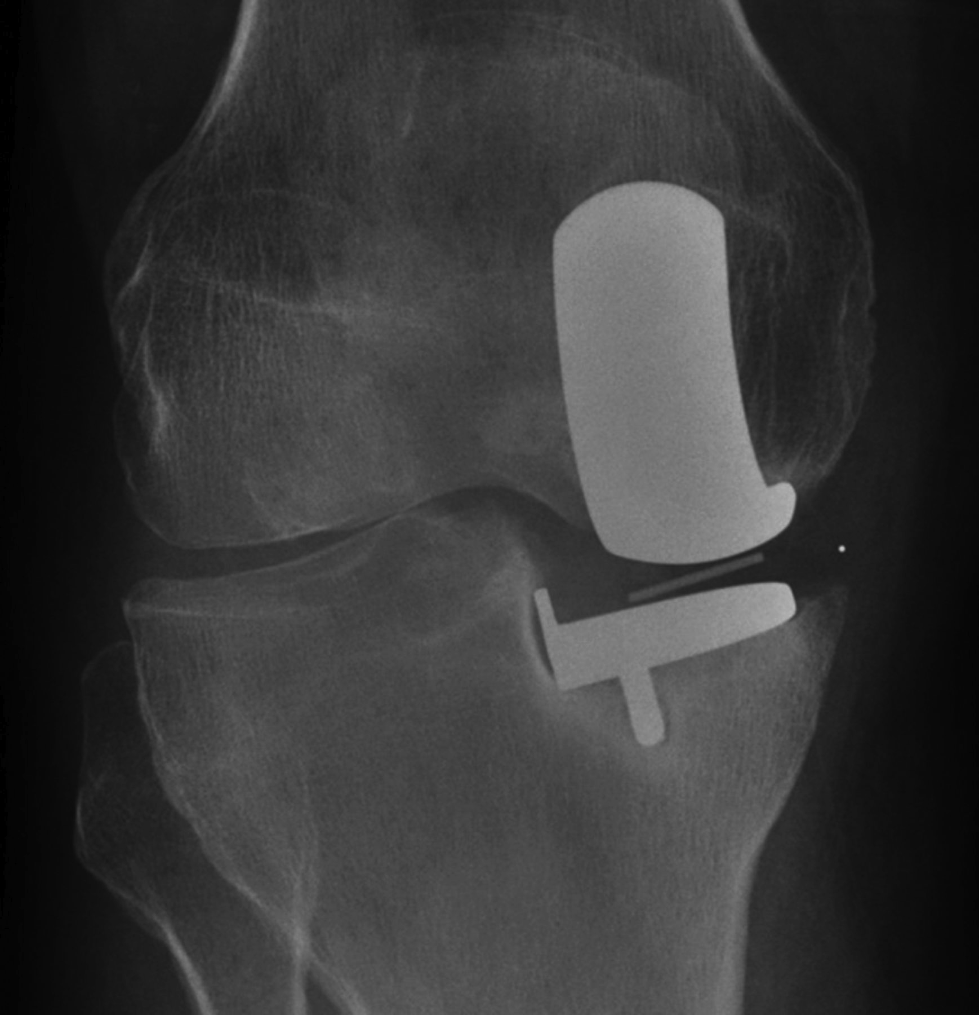
Age? Relative Indications
Relative contra-indications b/c of the osteoporotic tibia bone
  Reports of higher tibial subsidence,
However uni’s more favorable in elderly b/c less invasive?…..

Slide 39
Obesity?
Not proven to have negative outcome on survivorship of a “Uni”
Actually some studies more favorable than TKA b/c less invasive, improved pain, ROM
Overall increased BMI > 40 has higher risk for all complications in Uni and TKA

Slide 40
PFJ Indications
Isolated PFJ DJD

Slide 41
PFJ Similar Contraindications
Concomitant medial/lateral arthritis
“Inflammatory” arthritis
Patellar Mal-alignment
Varus/Valgus deformities
Flexion Contractures
Instability

Slide 42
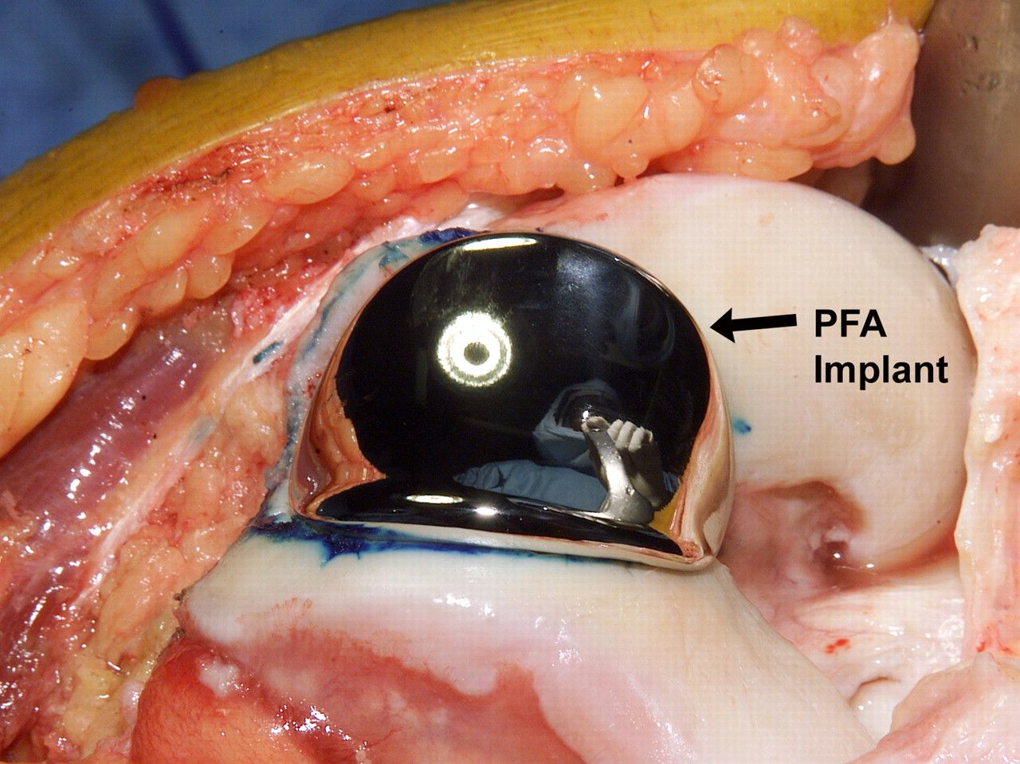

Slide 43
TKA Survivorship
Swedish and Australian Registries
  10 year @ 95%
  15 year @ 90%
  20 year @ 85%

Slide 44
Uni “Survivorship”
Have to stratify out medial, lateral, PFJ
Most common in medial uni
Older designs higher failure rate so “registry data” may be biased

Slide 45
Medial Uni Survivorship
10 year survivorship 90%+ ( TKA @ 95%)
15 year survivorship 85%+ ( TKA @ 90%)
Overall current technology Uni survivorship improving getting closer to TKA
But slightly inferior survivorhip

Slide 46
Lateral Uni Survivorship
JOA 2024
2001 to 2021, 161 knees
97% @ 5 years
95 % @ 10 years ( TKA @ 95%)
91 % @ 15 years ( TKA @ 90%)
Equivalent to TKA?

Slide 47
Uni Survivorship
Short to Medium term 10 year @ 90-95% depending on implant type/technique
15 year follow up ~ 89%
Uni Functional satisfaction > 95% @ 10 years
TKA Functional satisfaction ~ 85% @ 10 years

Slide 48
PJF Outcomes
Historically worse compared to TKA
  Due to design flaws
Improved designs over past decades
Survivorship improving

Slide 49
PFJ Survivorship
5 year 90%
10 year 80% ( TKA @ 95% )
15 year 70% ( TKA @ 90% )

Slide 50
Survivorship Summary
TKA
  10 year 95%
  20 years 85 -90 %
Medial/Lateral uni
  10 year 90-95%
  15 years 85%
  20 years 70-75%
PFJ
  5 year 90%
  10 year 80%
  15 year 70%

Slide 51
Survivorship Summary
Uni knee
  Great 10 year data
  Falls off after 15+ years due to progression in other areas or aseptic loosening
  Older designs higher failures
  Newer designs better success
  Higher Satisfaction rates @ 10 years compared to TKA

Slide 52
Survivorship Summary
Consider I can revise a failed uni to total knee easier than a failed total to a new total if and when that happens….So think about age of patient, how many surgeries will they need?

Slide 53
Uni Recovery/Rehab
Surgery < 1 hour
Outpatient Sx
WBAT, Immediate ROM
Recovery up to 6 - 12 weeks
~ ½ the time as TKA

Slide 54
My Uni Clinical Experience
< 10% of my practice
Average recovery is 4-6 weeks faster than TKA
I see patients having less pain / faster rehab
Typically back to baseline by 8+ weeks as opposed to 12-16+ weeks with a TKA

Slide 55
My Uni Clinical Experience
Uni knees have less muscle atrophy, mal-alignment, deformity, require less ligament releases to balance.
  On average they do recover faster
  Better patients??

Slide 56
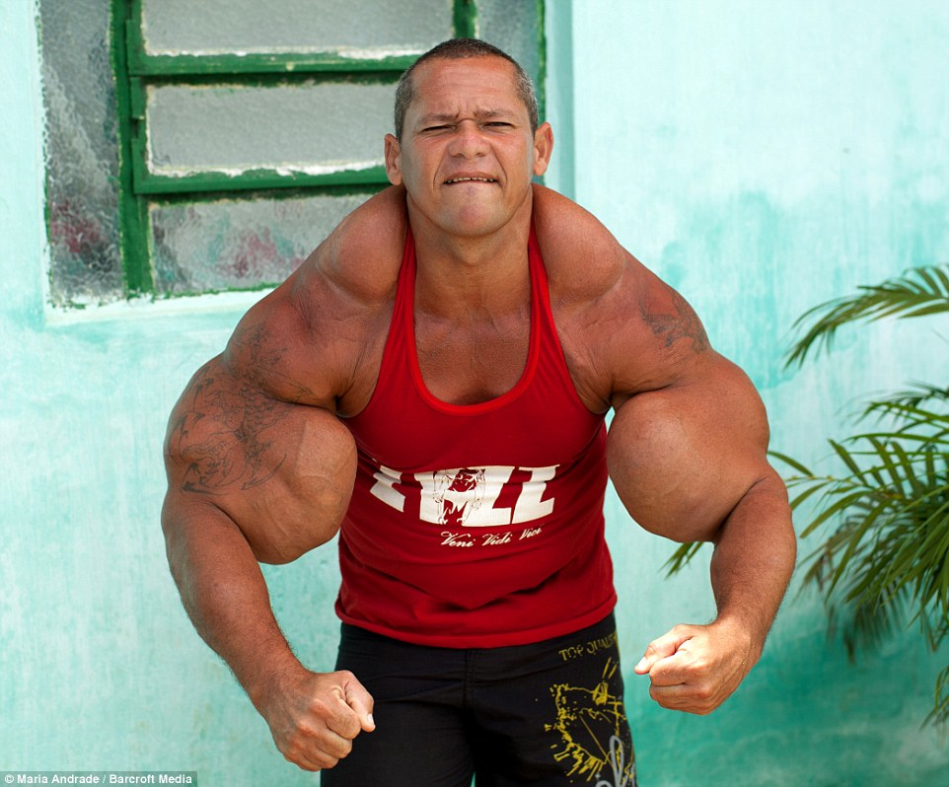


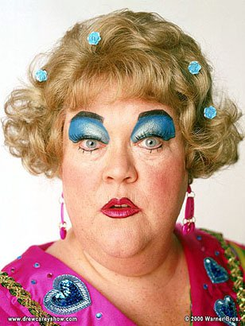
Have to consider who you are operating on and rehab potential to see the benefits of a UNI, Patient selection is key

Slide 57
K.C.
50 yr old female with chronic R Knee pain
  Prior knee scope 1 yr ago done up north
  2 knee cortisone injections since w/o relief
  Medial unloading brace
  narcotic usage for pain
  Walking limited to a few blocks

Slide 58
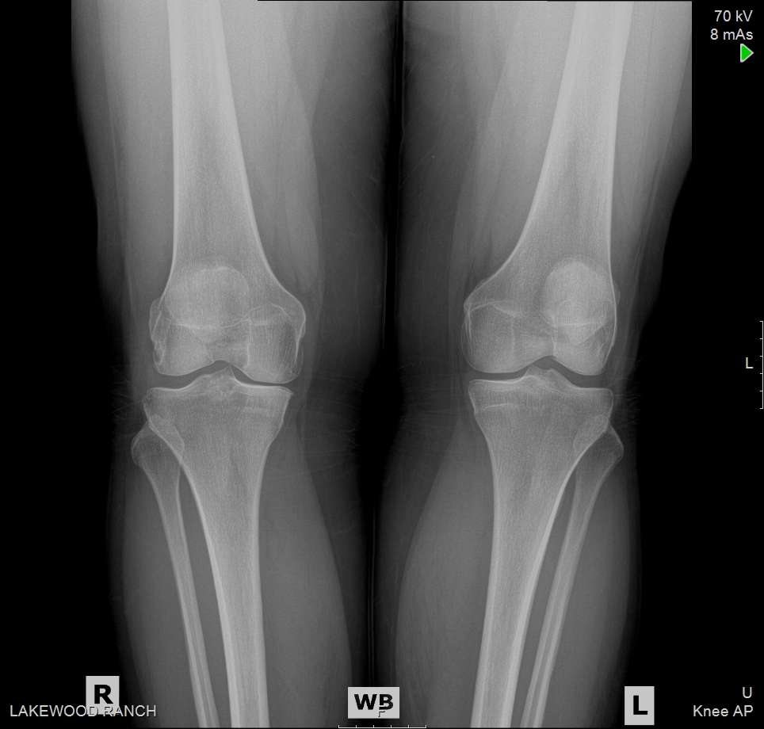
Pre op Xrays

Slide 59


Post Op Xrays

Slide 60
K.C.
50 yr old female
  2 weeks post op
    0-100/110
    SPC
    Minimal pain meds
  @ 6 weeks
    0-130+
    No cane
    Back to almost all ADL’s

Slide 61
E.H.
58 year old male
  7 years knee pain
  Prior knee scope, cortisone, bracing, narcotics
  ROM 0-120+ preop

Slide 62

Pre op Xrays

Slide 63


Post op Xrays

Slide 64
E.H
58 year old male
  1st post op @ 3 weeks
    ROM 0-110
    Pain 3/10
    Minimal pain meds
    SPC
    Home PT
  2nd post op @ 6 weeks
    Independent ambulating
    No pain
    ROM 0-130+
    Finishing up outpatient PT
    Back to almost all ADL’s

Slide 65


Slide 66


Slide 67


