Slide 1
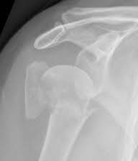
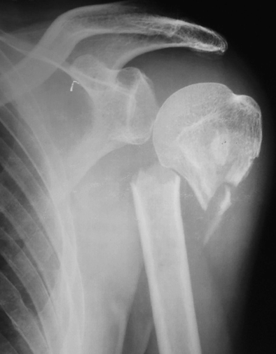
Proximal Humeral Fractures:
Non-op and operative treatment
Derek Cuff, MD
Suncoast Orthopaedic Institute
GORC 2025

Slide 2
Disclosures
Ignite Orthopedics- royalties, consulting, ownership share
Johnson and Johnson Med Tech- royalties, consulting

Slide 3
Goals
1. Discuss incidence and classification
2. Review four clinical scenarios and how to rehab
  Non-op treatment of minimally displaced fracture
  Plate and screw ORIF of a displaced fracture
  Shoulder replacement of a displaced fracture
  Non-op management of displaced fracture

Slide 4
Proximal Humeral Fractures
Incidence- per NIH
  3rd most common fracture (hip and wrist)
  5-6% of all fractures
  Bimodal distribution- high energy young patients, falls elderly
  Patients over 65 represents 10% of all fractures

Slide 5
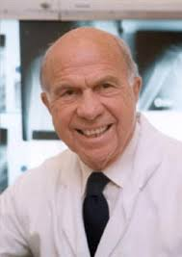
Proximal Humeral Fractures
Classification
Neer classification remains most common
Severity of the fracture based on:
  # of parts
  Displacement

Slide 6
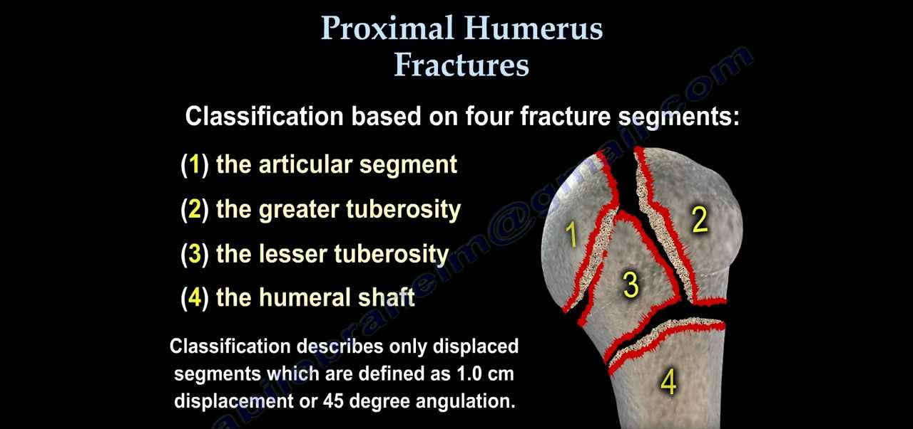
Proximal Humeral Fracture

Slide 7
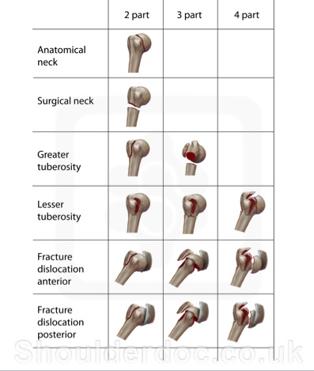
Proximal Humeral Fractures

Slide 8
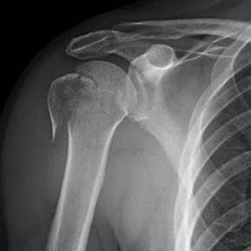
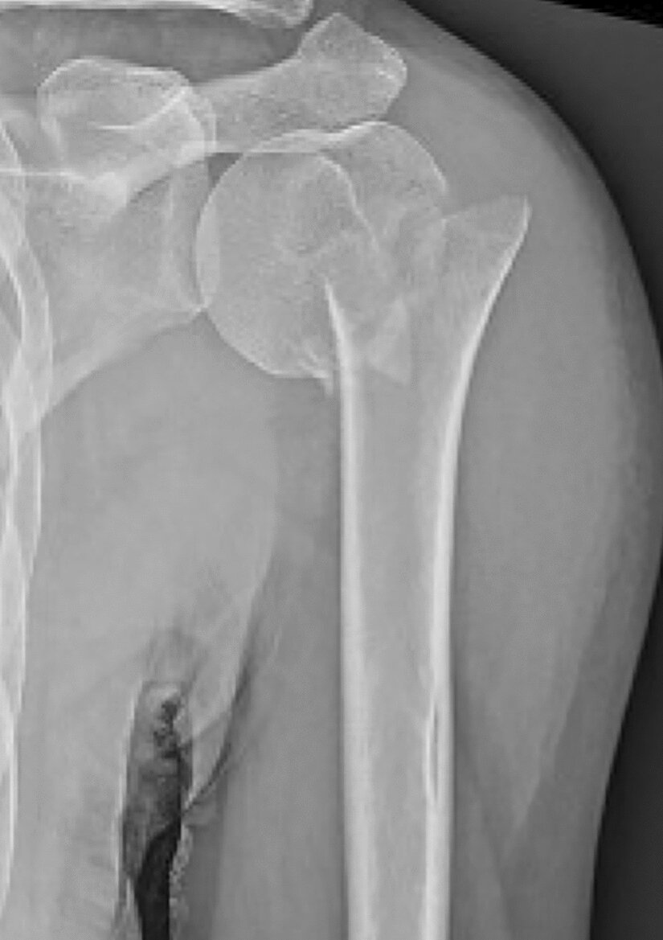
Proximal Humeral Fracture
Two-part proximal humeral fracture- pull of muscles influence

Slide 9
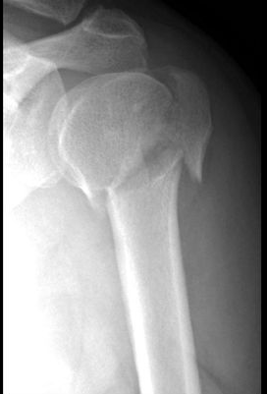
Proximal Humeral Fractures
Three-part fracture

Slide 10
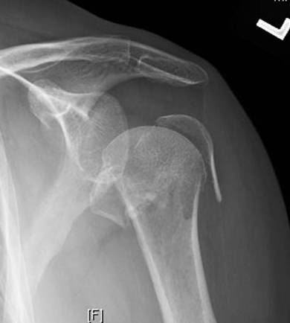
Proximal Humeral Fracture
Four-part fracture

Slide 11

Proximal Humeral Fracture
CT scan with 3-D reconstructions very helpful

Slide 12
Proximal Humeral Fracture
Scenario #1- Nondisplaced fracture
  62 year old female
  Falls from bike on Legacy Trail
  Severe pain and cannot lift arm at all

Slide 13
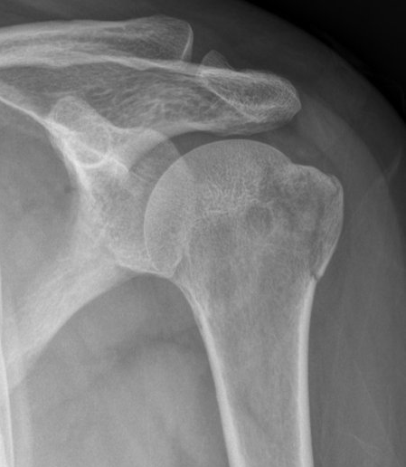
Proximal Humeral Fractures

Slide 14
Proximal Humeral Fracture
How do we manage?
  If fracture heals in this position = no major loss of function
  Non-op management is the goal
  Timing of rehab and how we initiate that is critical
  Want to avoid a frozen shoulder if you immobilizer to long
  BUT if you move too soon chance for displacement

Slide 15
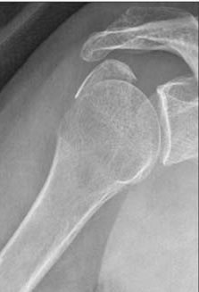
Proximal Humeral Fracture
Supra/infraspinatus attached to piece
If muscles firing can displace piece
Superior and posterior
Can turn non-surgical injury into surgery

Slide 16
Proximal Humeral Fracture
Rehab timeline- fx usually heals around 6-8 weeks
  Weeks 0-4 shoulder immobilizer no PT
  X-ray at week 2 and 4 to check position
  Week 4 d/c immobilizer- Passive ROM weeks 4-6, AAROM 6-8
  Week 8 x-ray to check healing
  Start light strengthening around week 8-10
  Return to full activity week 12

Slide 17
Proximal Humeral Fracture
Scenario #2- displaced 4-part fracture ORIF
50-year old roofer
Fall from ladder
Severe pain and no use of shoulder

Slide 18
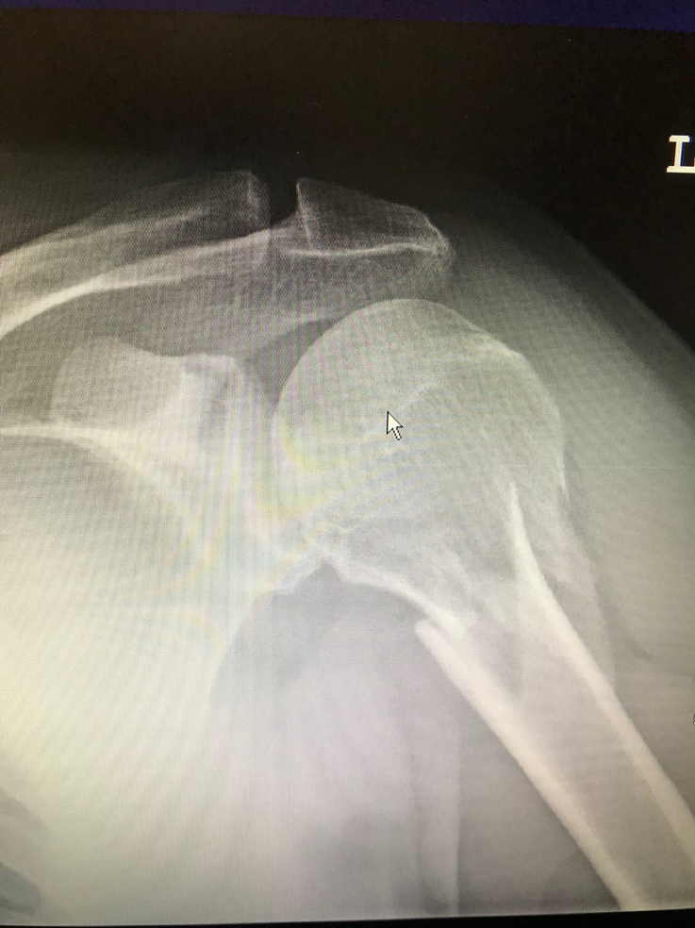
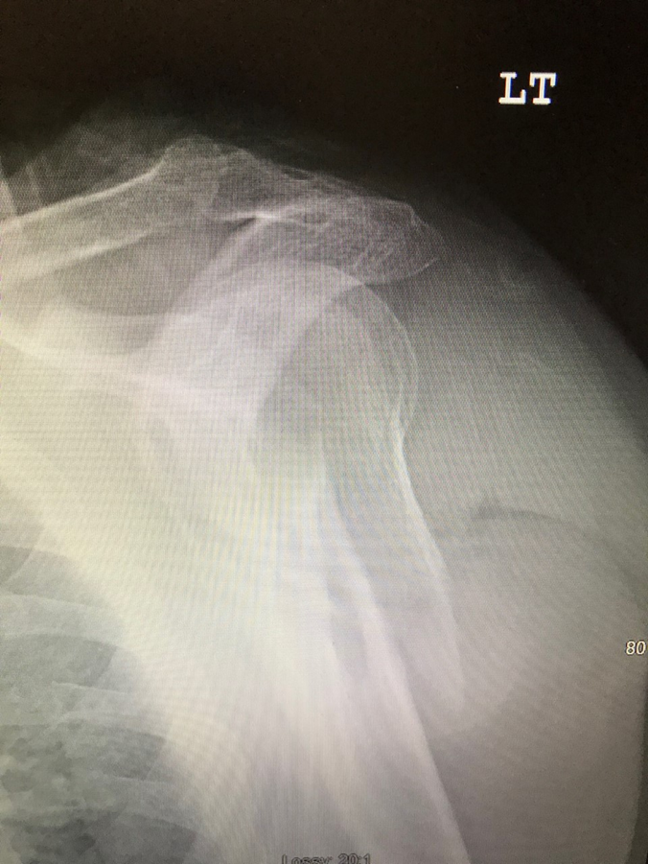
Proximal Humeral Fracture

Slide 19
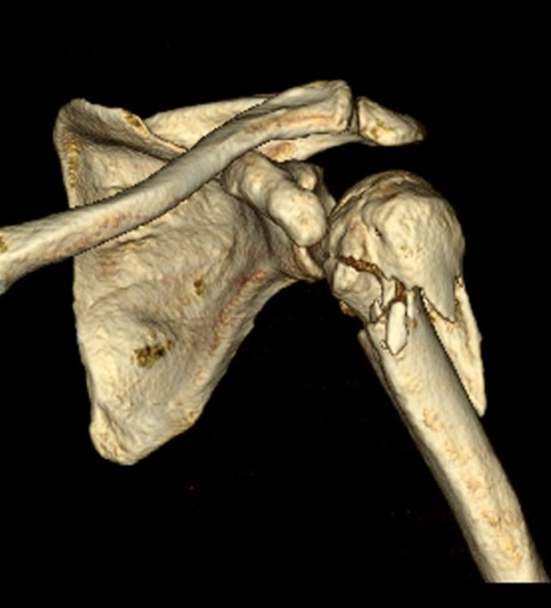
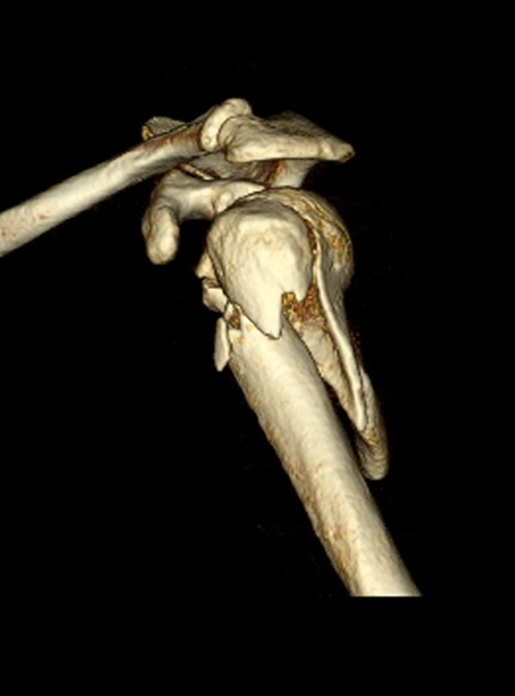
Proximal Humeral Fracture

Slide 20
Proximal Humeral Fractures
High energy injury in a younger laborer
Surgical indication for me
Good bone quality
Too young for a replacement
Goal is to use plate and screw and fix the fracture

Slide 21
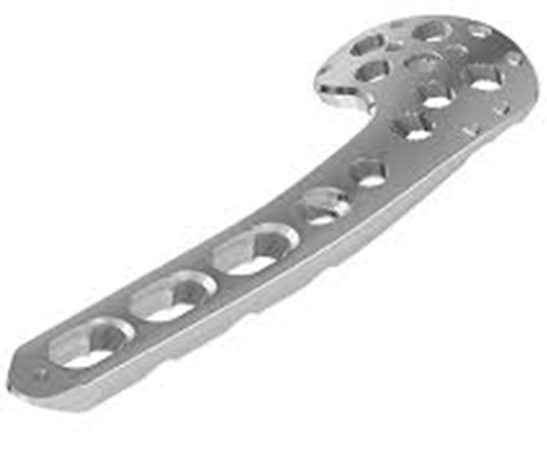
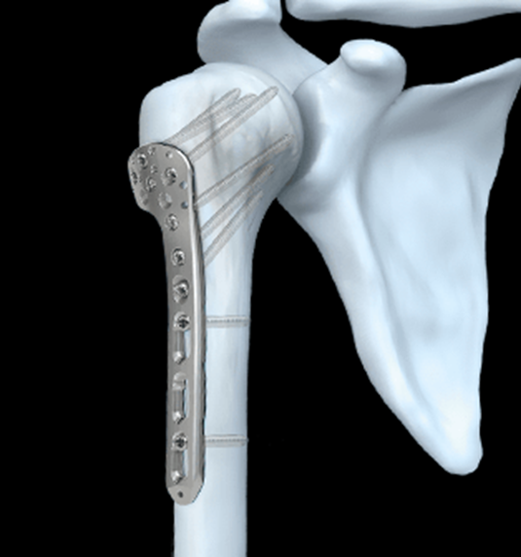
Proximal Humeral Fracture

Slide 22
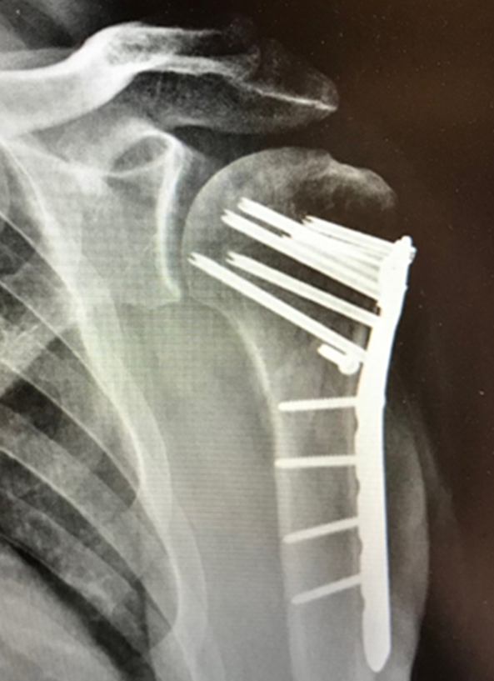
Proximal Humeral Fracture

Slide 23
Proximal Humeral Fracture
Rehab timeline- can be more aggressive if well fixed fracture
  Start pendulums POD #1, 3 x a day for 5 minutes
  Patient in immobilizer for first 4 weeks post op
  We see patient for wound check and x-ray POD #10
  Start outpatient PT end of week 2
  Weeks 2-6 passive ROM, I d/c immobilizer end week 4
  Weeks 6-10 progress AAROM to active ROM
  Week 10 start strengthening
  Week 12 full return

Slide 24
Proximal Humeral Fracture
Scenario #3- replacement of a displaced fracture
  75-year old female
  Falls while dancing on NYE
  Severe pain and bruising

Slide 25
Proximal Humeral Fractures

Slide 26
Proximal Humeral Fracture
Different considerations in elderly
Bone quality/healing potential may be poor
ORIF with plates and screws higher failure rate
If we cant repair it = we REPLACE it

Slide 27
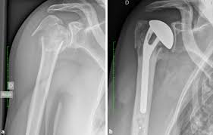
Proximal Humeral Fractures
What we used to do
  Hemiarthroplasty- partial replacement
  Remove broken ball
  Place prosthetic humeral head
  Then repair tuberosities around it
  Tuberosities had to heal to get good result

Slide 28
Proximal Humeral Fractures
What we used to do
  Tuberosity healing = good outcome
  Tuberosity not healing = bad outcome
  All or nothing type result
  60% healing rate- by some great surgeons

Slide 29
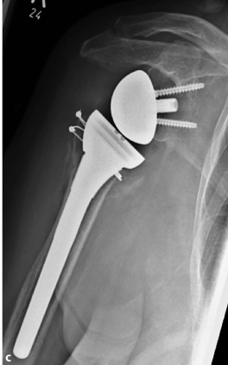
Proximal Humeral Fractures
RSA for fracture gains traction in Europe
  Early studies promising
  Less dependance on tuberosity healing
  Deltoid still able to power overhead elevations

Slide 30
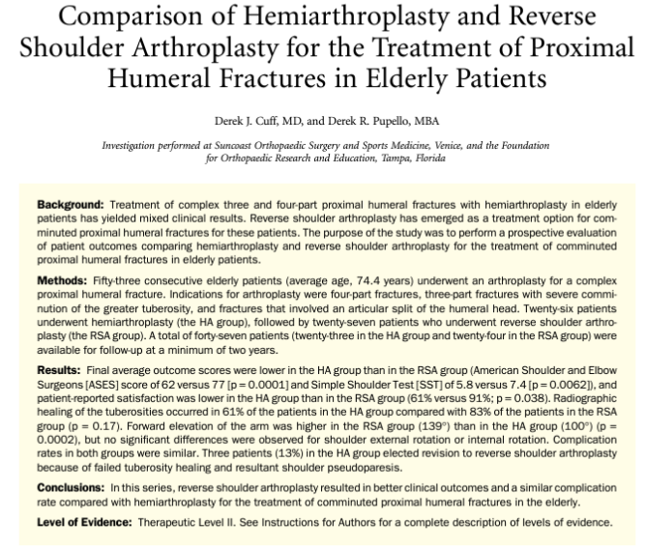

Proximal Humeral Fracture

Slide 31

Proximal Humeral Fractures
HA vs RSA
  Tuberosity healing rate- 61% HA; 83% RSA
  Patient satisfaction- 61% HA; 91% RSA
  Avg. forward elevation- 100⁰ HA, 139⁰ RSA

Slide 32
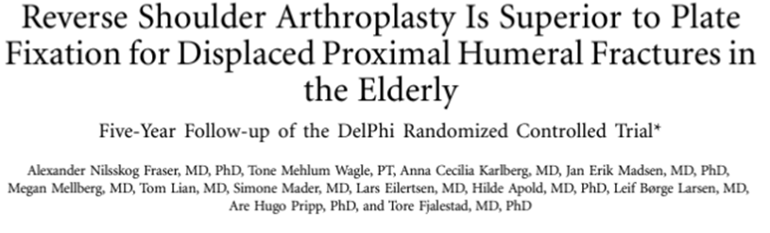
Proximal Humeral Fracture
Hemi for fx not often used
RSA or plating
In 65 and older RSA for 4 part has become standard
Many using for 3 part fx’s as well

Slide 33
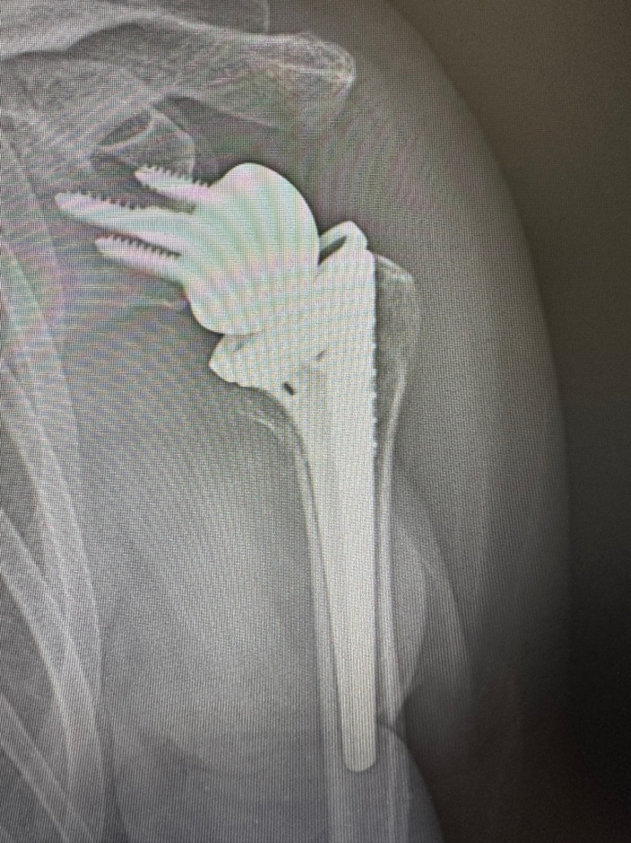
Proximal Humeral Fracture

Slide 34
Proximal Humeral Fractures
Rehab timeline
  Weeks 0-4 in immobilizer, pendulums 3 x a day
  Week 4 d/c immobilizer and start outpatient PT
  Passive ROM weeks 4-8, AAROM weeks 8-10
  Start strengthening weeks 10-12
  Results really impressive compared to older techniques

Slide 35
Proximal Humeral Fracture
Scenario #4- non-op of a displaced fracture
  86-year old lady
  Fall at her assistive living facility
  Mild dementia
  Multiple medical issues
  Poor surgical candidate

Slide 36
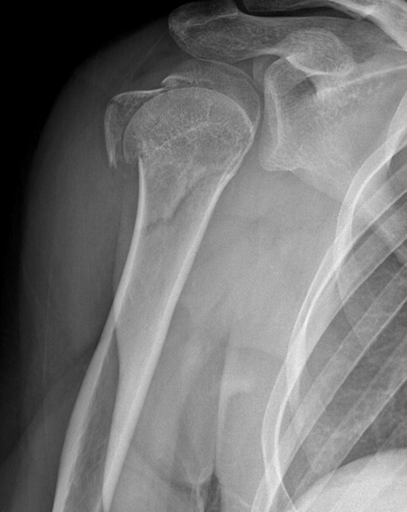
Proximal Humeral Fracture
Have seen some amazing results with PT/OT in some of these patients
Shoulder is not the hip or knee
More tolerant of deformity
Can still get a decent result with terrible looking x-ray

Slide 37
Proximal Humeral Fractures
Rehab timeline- We TREAT these patient, don’t just sling/ignore
  Weeks 0-4 immobilizer no PT/OT
  D/C immobilizer week 4
  Weeks 4-8 Passive ROM
  Weeks 8-12 Active assist
  Week 12 strength focusing on deltoid and scap stabilizers

Slide 38
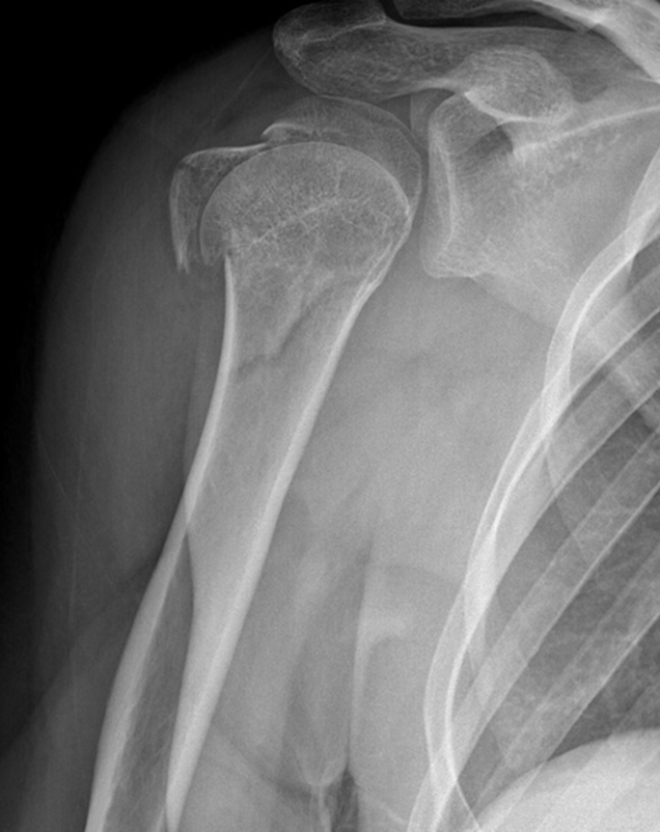

Proximal humeral fractures

Slide 39
Summary
Proximal humeral fractures are common injury
Different levels of severity mandate different treatment approaches
PT/OT plays a huge role in operative AND non-operative cases
Understand your surgeon’s goals and protocols for each fracture

Slide 40
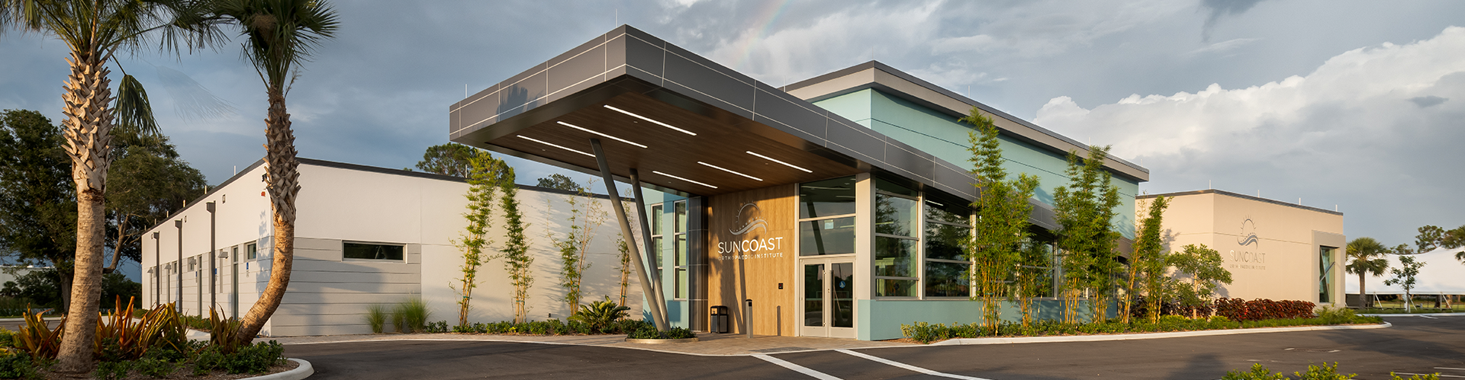
Thank You

