Slide 1

Pediatric Spondylolysis
Eric Sundberg MD FAAOS

Slide 2
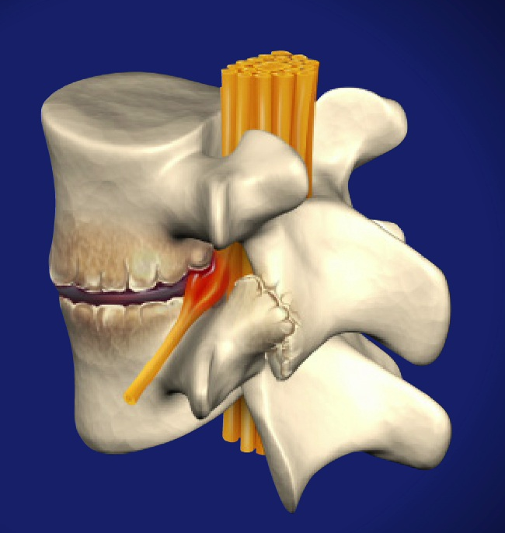

Terminology
Spondylosis: degenerative condition of the spine affecting the discs and facet joints
Spondylolysis: defect in the pars interarticularis
Spondylolisthesis: ventral migration of the spinal column over its caudal segment

Slide 3
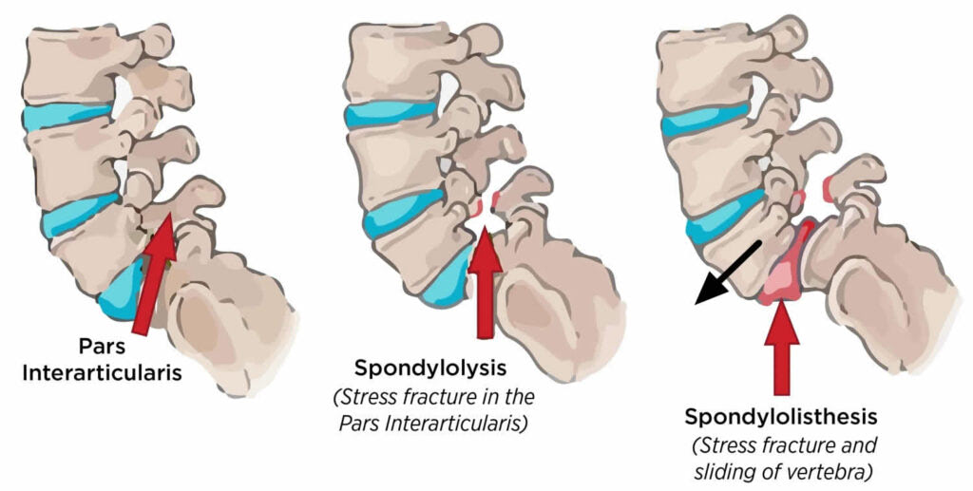
Terminology
Spondylosis: degenerative condition of the spine affecting the discs and facet joints
Spondylolysis: defect in the pars interarticularis
Spondylolisthesis: ventral migration of the spinal column over its caudal segment

Slide 4
Terminology
Spondylosis: degenerative condition of the spine affecting the discs and facet joints
Spondylolysis: defect in the pars interarticularis
Spondylolisthesis: ventral migration of the spinal column over its caudal segment

Slide 5
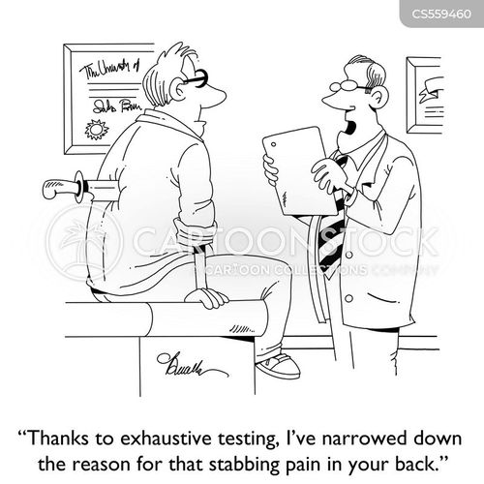
Spondylolysis
most common at the L5-S1 segment
bilateral in 80% of cases
incidence between 3-11.5% (general population)
as high as 23-65% in young athletes

Slide 6
Spondylolysis
congenital theory disproved by Rowe and Roche (500 infants)
genetic predisposition
history of trauma is common, but a true traumatic spondylolysthesis is rare (repetitive mechanical stress)
some studies have shown that up to 50% of back pain in adolescent athletes is attributable to spondylolysis
football, weightlifting, wrestling, diving, gymnastics

Slide 7
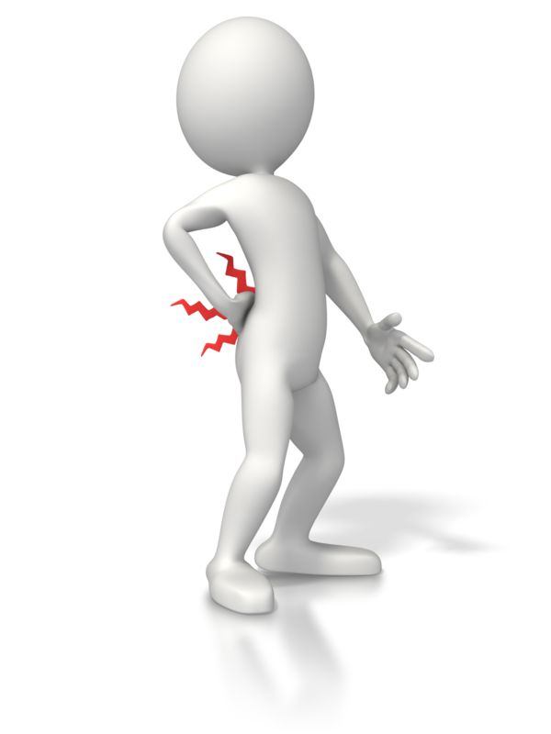
Spondylolysis Presentation
often asymptomatic, esp when unilateral, 20% are symptomatic
onset of symptoms often coincides with growth spurt (10-15yo)
Typically presents as back pain, worse with activities, rarely associated with neurologic symptoms

Slide 8
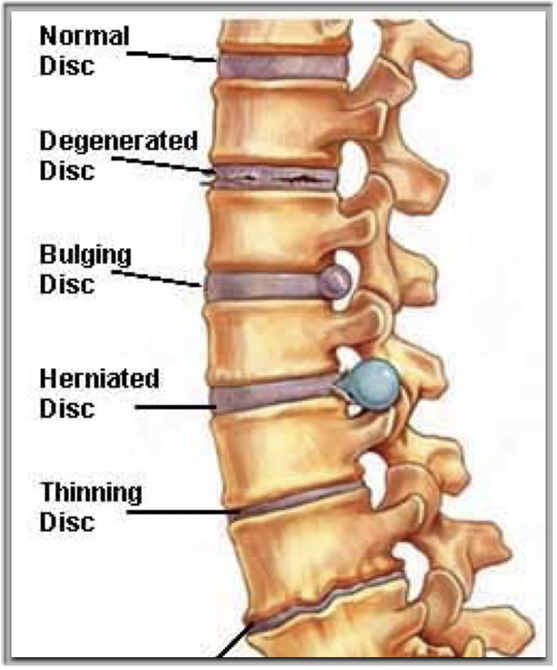
Differential
Lumbar HNP
Lumbar DDD
Strain/Sprain

Slide 9
Progression to Spondylolisthesis
Laurent et al demonstrated progression of spondylolisthesis in 44% of adolescents with spondylolysis
Inoue et al found that 25% of patients with spondylolysis had concurrent spondylolisthesis in the 3rd decade of life but 80% had spondylolisthesis by the 6th decade of life
The progression of spondylolysis to isthmic spondylolisthesis has been associated with increased LBP and radicular symptoms

Slide 10
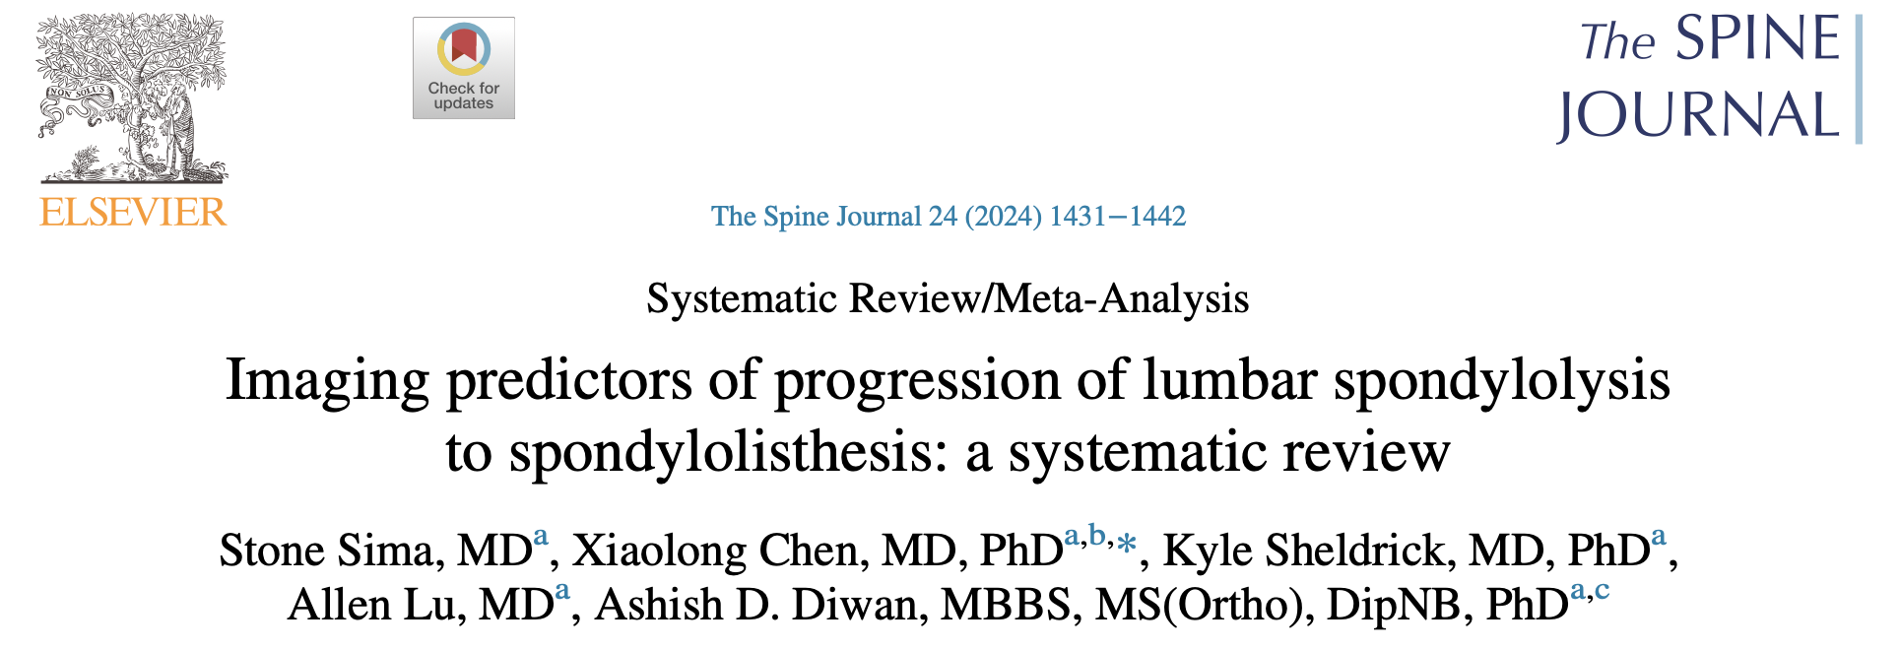
Moderately Strong Evidence - Disc Degeneration
Some Evidence - transverse process width, pelvic incidence, pelvic tilt, sacral slope, lumbar lordosis, lumbar index, thoracic kyphosis, facet joint angle above the level of defect, facet joint degeneration, facet tropism, multifidus size

Slide 11
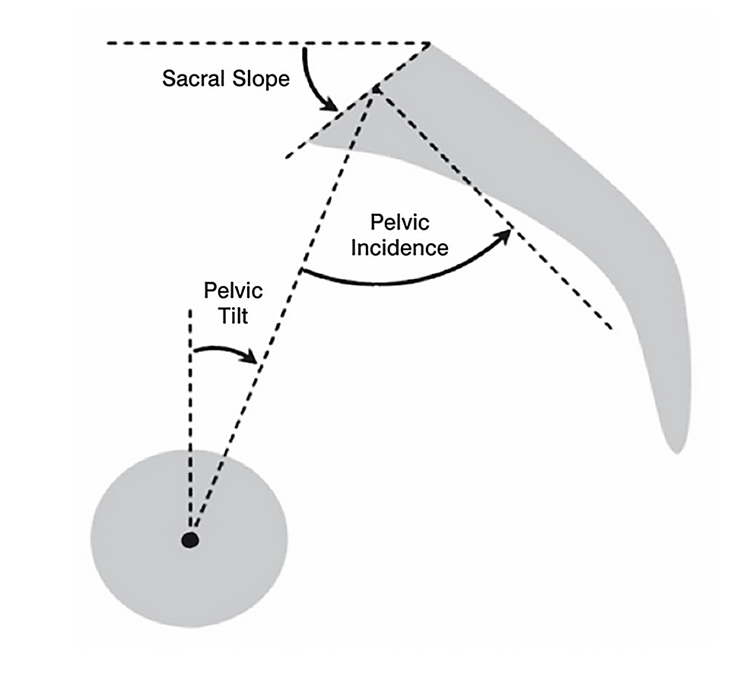
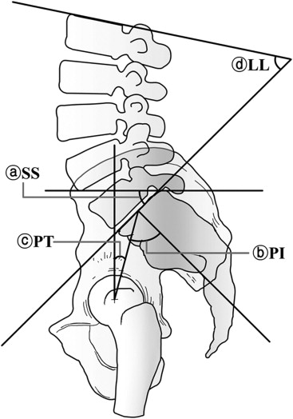
Pelvic Incidence = Pelvic Tilt + Sacral Sclope

Slide 12
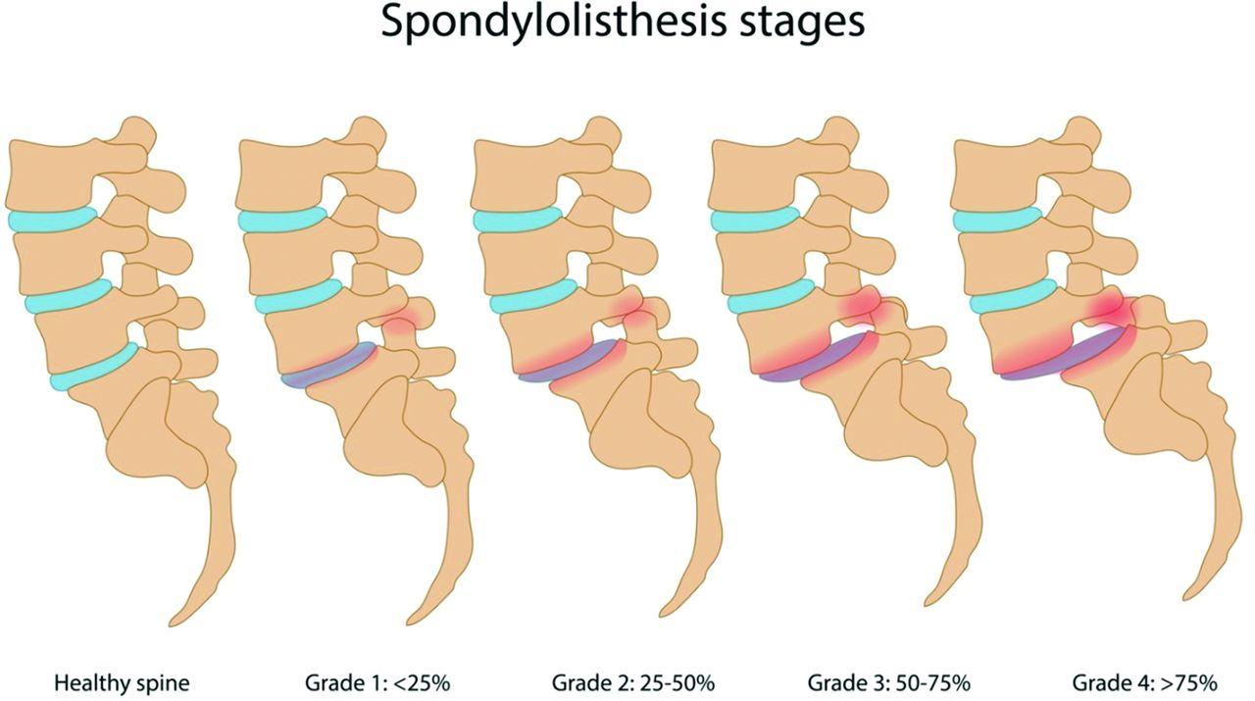
Meyerding Classification

Slide 13
Treatment
Initial treatment is nonsurgical
  Activity modification 3-6 months (can be challenging) and NSAIDs
    a 2005 study of adolescent soccer players showed improved return to sport with 3 months of rest (100% versus 75%)
  Bracing (avoid hyperextension because of shear stress it generates)
    a 2009 meta-analysis did not show a difference in outcomes with bracing
  Physical Therapy
    range of motion, progressive strengthening (esp abdominal strengthening), sport specific training
  Facet/Pars Injections

Slide 14
Treatment
Results
  2001 study showed favorable results with nonoperative management with 90% excellent results at 11 years
  treatment of acute spondylolysis results in healing rates >90%
  treatment of chronic spondylolysis is more likely to results in nonunion

Slide 15
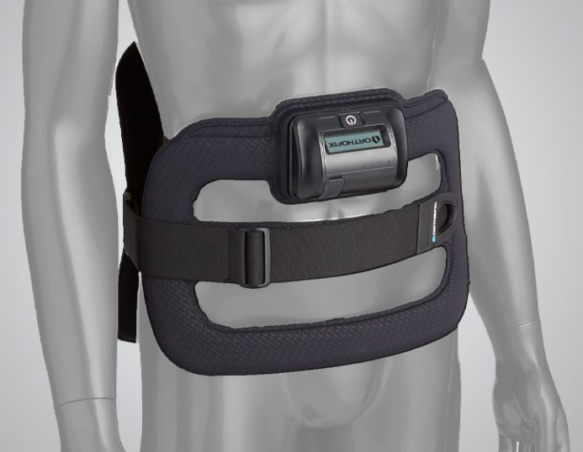
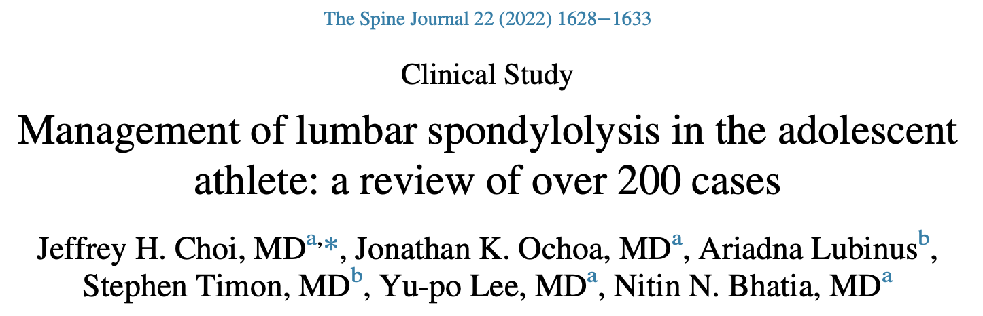
Bone Stimulators
152 of 201 athletes received a bone stimulator with 79.6% healing versus 24.4%

Slide 16
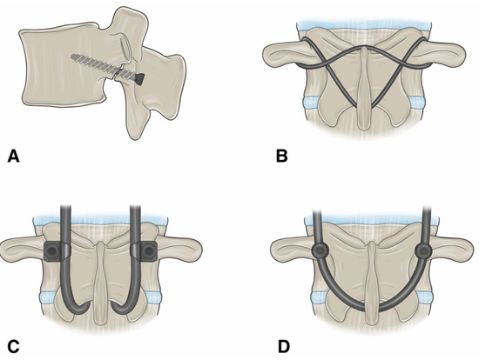
Treatment
Surgical
  failure >6 months nonoperative management
  progressive neurologic deficit
  progressive spondylolisthesis
Pars repair v. decompression/fusion

Slide 17
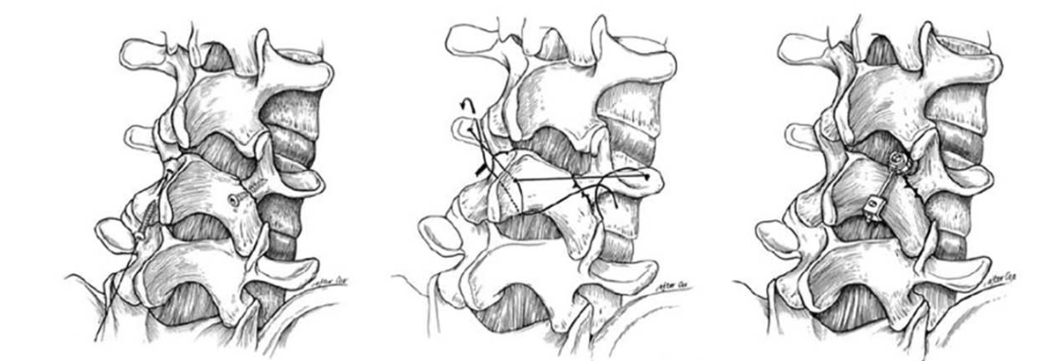
Cerclage Wiring
Lag screw
Pedicle Screw/Hook

Slide 18
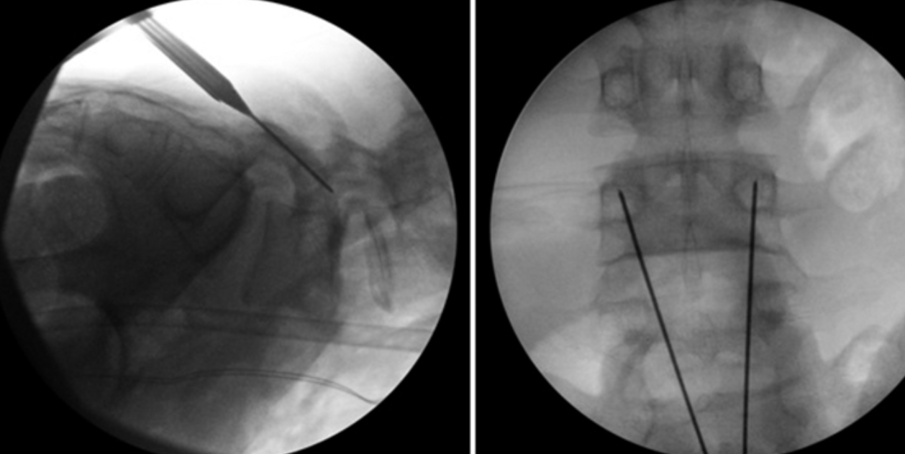
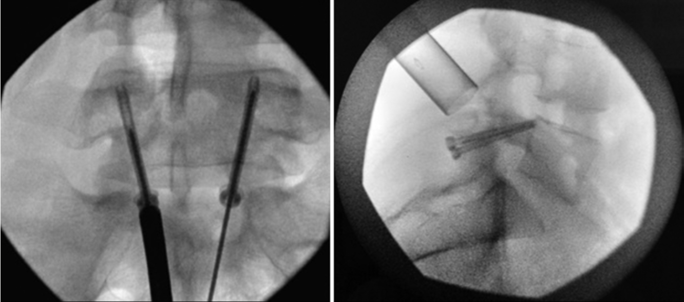
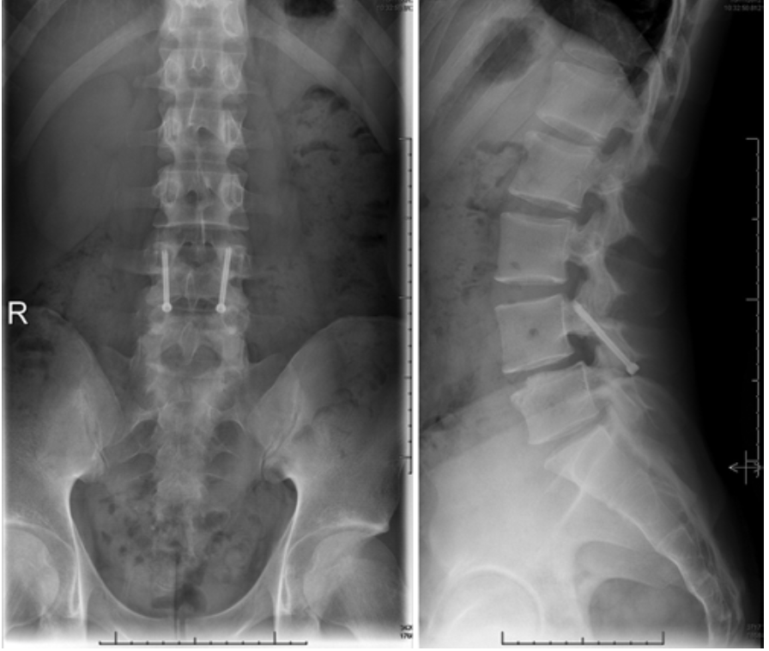
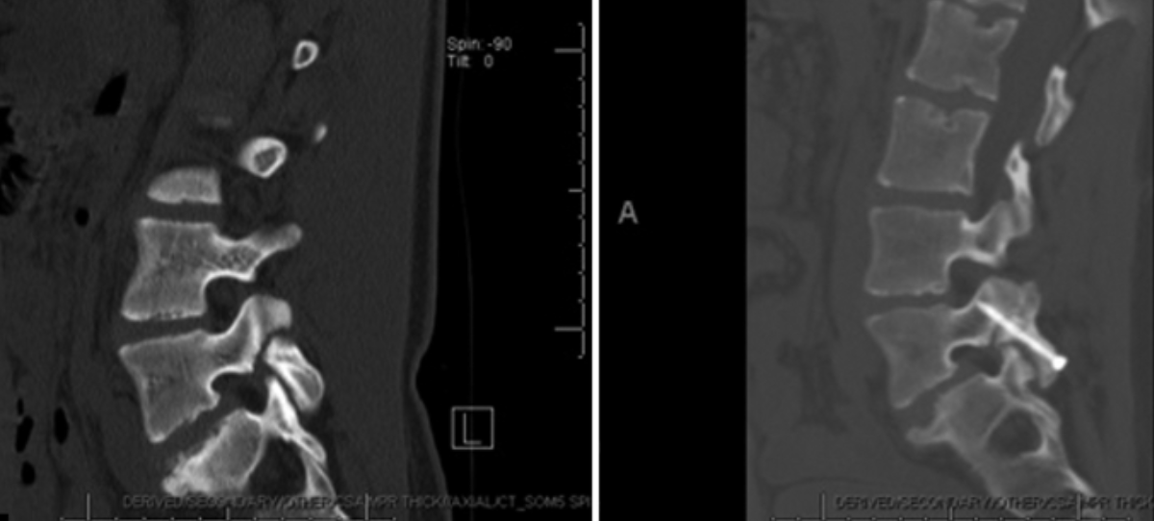

Slide 19
Percutaneous Direct Pars Repair in Young Athletes
retrospective observational study in athletes referred for minimally invasive direct pars repair after >6 months of failed nonoperative management
VAS improved from 7.62 to 0.28
20/21 patients showed evidence of union on final follow up
Jamshidi et al. Neurosurgery 2023

Slide 20
References
Choi et al. Management of Lumbar Spondylolysis in the Adolescent Athlete. The Spine Journal 2022
Hsu WK et al. Management of Lumbar Conditions in the Elite Athlete. JAAOS 2017
Hsu W et al. Lumbar Spine Injuries in Recreational Athletes: A Review. JAAOS 2025
Rambo AJ et al. Lumbar Spondylosis in the Pediatric Population: A Retrospective CT review and Radiology Rereview. JAAOS 2025
Ghobrial GM et al. Minimally Invasive Direct Pars Repair with Cannulated Screws and rhBMP. Neurosurgical Focus 2017
Jamshidi et al. Percutaneous Direct Pars Repair in Young Athletes. Neurosurgery 2023
Sima S et al. Imaging Predictors of Lumbar Spondylolysis to Spondylolisthesis: A Systematic Review. The Spine Journal 2024

Slide 21
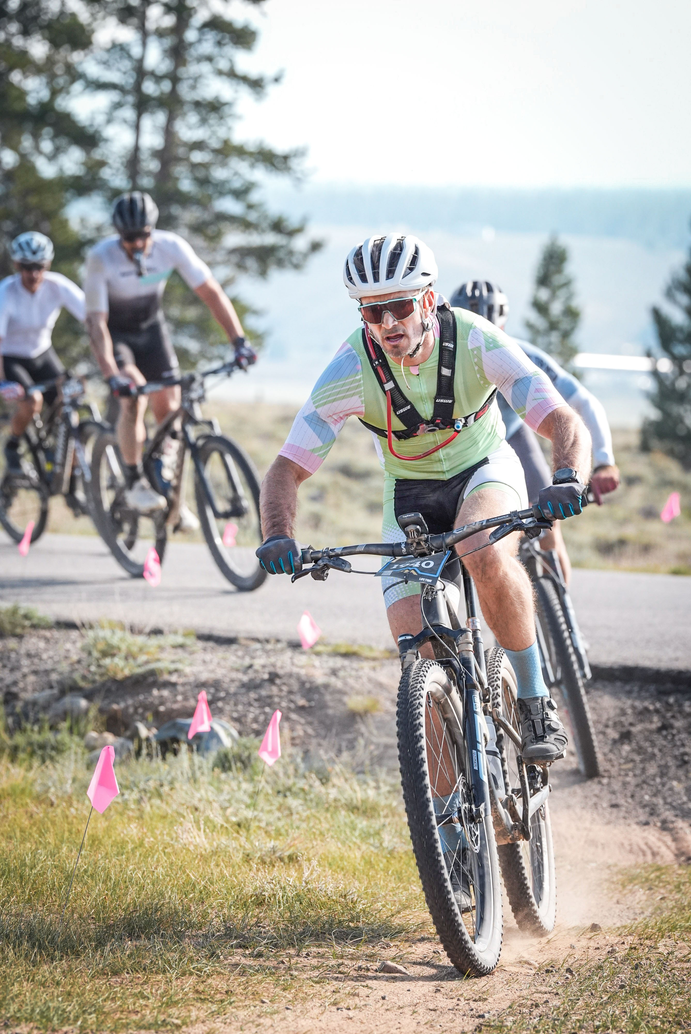

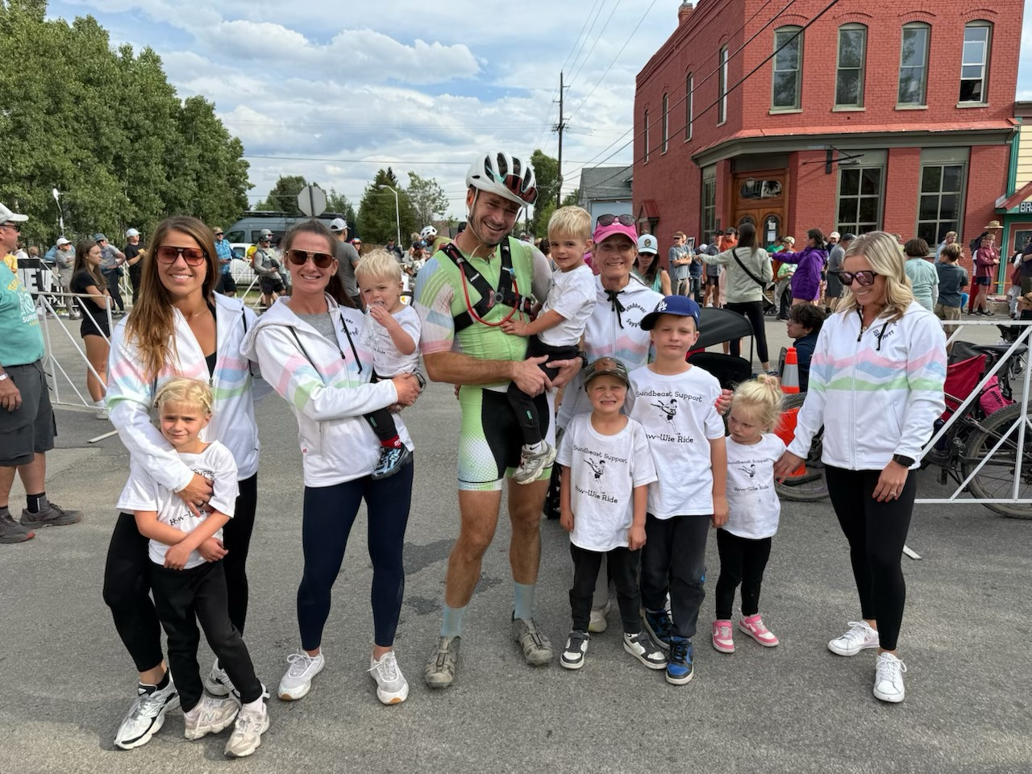

Thank You

