Slide 1
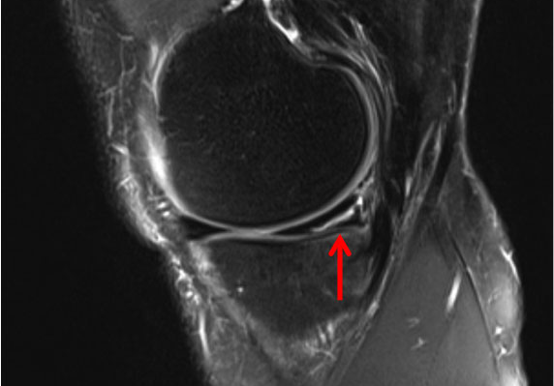
Meniscal root tears
JOSEPH NOAH MD
SUNCOAST ORTHOPAEDIC INSTITUTE

Slide 2
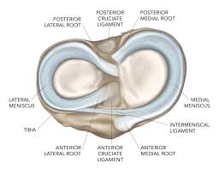
Meniscus anatomy
EACH KNEE HAS A MEDIAL AND LATERAL MENISCUS
THE MENISCI ARE SEMILUNAR WEDGES MADE OF FIBROCARTILAGE
THEIR FUNCTION IS TO HELP DISTRIBUTE AXIAL LOAD AND REDUCE JOINT FORCES
ALSO HAVE IMPORTANT ROLE IN JOINT STABILITY
LOSS OF MENISCUS TISSUE INCREASES JOINT FORCES

Slide 3
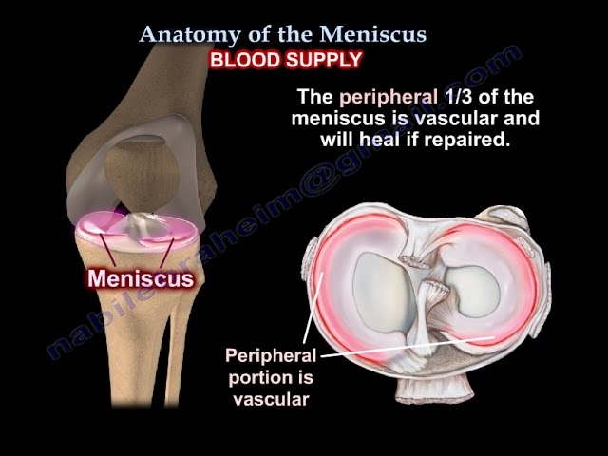
MENISCUS ANATOMY
MENISCUS TEARS GENERALLY OCCUR WITH A TWISTING/PIVOTING INJURY. ALSO SEEN WITH LIGAMENT INJURIES
CAN ALSO OCCUR WITH DEEP FLEXION INJURY
MOST OF THE MENISCUS LACKS ADEQUATE BLOOD SUPPLY SO HEALING IS INCONSISTENT

Slide 4
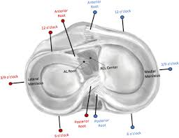
Meniscus anatomy
Each meniscus is anchored both anteriorly and posteriorly to the tibia (meniscal roots)
The mid portion of the meniscus is secured to the knee capsule

Slide 5
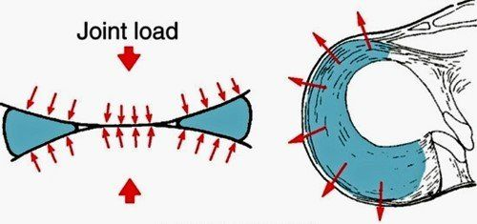
Meniscus ROOT TEARS
IMPORTANCE
MENISCAL ROOT TEARS ARE LESS COMMON THAN MENISCAL BODY TEARS
MENISCUS ROOT AIDS THE FUNCTION BY SECURING THE MENISCUS IN PLACE
ALLOWING FOR OPTIMAL SHOCK ABSORBING FUNCTION
CONTROLS "HOOP STRESS"

Slide 6
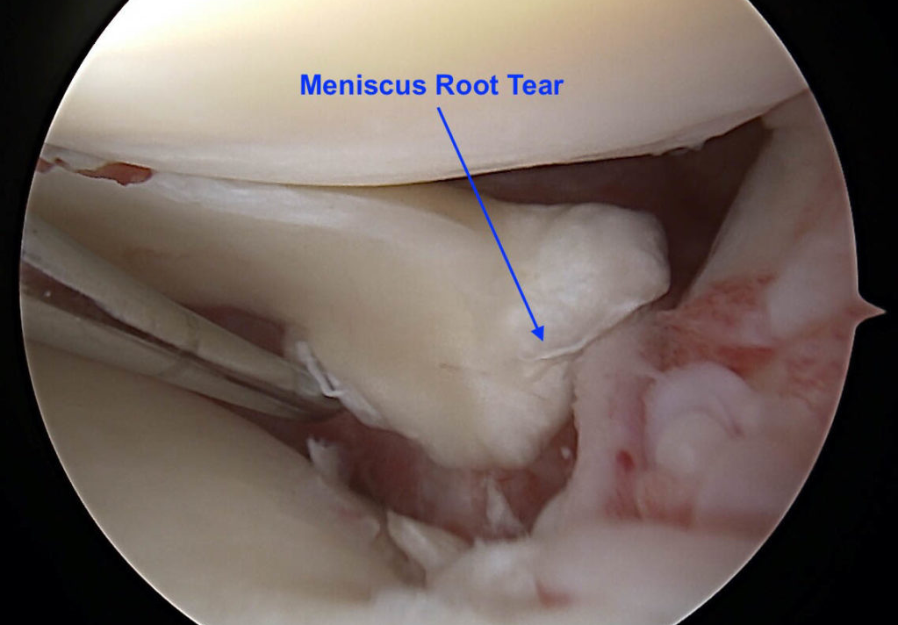
Meniscus ROOT TEARS
IMPORTANCE
ROOT TEARS ARE ASSOCIATED WITH MENISCAL EXTRUSION ALTERATION OF CIRCUMFERENTIAL HOOP STRESS
ALTERATION OF KNEE BIOMECHANICS
INCREASES TIBIOFEMORAL CONTACT PRESSURE

Slide 7
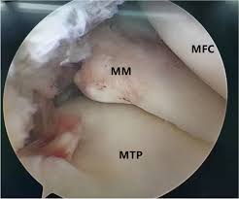
Meniscus ROOT TEARS
IMPORTANCE
BIOMECHANICAL STUDIES SHOW THAT ROOT TEARS ARE THE EQUIVALENT OF A TOTAL MENISCECTOMY
25% INCREASE IN MEDIAL COMPARTMENT PEAK CONTACT PRESSURE
LEFT UNTREATED SIGNIFICANT DEGENERATIVE CHANGES CAN OCCUR

Slide 8
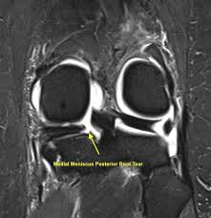
Meniscus ROOT TEARS
DIAGNOSIS
CAN OCCUR SECONDARY TO TRAUMA (HYPERFLEXION)
70% ARE DEGENERATIVE OR ASSOCIATED WITH MINOR EVENT (SQUATTING)
ASSOCIATED WITH PAIN AND SWELLING
WEIGHTBEARING PAIN
MORE COMMON IN HIGHER BMI PATIENTS

Slide 9
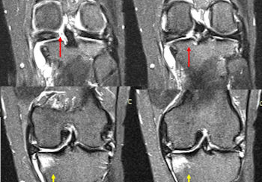
Meniscus ROOT TEARS
IMAGING
IN LONGER STANDING TEARS MEDIAL BONE EDEMA AND STRESS REACTION SEEN
MOST COMMONLY ON TIBIAL SIDE BUT CAN ALSO FEMUR
THIS MAY EXPLAIN THE INCREASED PAIN SEEN IN SOME PATIENTS

Slide 10
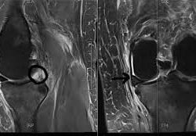
Meniscus ROOT TEARS
IMAGING
ROOT TEARS ARE ALSO ASSOCIATED WITH "GHOST SIGN"
ALTERATION OF KNEE BIOMECHANICS LEADS TO MENISCAL EXTRUSION

Slide 11
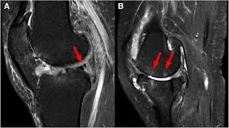
Meniscus ROOT TEARS
TREATMENT
NONSURGICAL
IN SOME OLDER OR LESS ACTIVE PATIENTS NONOPERATIVE TREATMENT CAN BE TRIED
ACTIVITY MODIFICATION (WEIGHTBEARING)
NSAIDS AND STEROID INJECTION TO REDUCE INFLAMMATION
PHYSICAL THERAPY TO INCREASE QUAD AND HAMSTRING STRENGTH
REPAIR NOT INDICATED IN PATIENTS WITH SIGNIFICANT DENEGERATIVE CHANGES AND TRICOMPARTMENTAL DISEASE

Slide 12
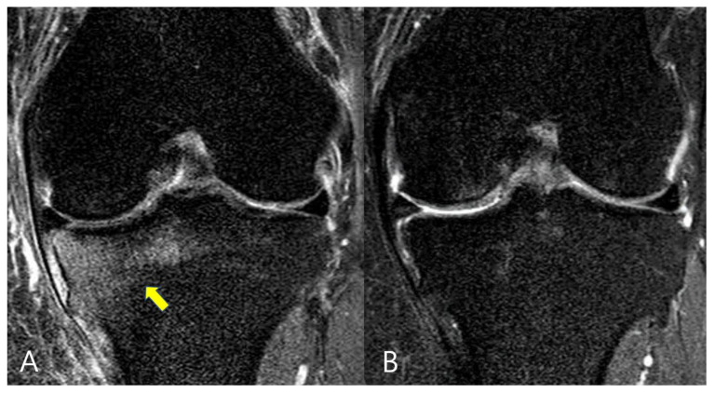
Meniscus ROOT TEARS
TREATMENT
SURGICAL
IN SOME PATIENTS, OLDER AND WITH UNICOMPARTMENTAL MEDIAL COMPARTMENT DISEASE (EXTENSIVE BONE EDEMA AND CARTILAGE WEAR) AND A ROOT TEAR, PARTIAL KNEE ARTHROPLASTY MAY BE BEST SOLUTION
FOR MOST PATIENTS, ARTHROSCOPIC REPAIR OF THE ROOT WILL BE RECOMMENDED
NO PLACE FOR ARTHROSCOPIC PARTIAL MEDIAL MENISCECTOMY SINCE IT CANNOT IMPROVE FUNCTION
REPAIR CAN SOMETIMES REVERSE BONE CHANGES (EDEMA) AS JOINT BIOMECHANICS ARE RESTORED

Slide 13
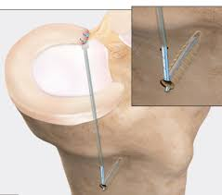
Meniscus ROOT TEARS
TREATMENT
SURGICAL
THE GOAL TO REPAIR IS RETURN THE MENISCUS ROOT BACK TO ITS NORMAL INSERTION
THIS REQUIRES REINSERTING THE ROOT BACK DOWN TO THE TIBIA
THE REPAIR NEEDS TO BE AS ANATOMICAL AS POSSIBLE TO RESTORE NORMAL JOINT BIOMECHANICS

Slide 14
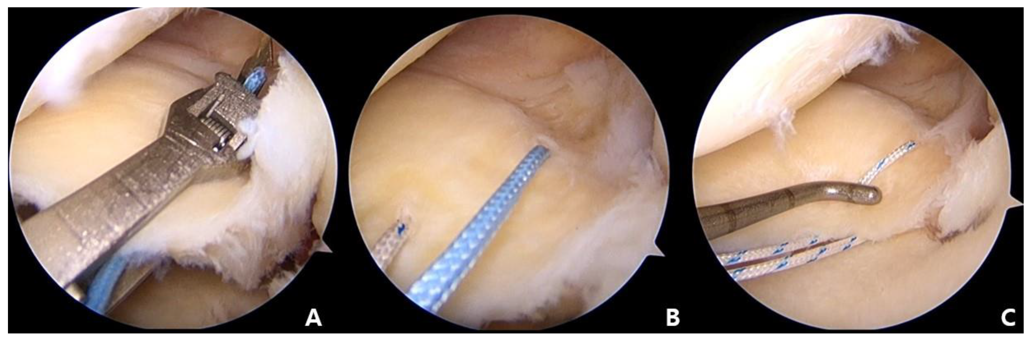
Meniscus ROOT TEARS
TREATMENT
SURGICAL
THE MENISCUS IS MOBILIZED MAKING SURE THAT IT CAN BE REDUCED BACK TO IT NORMAL INSERTION
A MENISCAL SUTURE PASSER IS USED TO PASS NONABSORBABLE SUTURES THROUGH THE MENISCAL ROOT TISSUE
THESE SUTURES WILL LATER BE PULLED OUT THROUGH A TUNNEL CREATED IN THE TIBIA

Slide 15
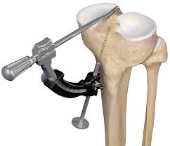
Meniscus ROOT TEARS
TREATMENT
SURGICAL
A TUNNEL IS CREATED USING A SPECIALIZED GUIDE
A TUNNEL IS DRILLED EXITING INTO THE KNEE
A SUTURE RETRIEVER IS THEN PASSED AND PULLED OUT THE FRONT OF THE KNEE
THE MENISCAL SUTURES ARE PASSED INTO THIS SUTURE RETRIEVER

Slide 16
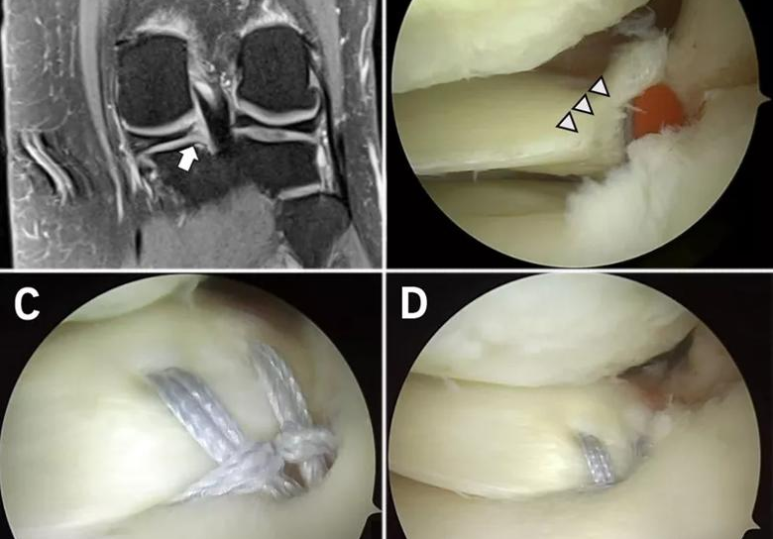
Meniscus ROOT TEARS
TREATMENT
SURGICAL
THE SUTURES ARE THEN PASSED INTO THE PREVIOUSLY PLACED RETRIEVER AND PULLED OUT THE TIBIAL TUNNEL
THE SUTURES ARE TENSIONED PULLING THE ROOT INTO THE TIBIAL TUNNEL
THE SUTURES ARE THEN SECURED TO THE TIBIA VIA AN ANCHOR OR BUTTON

Slide 17
MENISCUS ROOT TEARS
SURGICAL TREATMENT
REHAB
PHASE 1: WEEKS 0-6
WEIGHT BEARING: STRICT NWB
HINGED KNEE BRACE: 6 WKS
BRACE IS LOCKED IN FULL EXTENSION FOR AMBULATION AND SLEEP
CAN BE REMOVED FOR HYGIENE AND THERAPY
BRACE CAN BE UNLOCKED 0-30 DEGREES WHILE PATIENT IS AWAKE
PROTECT AGAINST HAMSTRING CONTRACTION (ATTACHES TO POSTERIOR ROOT)

Slide 18
MENISCUS ROOT TEARS
SURGICAL TREATMENT
REHAB
RANGE OF MOTION: AAROM-AROM FOR EXTENSION
PROM FOR KNEE FLEXION
0-4 WEEKS: NO FLEXION >90*
4-6 WEEKS: FULL ROM
EXERCISES USUALLY START AT 2-3 WEEKS POSTOP
QUAD SETS, PASSIVE HEEL SLIDES, 4 WAY STRAIGHT LEG RAISES IN BRACE
ISOMETRIC ABD AND ADDUCTIONS
PRONE AND SUPINE HANGS FOR FULL EXTENSION
AT 4 WKS PROTECTED SUPINE WALL SLIDES TO <90*

Slide 19
MENISCUS ROOT TEARS
SURGICAL TREATMENT
REHAB
PHASE 2: WEEKS 7-11
AVOID SQUATTING/FLEXION > 90° IN WEIGHT BEARING
WEIGHT BEARING: AS TOLERATED – OFF CRUTCHES 6-8 WKS WHEN NORMAL GAIT ACHIEVED
BRACE IS REMOVED IN COMPLIANT PATIENTS
EXERCISES : CLOSED CHAIN
LUNGES: 0-60 , LEG PRESS: 0-90, NORDIC TRACK, ELLIPTICAL, DEEP WATER RUN
PROPRIOCEPTIVE AND BALANCE EXERCISES
LIGHT HAMSTRING WORK AT 8 WKS
STATIONARY BIKE (HIGH SEAT, LOW RESISTANCE <110*

Slide 20
MENISCUS ROOT TEARS
SURGICAL TREATMENT
REHAB
PHASE 3: WEEKS 12-16
FULL WEIGHT BEARING
FULL PAINLESS MOTION SHOULD BE ACHIEVED
INCREASED HAMSTRING AND QUAD STRENGTHENING
FOCUS ON SINGLE LEG STRENGTH (PLYOMETRICS AND SPORTS SPECIFIC DRILLS)
4 WAY RESISTED BAND WORK
BALANCE BOARD
FOCUS ON RETURN TO NORMAL ACTIVITIES

Slide 21
MENISCAL ROOT TEARS
SUMMARY
ARE SIGNIFICANT INJURIES THAT CAN LEAD TO RAPID JOINT DEGENERATION
NONOPERATIVE TREATMENT CAN BE USED IN LESS ACTIVE OLDER PATIENTS
SURGERY WHEN PERFORMED MUST REDUCE MENISCAL ROOT TO ANATOMICAL POSITION
SURGICAL TREATMENT REQUIRES AN EXTENSIVE POSTOP REHAB COURSE
IN OLDER SYMPTOMATIC PATIENTS OR THOSE WITH SIGNIFICANT UNDERLYING JOINT DEGENERATION OR WHO CANNOT ADHERE TO POSTOP REHAB
IMPLANT ARTHROPLASTY (PARTIAL OR TOTAL KNEE) MAY BE BEST OPTION
CAN BE FULL WEIGHT BEARING AND START IMMEDIATE ROM EXERCISES

Slide 22
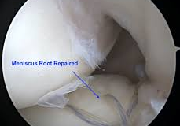
JOSEPH NOAH, MD
SUNCOAST ORTHOPAEDIC
INSTITUTE
THANK YOU

