Slide 1
AI, Implants, and Wearables
New Technologies and How Their Improving Total Joint Replacements!
Edward Stolarski, M.D.
Adult Reconstruction
Kennedy White Orthopedic Center
Chief of Surgery, SMH

Slide 2
Who am I?
Edward John Stolarski, M.D.
  Fellowship Trained - Adult Hip and Knee Reconstruction
  University of Pennsylvania
  Pennsylvania Hospital (more joint replacements than any other hospital in United States)
  Presbyterian Hospital
  VA Hospital, Philadelphia, PA
  Mentors: Paul Lotke, M.D.
  Jonathan Garino, M.D.
  Charles Nelson, M.D.
  Trained in minimally invasive joint replacement, impaction grafting, revision joint surgery, partial knee replacements

Slide 3
Great procedures with great risks!
Summary of risk
Bleeding
Infection
Stiffness
Blood clots
Embolism
Injury to nerves and vessels
Fractures
Possible revision (redo of joint)
Delayed recovery
Death

Slide 4
Rosa Robotic Knees and Hips
Quantify patients unique anatomy
  dynamically!
Make adjustments to every variable to optimize balance
Work flow is maintained
Still need to use common sense

Slide 5
ROSA Hip
Surgeon Centered
Flexibility to verify reamer and cup positions
Surgeon choice for ROSA Arm cup impaction assistance or traditional inserter
Surgeon chooses stem, leg length and offset goals
Trial panel evaluation grid for surgeon guidance to choose neck and head options based on actionable data

Slide 6
IMAGES OVERVIEW
ROSA HIP needs a minimum of 7 AP fluoroscopic views for its MAIN workflow
Reference Images (before incision):
  AP Pelvis
  AP Hip (operative hip)
Inclination and version (cup):
  Calibration image
  Navigation image
  Cup Verification image
Leg length and offset (stem):
  Trial image
  Final image
THE KEY TO ROSA HIP IS AFTER THE 2 REFERENCE IMAGES THE 5 REMAINING IMAGES MUST MATCH THE REF AP HIP IMAGE AS MUCH AS POSSIBLE FOR BEST RESULTS

Slide 7
What’s New?

Slide 8
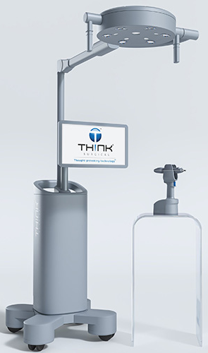
T-Mini

Slide 9
CT -Based
3D - Planner
Fine - Tuning

Slide 10
We are better with Robotics
More balanced knee with fewer releases
Negligible increase in OR time
Surprisingly it has improved our knee replacements we perform without Rosa.
Ultimate gap balancing technique
New study showing reduced inflammatory markers with robotic knee
Still need common sense!

Slide 11
Augmented Reality and Hip Insight
The HipInsight™
  Mixed reality-based digital surgery platform
for total hip arthroplasty.
  “x-ray vision” to see anatomy,
instruments, and implants inside the patient’s
body in real-time.
Already over 100 cases completed
ZERO cup repositions
ZERO dislocations

Slide 12
Augmented Reality and Hip Insight
The HipInsight™
  All approaches
    Anterior
    Posterior
    Lateral
  Revisions from all approaches
  Custom Triflanges

Slide 13
Posterior Approach
Lying on your side
  Pelvis moves
  Difficult to accurately put in implants
  Can’t verify leg length
Cut more muscle

Slide 14
Posterior Approach
HipInsight even more important
Wonderful approach for complex revision
Even more difficult to verify component positioning, leg length and offset

Slide 15
Anterior Approach
Laying on your Back
  Level Pelvis
  Accuracy in implants
  Leg lengths can be verified

Slide 16
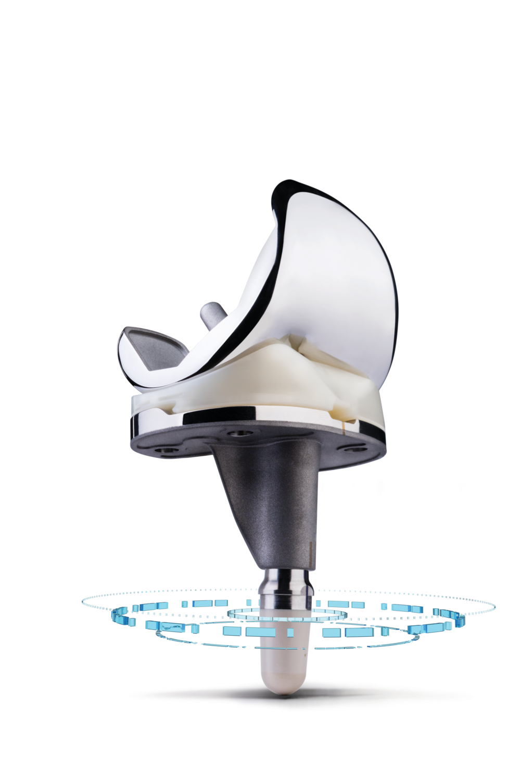
Persona IQ® Smart Knee
Digitize, Visualize, and Revolutionize TKA Recovery

Slide 17
The Old Model: Static, Reactive, One-Size-Fits-All
Recovery today is largely guesswork between post-op visits.
Surgeons rely on:
  Infrequent clinic check-ins
  Patient self-reports (“I think I’m doing okay…”)
  Manual goniometer measurements
There’s no continuous feedback loop.
Patients recover differently, but protocols often don’t adapt in real-time

Slide 18
⚠️ Why That’s a Problem
Payers are demanding outcomes. Administrators are demanding efficiency.
Patients want personalization and digital support, not a 3-ring binder and a six-week wait.
Orthopedics is in the value-based era, but:
  We lack the data to prove value.
  We lack the insight to intervene early.
  We lack the tools to differentiate ourselves in a sea of sameness.

Slide 19
✅ The New Mandate
To compete in modern medicine, we must evolve from episodic care to continuous, connected care that’s powered by data.
Surgeons must have:
Real-time insight into patient recovery
Personalized data to tailor treatment
Tools to scale efficiency without sacrificing care
Proof of performance to justify their clinical and
business value
Notes:
To compete in modern medicine, we must evolve from episodic care to continuous, connected care.

Slide 20
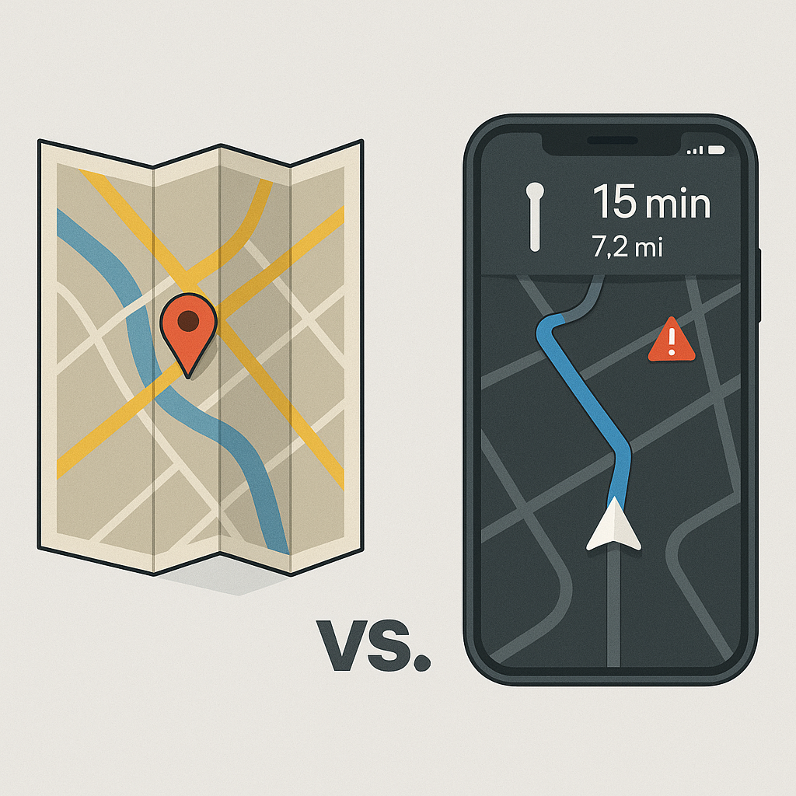
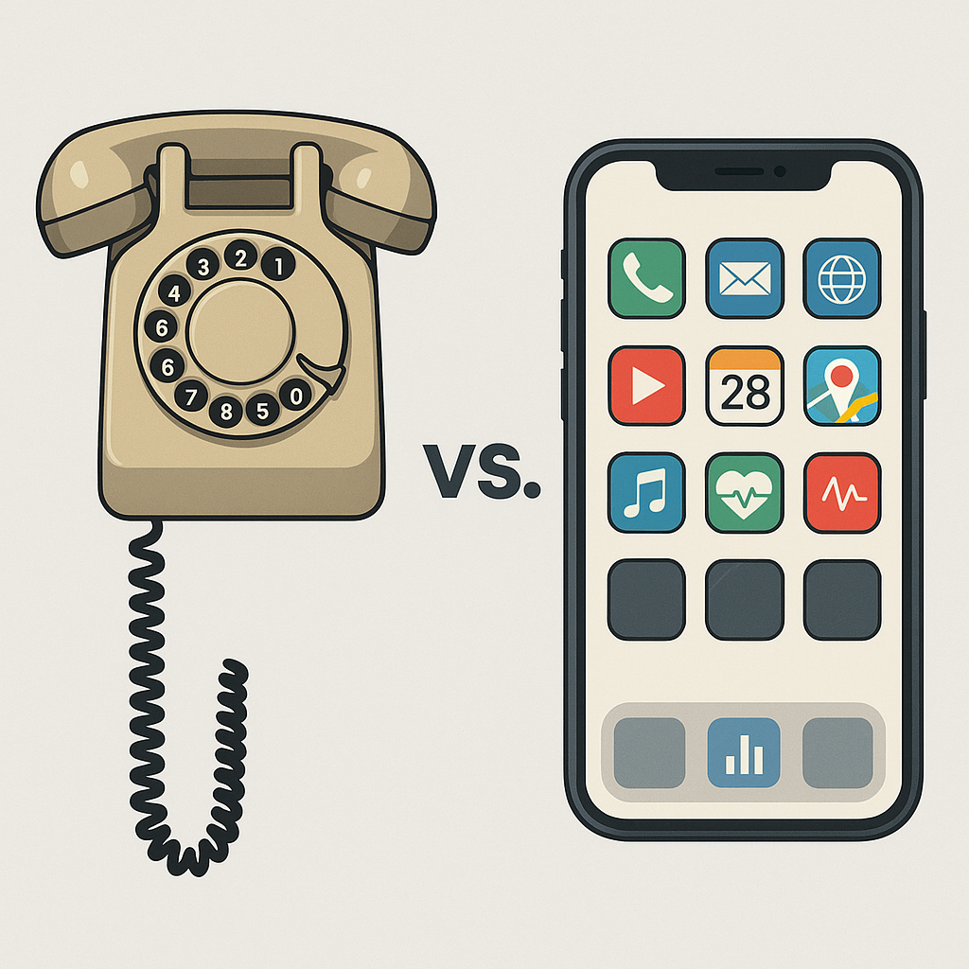
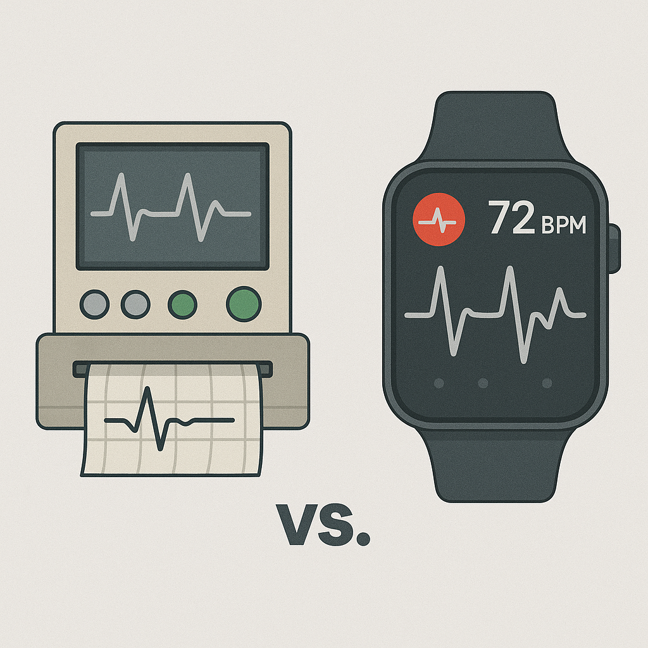
When Technology Goes Smart, There's No Going Back.
From static guidance to adaptive navigation
From basic communication
to intelligent interaction
From episodic diagnosis
to continuous wellness intelligence
Notes:
Think about the last time you checked your heart rate… your location… or your calendar.
You didn’t pull out a clipboard. You didn’t ask a nurse. You looked at your watch—or your phone—and it was all there.
History shows us:
Maps became real-time GPS navigation. Now the quickest route adjust in real time.
Phones became smartphones. Communication evolved into a dynamic, interactive, and data-driven ecosystem.
Cardiology got Holter monitors. Now remote rhythm tracking is standard through Wearables: Passive, constant monitoring that sends alerts, trends data, and empowers action before problems escalate.
Once we experienced what it was like to have real-time data in our hands, we never looked back.

Slide 21
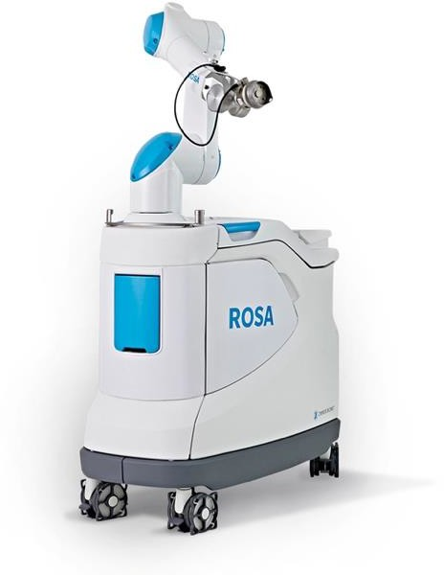
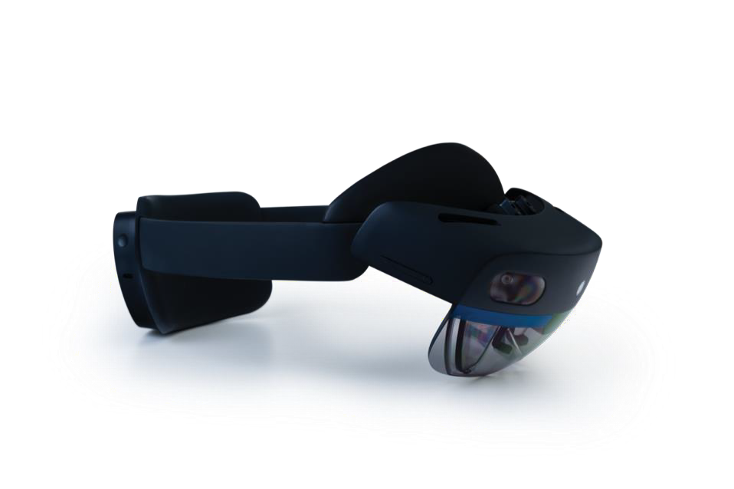
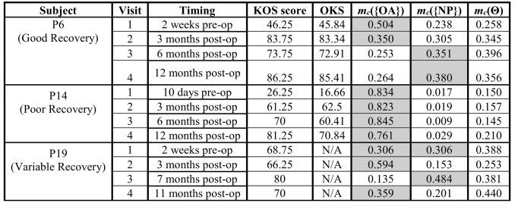
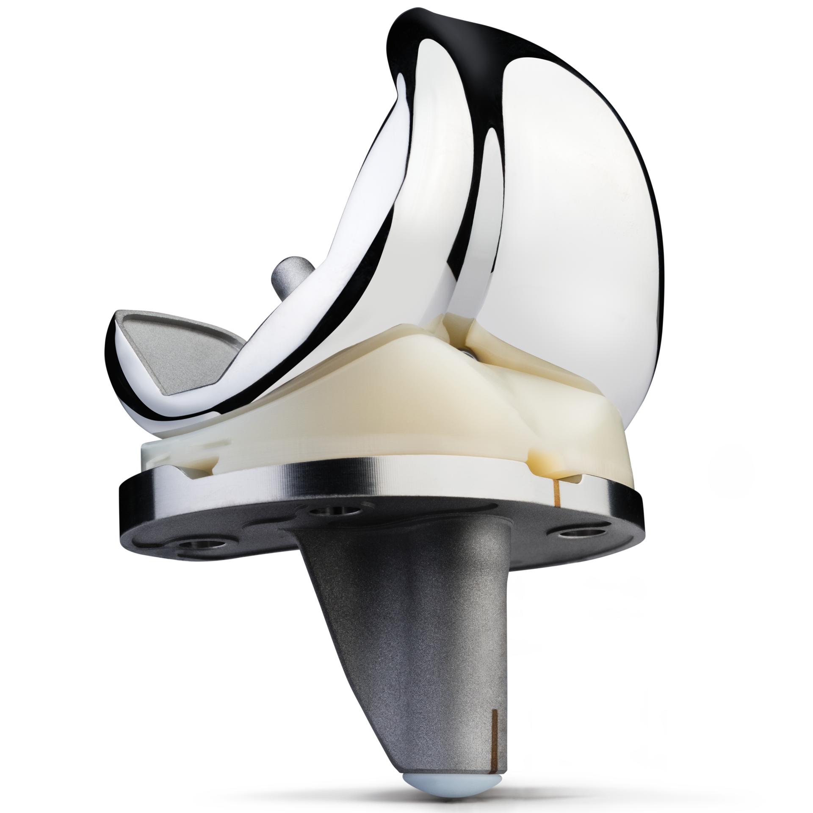
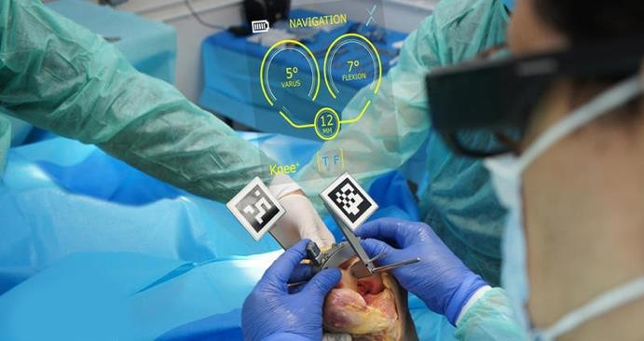
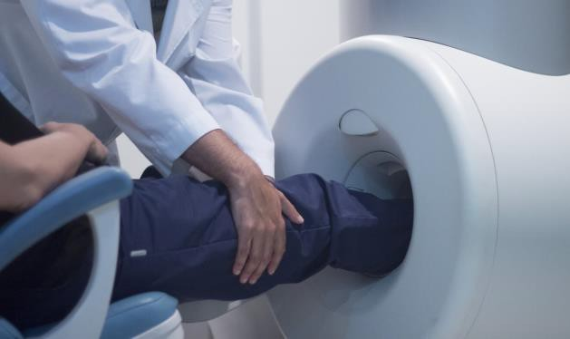
Analogue and Subjective
Surgery
Standard Implant
Subjective, Reactive Recovery
Patient Reported Outcome Measures
Oxford Knee Score (OKS)
Knee Injury and Osteoarthritis Outcome
Score (KOOS)
Virtual Reality
Robotics
Augmented Reality
X-ray/CT/MRI
Digital Tech
Analogue
Analogue / Subjective
Notes:
Surgeons rely on patient-reported outcomes or delayed X-rays to assess success—reactive medicine.

Slide 22
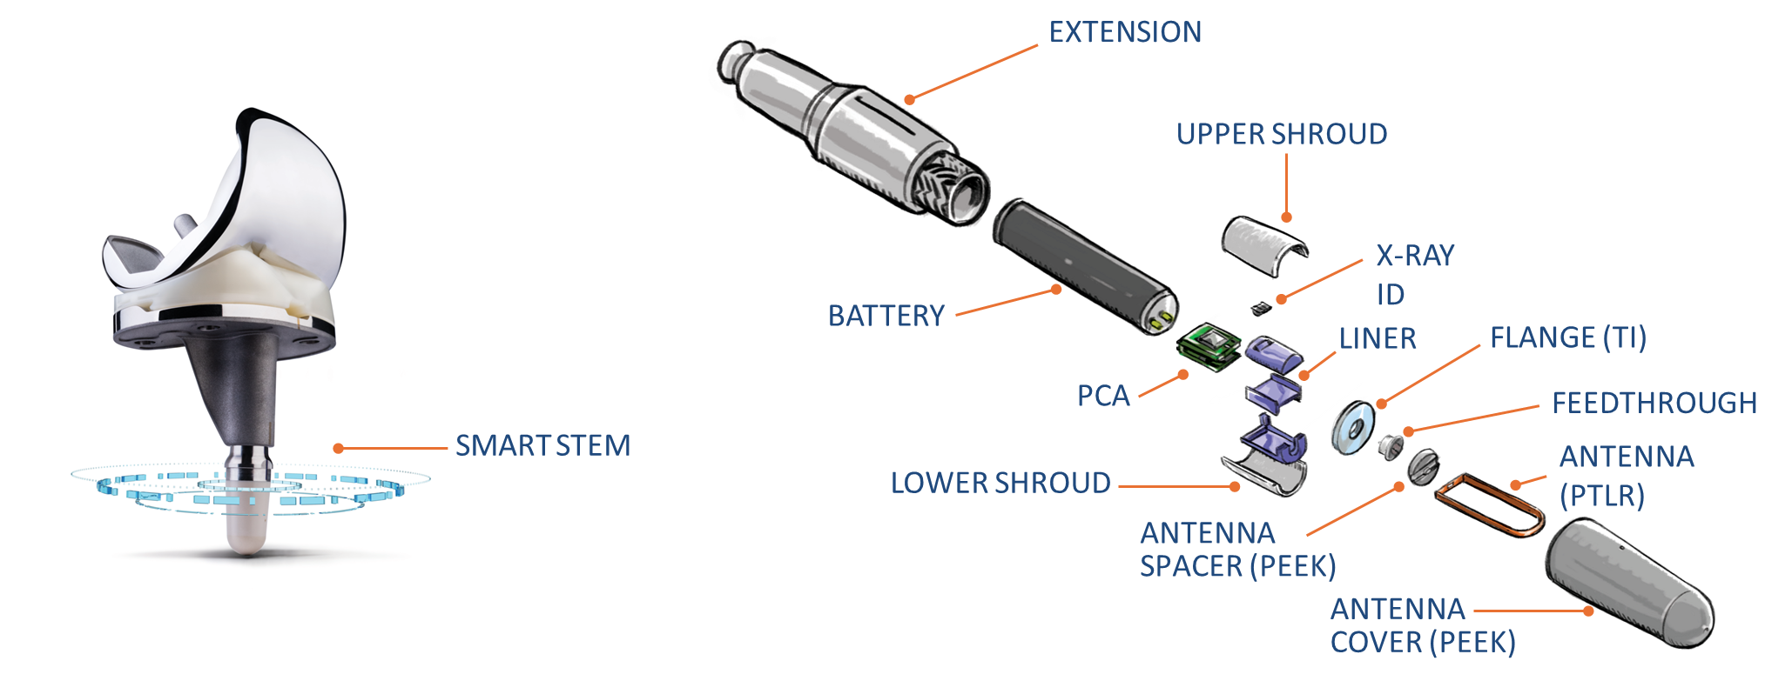
Make the Implant Smart
Notes:
The accelerometer and gyroscope are nestled in a 30mm stem extension, and together with a battery and antenna collect and connect data from the patient’s knee.
Embedded sensors track range of motion, gait speed, step count, cadence, stride length, and more – automatically
Battery:
Lithium carb-monofloride chemistry (Li/CFx)
Similar battery technology used in pacemakers
Lasts at least 10 years

Slide 23
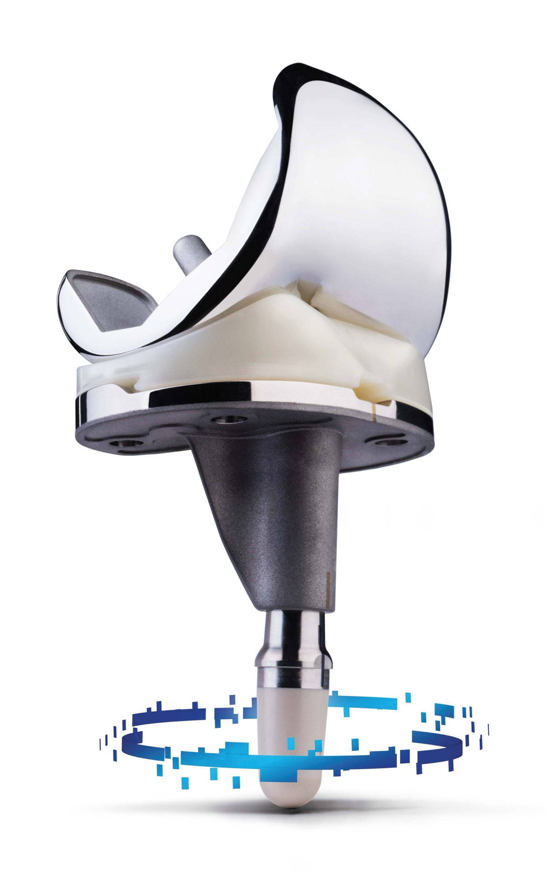
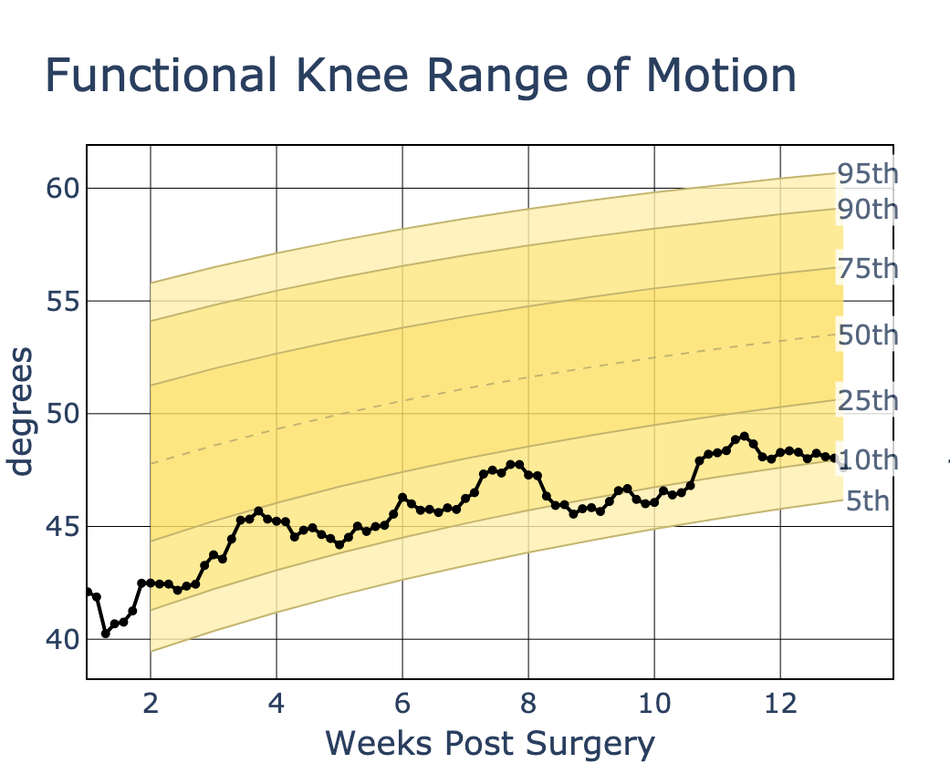
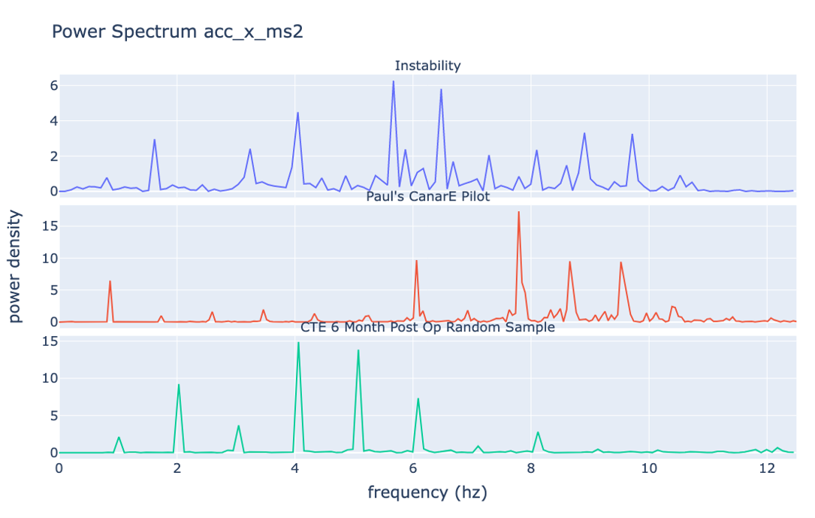
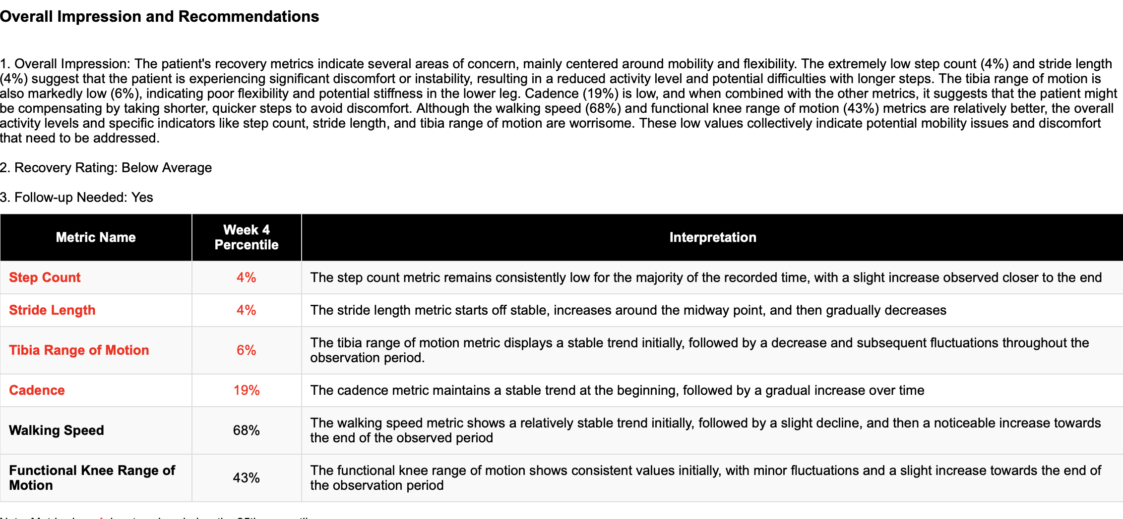
From Smart Implant to Insights
Surgery
Smart Implant
Objective, Proactive Recovery
Recovery Curves
Robotics
Virtual Reality
Analytics
LLMs
Augmented Reality
Digital
Digital
Digital / Objective
Notes:
🎯 Don’t let your implant go silent. Let it speak. Let it guide. Let it transform.

Slide 24
DIGITIZE — Turn Recovery Into Data
🎯 Persona IQ turns every knee into a recovery platform.

Slide 25
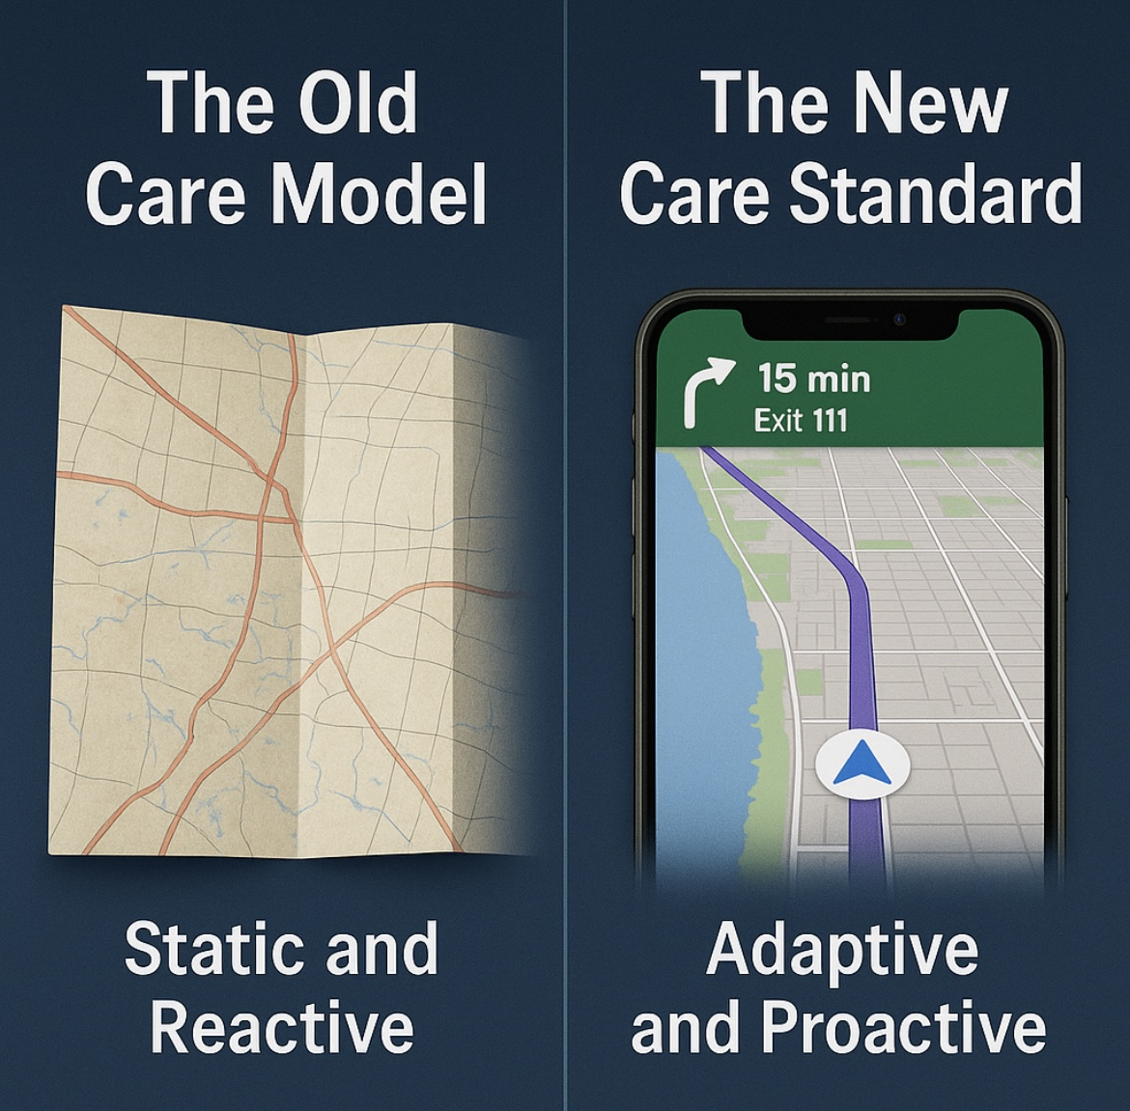
The Old Care Model
Running recovery with infrequent check-ins and guesswork is like driving cross-country with a paper map.
🗺️ No real-time updates.
🛑 No course corrections.
🤷‍♂️ You only know there’s a problem when
you’re already lost.
The New Care Standard
Running recovery with Persona IQ is like driving cross-country with a real-time navigation and alert notification system
📡 Continuous, connected care
📊 Live insight into patient progress
🎯 Proactive course-correcting adapting
to fit each patient’s needs
📈 Proof of performance that payers and
administrators demand
Notes:
Traditional Recovery pathways are like maps rigid and generalized—patients followed standard protocols regardless of individual performance or setbacks.
Like the smartphone transformed our world , Persona IQ transforms the knee implant into a connected, intelligent health platform—communicating performance data, personalizing care, and enabling smarter decisions in real time.
Like responsive GPS, Persona IQ real-time motion and recovery data, care teams can reroute recovery—responding early, adjusting rehab plans, and optimizing every step.

Slide 26
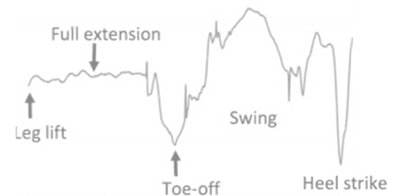
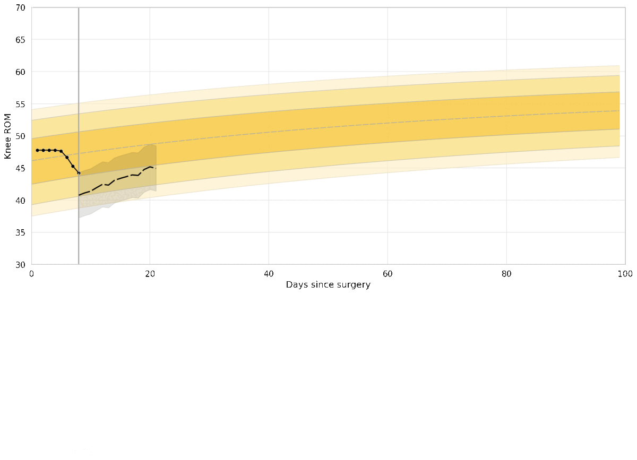
Digitize The Recovery
Tibia Range of Motion
Notes:
💡 See More
This is the Holter Monitor moment for orthopedics: Cardiology revolutionized outcomes by tracking heart rhythm continuously.
Persona IQ does the same for motion—the most vital sign in orthopaedics.
You’re not just seeing one data point. You’re watching the entire story of function return, day by day, step by step.

Slide 27
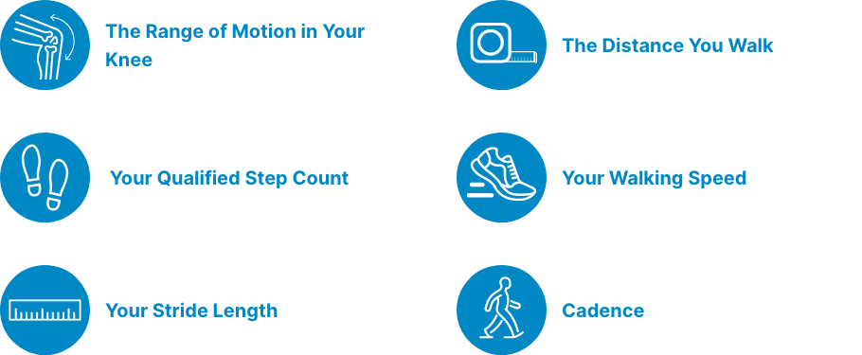


PIQ Metrics Captured Automatically
Persona IQ does not collect data on:
Your location
Where you’ve been where you’re going
Notes:
Embedded sensors track gait range of motion, gait speed, step count, cadence, distanced walked stride length,
and more automatically without having to charge a battery or remember to put something on.

Slide 28
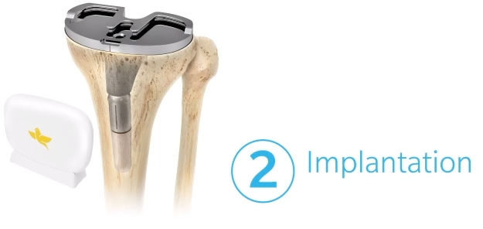
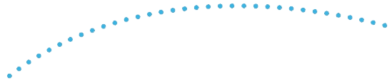
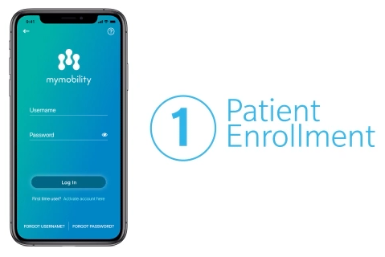
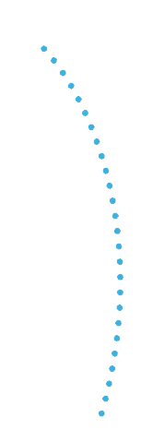
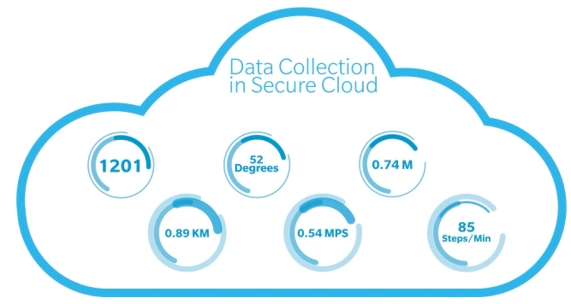
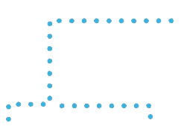
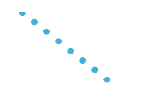
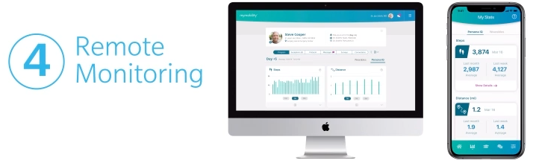
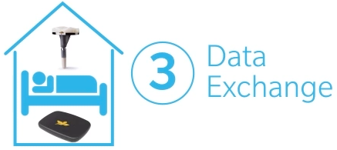
PIQ Streamlined Workflow
TOC
Notes:
PIQ Streamlined workflow transforms the entire post-op care model into a streamlined, insight-driven experience.
Persona IQ doesn’t change how you operate. It changes what happens afterwards, and that changes everything

Slide 29
VISUALIZE — See Recovery Like Never Before
🎯 Persona IQ makes recovery measurable, visible, and actionable.

Slide 30
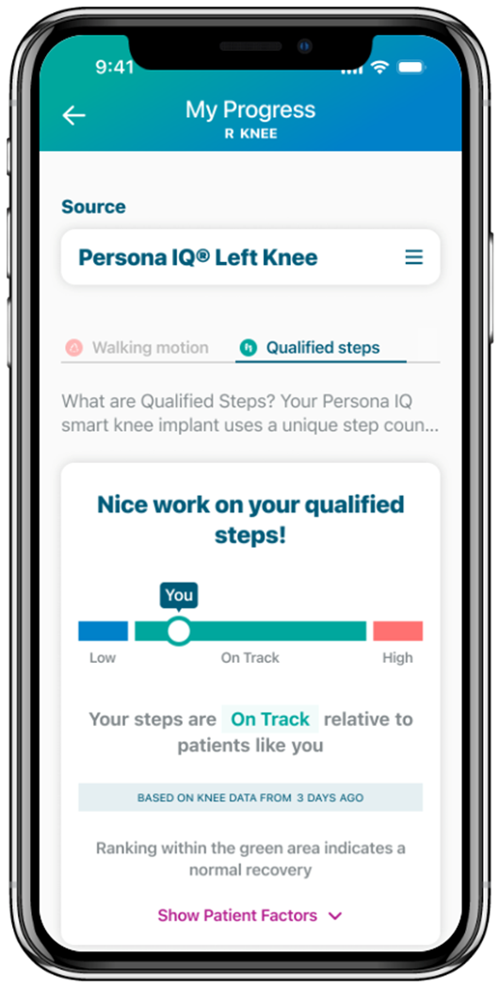
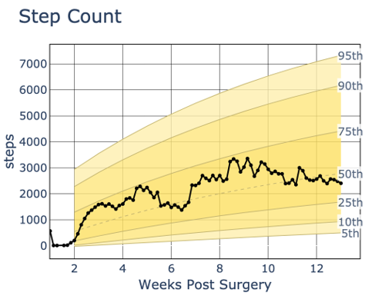
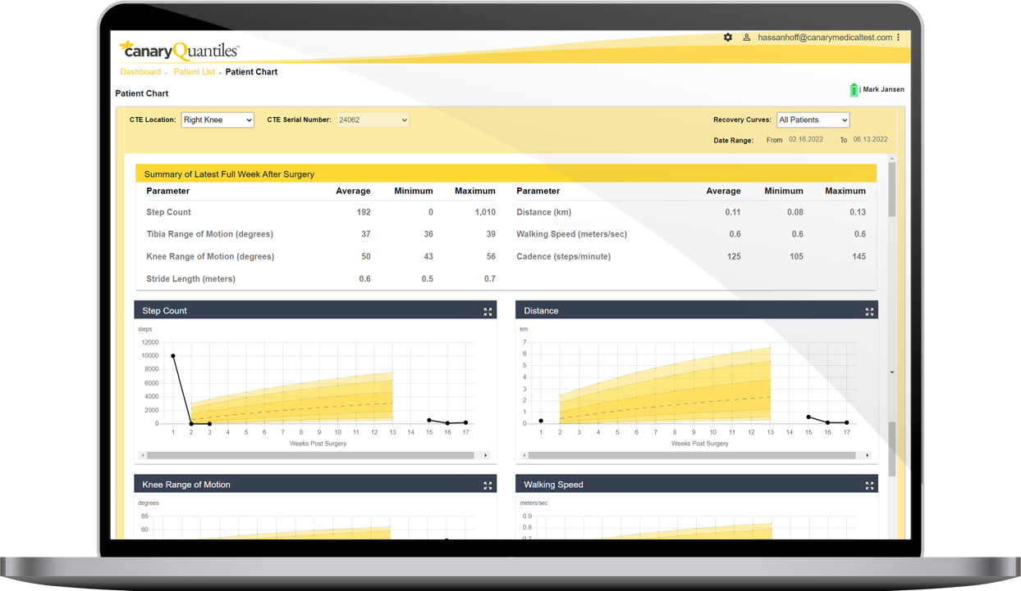
Connecting Care
PIQ Connects the Surgeon and Patient to the Recovery Phase
Patient View
Clinician View
Notes:
Patient view: Reinforces patient confidence with objective progress tracking in their mymobility® app. Motion data correlates with functional milestones
Clinician View: Provides an unprecedented benchmarking tool. Compare outcomes across patients, cohorts, or protocols.

Slide 31
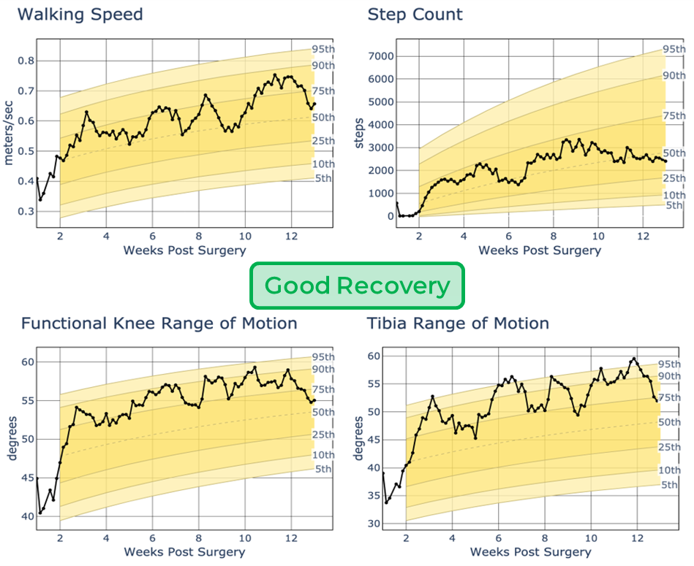
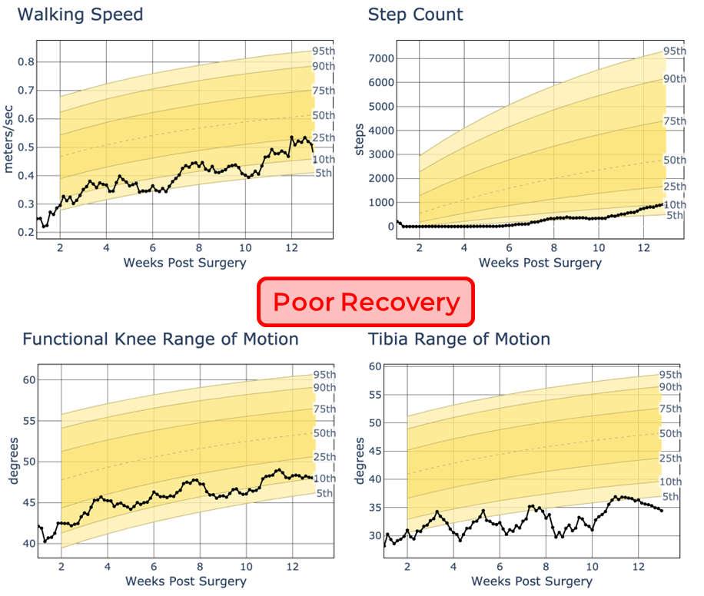
💡 See More
Every patient has a unique recovery fingerprint
Notes:
💡 See More
Every patient has a unique recovery fingerprint—and Persona IQ captures it.
Using the clinician dashboard, you can view:
Range of motion over time
Real-Time Progress Tracking: View daily, weekly, and monthly recovery trajectories.
Spot patients falling behind—or accelerating ahead—instantly.
You’re not just seeing isolated check-ins—you’re watching a real recovery story unfold.

Slide 32
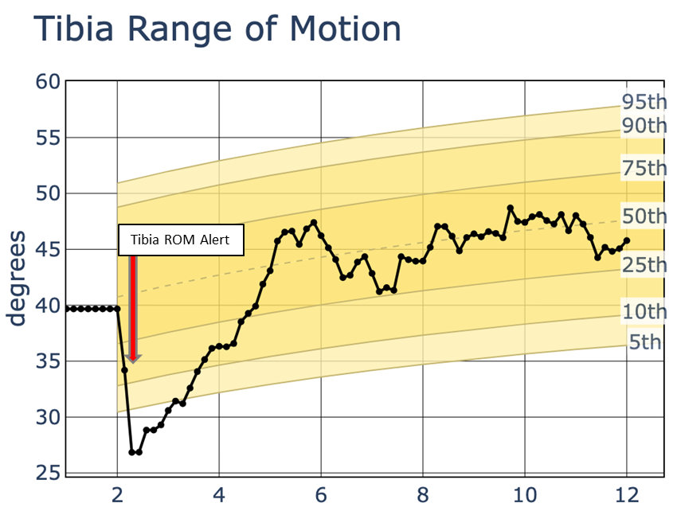
📊Intervene Early
Identify at-risk recovery patterns before patients even report issues.
Before
After
Patient brought to the office for an unscheduled visit
Received tissue massage and mild mobilization
Exercises were modified
Compression stockings were prescribed
WARNING-The kinematic data obtained from this device have not been demonstrated to have clinical benefit. It is not intended to be utilized for clinical decision-making, and no data have been evaluated by FDA regarding clinical benefits.
Notes:
Surgeons access real-time recovery data, not just snapshots at post-op visits.
Data continuity helps identify subtle declines that would otherwise go unnoticed
Identify recovery patterns before patients even report issues and adjust care protocols earlier based on actual performance, not assumptions.
Without Persona IQ:
You're operating blind between visits
You're relying on anecdotal feedback
Your implant goes silent
With Persona IQ:
You monitor recovery in real-time
You identify issues early and intervene proactively
You turn the implant into a smart recovery platform

Slide 33
Revolutionize — PIQ Sets a New Standard of Care
🎯 Persona IQ doesn’t just enhance recovery; it fundamentally transforms it.

Slide 34
Clinic Workflow Step | Without Persona IQ | With Persona IQ
Pre-Visit Review | Limited EMR memory | Real-time recovery data
Patient Discussion | "I think I’m doing OK" | "You doubled your steps last week"
ROM Assessment | Manual goniometer | Continuous Gait ROM
Gait Review | None unless visualized | Full gait metrics (cadence, stride…)
Decision-Making | Reactive, assumption-based | Proactive, data-guided
Patient Confidence | Uncertain | Empowered by progress visuals
Clinic Efficiency | Slower, redundant | Streamlined, focused
Visit Frequency | More visits, lower value | Fewer, higher-value visits
Without vs. With Persona IQ

Slide 35

Practice Efficiency: Persona IQ Flips the Script on Outdated Care Models
Notes:
Persona IQ reduces the need for in-office visits
✅ No need to bring in patients “just to check” if they’re progressing. You already know.
✅Persona IQ helps identify: Patients ahead of recovery curve who can skip or delay in-person check-ins
✅Patients who are recovering well can stay home and avoid unnecessary post-op visits. The care team can monitor recovery passively, freeing up in-clinic resources.
✅Patients falling behind who need targeted support can be prioritized freeing up appointments for patients who truly need them.
✅ Drives efficiency and reduces wait times for all patients.

Slide 36


Automate Post-op Patient Screening
Reduce the need for in-office visits
Traditional
Patient
Management
In office
In office
In office
In office
Multiple office visits for majority of patients
Multiple diagnostic imaging studies
Multiple PT assessments and treatments
No information for patients lost to follow up
2 week
follow up
visit
12 week
follow up
visit
6 month
follow up
visit
1 year
follow up
visit
High Volume
Practice
Early
Intervention
/ Potential
Remote
Potential
Remote
Potential
Remote
Remote identification of normal vs. abnormal
Reduce office visits for patients recovering well
Focus visits on patients in need
Bill monthly for remote monitoring & remote care management
Imaging for those who need it
PT for those who need it
Technology to differentiate practice
In office
Persona IQ
Patient
Management
2 week
follow up
visit
12 week
follow up
visit
6 month
follow up
visit
1 year
follow up
visit
Notes:
Persona IQ reduces the need for in-office visits—but when they happen, they’re more impactful."

Slide 37
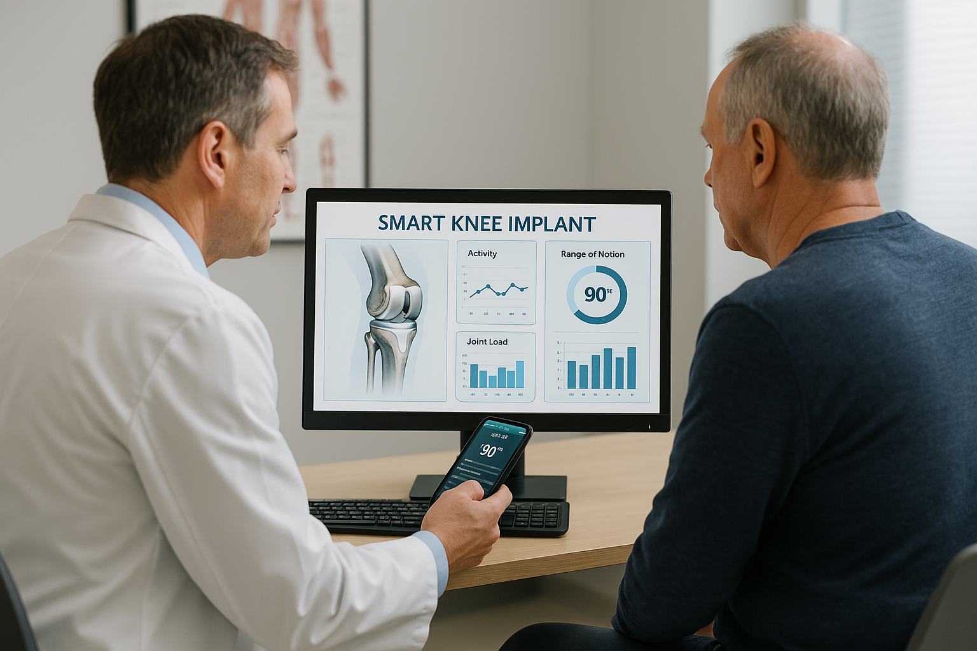
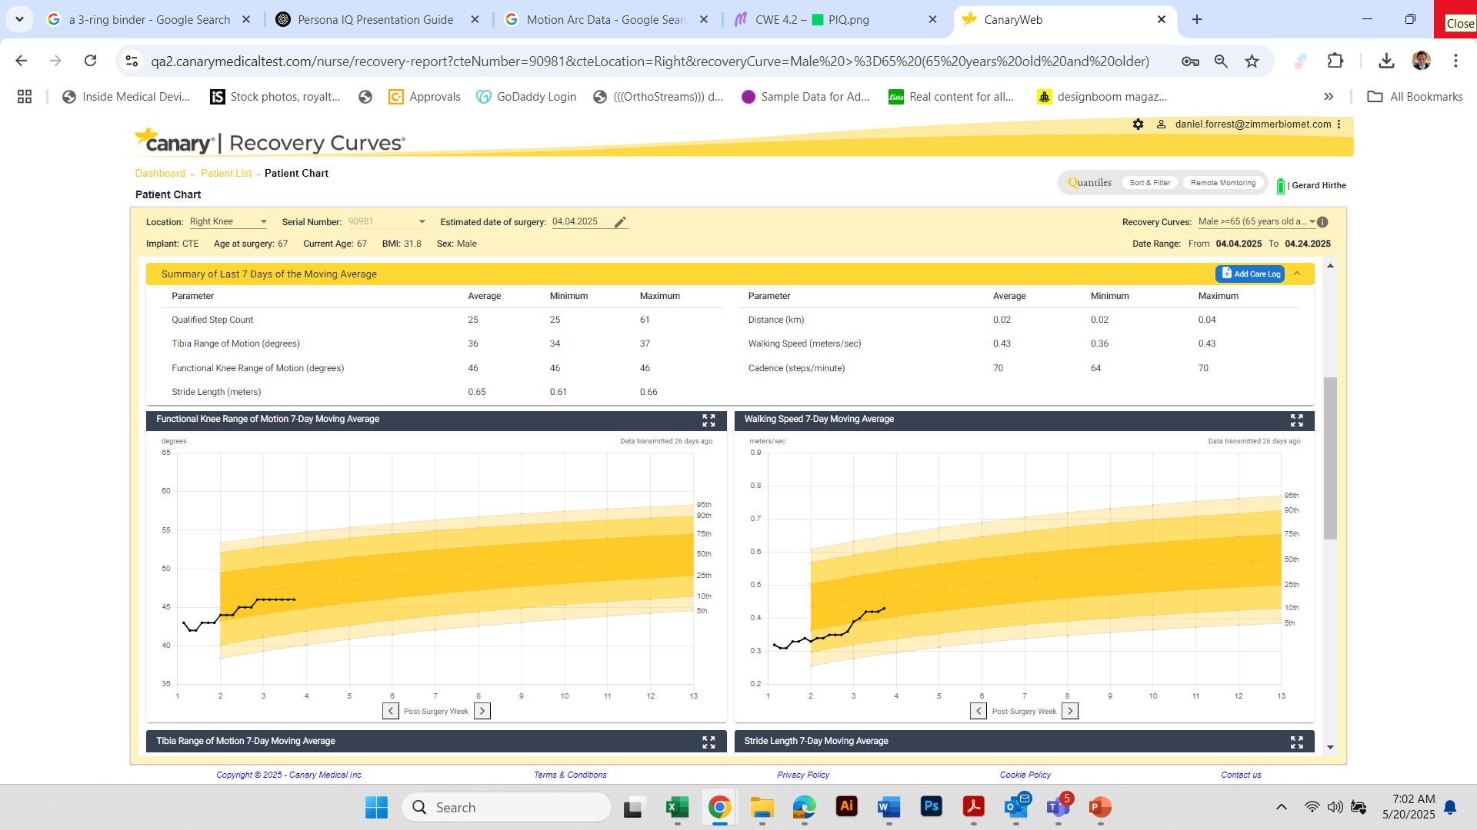
🤝 High-Value Visits, Not Just Fewer Visits
Persona IQ reduces the need for
in-office visits, but when they happen, they’re more impactful.
Notes:
"Persona IQ reduces the need for in-office visits—but when they happen, they’re more impactful."
“It’s not just about reducing office visits—it’s about making every visit count.”
Before Persona IQ:
You walk in blind.
You rely on subjective feedback.
You spend time figuring out what’s going on before you can act.
With Persona IQ:
You already know how they’ve been moving, how far they’ve walked, how their ROM is trending.
You walk into the room prepared to discuss next steps, not basic diagnostics.
Patients feel seen, understood, and engaged—because you’re speaking from data, not memory.
Persona IQ turns the clinic into a command center, not a guessing game.

Slide 38
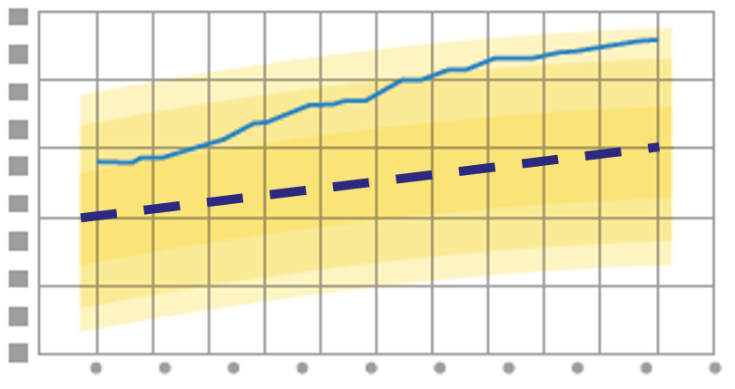
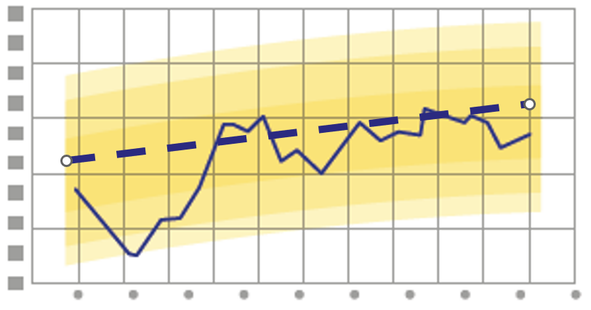
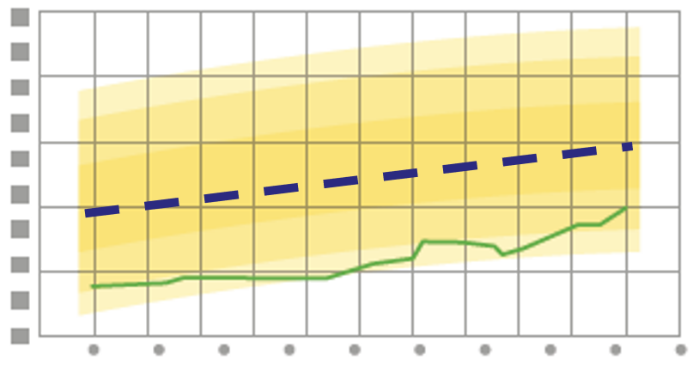
Common Patient Personas
Recovery isn't just physical. It's perceptual.
“The Worried Well”
Thinks they’re doing poorly. Reporting low outcomes. In reality, they’re recovering exceptionally well.
“The Oblivious Optimist”
Feels like they’re doing great. But gait data reveals they’re significantly lagging.
“The Unaware Underperformer”
They’ve adapted to a diseased gait for so long, they don’t recognize what "normal" should feel like.
Notes:
1. The Worried Well
Thinks they’re doing poorly. Reporting low outcomes. In reality, they’re recovering exceptionally well.
Smart data reassures them and prevents unnecessary escalations or interventions.
2. The Oblivious Optimist
Feels like they’re doing great. But gait data reveals they’re significantly lagging.
Persona IQ enables timely coaching and adjustments.
3. The Unaware Underperformer
They’ve adapted to a diseased gait for so long, they don’t recognize what "normal" should feel like.
Persona IQ sets a clear visual benchmark and targets to retrain movement and reset expectations.
"Recovery isn't just physical. It's perceptual. Persona IQ makes it visible for everyone involved."

Slide 39
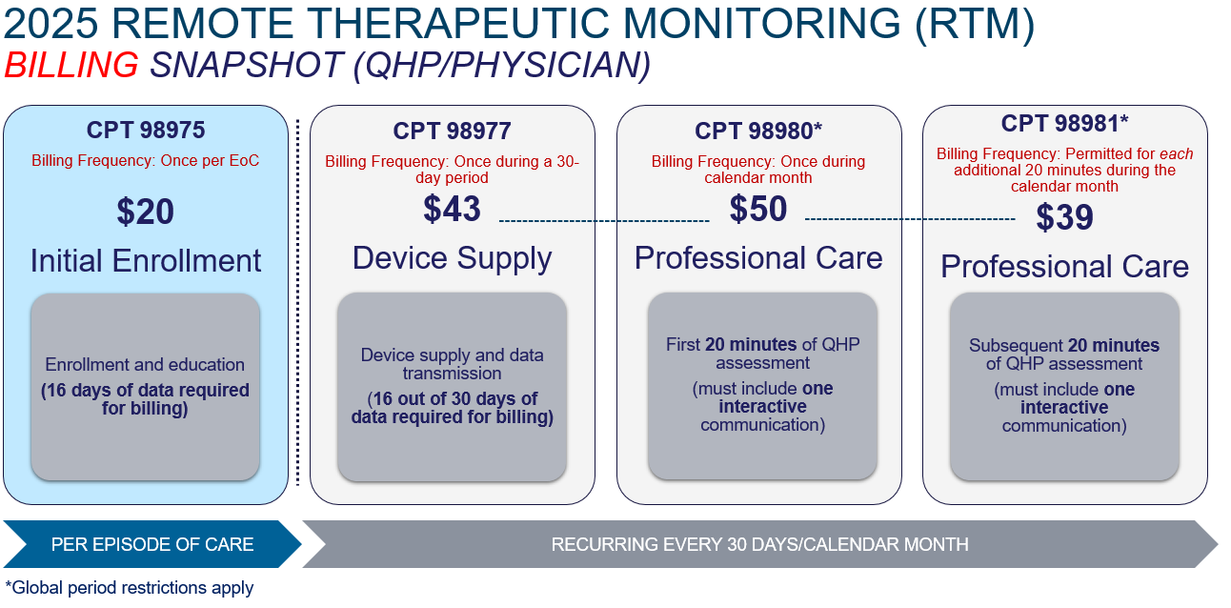

Slide 40
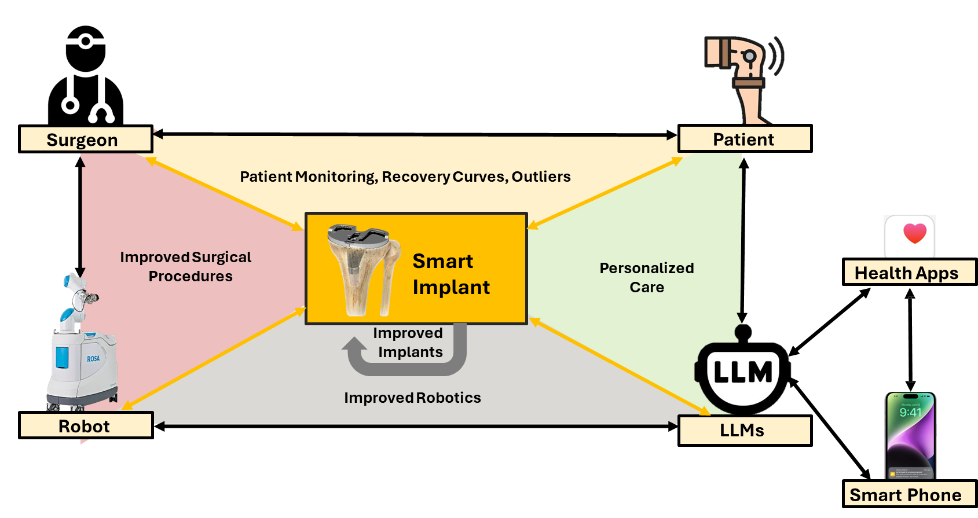
PIQ Closes The Loop
Persona IQ changes that. It transforms the knee into a smart, connected device that closes the loop between surgical intervention and recovery outcome.
Notes:
What if you could prove:
Your protocol returns patients to function faster?
Your outcomes are superior not just by PROMs, but by motion science?
A patient walking 4,000 steps/day in week 3 is ahead of the curve?
Persona IQ gives you proof, not perception.
For researchers, group practices, or value-based care models, this becomes a goldmine of insights:
Compare outcomes by implant, technique, or rehab plan
Track differences across age, BMI, or comorbidities
Build predictive models for discharge planning or therapy optimization

Slide 41
Areas Where PIQ Can Make a Big Difference
  Better Outcomes
  Identify patients that need intervention
  Better PROMs
  Reduction in MUAs
  Reduction in complications
  Practice Efficiency
  Reduction in post-op visits
  Reduction in phone calls
  Identify patients that are above the curve
  Identify patients that are below the curve
  Reduce time per patient during clinic
  Patient Experience
  Reduced travel
  Reduced post-op costs
  Positive patient reviews
  Reduced pain
  Reduced PT visits
  Differentiate in a Market
  Greater patient volume
  Change in payer mix
  Greater PCP referrals
  Additional Revenue/Cost Savings
  Reduce visit in global period
  RTM Revenue
  Reduce readmissions
  Patient Engagement
  Higher PROMs compliance
  Better exercise adherence

Slide 42
DIFFERENTIATE YOUR PRACTICE
This Isn’t a Feature. It’s a Flag You Plant.
With Persona IQ, you can:
Lead your region in smart recovery care
Win over patients looking for innovation
Attract tech-savvy referring physicians
Build data for research, publications, and presentations
Align with system-wide goals for value and efficiency
Notes:
With PIQ, your implant choice doesn’t just fix the joint. It fuels your growth

Slide 43
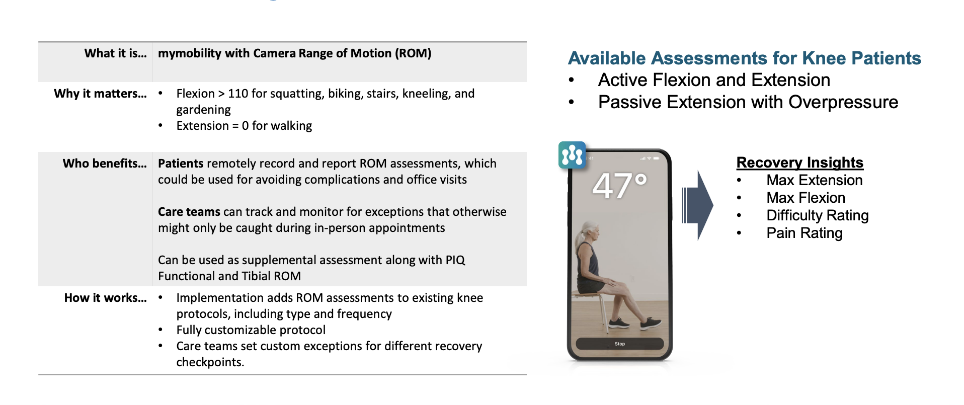
My Mobility

Slide 44

Zimmer Persona IQ Smart Implant
Fitbit for the knee

Slide 45
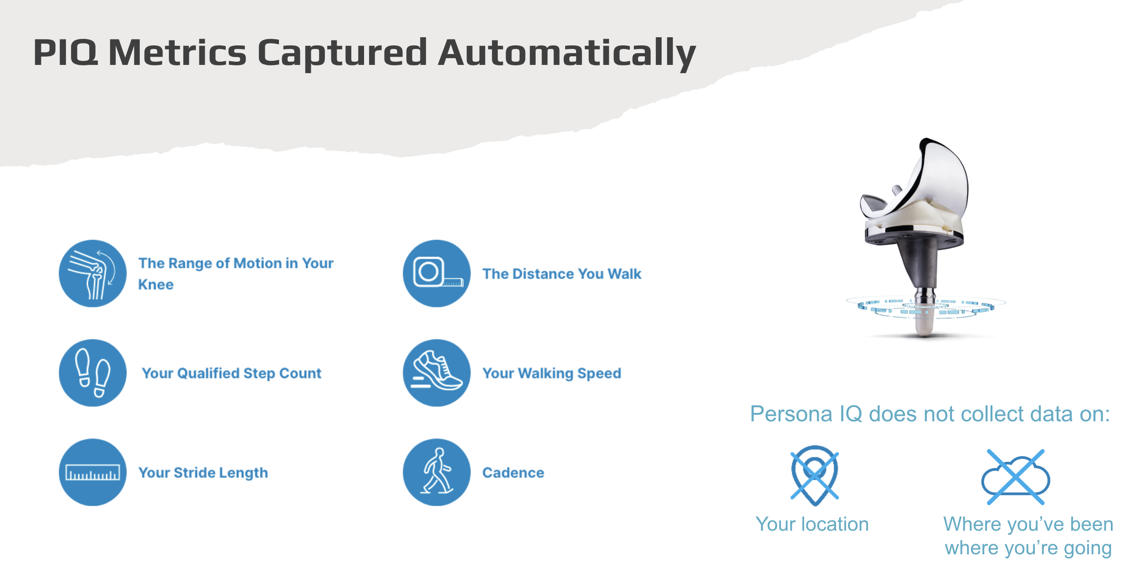

Slide 46
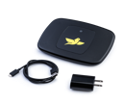
Implementation

Slide 47
Closing The Loop

Slide 48
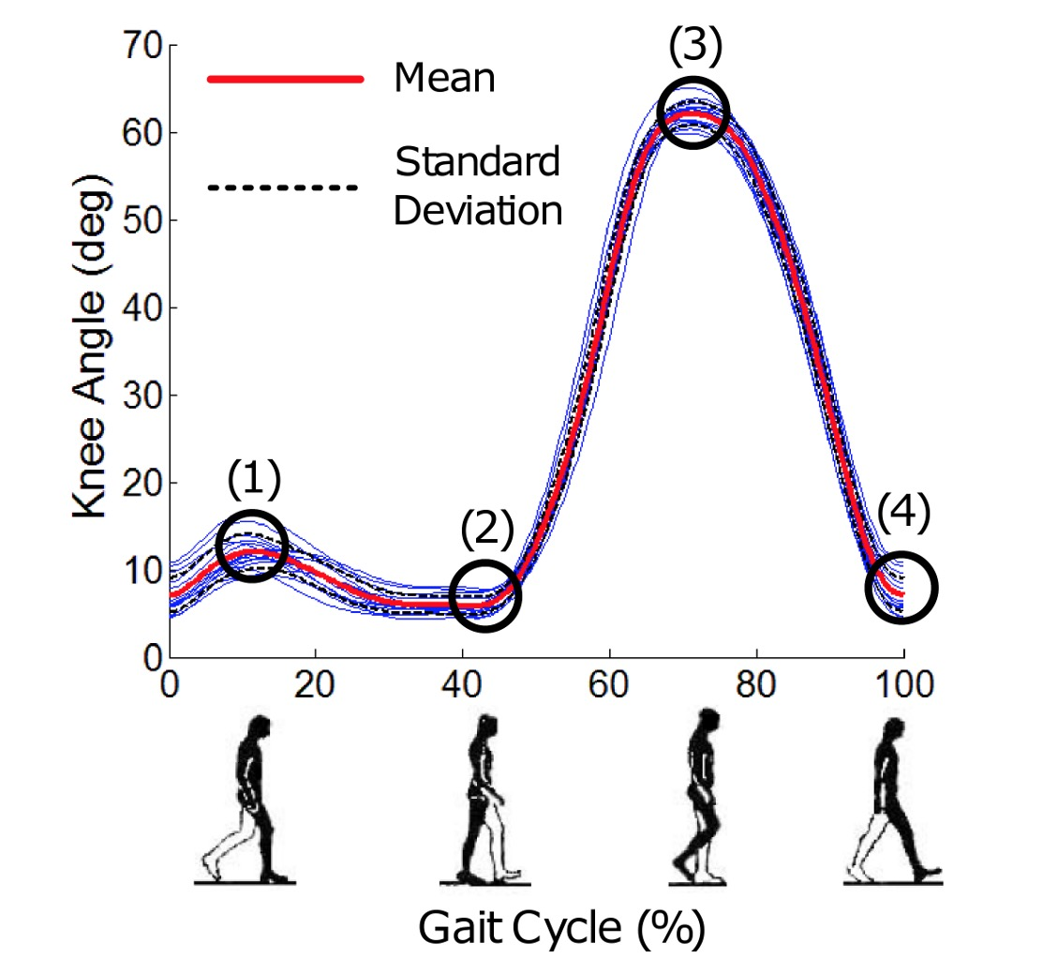
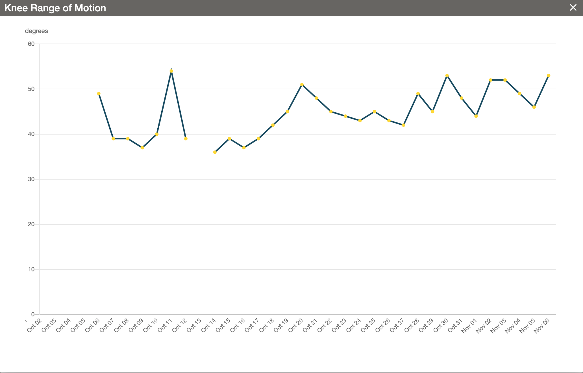
Knee ROM During Gait
³
Images Courtesy of Peter K. Sculco, M.D.

Slide 49
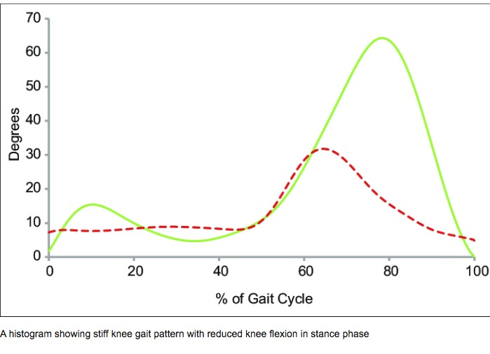
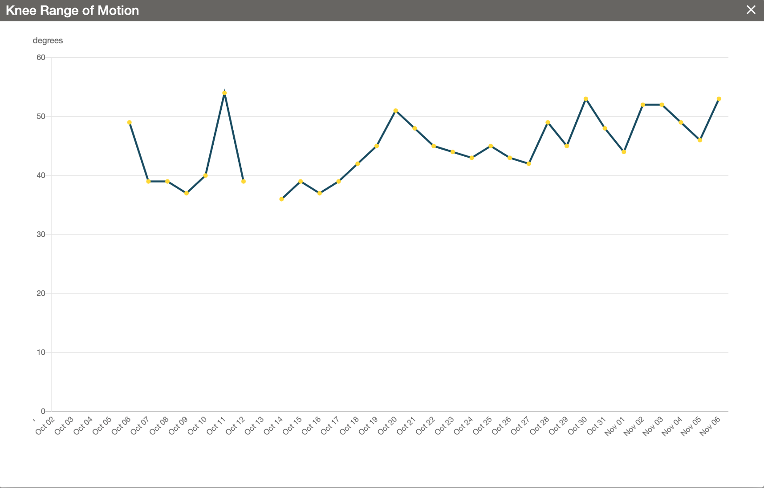
Stiff Knee Gait Pattern
⁴
Images Courtesy of Peter K. Sculco, M.D.

Slide 50

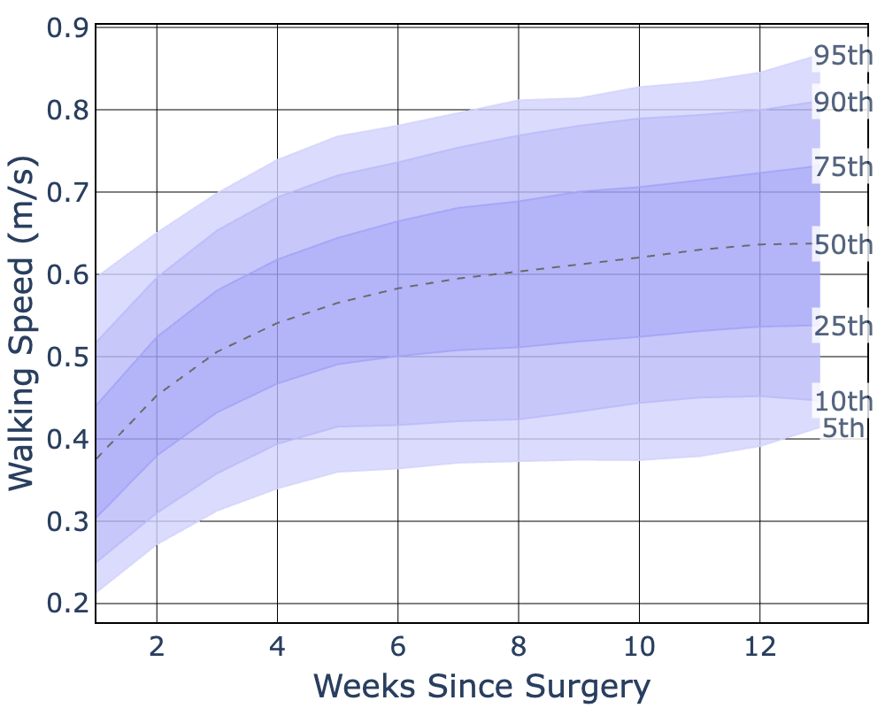
Introducing Recovery Curves
(release Q4 2022)
Recovery Curves quantify “normal” recovery (vs. good / bad)
In November we plan to release Recovery Curves for all activity level and gait quality parameters:
  Walking speed
  Step count
  Knee range of motion
  Tibia range of motion
  Stride length
  Cadence
  Distance
Initial peer grouping by age & gender, later height, weight, BMI etc.
DISCLAIMER: Products presented herein are research and development concepts that may be developed into medical devices for US Food and Drug Administration commercial market application review and subsequent commercial use. These representations are forward looking research design concepts and have not entered development and are not commercially available.
As of 10.25.22 LIT-1014 Rev. A PIQ Surgeon Data Review – Louisville

Slide 51


Slide 52


Slide 53
Canary Gait Quality Index
Clinicians will be able to remotely monitor patients to know if they’re limping
  Helpful to triage patients who may need an intervention
The Gait Quality Index is a digital biomarker that ranges from 0 to 100
  e.g. 0-20: Severe limping, 20-70: Mild/moderate limping, 70-100: Healthy gait
The GQI will be trained and validated on clinical trial data
We plan to submit to the FDA in Q1 2023, and are aiming for a Q2 2023 release if we get approval
DISCLAIMER: Products presented herein are research and development concepts that may be developed into medical devices for US Food and Drug Administration commercial market application review and subsequent commercial use. These representations are forward looking research design concepts and have not entered development and are not commercially available.
As of 10.25.22 LIT-1014 Rev. A PIQ Surgeon Data Review – Louisville

Slide 54

My Mobility & PIQ

Slide 55
Current Studies
A Multicenter, Single-Arm Study of Quantitative Assessment of Walking (Squawk) with the Canary canturio™ te (CTE) Tibial Extension
  Goal: Demonstrate the accuracy of a limp detection model using healthcare provider visual assessments.
  Method: Limp severity is assessed 4–6 weeks post-surgery using a 3-point visual Likert scale.
A Multicenter, Postmarket Surveillance Study of Subjects With the Canary canturio™ te Tibial Extension
  Goal: Evaluate the safety, reliability, reproducibility, and accuracy of the CTE post-total knee arthroplasty (TKA).
  Method: Comparison of test (CTE) vs. control group over 5 years; includes safety monitoring, gait data collection, and gait lab assessments.
A Multicenter Observation Trial of Total Knee Arthroplasty (TKA) Patients with a TKA-Related Complication
  Goal: Study how patients walk and move their knee when experiencing a TKA-related complication before undergoing revision surgery.
  Method: Observational tracking of movement and gait in affected patients across multiple centers.

Slide 56
The Vision for PIQ
Capture high quality data from every patient every day*
Use the data to improve clinician/patient monitoring throughout recovery and beyond
Create diagnostic and predictive information to help mitigate and avoid all significant complications.
*Reduce sampling in year 2+
As of 10.25.22 LIT-1014 Rev. A PIQ Surgeon Data Review – Louisville

Slide 57
Conclusions and review
Technology
  will continue to advance in hopes of improving outcome and reducing complications
  Does not replace common sense
  Physical therapy will always enhance outcomes regardless of how advanced the surgery becomes
  We need someone to blame when things don’t go as expected

Slide 58
Thank You!

