Slide 1
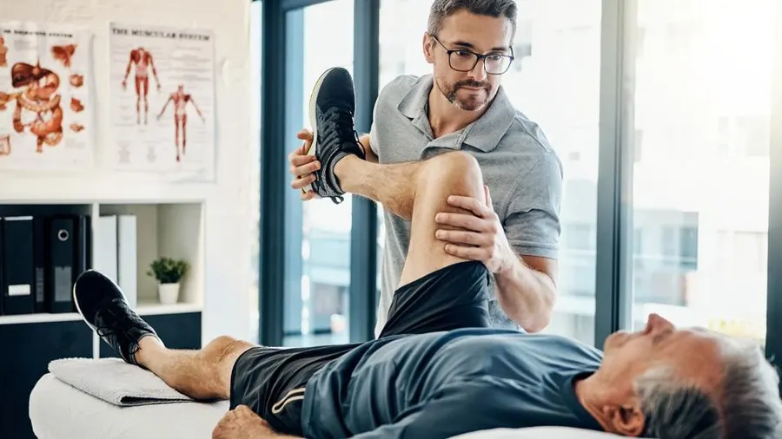
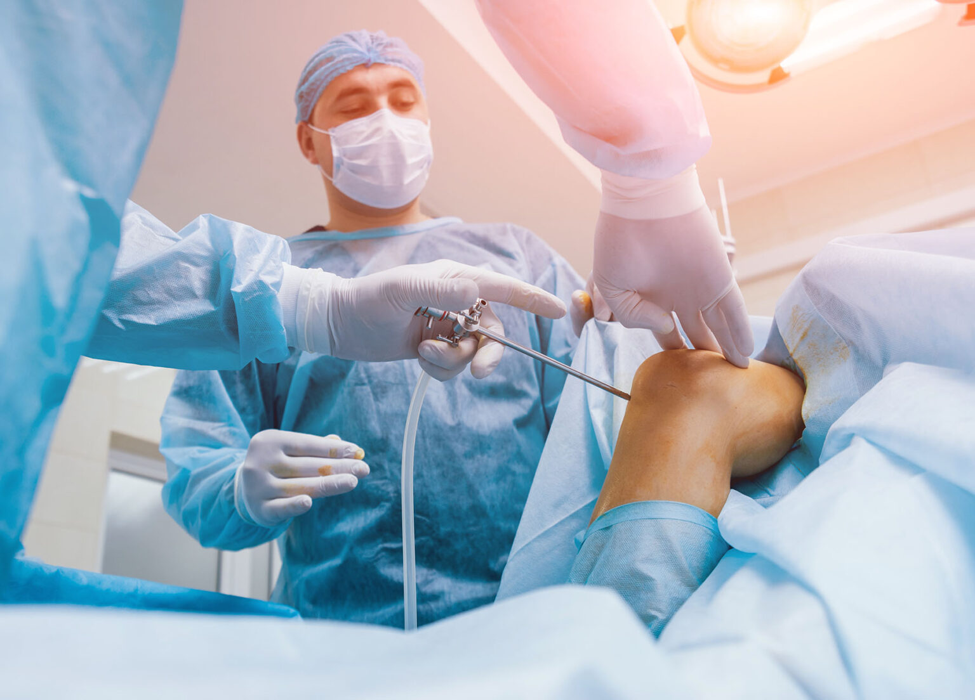
Surgeon-Therapist Relationship
Derek Cuff, M.D.
Suncoast Orthopaedic Institute
9th GORC, August 23, 2025

Slide 2
Disclosures
Ignite Orthopedics- royalties, ownership share, consultant
Johnson and Johnson Med Tech- royalties, consultant
Complete Surgical Nutrition- ownership share
Ortholazer franchise owner

Slide 3
Surgeon-Therapist Relationship
Goals
  1. Reinforce why this relationship remains important
  2. Case examples
  3. Discuss future directions

Slide 4
Surgeon-Therapist Relationship
Surgery is a team sport
  Surgeon
  Patient
  Operating room personnel
  Nursing
  Therapists

Slide 5

Surgeon-Therapist Relationship
Look closely again at that list
  Surgeon
  Operating room personnel
  Nurses
  Therapists- have the most points of contact with my patients

Slide 6
Surgeon-Therapist Relationship
Best outcomes when both surgeon and therapist excel
Bad surgery + great therapist = bad outcome
Great surgery + bad therapist = bad outcome

Slide 7
Surgeon-Therapist Relationship
Next level of relationship
  Interact beyond just PT notes
  Volume of some surgeons practice is crazy
  Phone/e-mail/text
  Alert us to compliance issues

Slide 8
Surgeon-Therapist Relationship
Expanding your education is key
  Learn about the procedures
  Watch surgery- in person or online
  Taking your time to come to this course :)

Slide 9

Surgeon-Therapist Relationship
Case Examples
  Therapists reaching out
  Specific examples of things they learned at this course
  Gratifying to hear

Slide 10
Surgeon-Therapist Relationship
Case 1
  52-year old male
  Lifting event in garage and feels a slight pop in elbow
  Complains of pain and weakness
  Nurse practitioner dx “elbow strain” and sends to PT
  First visit with PT 2 weeks post injury

Slide 11
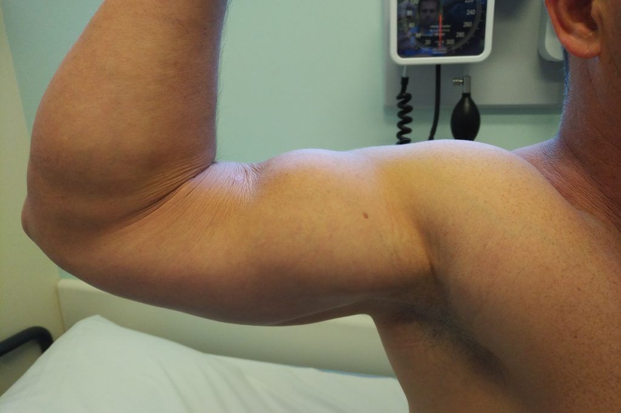
Surgeon-Therapist Relationship
PT notices slight deformity at biceps
Decreased strength flexion and sup
Calls my PA
“I think he ruptured his biceps”

Slide 12

Surgeon-Therapist Relationship
Timing is of the essence with this injury
Want to fix acutely within 4-6 weeks
If not can scar in and be difficult to repair
MRI obtained immediately

Slide 13
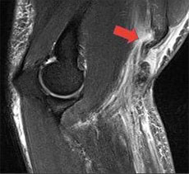
Surgeon-Therapist Relationship
MRI confirms distal biceps tear
Patient scheduled for surgery
In OR 4 weeks post injury
Solid repair = excellent outcome

Slide 14
Surgeon-Therapist Relationship
Case 2
66 year old female status post total shoulder
9 months post op- never been pleased with result
Referred back to PT for more strengthening

Slide 15
Surgeon-Therapist Relationship
PT exam:
  FE to 140, ER to 75, IR to buttock
  With abduction-ER subtle clunk is felt
  Patient is weak in internal rotation 4/5

Slide 16
Surgeon-Therapist Relationship
Therapist texts me directly
Correctly is concerned about subscapularis repair after TSA
Recalls that subscapularis tear/incompletely healing after TSA is known complication (3-5% incidence)
Patient comes in for eval and 2nd opinion

Slide 17
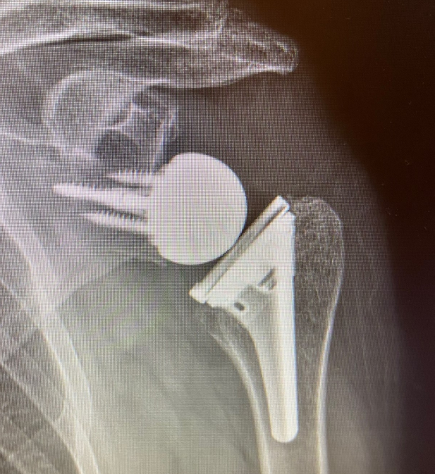
Surgeon-Therapist relationship
CT arthrogram confirms subscapularis tear
Patient required revision to reverse TSA
Stable shoulder and pleased with outcome

Slide 18
Surgeon-Therapist Relationship
Future collaborations
  Surgical Nutrition
  Photo-bio-modulation

Slide 19
Surgeon-Therapist Relationship
Introduced this last year- Early results have been impressive
Surgical nutrition
  Something I think therapist can help with
  Education of the patient is the key for this
  Has been neglected to date
  Trying to consider everything we can to improve patient outcomes

Slide 20

NUTRITION
is an integral part
of surgical recovery.
  Surgery places increased stress on the body and results in unique nutritional needs.
CLINICAL
EXPERIENCE
EVIDENCE BASED PRACTICE
  Multiple studies have demonstrated that protein, a pre-surgery carbohydrate drink, and particular vitamins improve SPEED of recovery and OUTCOMES.
RESEARCH
& EVIDENCE
PATIENT PREFERENCE

Slide 21


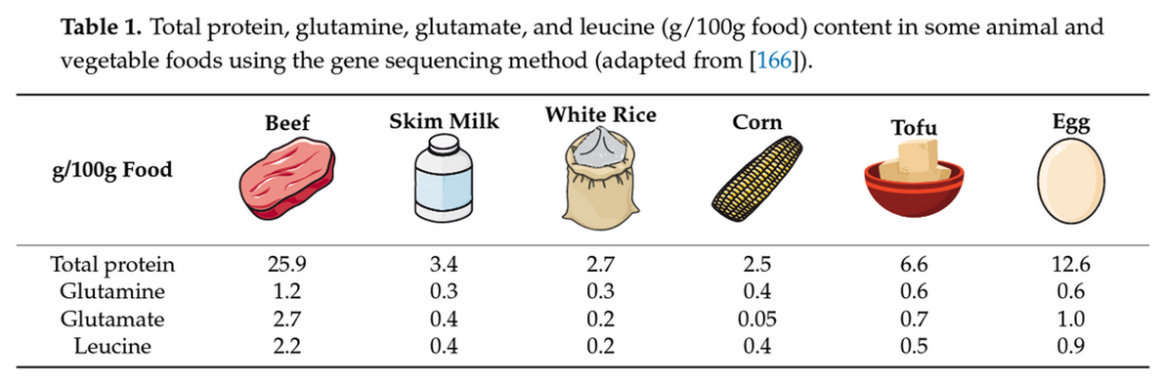
NUTRITION INTERVENTION
Normal Daily
Protein Requirement
Post-Surgery
Protein Requirement
  1.2-2.0 g/kg per day
  80-150 grams per day
  1.6-3.0 g/kg per day
  110-210 grams per day
Surgery patients consume only 22-36% of protein requirements

Slide 22
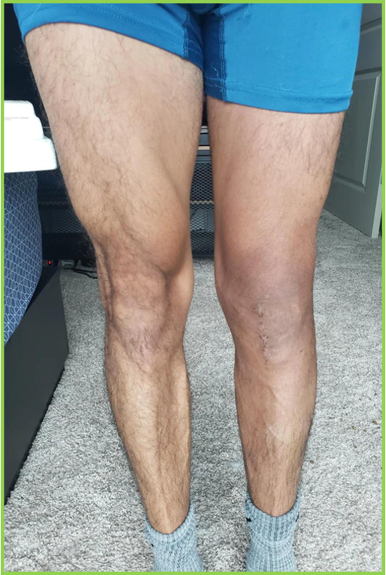
MUSCLE LOSS AFTER SURGERY
  1% per day after TKA
  7 days of Immobilization decreases strength 8-21%

Slide 23
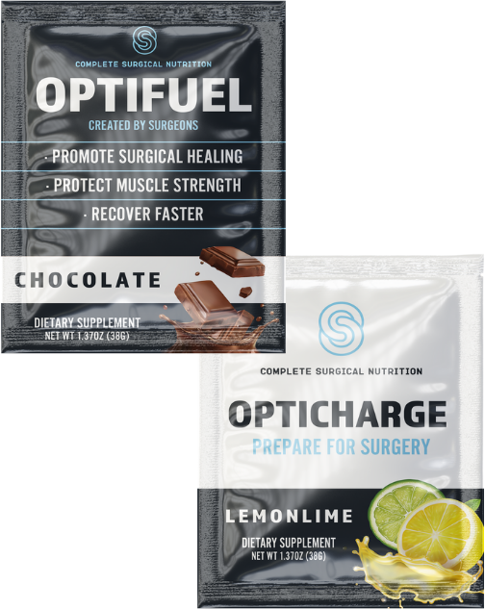







PRODUCT INFO
PROMOTE SURGICAL HEALING
PROTECT MUSCLE STRENGTH
RECOVER FASTER
It's what's inside that counts.
OPTIFUEL
OPTICHARGE
Once per day protein mix x 4 weeks (2 weeks pre-op & 2 weeks post-op
One time carbohydrate drink
taken the night prior to surgery (100g)
25 GRAMS OF PROTEIN
50 GRAMS OF CARBOHYDRATES
3G LEUCINE & 2G GLUTAMINE
OPTION TO REPEAT 50G 2 HRS PRE-OP
500MG VITAMIN C, 800 IU VITAMIN D
LOWERS INSULIN RESISTANCE
400MG CA, B VITAMINS, Magnesium

Slide 24

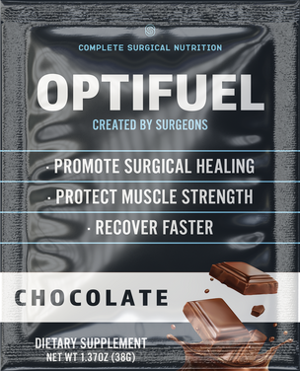
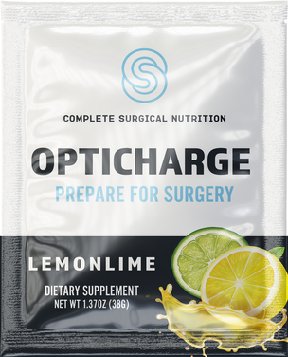

SIMPLE TO USE
CSN's protocol only requires patients to take supplements once a day.
14 DAYS PRE-OP
1 DAY
PRE-OP
14 DAYS POST-OP
Optifuel 1x day
Opticharge 1x
Optifuel 1x day
Loading Phase
Prevent Muscle Loss
Carbohydrate Prep
Promote Surgical Healing
Recovery Phase
Protect Muscle Strength

Slide 25

COMPLETE SURGICAL NUTRITION
2024
HELP PATIENTS RECOVER FROM SURGERY BETTER & FASTER THROUGH OPTIMAL NUTRITION

Slide 26
Surgeon-Therapist Relationship
Ask you to stress the importance of nutrition to your patients
Early data is showing impressive results first 90 days post op
This is an easy low risk intervention
Can improve patient’s recovery and outcomes

Slide 27
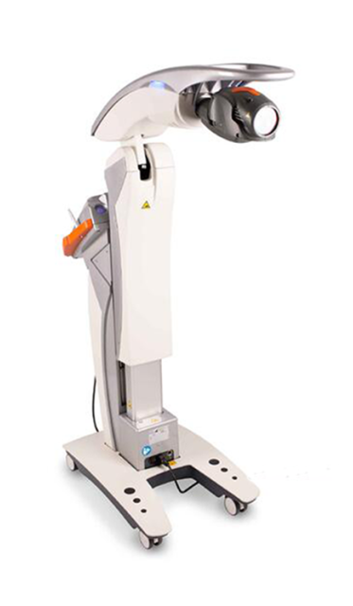
Surgeon-Therapist Relationship
Another new interest
Photo-bio-modulation
Laser treatment gaining more acceptance
Anti-inflammatory effects
Increase blood flow to stimulate healing

Slide 28
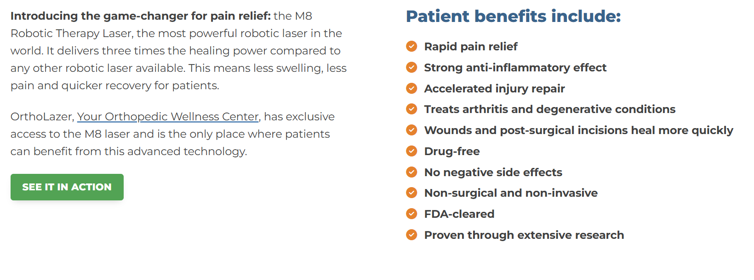

Slide 29
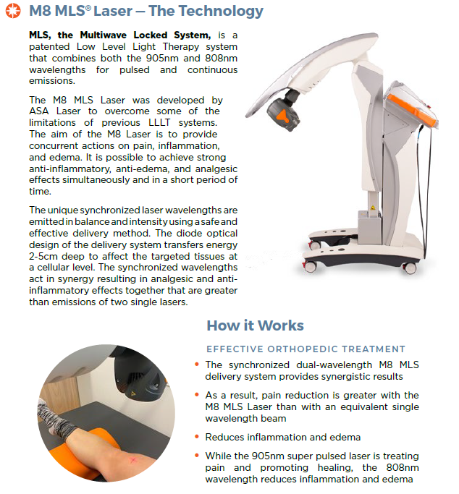

Slide 30
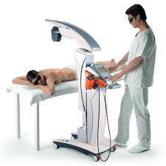
Surgeon-Therapist Relationship
Now endorsed by:
  CDC
  AAOS
  Accepted treatment add on

Slide 31
Surgeon-Therapist Relationship
What can we treat with this?
  Chronic tendonopathy- overuse injuries
  Muscle strains
  Post-op inflammation and edema
  Safely being used on every area of the musculoskeletal system
  Treatment takes about 5-10 minutes

Slide 32


Slide 33
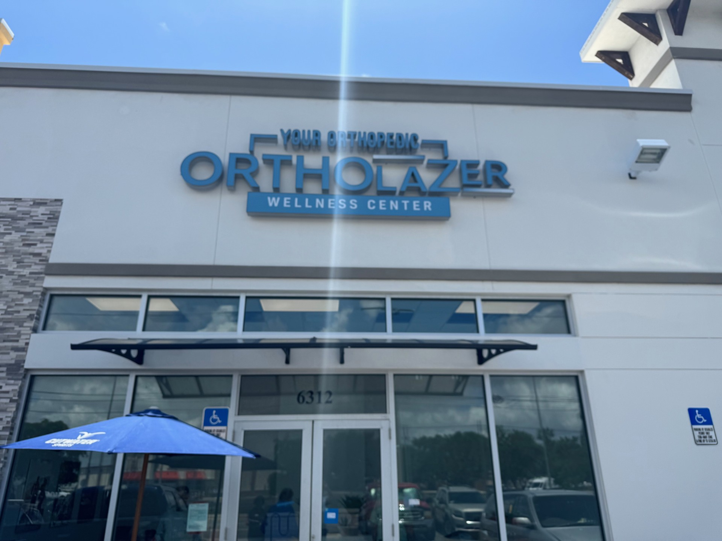
Surgeon-Therapist Relationship
16 OrthoLazer centers nation wide
1st one in FLA opening in Sarasota
Option for your patients to consider in conjunction with PT/OT
Laura- Center Director

Slide 34
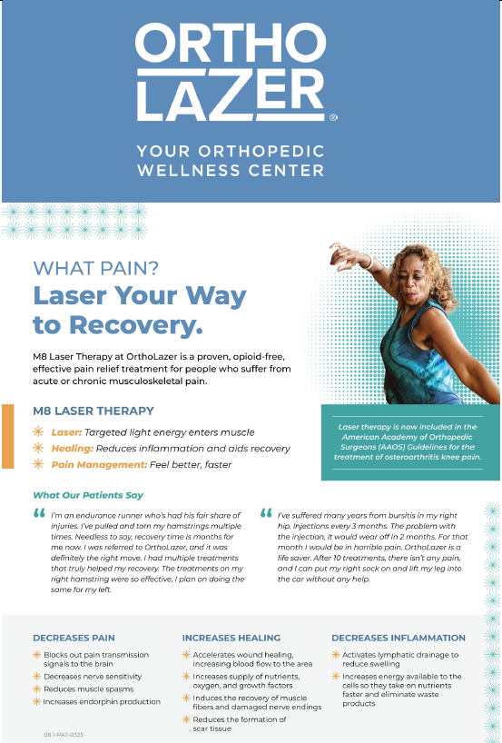
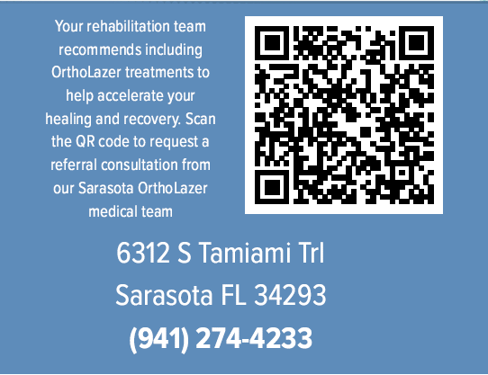

Slide 35
Summary
Continue to cultivate the surgeon-therapist relationship
Together we can improve outcomes and decrease complications
Maintain open lines of communication
Take of holistic view of how to help your patients

Slide 36
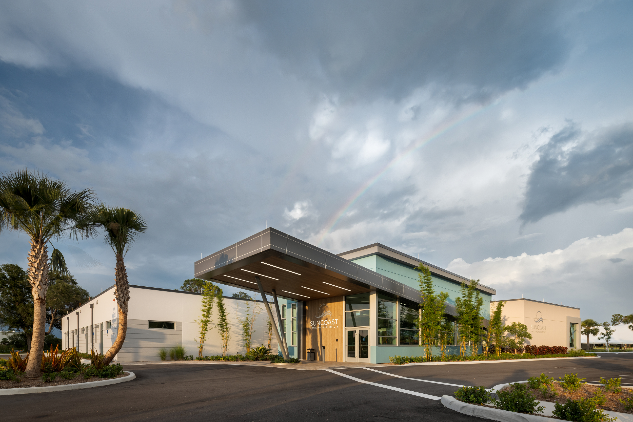
Thank You

