Slide 1

Rotator Cuff Tears:
How I Repair and Rehab
R. Stephen Otte, MD
Coastal Orthopedics
Gulfcoast Orthopaedic Rehabilitation Conference
August 23, 2025

Slide 2
Disclosures
  Zimmer-Biomet: Education, consulting, design

Slide 3
Outline
  Rotator cuff overview
  Surgical techniques
  Post-operative rehab
  Cases

Slide 4
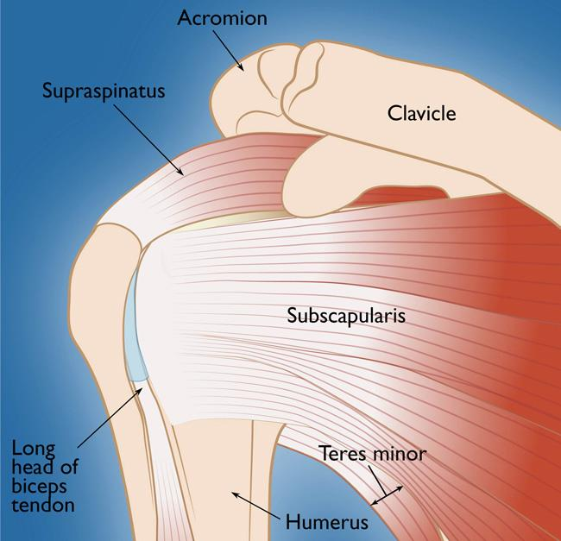
Rotator Cuff Anatomy
Four muscle/tendon units
  Supraspinatus, Infraspinatus, Subscapularis, Teres Minor
Function to stabilize the GH joint(concavity compression), enable elevation & rotation of the arm

Slide 5
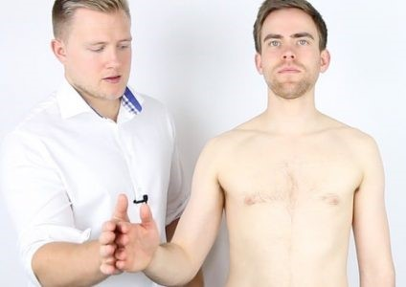
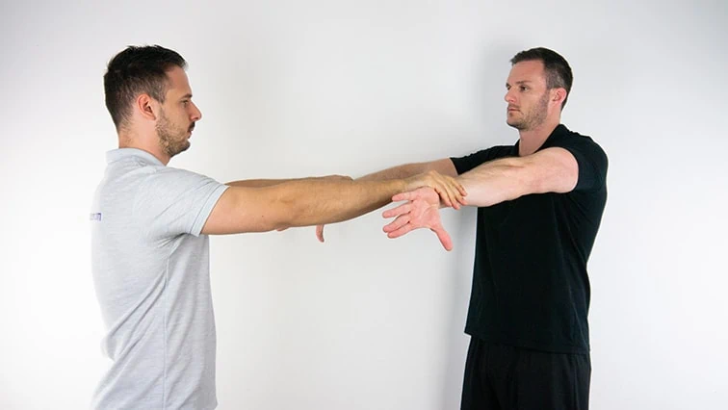
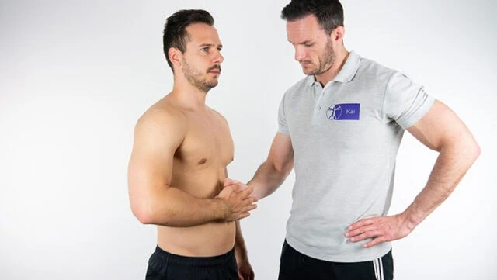
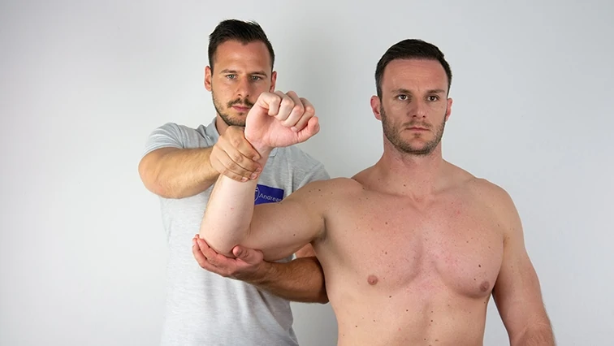
Rotator Cuff Anatomy
Physical Exam
Supraspinatus
  Empty can
Subscapularis
  Belly lift off, bear hug
Infraspinatus
  Resisted external rotation
Teres Minor
  Horn blower

Slide 6
Rotator Cuff Tears
Acute/traumatic
  Acute injury, no prior symptoms
  Improved outcomes with surgical repair within 3 months
Chronic/degenerative/atraumatic
  No specific injury
  Can often do very well without surgery

Slide 7

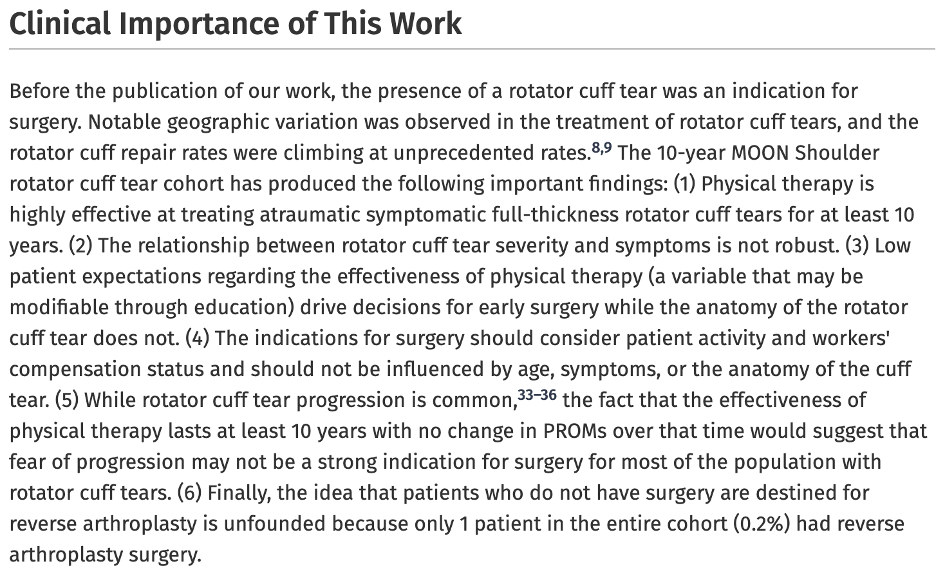
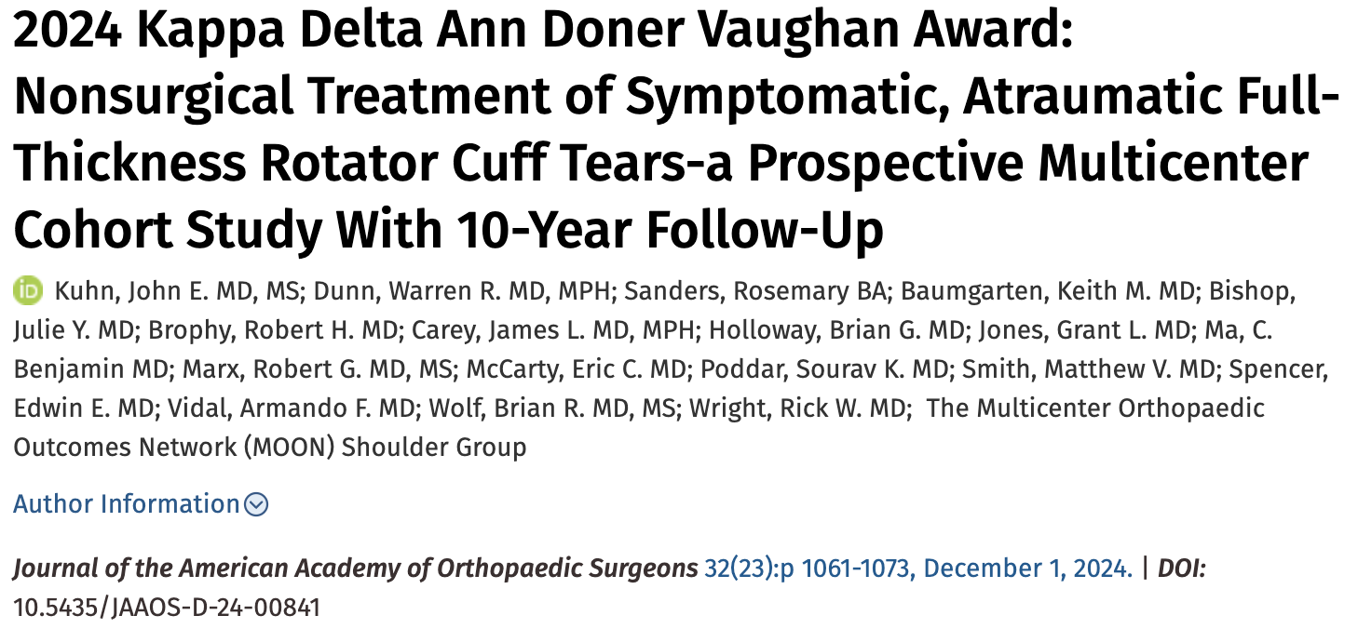
Rotator Cuff Tears
VAST MAJORITY DO NOT NEED SURGERY
Moon group study - 70% of full-thickness, atraumatic rotator cuff tears do well with dedicated PT at 10 year follow-up.
Patient buy-in that therapy will work is critical to success

Slide 8

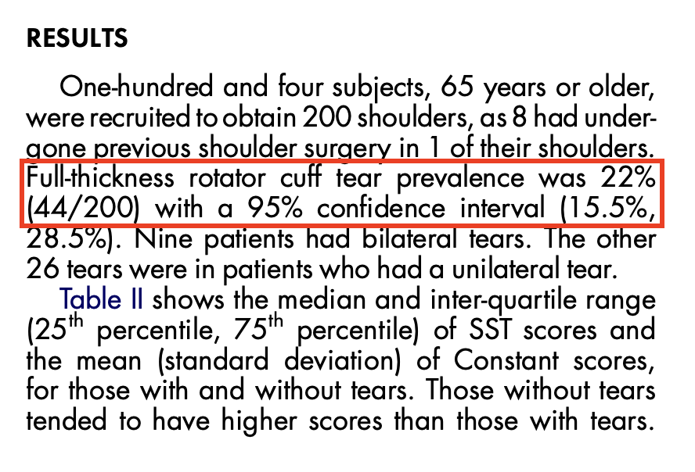
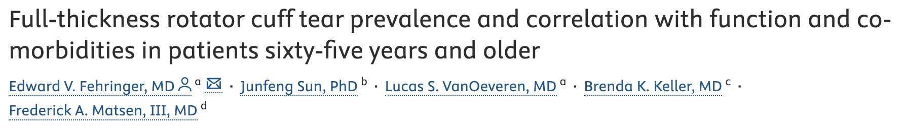
Rotator Cuff Tears

Slide 9
Rotator Cuff Tears
Indications for repair
  Full thickness tear with symptoms
  Acute traumatic tear in active/young patient
  Failure of conservative treatment
  Significant functional impairment
  Key point: rotator cuff tears cause pain and weakness, they do NOT cause lack of passive motion(adhesive capsulitis). Physical exam is paramount, compare to contralateral shoulder.

Slide 10
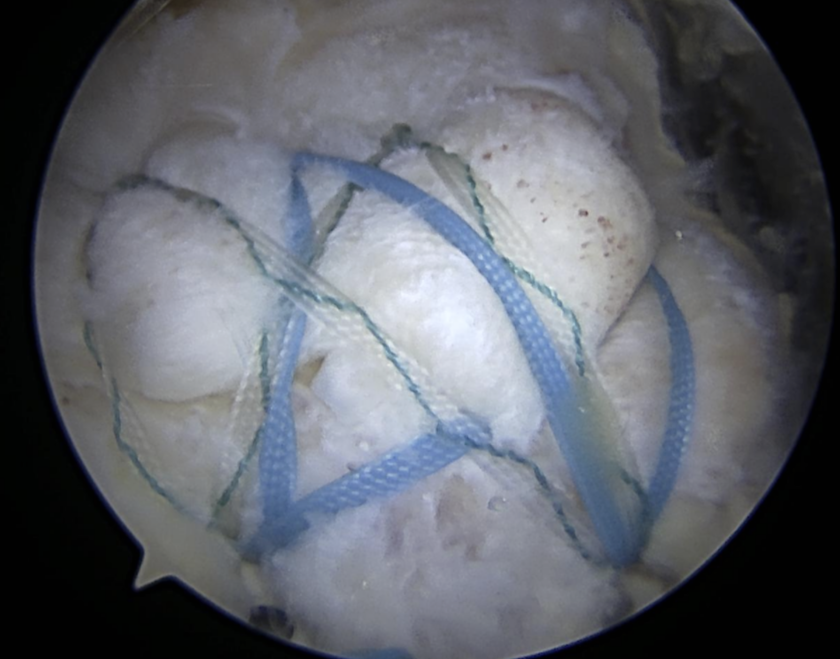
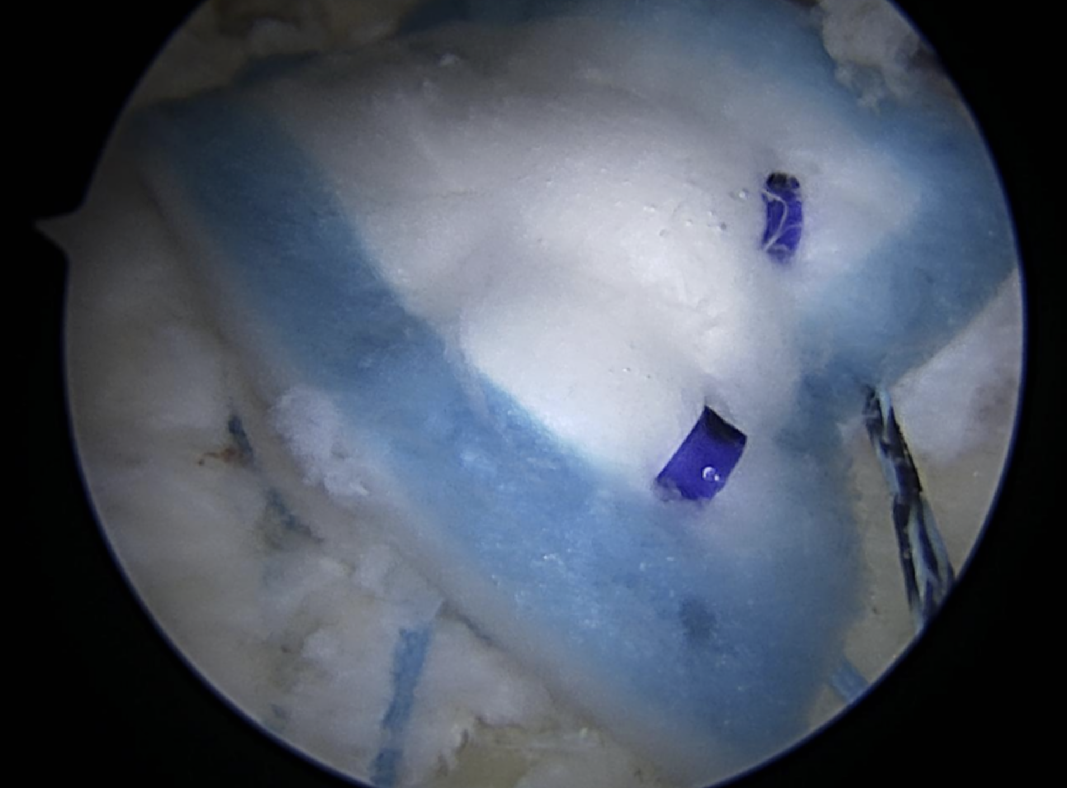
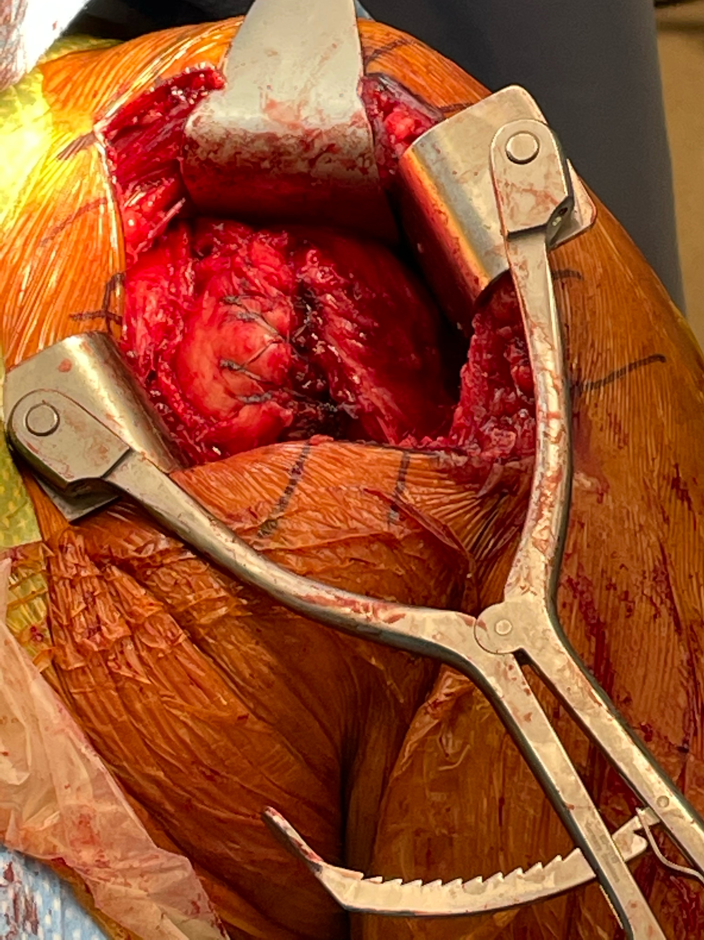
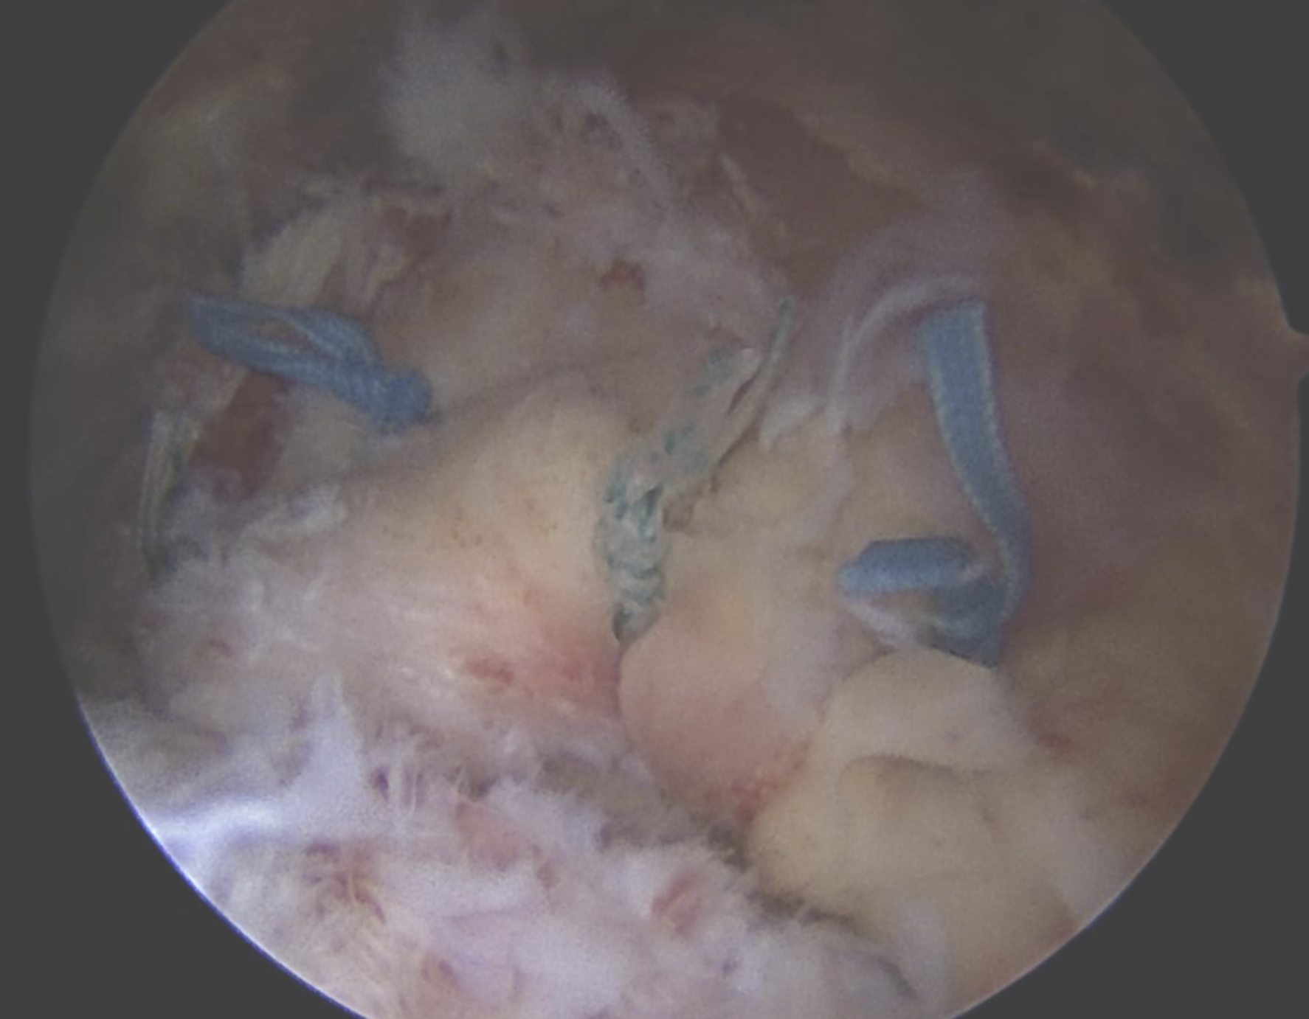
Operative Techniques
Arthroscopic(98% of what I do)
Open(subscap repairs)
Mini-open
Double row/TOE
Single row/SCOI row
Patch augmentation
(Reverse total shoulder)

Slide 11
Operative Techniques
Surgical Steps
Positioning: beach chair or lateral
Diagnostic arthroscopy
Mobilization of torn tendon, debridement of bursa
Prepare the footprint
Place anchors & pass suture
Tension free anatomic repair

Slide 12
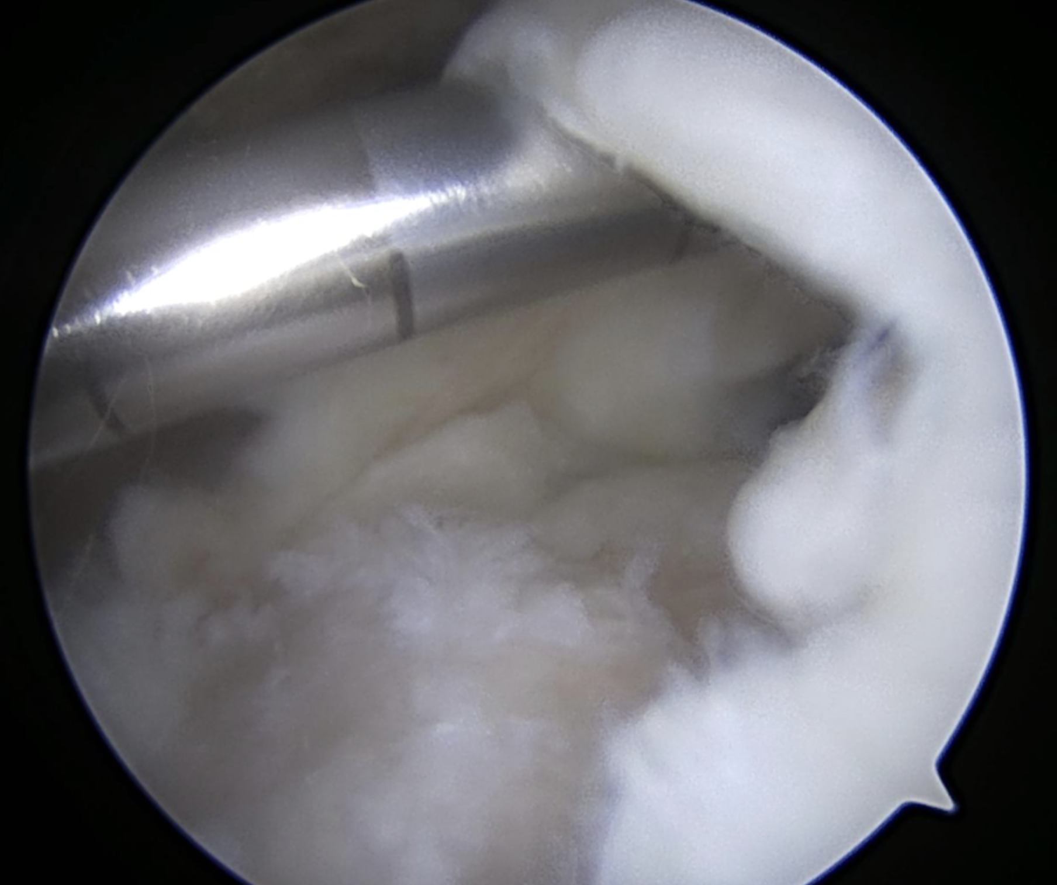
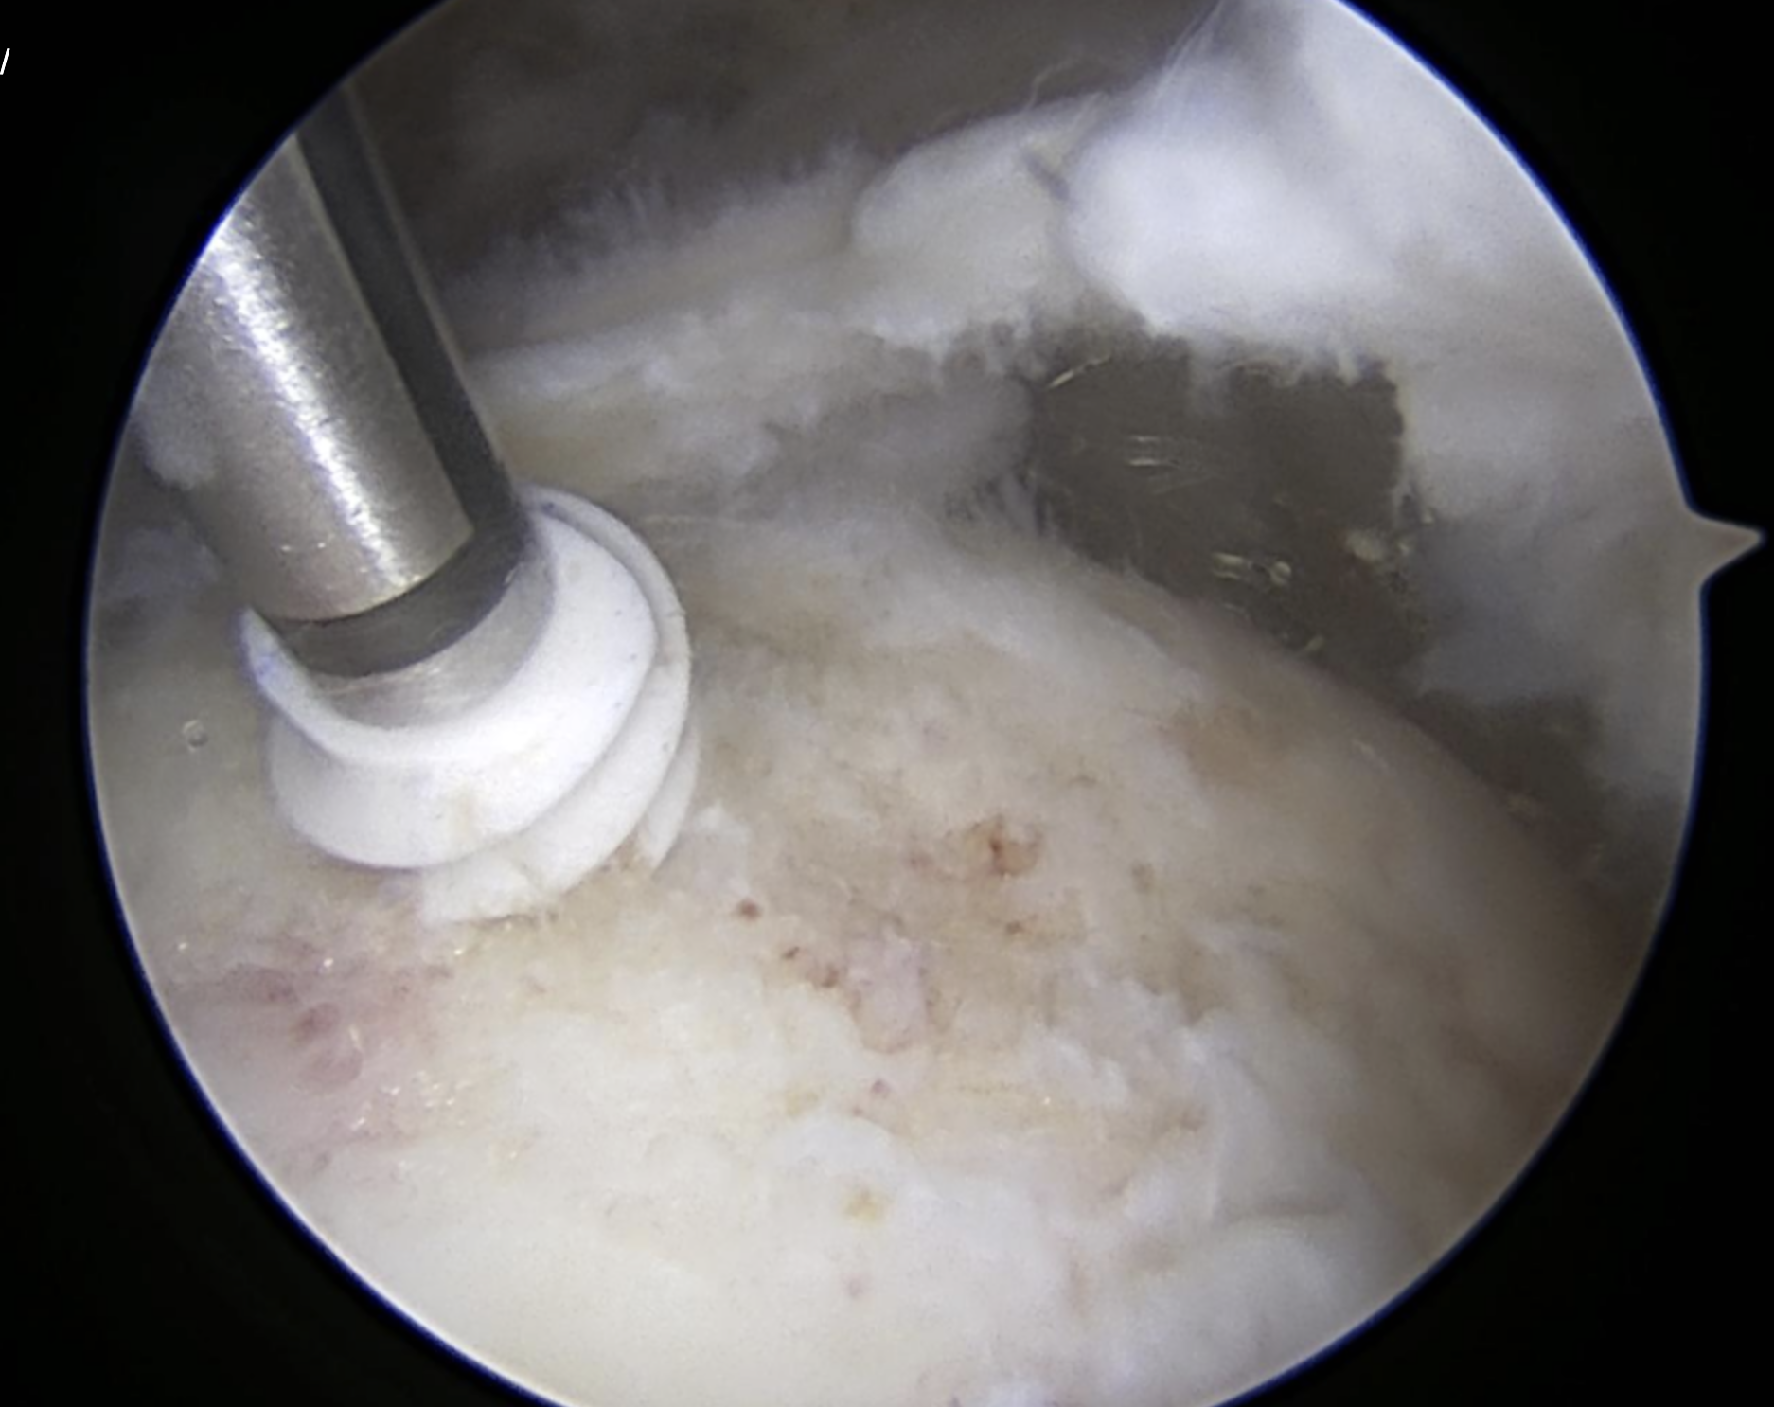
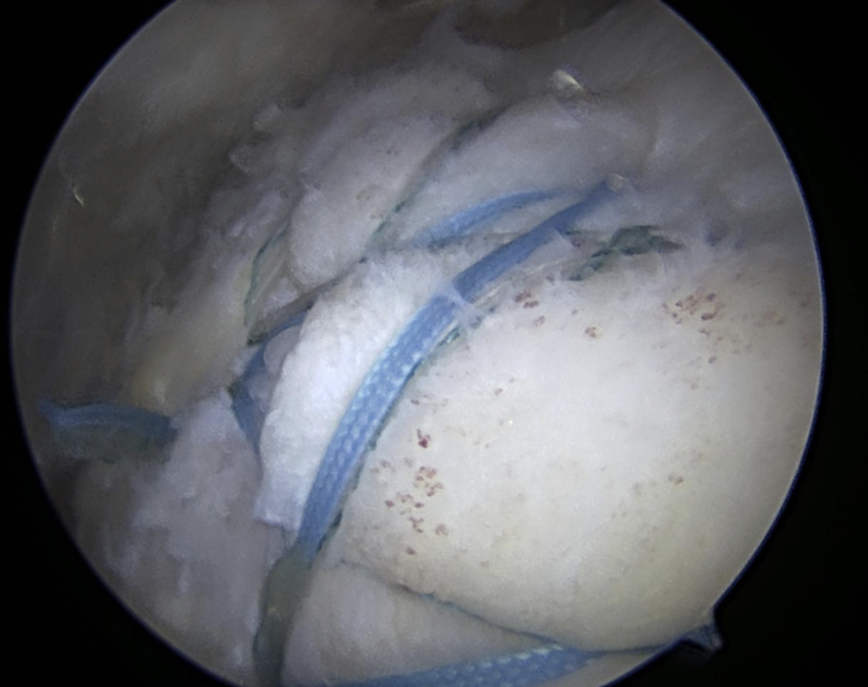
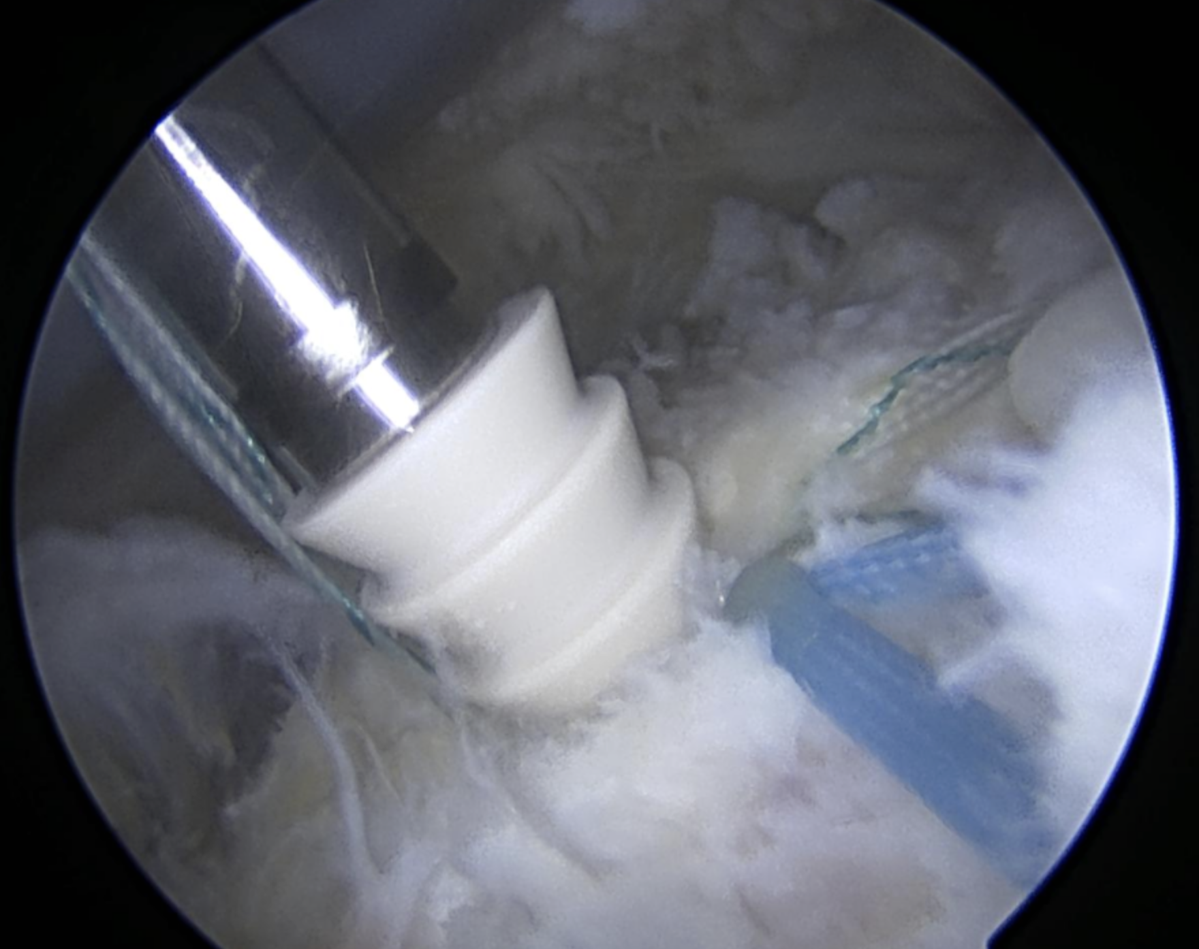
Arthroscopic Repair
SS
SS
HH
Anchor
GT
Articular margin

Slide 13
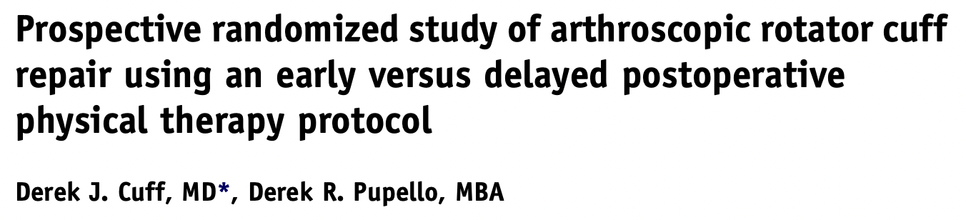
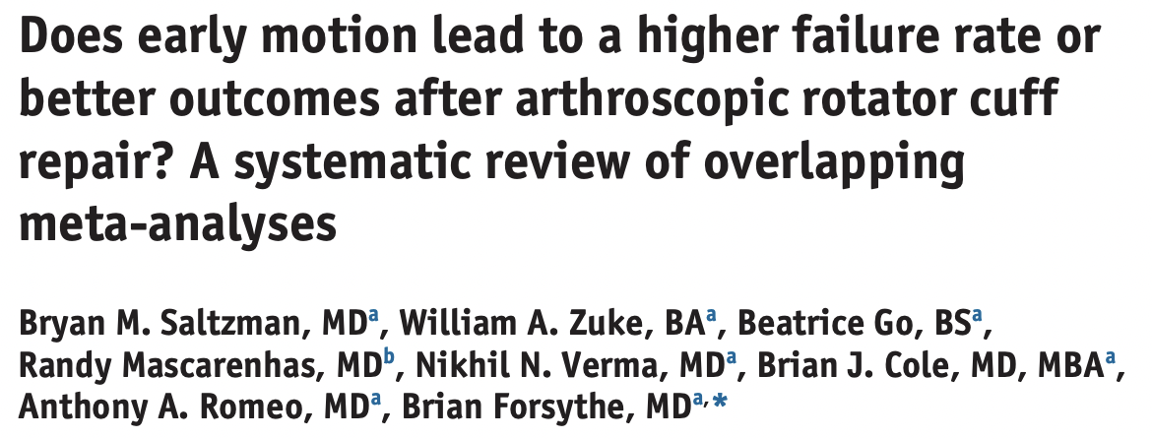
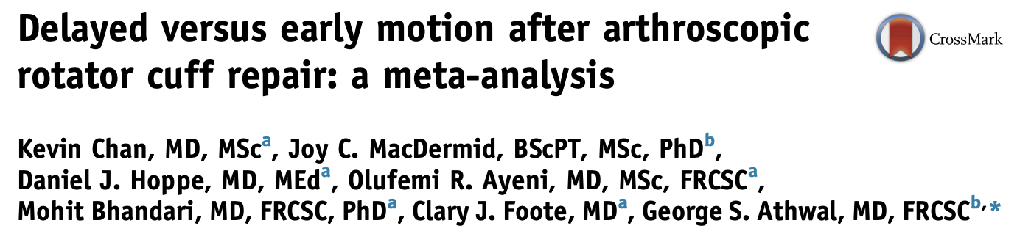
Post-Operative Rehab
  Theme: no statistically significant difference in functional outcome. Early motion trended towards regaining better motion early. Possible trend toward higher failure in larger tears with early motion protocols.

Slide 14
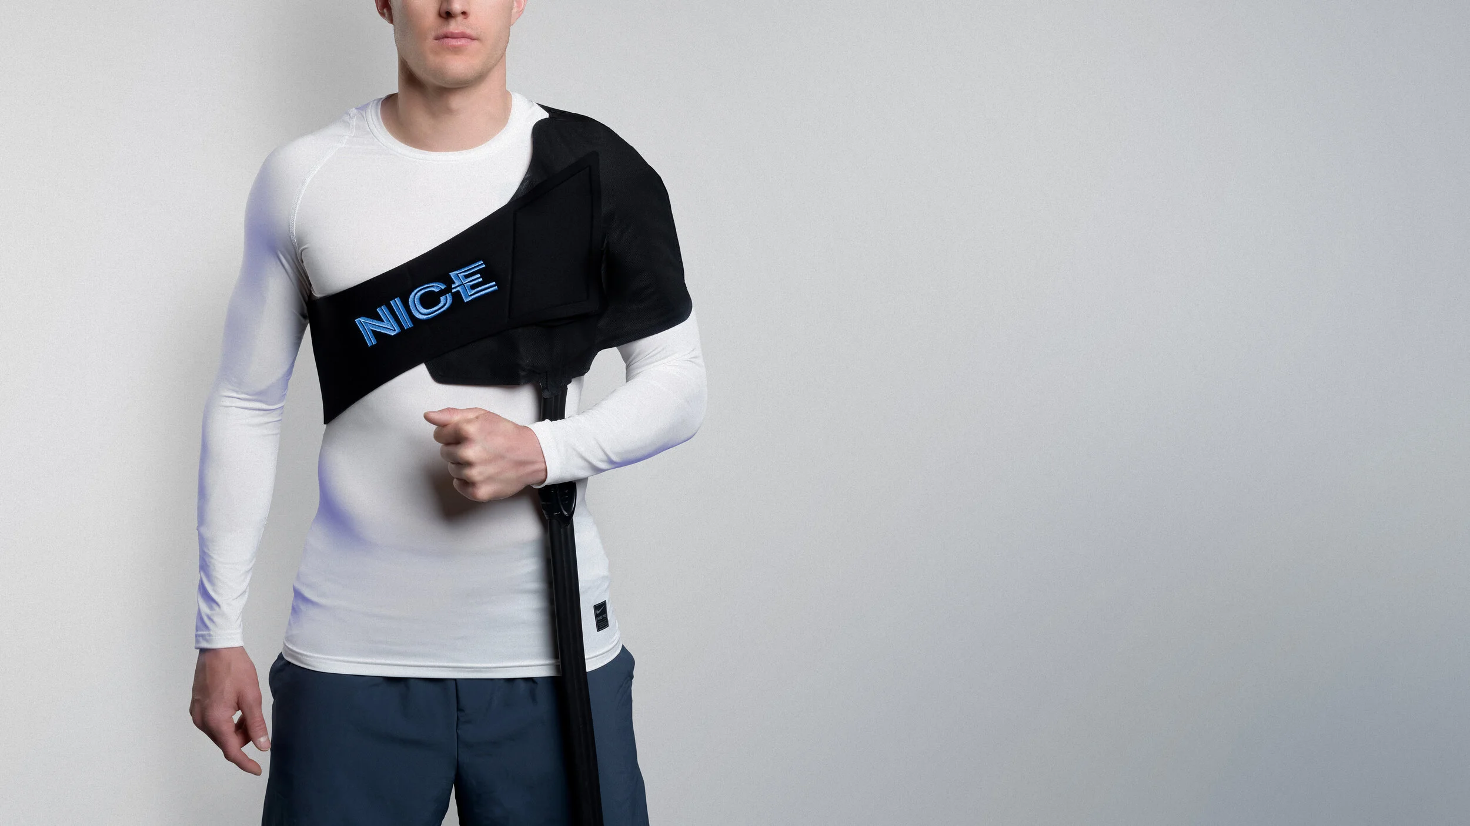
Post-Operative Rehab
3 Phases
Weeks 0-2 - EVERYONE
  Sling
  AROM hand, wrist, elbow, pendulums
  Ice
  Protect the repair

Slide 15
Post-Operative Rehab
3 Phases
“Protocol A”
Phase 1: weeks 2-6
  Pain control, NSAIDs, ice. Start PT @ 3 weeks
  PROM to pain tolerance
  Hand, wrist, elbow, pendulums at home. Scapular mobility and posture
  Protect the repair
  Modalities
  D/c sling starting week 4, fully by week 6
Phase 2: weeks 6-10
  Restore active motion, goal 90% of full by 3 months post op.
  Transition from PROM to AAROM, isometrics and AROM
  Scapular stabilization, mirror work
  Posterior capsule stretching
Phase 3: weeks 10-14
  Progressive RC strengthening
  Therabands, weights
  Proprioceptive training
  Return to functional activities gradually
    Golf, pickleball, etc.

Slide 16
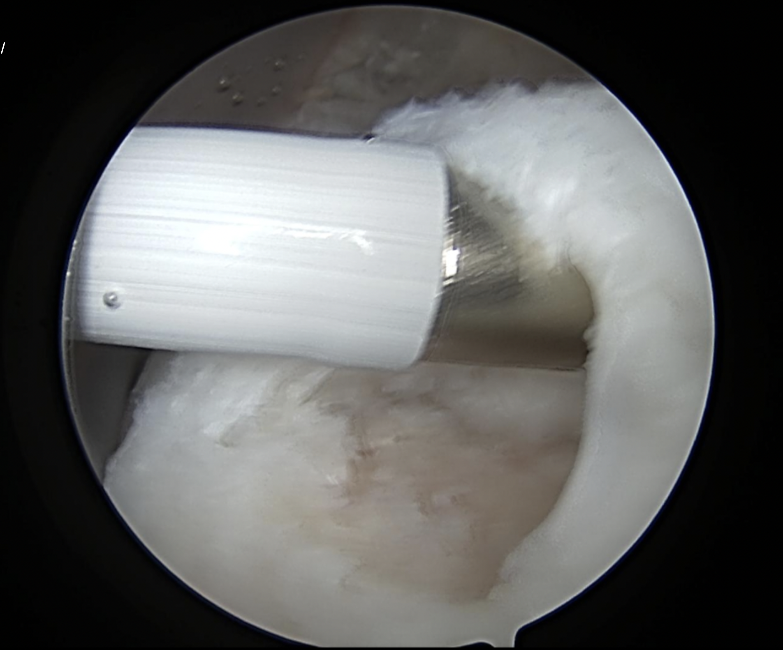
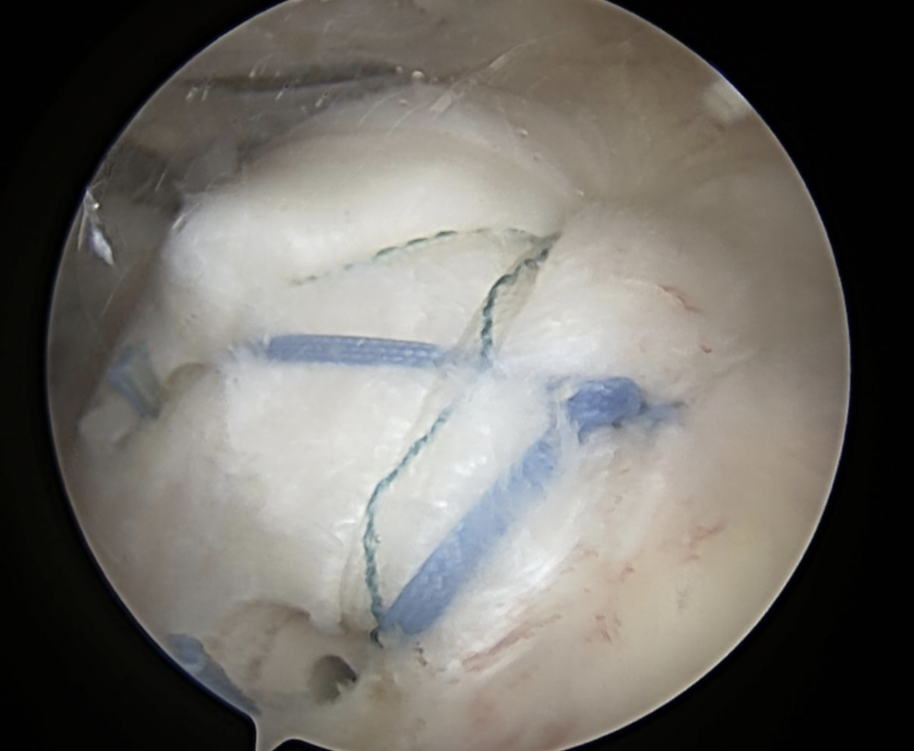
Post-Operative Rehab
ACCELERATED REHAB

Slide 17
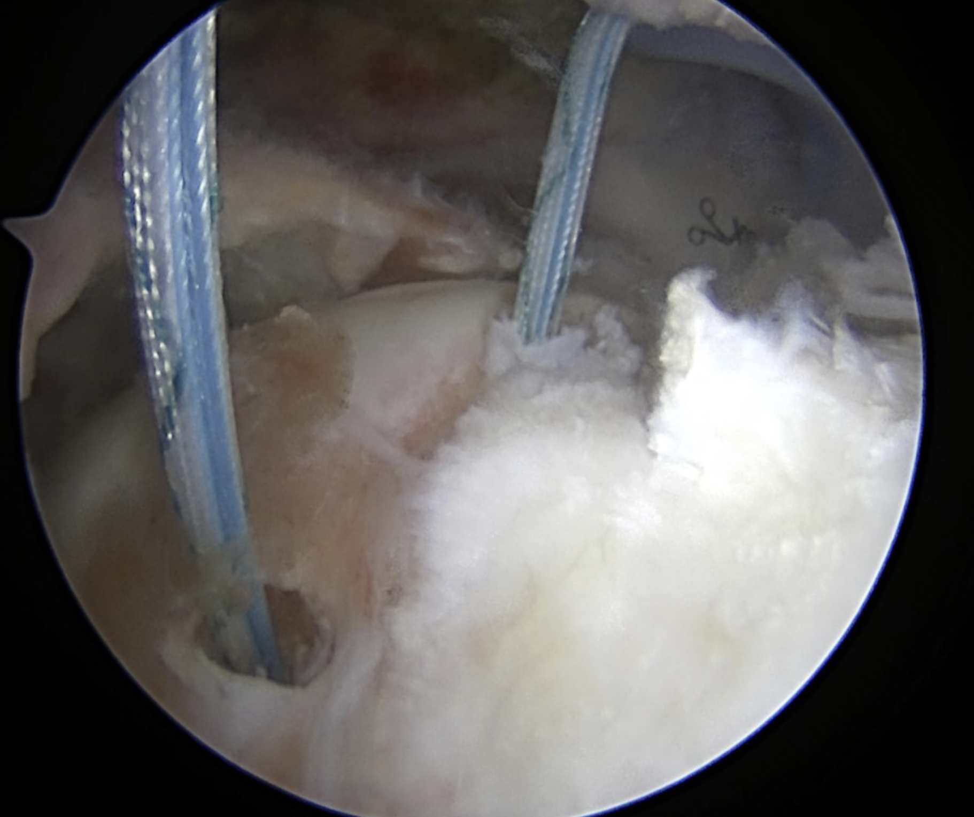
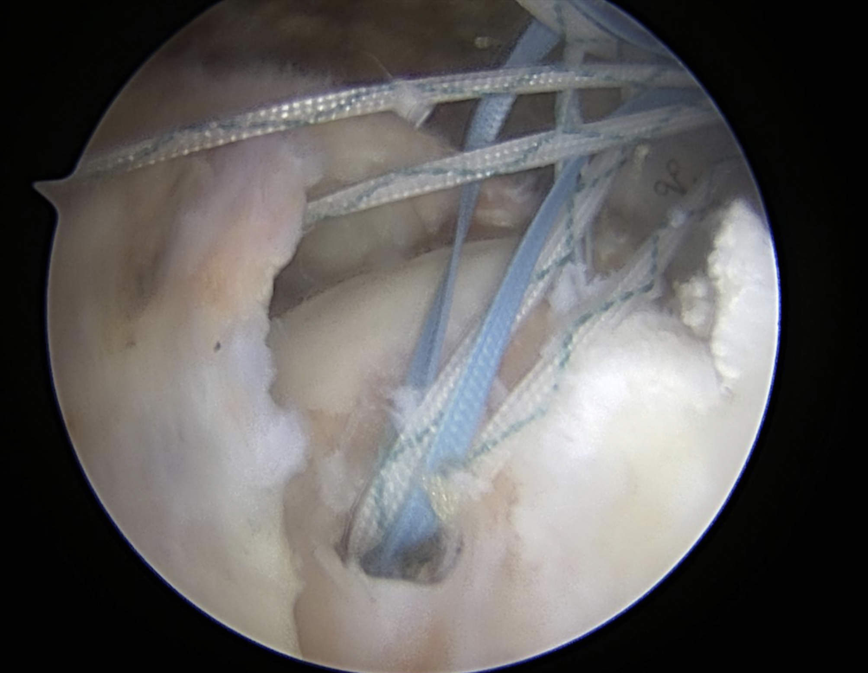
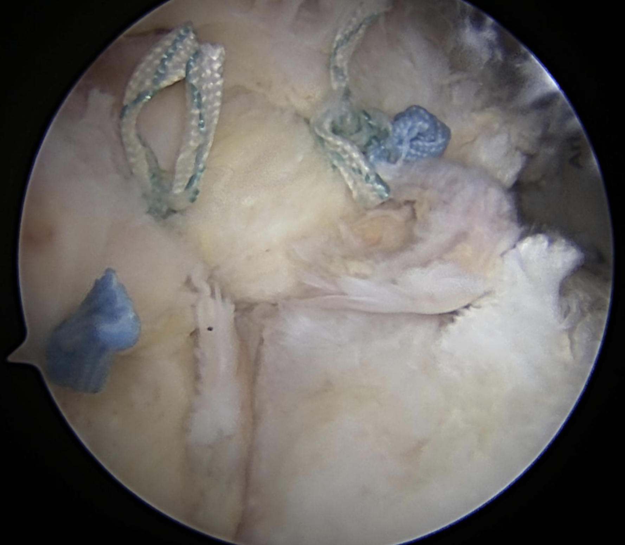
Post-Operative Rehab
DELAYED REHAB

Slide 18
Case #1
26 yo medical student, son of local anesthesiologist
Snowboarding injury, shoulder dislocation
X-rays on his phone
Greater tuberosity fracture with associated supra/infra tears

Slide 19
Case #1
Surgery recommended
Discussed both arthroscopic and possible open scenarios

Slide 20
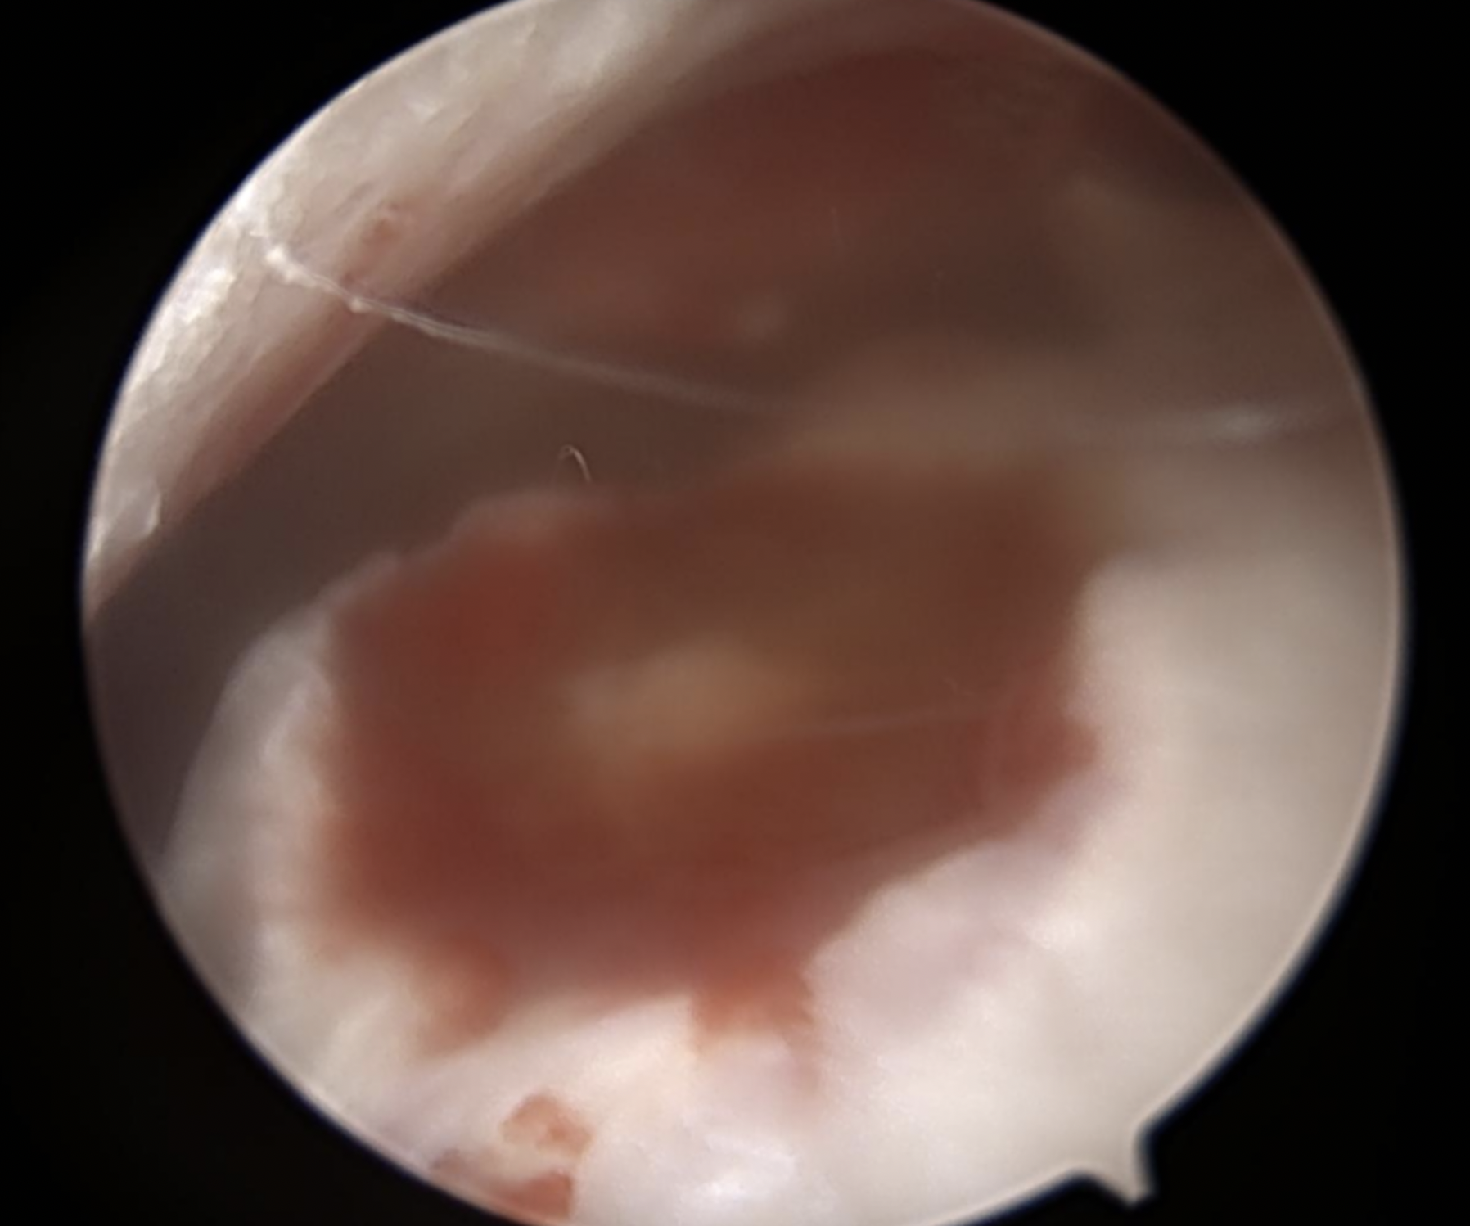
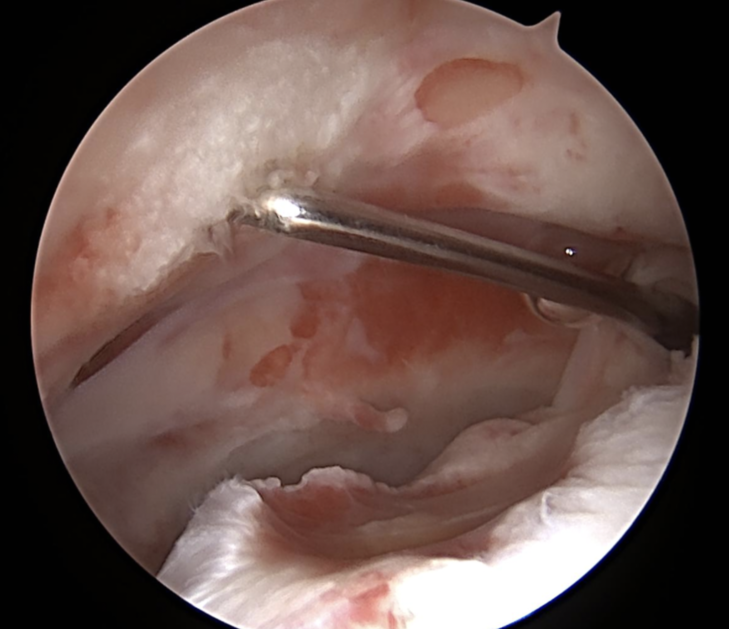
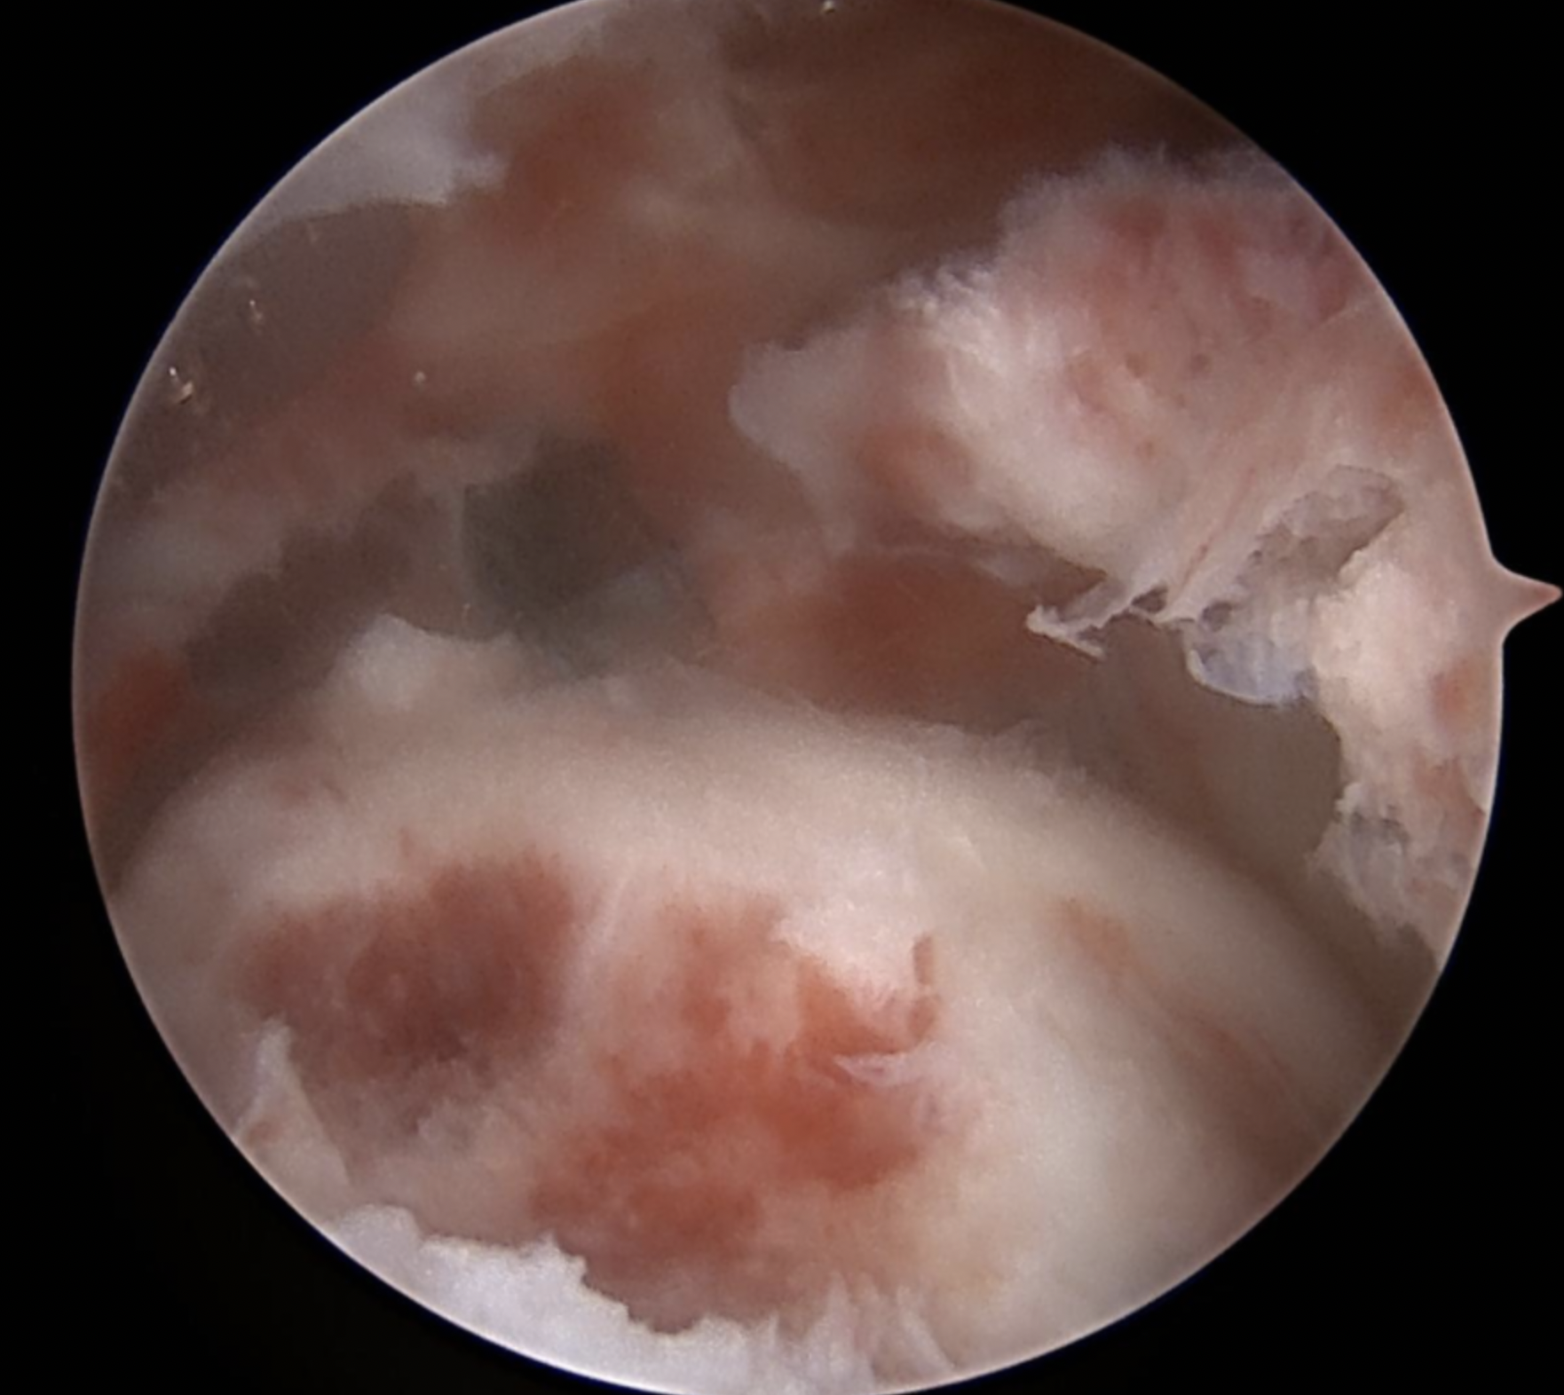
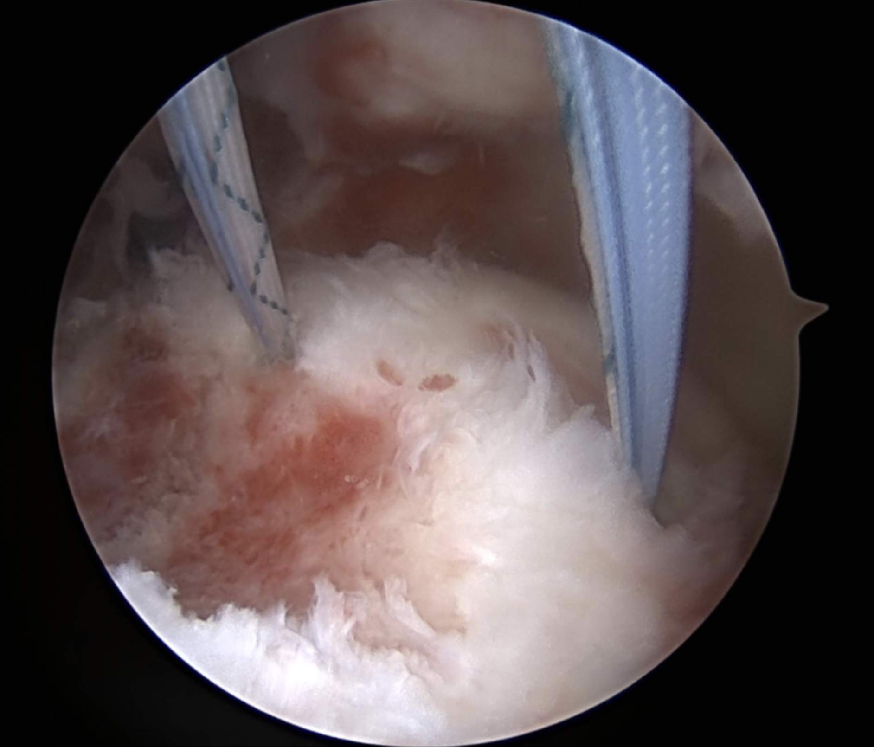
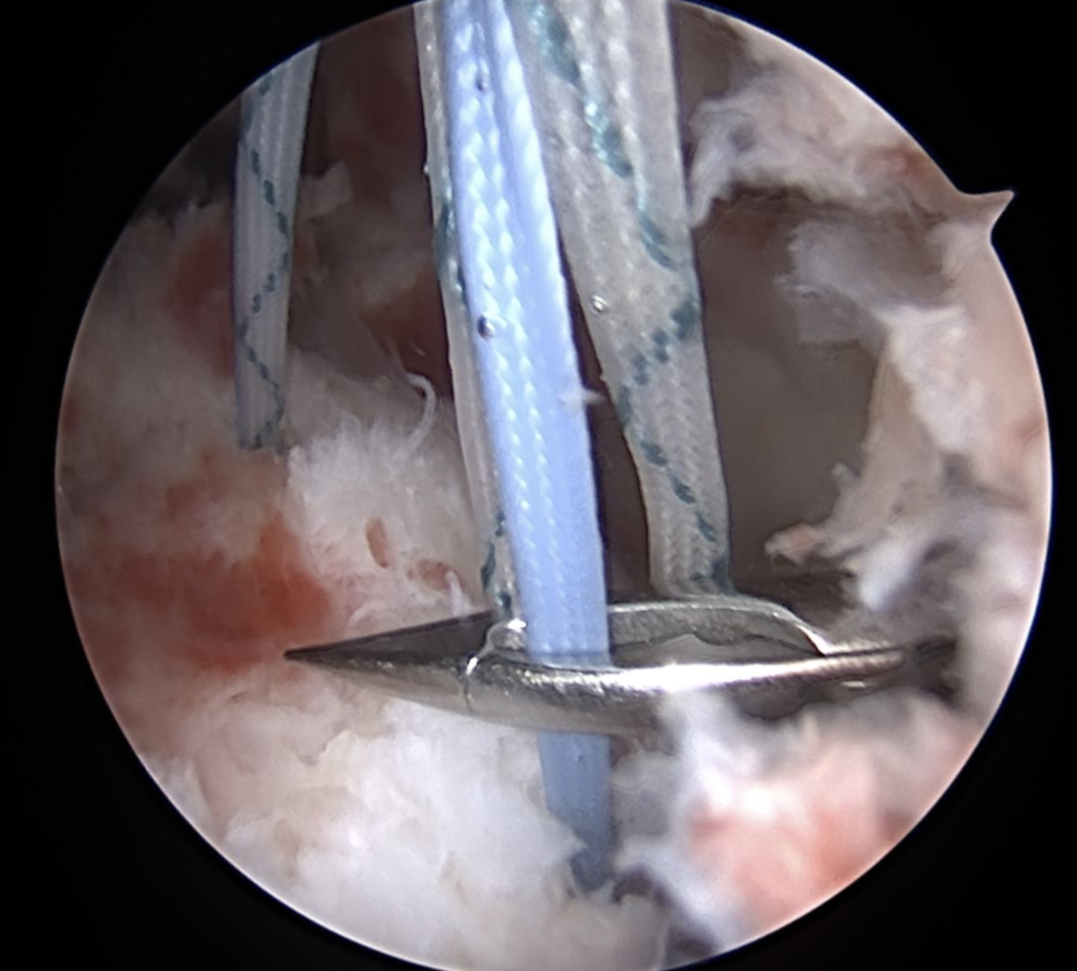
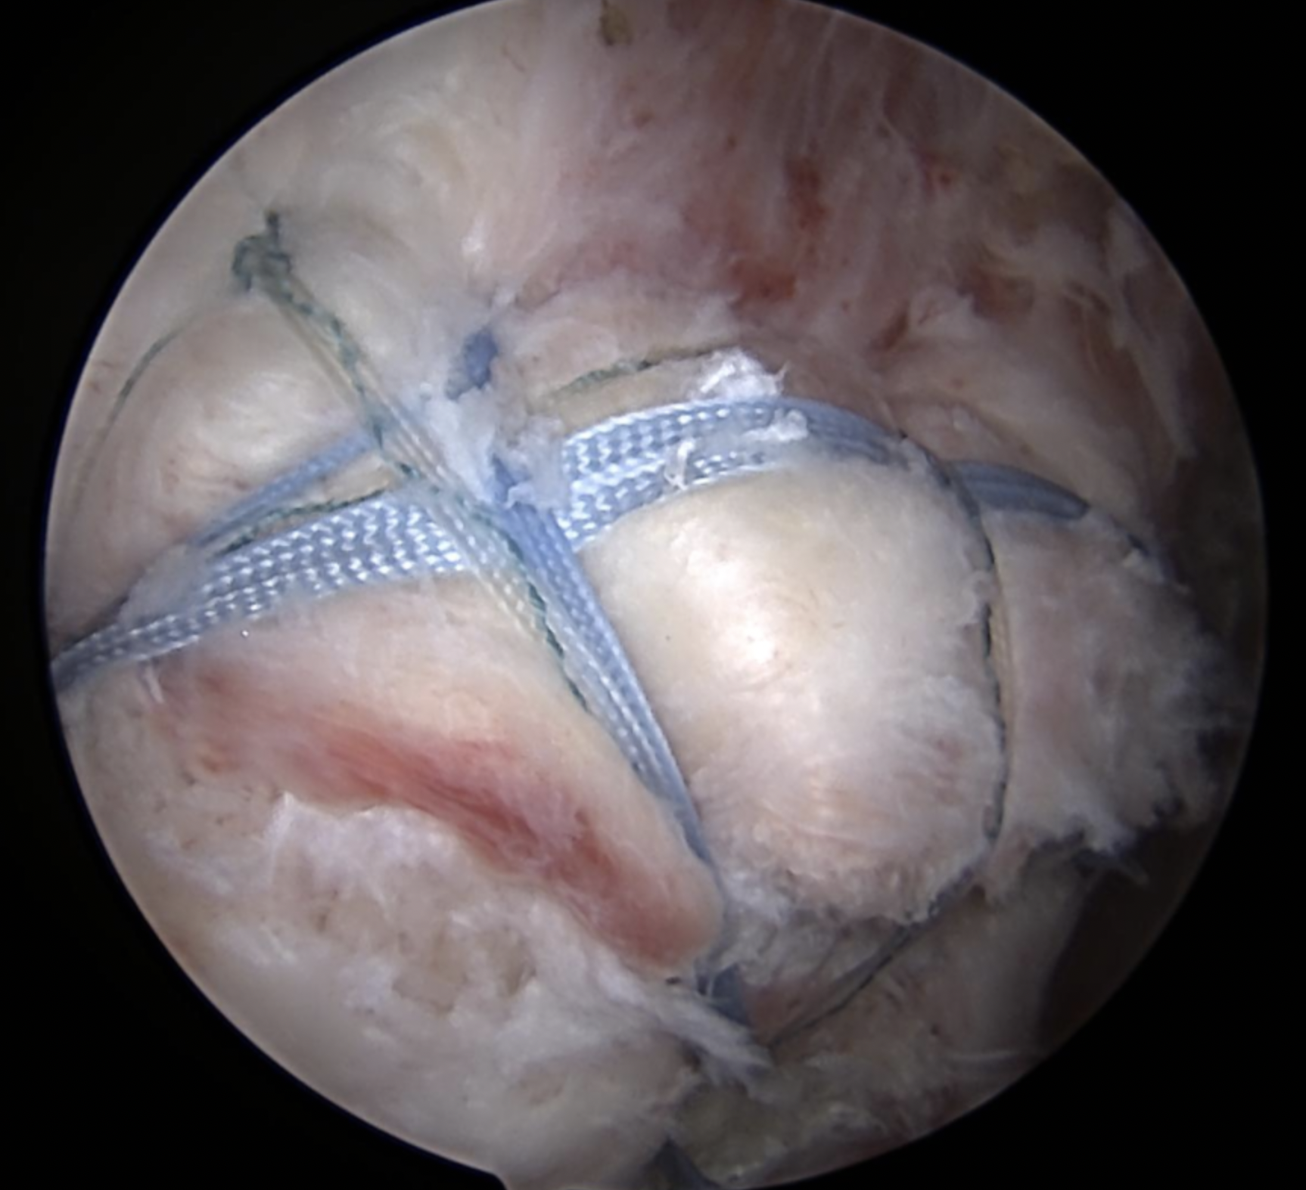
Case #1
FRACTURE FRAGMENT
HH
DONOR SITE
DONOR SITE
DONOR SITE
REPAIR
DONOR SITE

Slide 21
Case #1
POST-OP
Protocol A - good tissue, robust repair
4 months post op:
  Minimal pain
  150 FE
  135 Abd
  40 ER

Slide 22
Case #2
45 yo, work injury
Prior RCR
Pain, weakness, mechanical symptoms
Failed injections, PT, massage therapy
MRI…
NEVER GET MRIs AFTER RCR

Slide 23
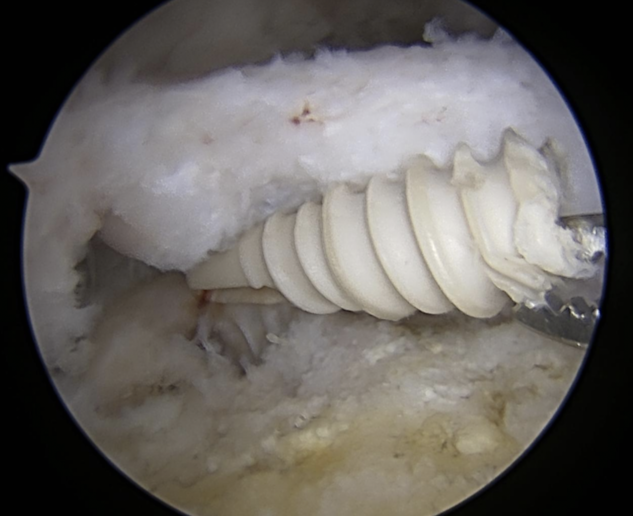
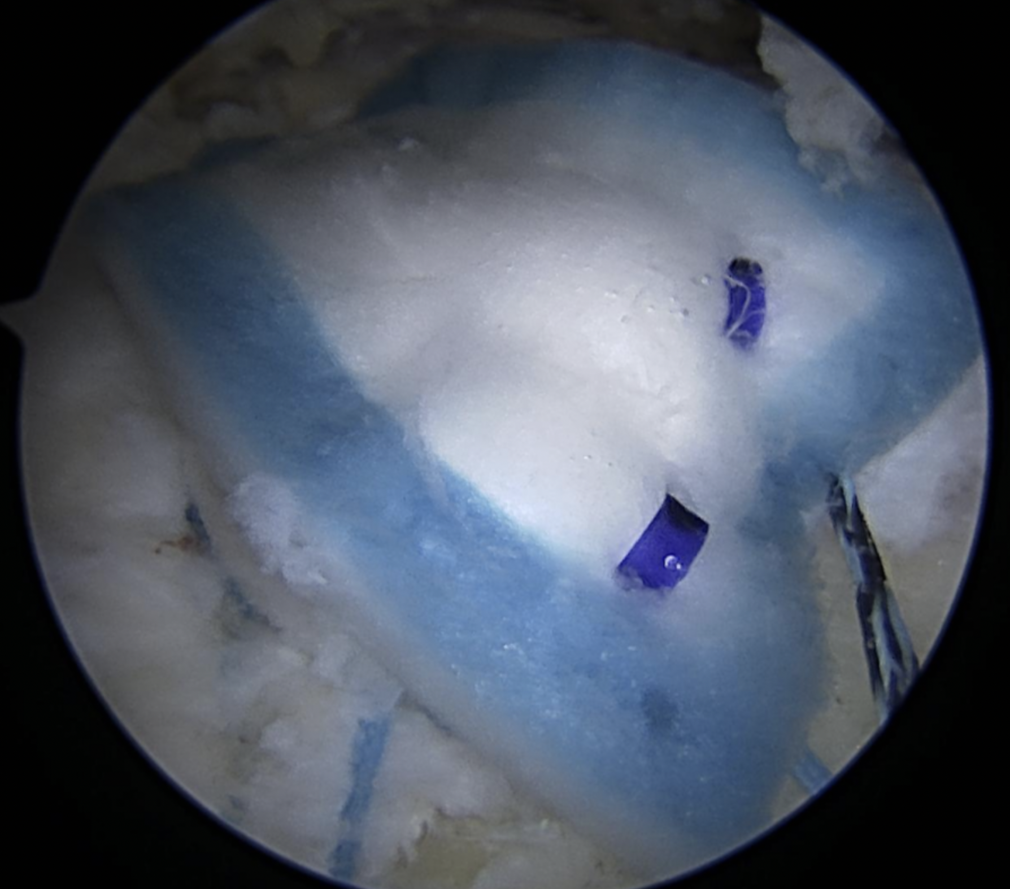
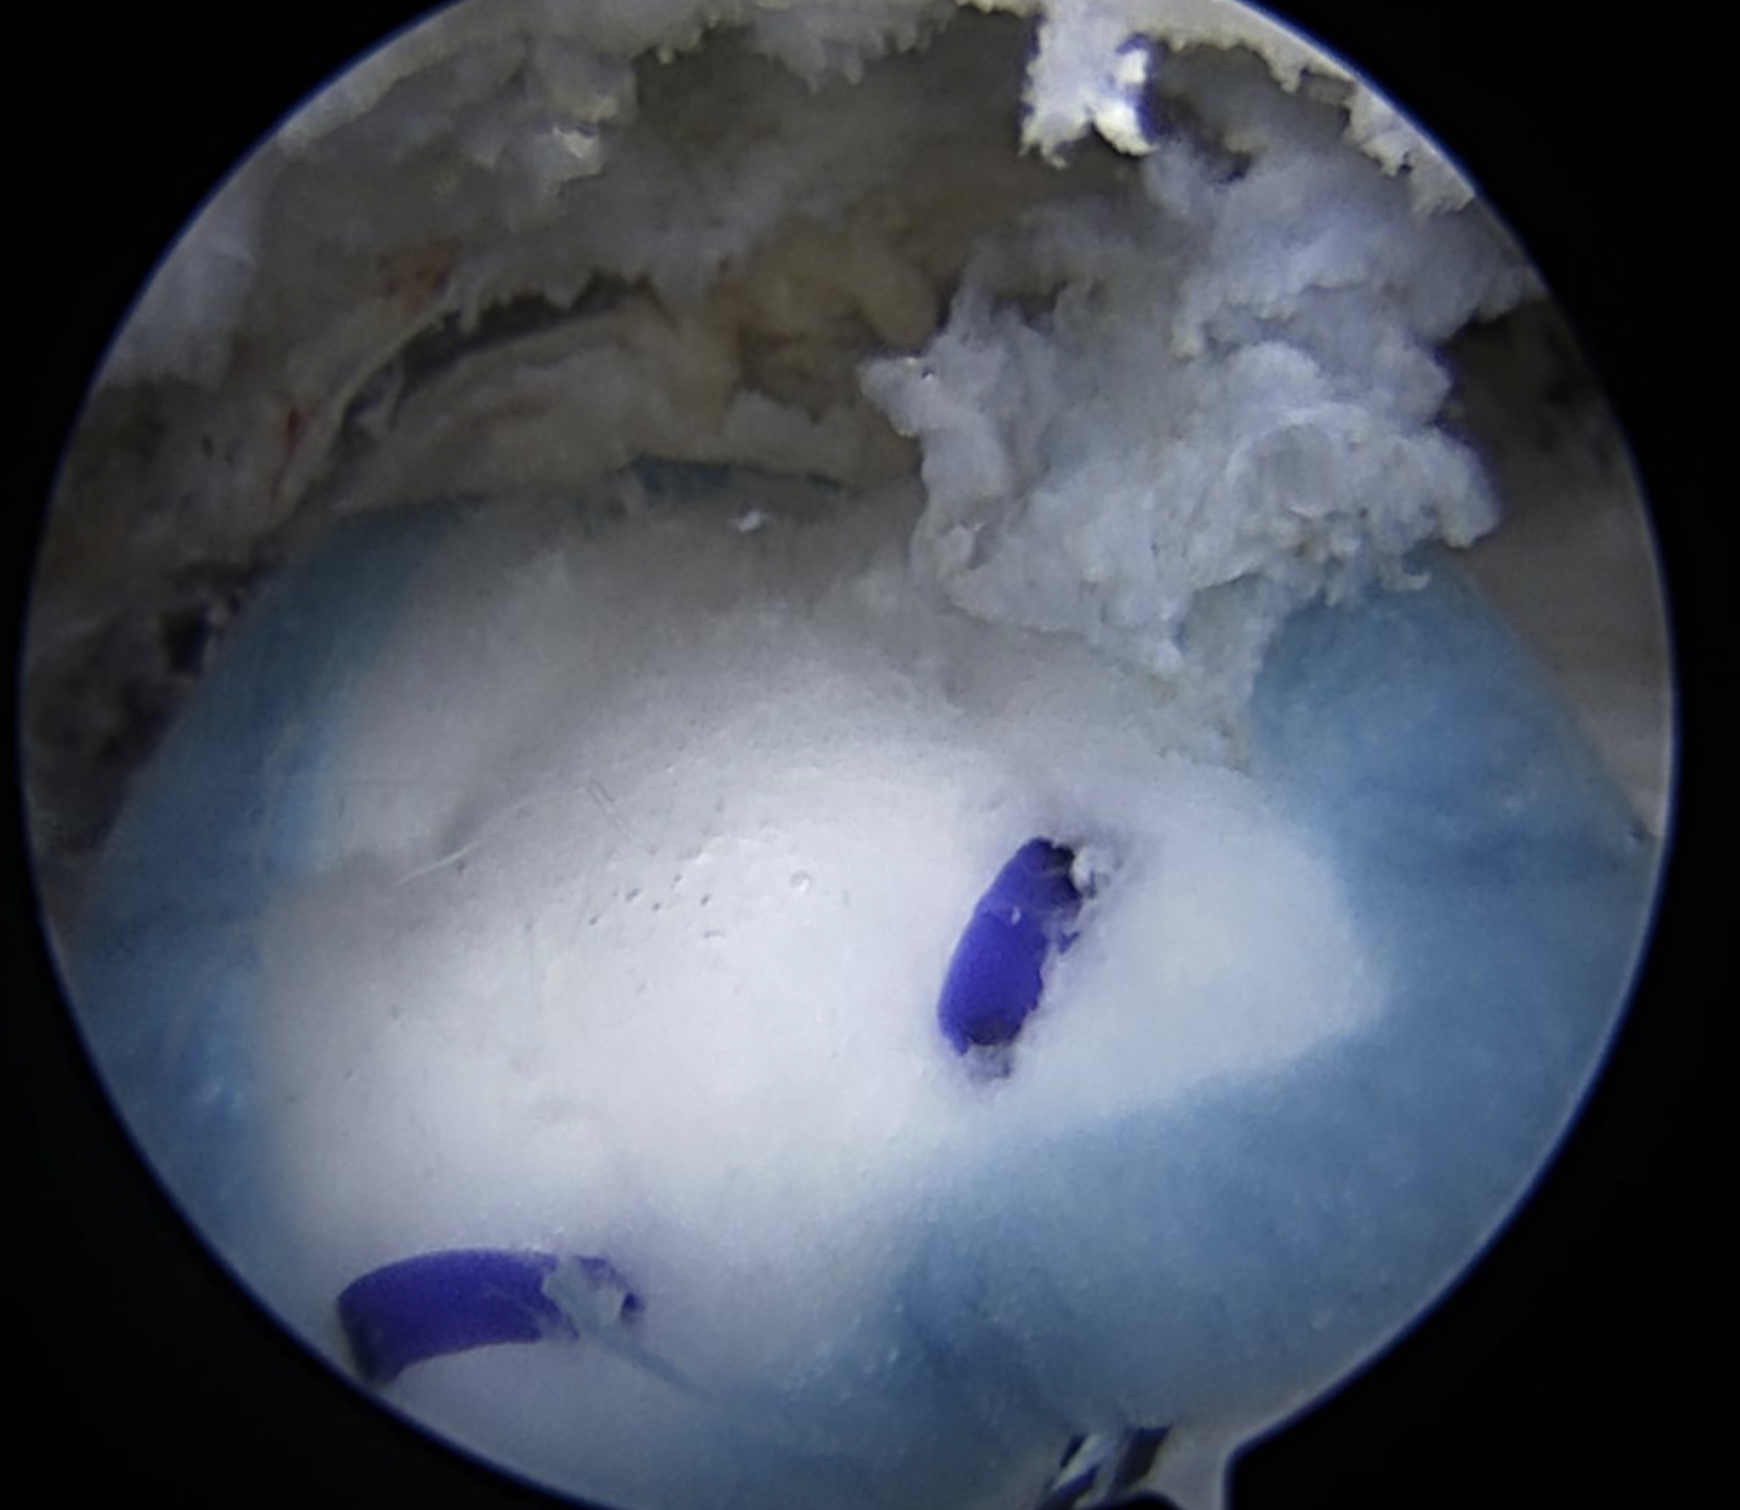
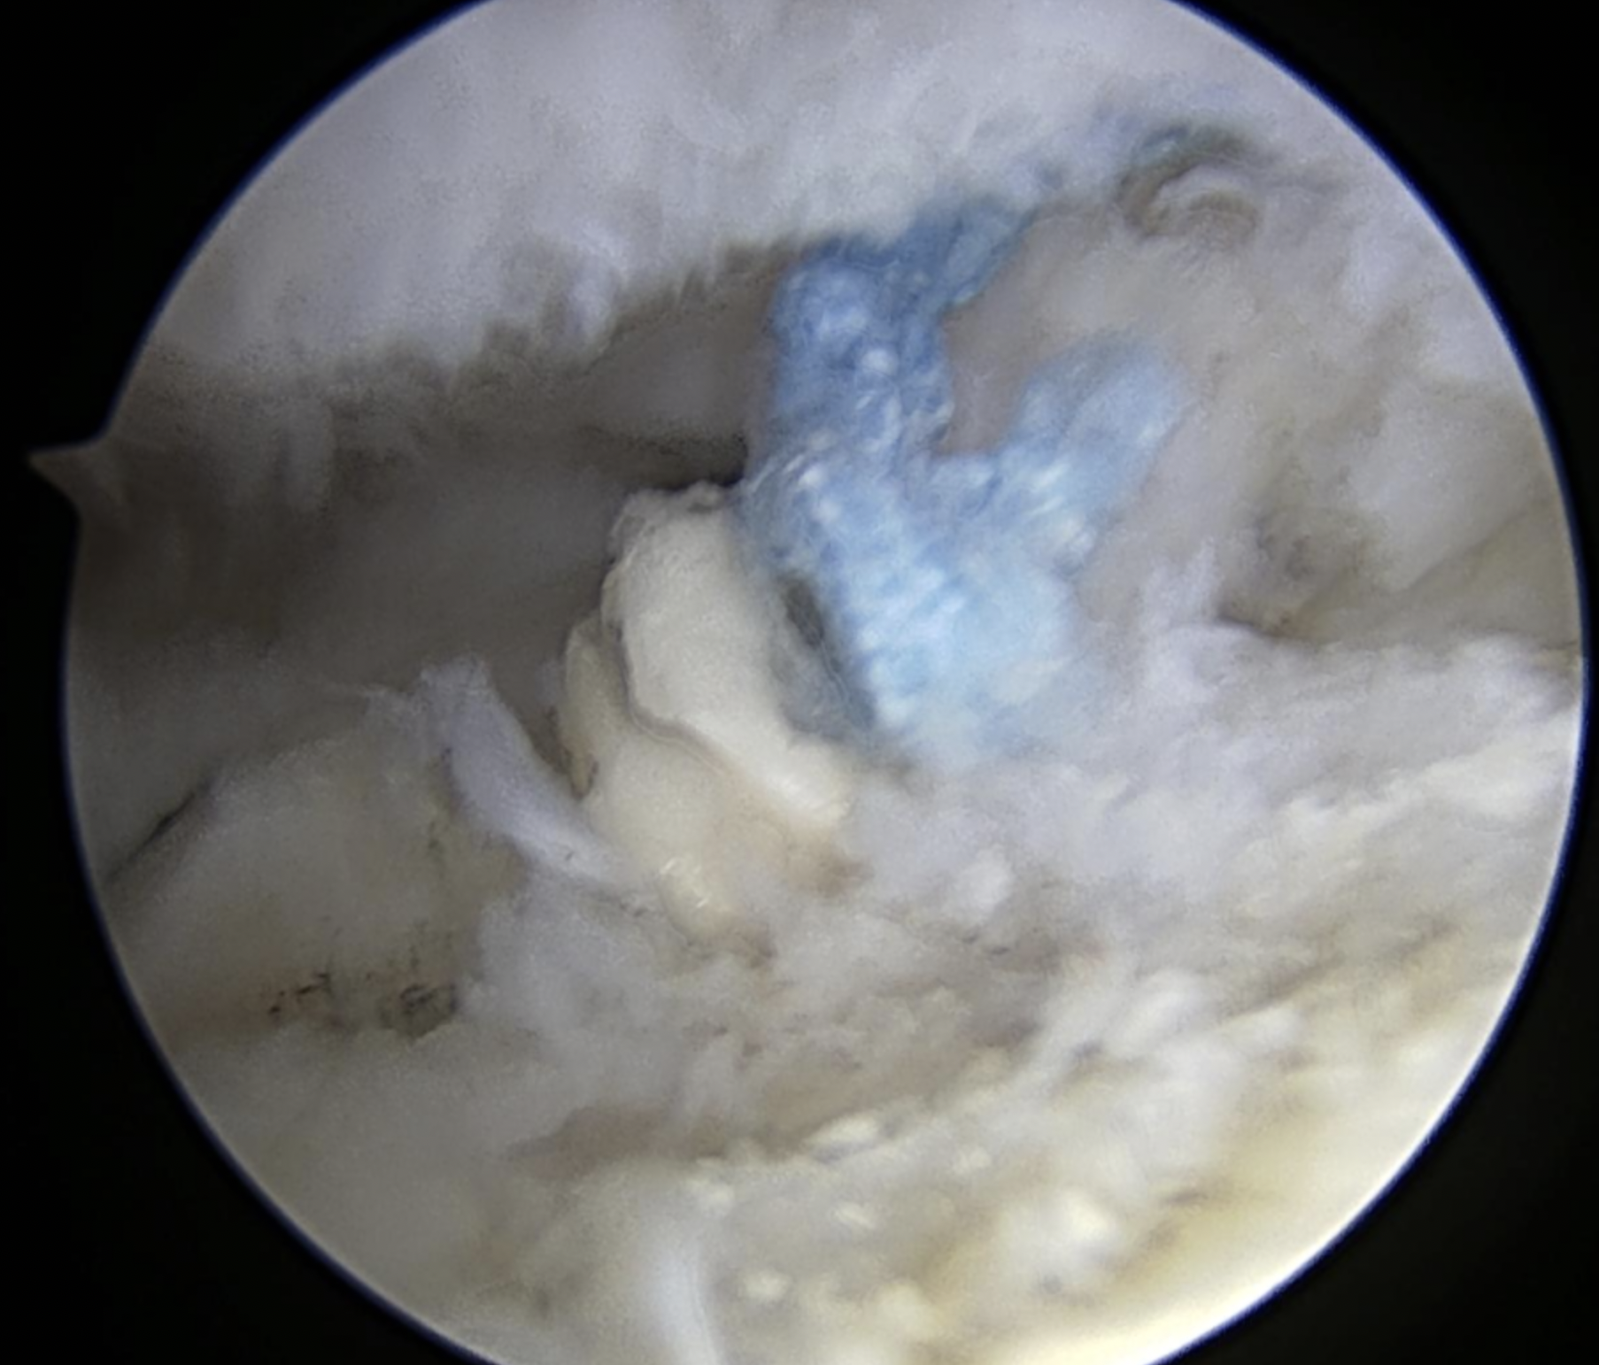
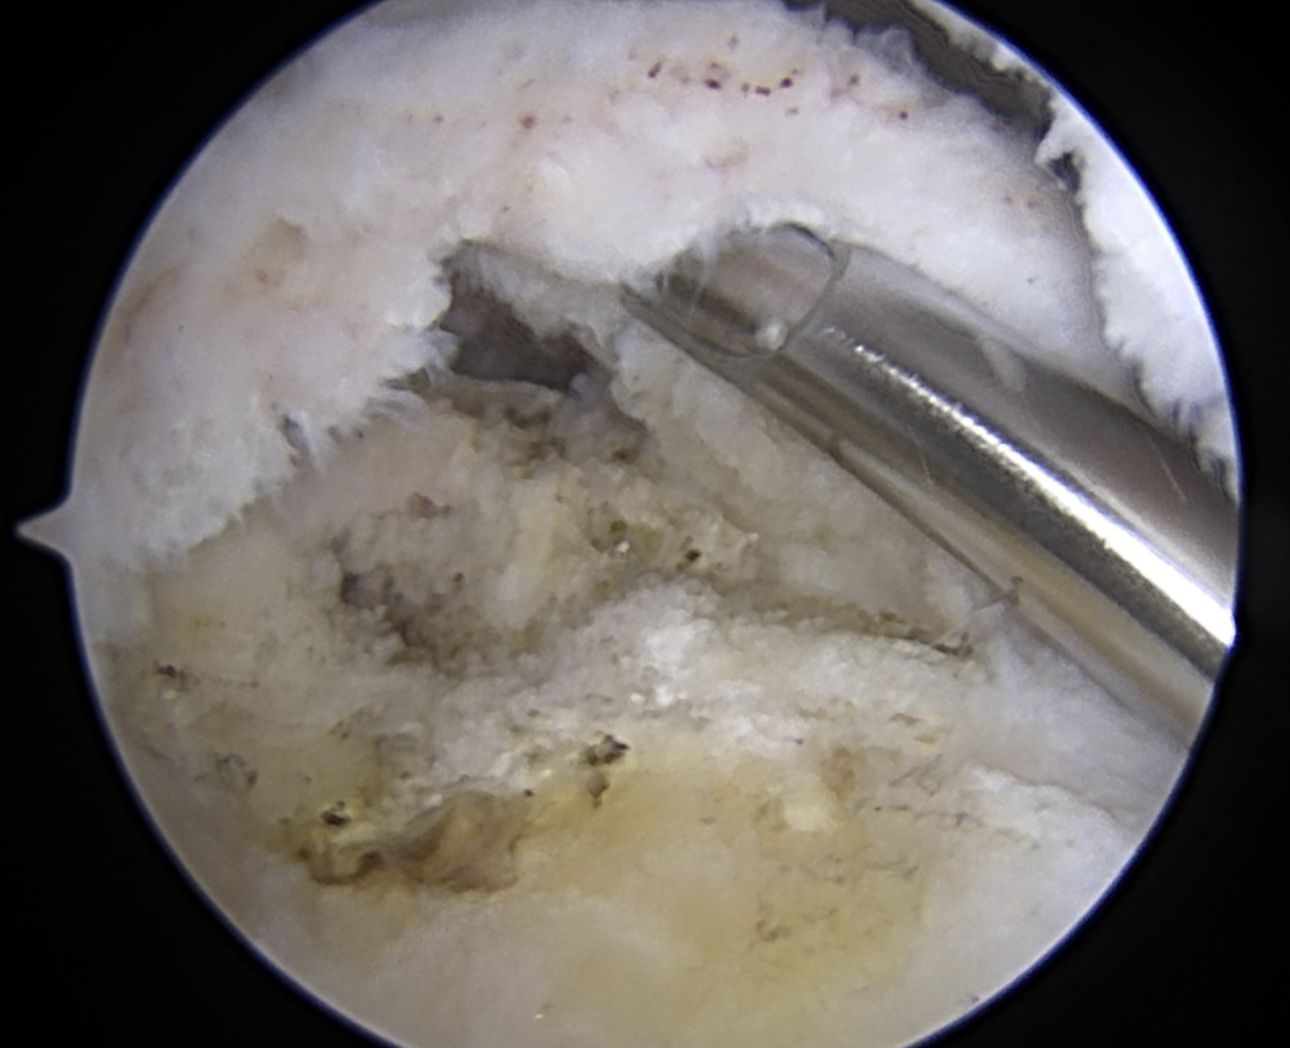
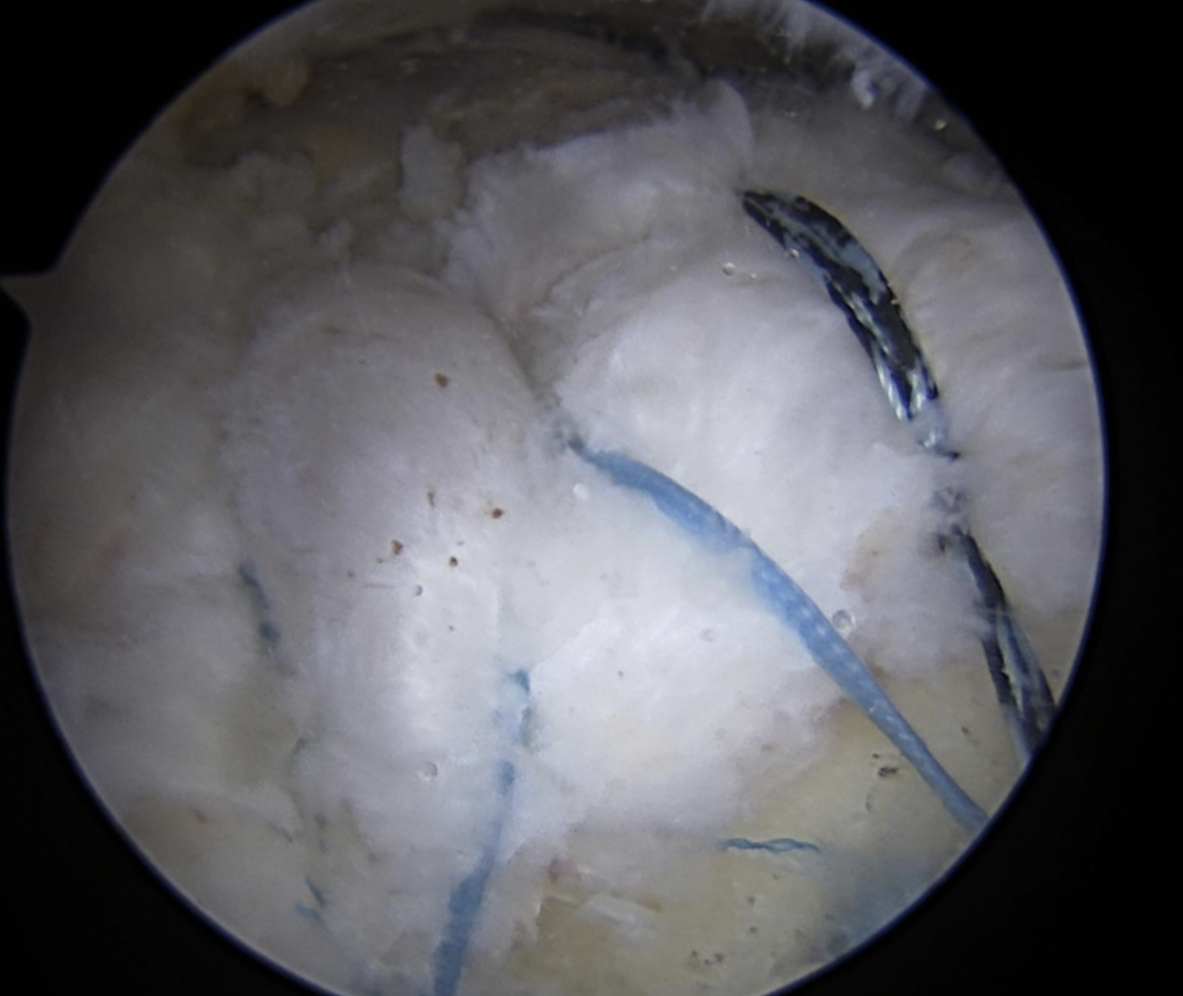
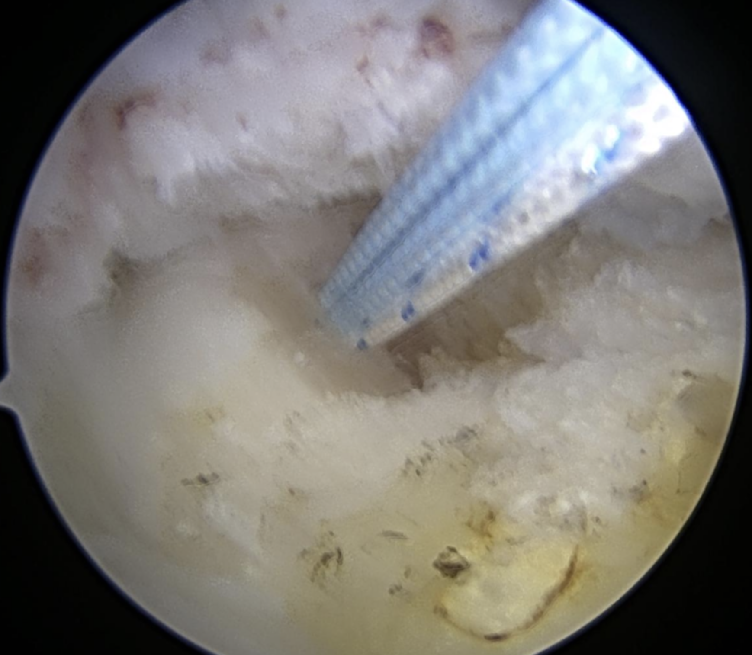
Case #2
Revision arthroscopic repair, allograft augmentation

Slide 24
Case #2
POST-OP
Delayed protocol - revision, poor tissue
5 months post op:
  Mild pain, improved from pre-op
  140 FE
  40 ER
  Strength improving
  Light duty

Slide 25
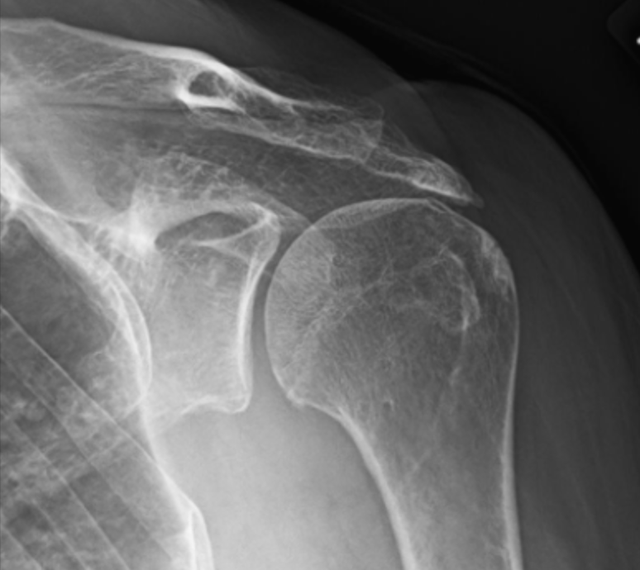
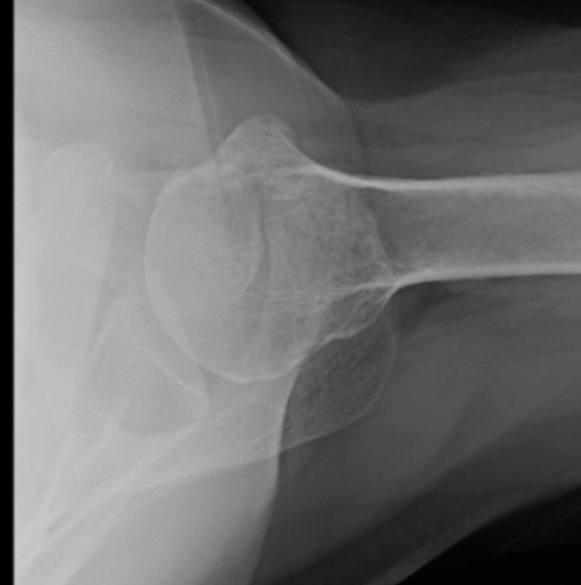
Case #3
74yo female
Worsening pain over last year
Weakness
  FE 160
  ER 30
  3/5 empty can
  4/5 resisted external rotation
  Neg. belly press
XR: Hamada 3-4 changes

Slide 26
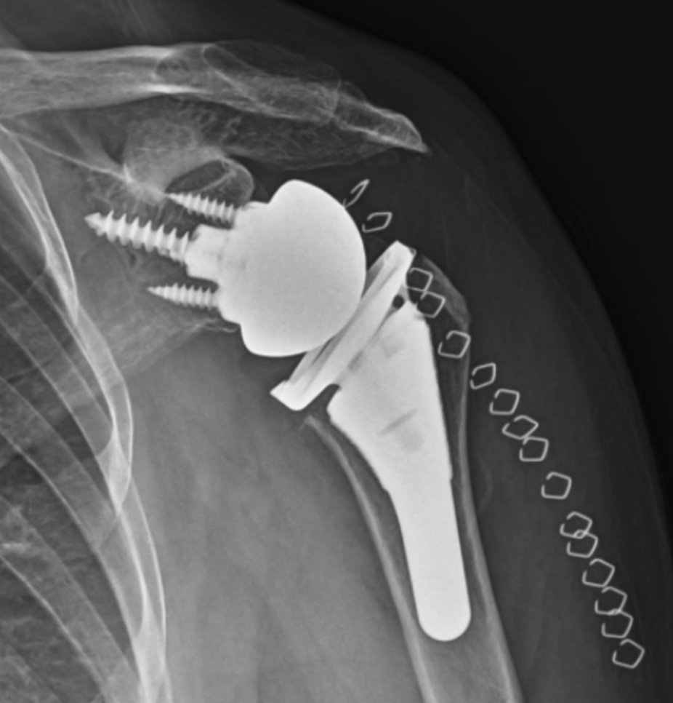
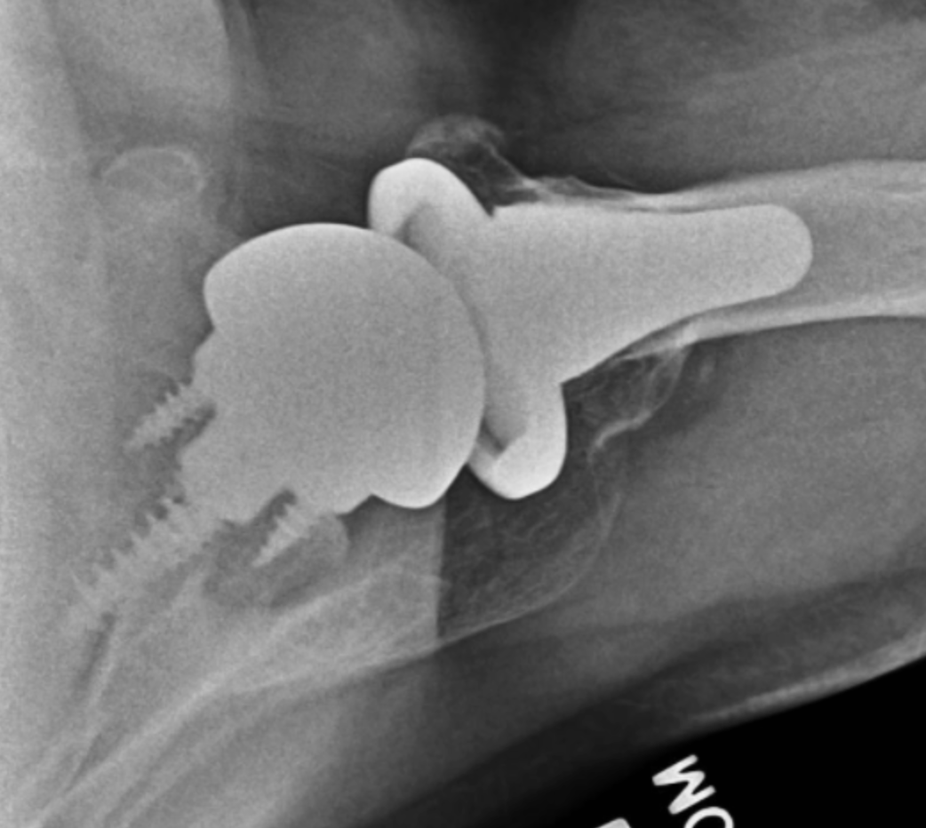
Case #3
Surgical options
  RCR +/- patch augmentation
  SCR
  Subacromial balloon
  RTSA

Slide 27
Rotator Cuff
Key Points
Thorough physical exam critical, matched with imaging findings
Many can do well with non-surgical management
Tailor surgical treatment to pathology present, patient characteristics, goals, predictability. Not one size fits all.
Clear communication of surgical findings with therapist
Patient education on expectations and importance of following therapy protocol

Slide 28
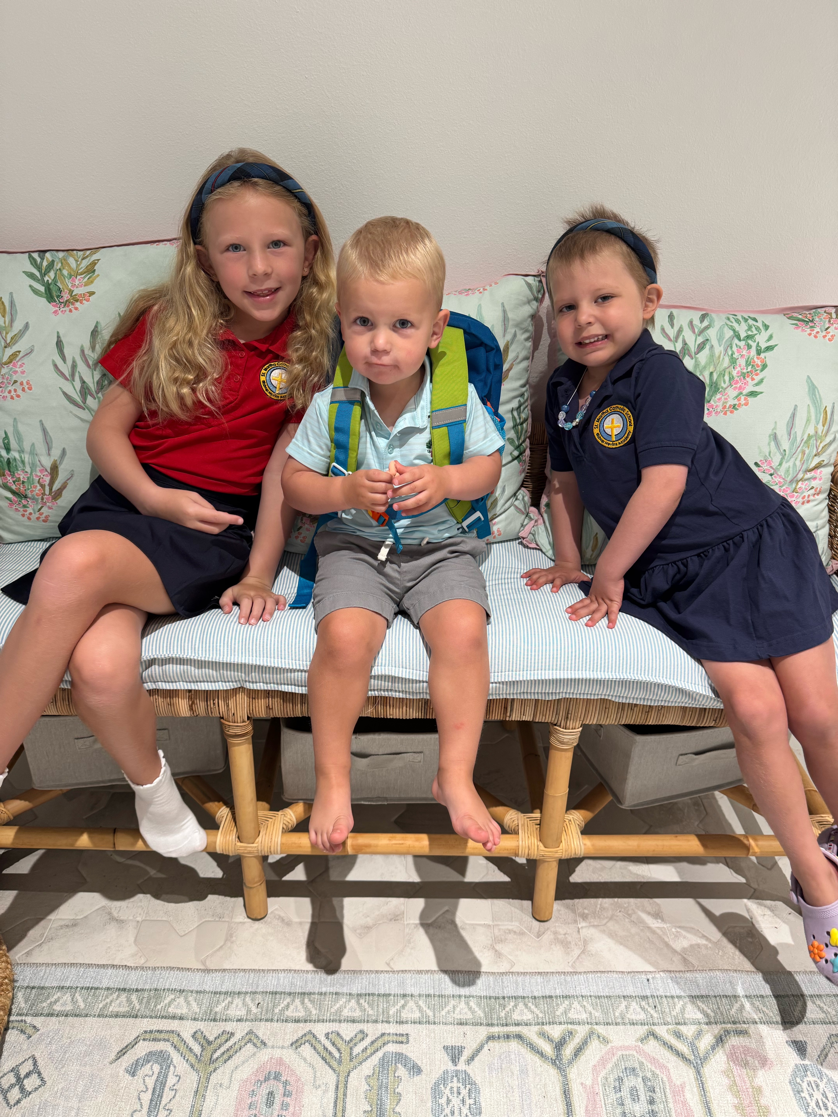
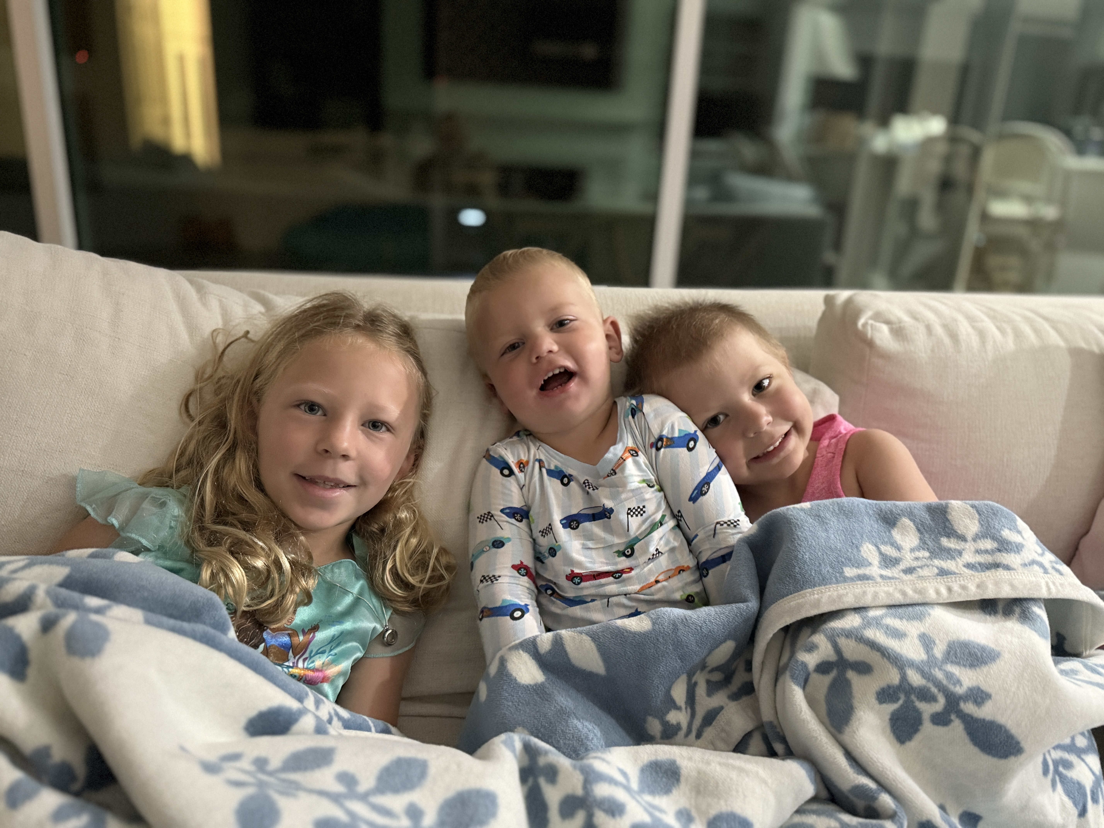
Thank you!
R. Stephen Otte, MD
(402)770-4734
rsotte@coastalorthopedics.com

