Slide 1
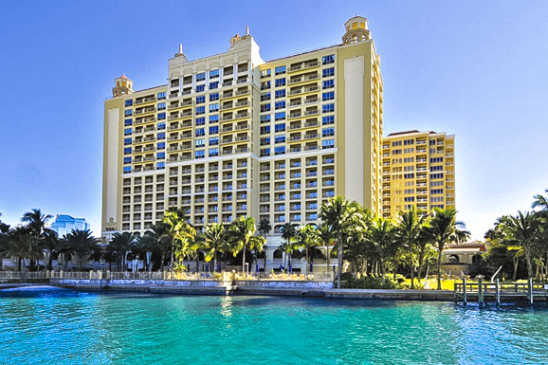
Welcome
9th Gulfcoast Orthopaedic Rehabilitation Conference

Slide 2
Goals
Interaction of surgeons and therapist
  Chance to network
  Establish and maintain relationships

Slide 3
Goals
Allows for open discussions
  Multiple questions and answer sessions
  Don’t be shy

Slide 4
Goals
Opportunity to learn from each other
  Flow of knowledge goes both ways
  There is not always a “right” answer

Slide 5
Schedule
5 sets of lectures
  Please hold all questions until each series is finished
  15-20 minutes built in for Q and A at end of each section

Slide 6
Schedule
All M.D.’s lectures will be made available
Will be loaded on website with a link
www.suncoastorthopeadic.com

Slide 7
Schedule
Mid-morning break around 10:25-10:40
Buffet lunch for all
Day will conclude 3:15

Slide 8
CEU’s
Make sure you signed in this morning
Make sure you verified your correct license number
CEU’s automatically uploaded into CE broker by end of day
Certificate of attendance available after the final talk of the day

Slide 9
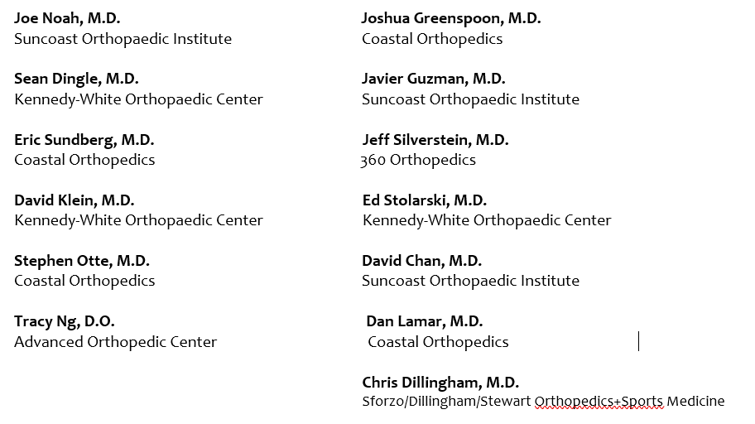
Thank You Faculty

Slide 10
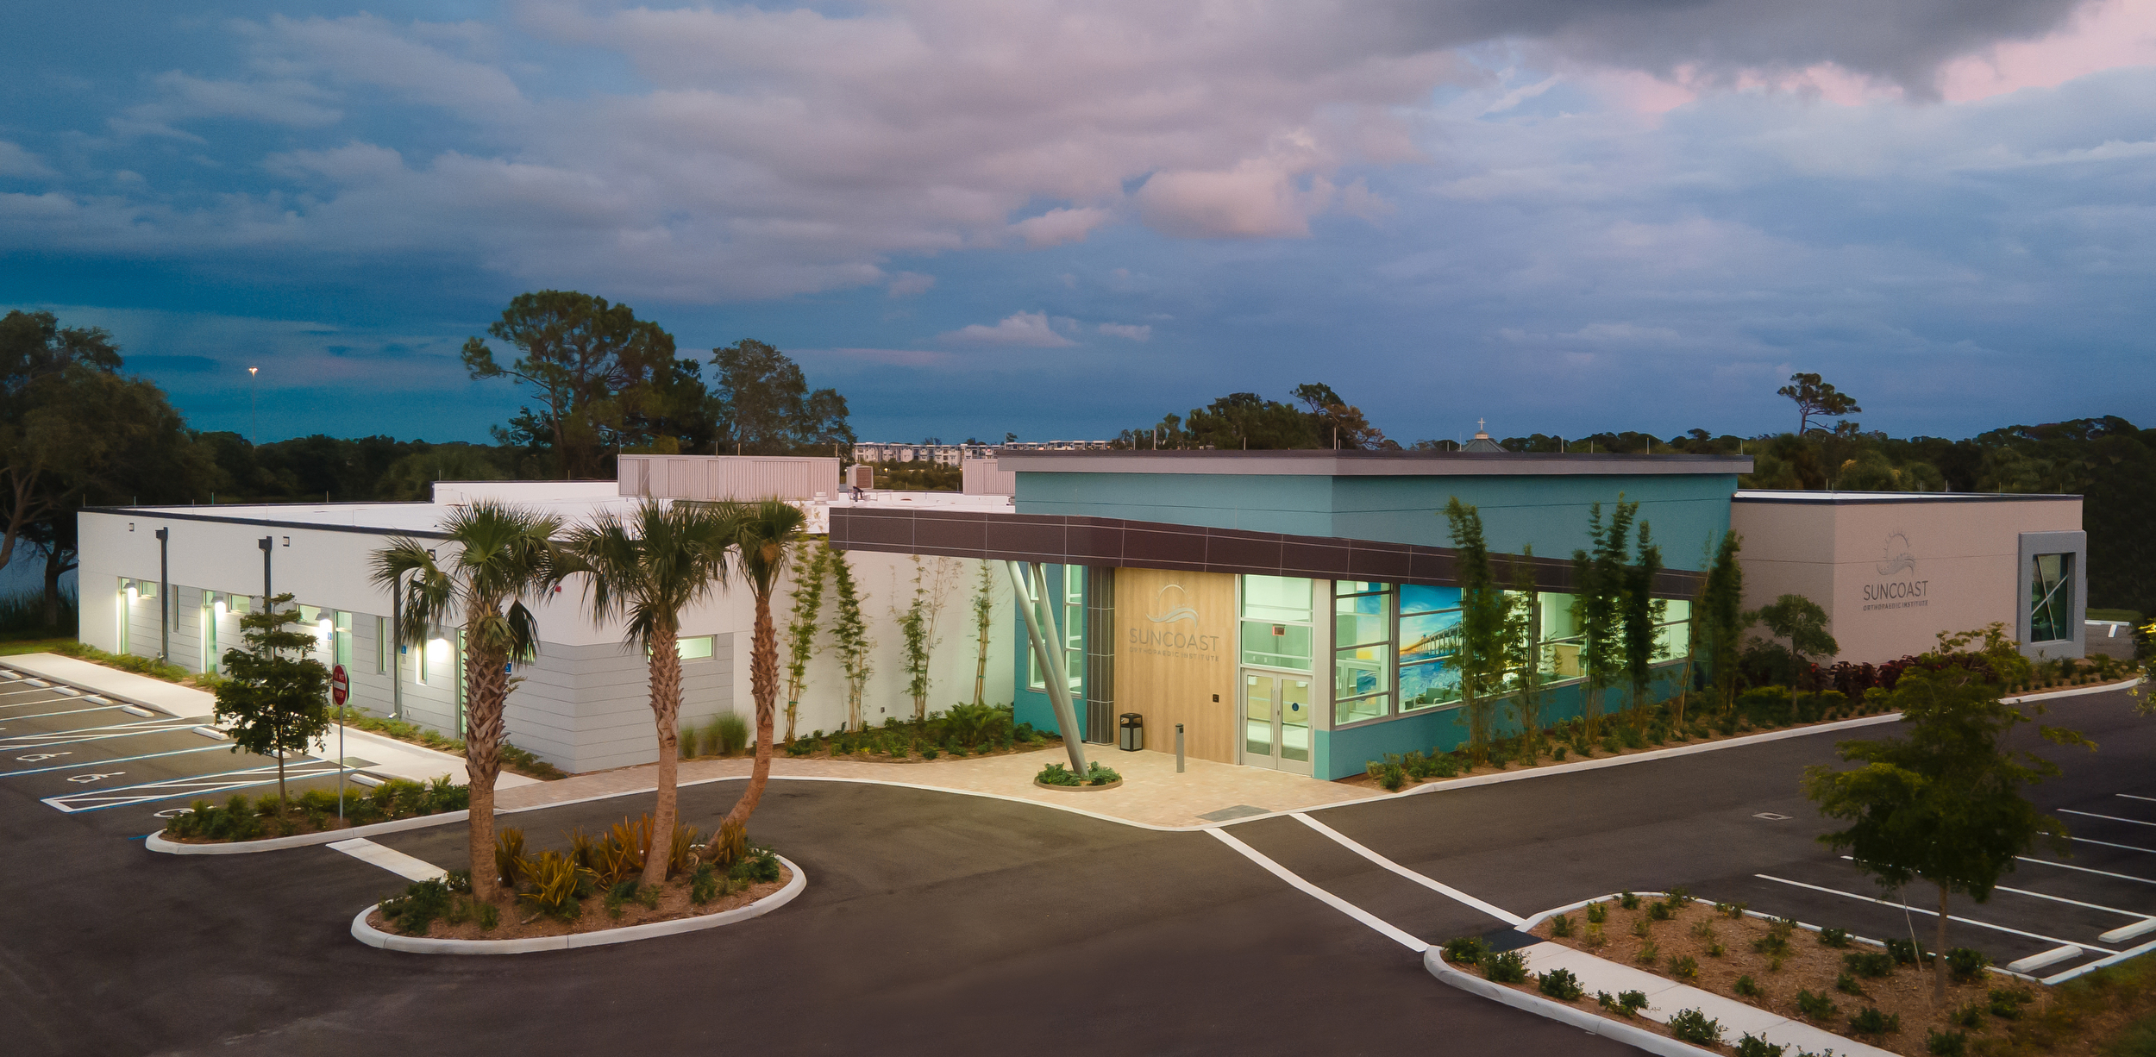
Special Thanks
Suncoast Orthopaedic Institute
David Brown, DSC, MA, PT
Amber Harris

Slide 11
Thank You Sponsors
Amedisys (Infinity) – Carmel Brady
Arthrex – Ryan Welke & Jessie Washington
Aveanna Health – Kimberly Nordgren & Steve Forbess
Doctors Hospital – Diane Lehman
Empath Health – Jacqueline Harvey & Chelsea Romano
EnCompass Health- Amy O’Conner
Ermi Motion – Grace Zamrowski
Fitness Quest – Scott Porter & Ed Inesta
FYZICAL – Rob Vandergrift
Heidi Health – William Parkhurst & Katherine Christen
J & J MedTech/DC Medical – Steven Greggo & Eddie Maher
Orthofix – Lauren Spurgin, Ali Reeder & Chessie
OrthoLazer – Laura Schmidt, Jennifer McKinley, Robert Milam, Rachel Tucci & Mike Blasewitz
Patients First Home Care – Amy Cooley & Susan McNamara
Sarasota Home Health – Mike Velonskis
Sarasota Memorial Hospital – Mackenzi Jones
Smart Recovery – Drake Franklin
St Andrews Sx Center/Drs Same Day Sx – Shawna Ross, Lori Swanson & Alex Orman
Total Therapy Florida – Jason & Ashley Ruberg & Justin Stiver
VitalCaring Group – Evan Smith & Patrick May
WRS – Michael Uttridge & Patrick Gronvall
Zimmer-Biomet – Mike Blasewitz

