Slide 1
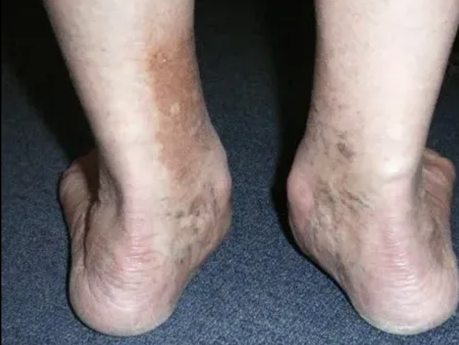

Foot Deformity: Treating Flat Feet and High Arches

Slide 2
Objectives:
Biomechanical principles
Clinical and radiographic hallmarks
Conservative and operative management
Physical therapy framework

Slide 3
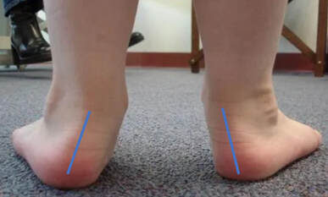
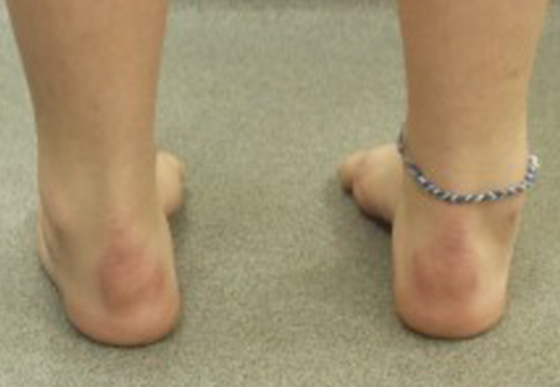
Foundational Biomechanics
Pronation: forefoot abduction, hindfoot valgus(eversion)
Supination: forefoot adduction, hindfoot varus(inversion)
Functional gait: Subconscious interplay between the two
Notes:
As a review

Slide 4
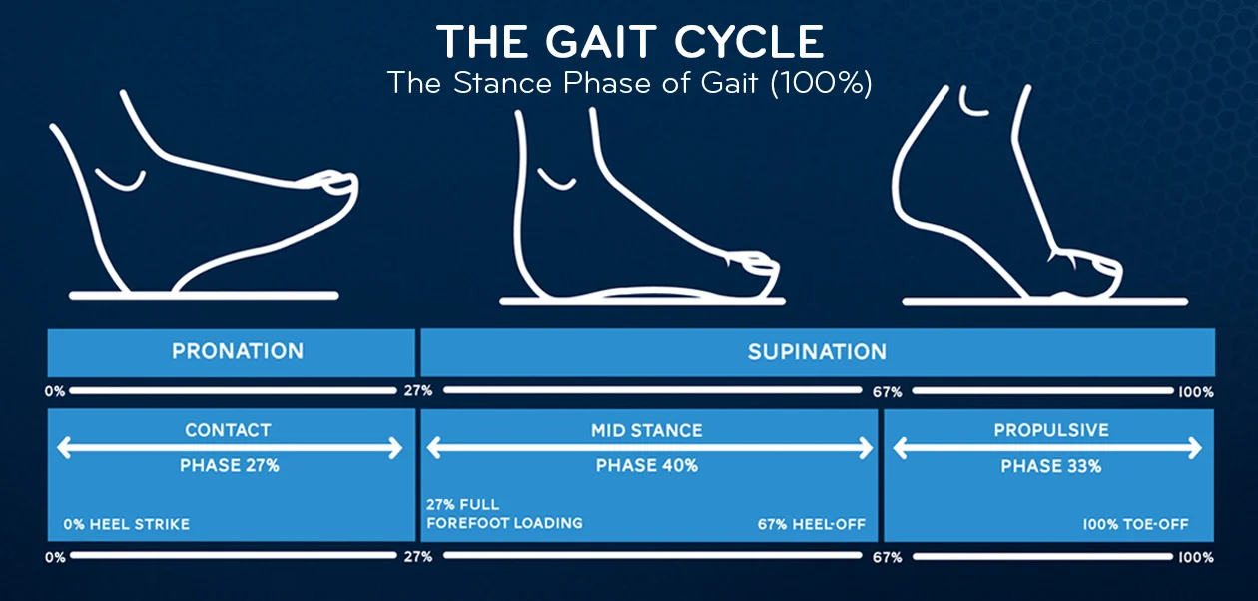
BOTH OCCUR DURING NORMAL GAIT

Slide 5
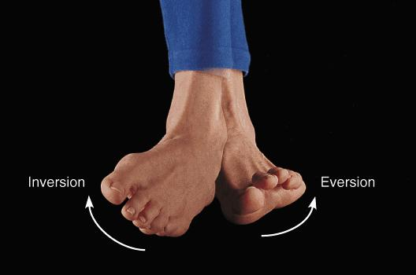
Coronal Plane Motions
Inversion: Medial rotation of the plantar aspect of the foot
Eversion: Lateral rotation of the plantar surface

Slide 6
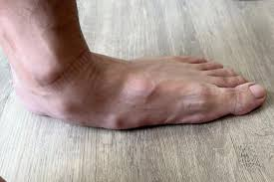
Flatfoot:
loss of the medial arch
valgus heel
forefoot abduction

Slide 7
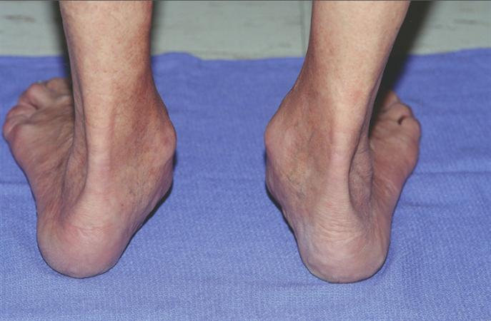
Clinical Features of Flatfoot
  Too many toes" sign
  impaired single-leg heel rise
  medial column tenderness
  progressive heel valgus

Slide 8
Adult-Acquired Flatfoot (PTTD / PCFD)
Etiology: Degeneration or insufficiency of the posterior tibial tendon
Pathophysiology: Progressive collapse of medial column with compensatory forefoot abduction and valgus hindfoot
Demographics: More common in women >40 years; obesity

Slide 9
Nonop Management Pes Plenovalgus
Activity modification
short-term immobilization(acute flare)
Orthotic interventions:
  Custom (medially posted)
  OTC Orthotic (ex. aetrex L420)
Physical therapy:
  eccentric posterior tibialis strengthening
  intrinsic foot muscle activation
  gastroc-soleus stretching

Slide 10

Physical Therapy
Effect of eccentric exercise program for early tibialis posterior tendinopathy (2009)
10-week twice daily
Improvements in symptoms and function without changes in tendon morphology or neovascularization
Nonsurgical management of posterior tibial tendon dysfunction with orthoses and resistive exercise: a randomized controlled trial (2009)
Eccentric and concentric progressive resistive exercises
progressive eccentric tendon loading
calf stretching program with orthoses
reduced pain and improved perceptions of function.

Slide 11
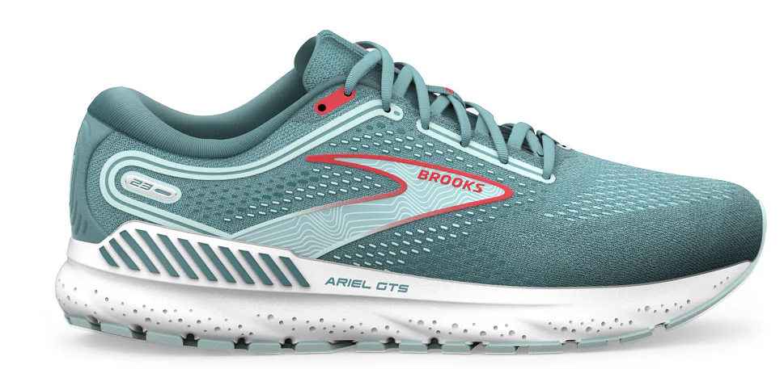
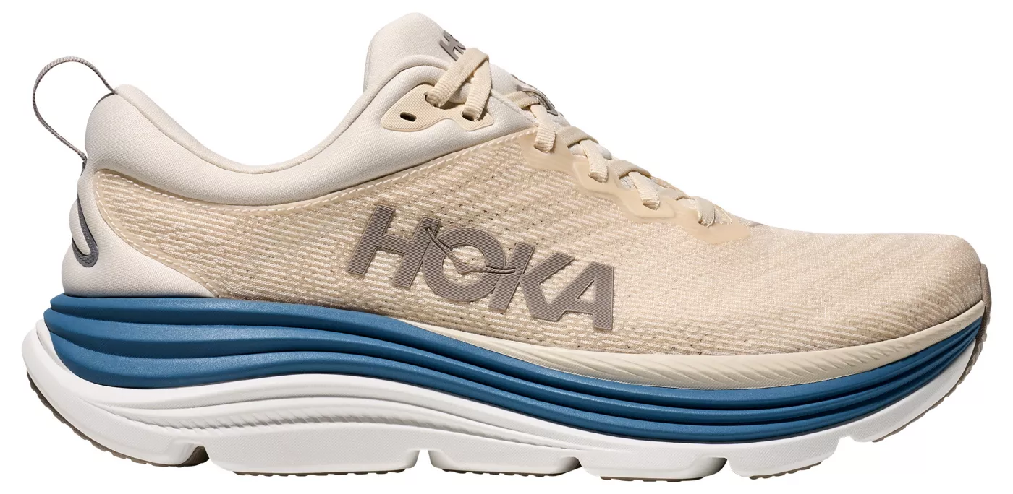
Shoe wear
Need Hindfoot control
Stability to prevent overpronation
”sloppier” shoe will allow foot to fall into max pronation
BROOKS ARIEL
Hoka Gaviota

Slide 12
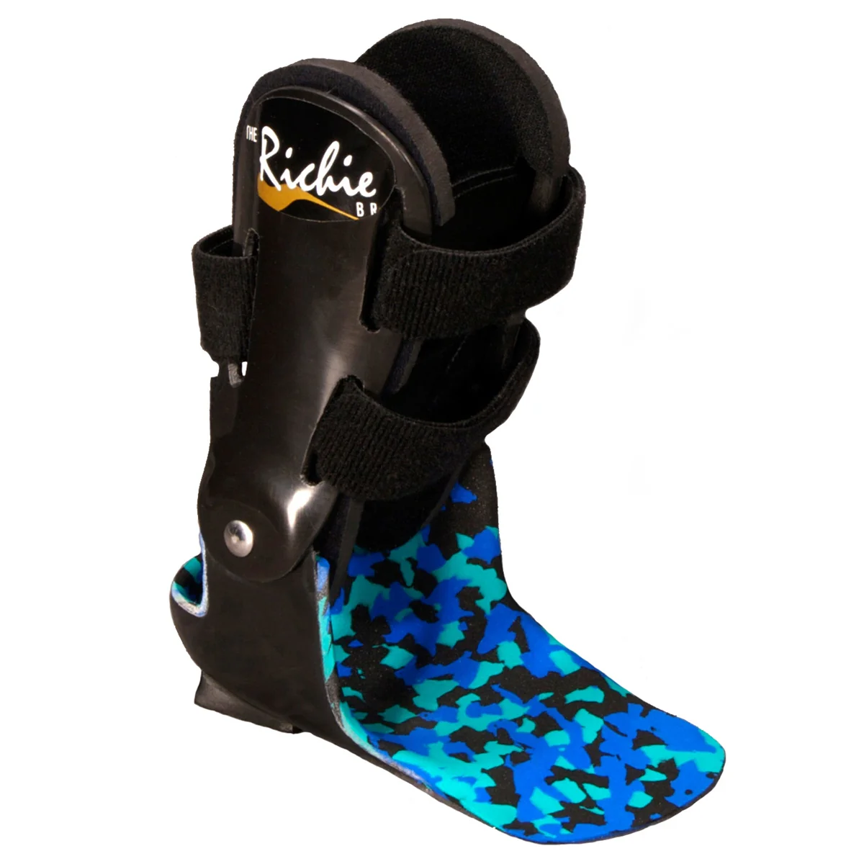
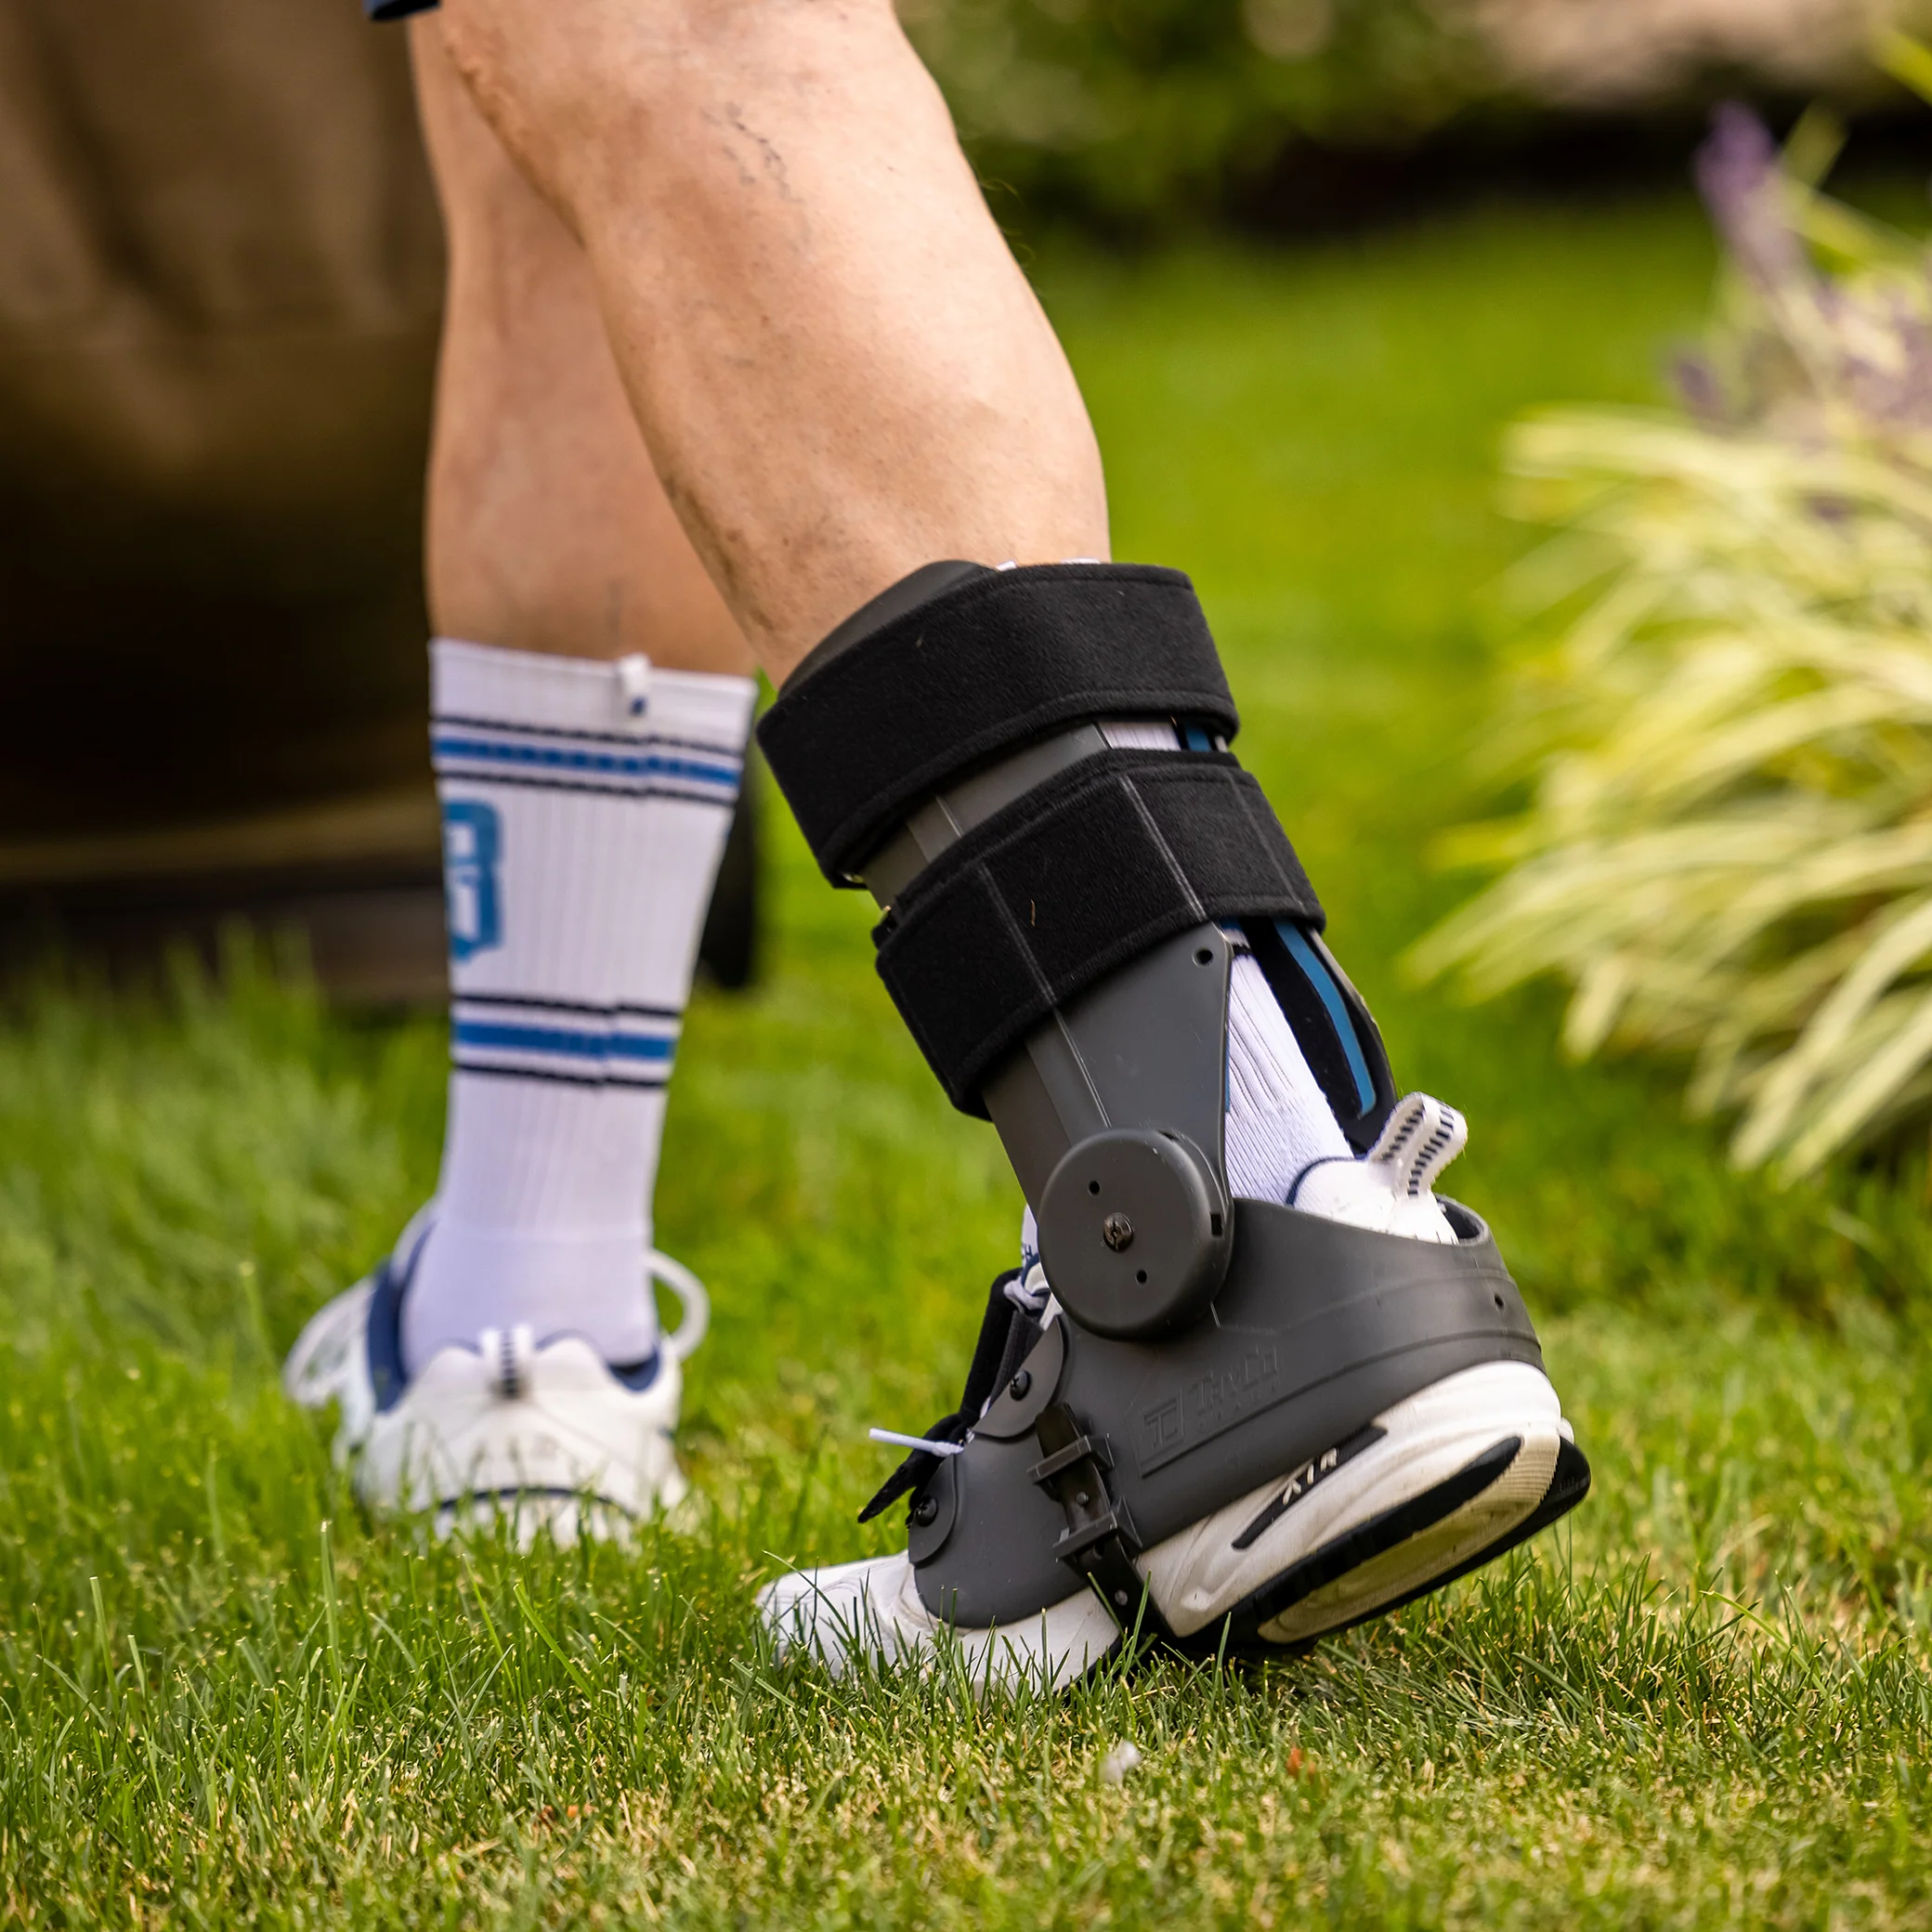
Braces
Notes:
PowerStep Pinnacle/Aetrex L420/Superfeet Green/ Moore Balance brace

Slide 13
General Principles of Operative Management
Rigid Deformity requires fusion
Older patients >65 consider fusion
Flexible-Consider reconstruction

Slide 14
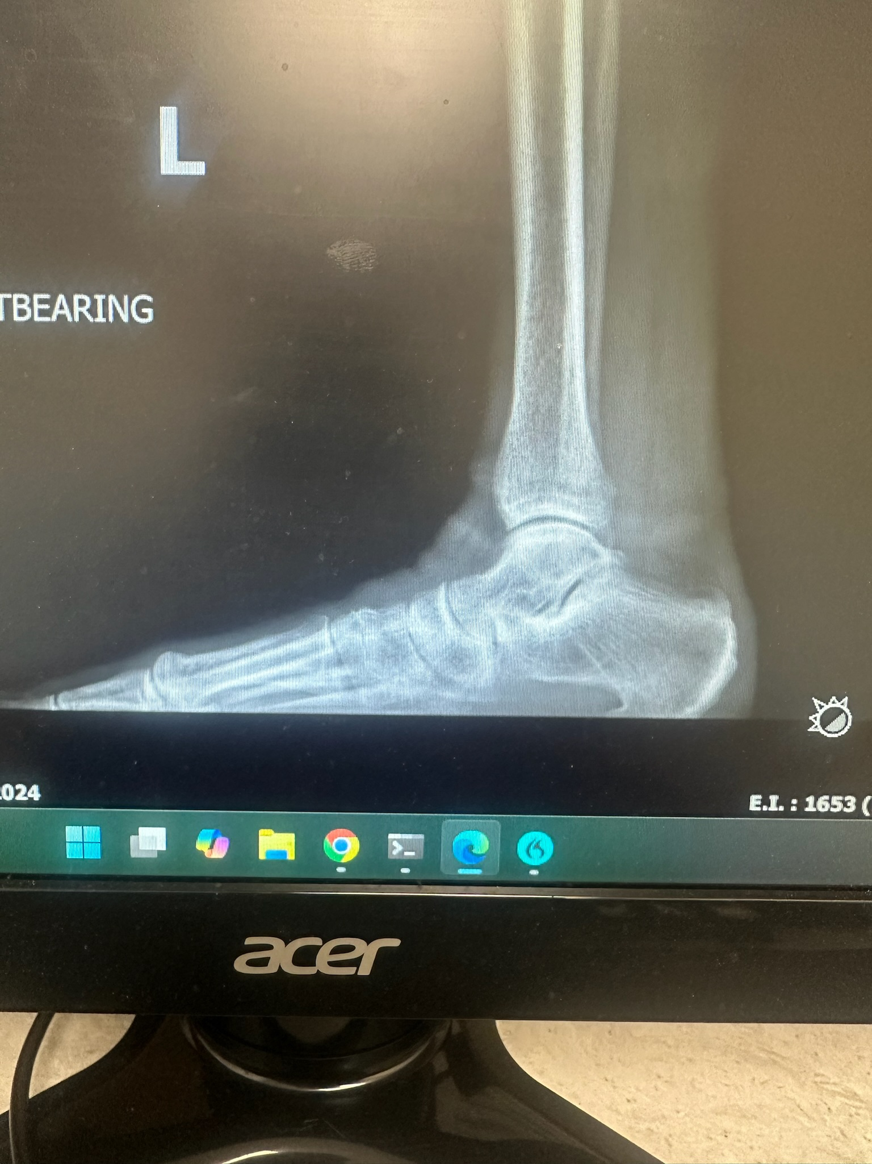
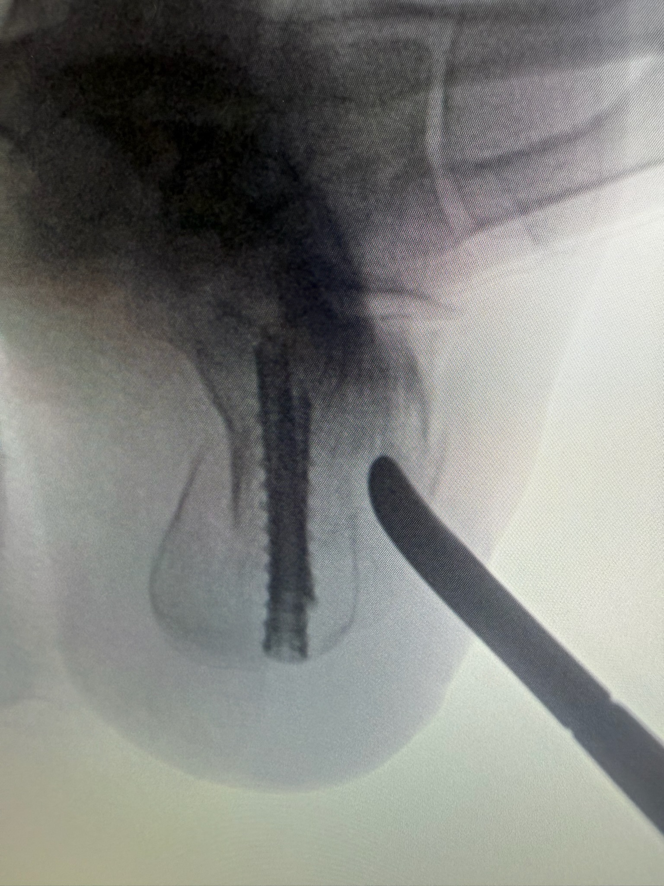
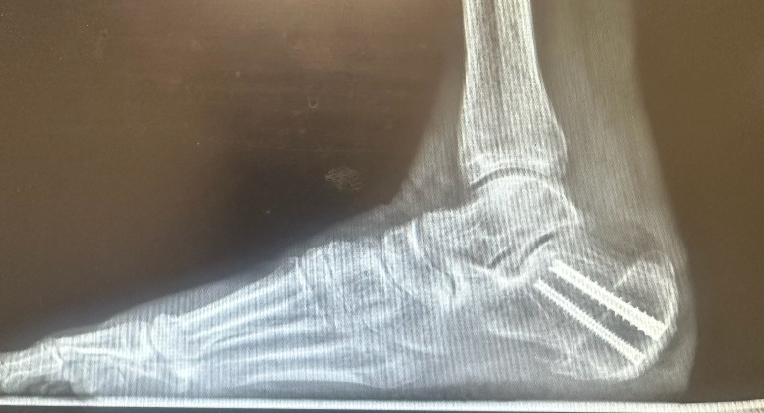

RECONSTRUCTION
a. MDCO
b. FDL transfer
c. Spring ligament
repair

Slide 15
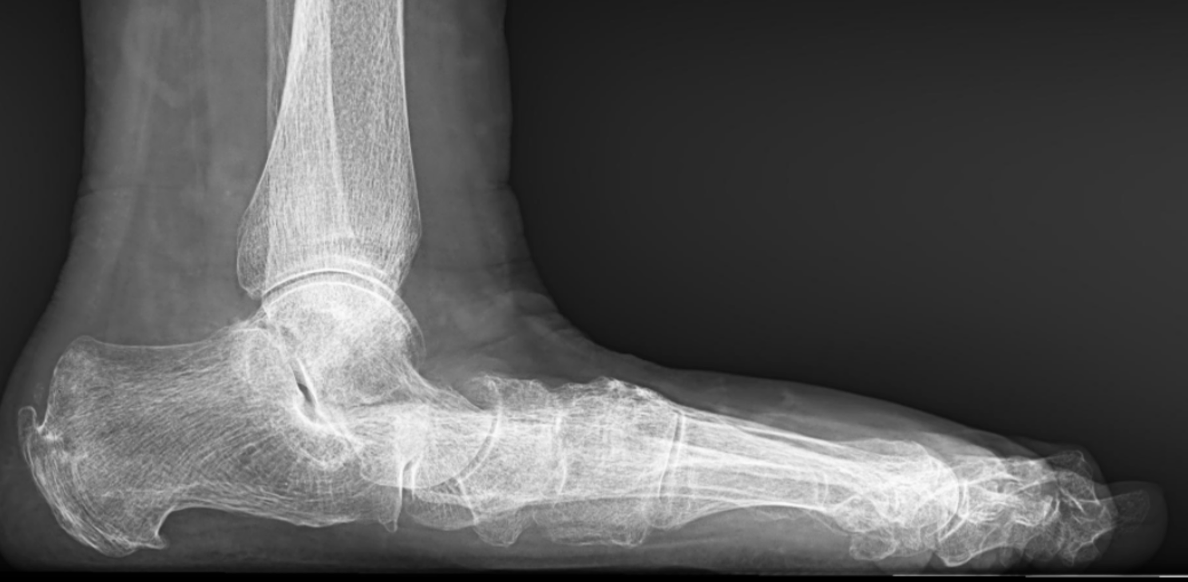
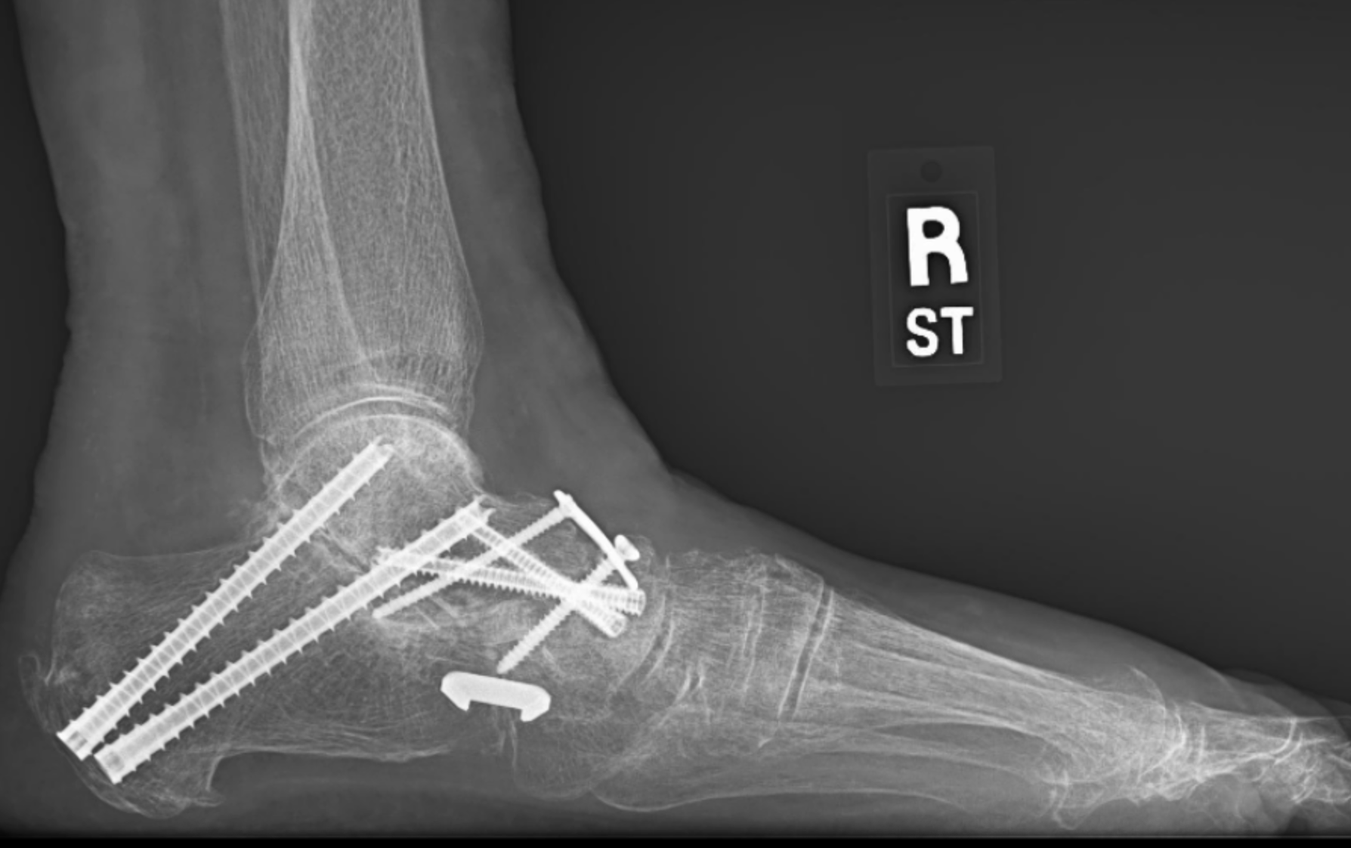

TRIPLE ARTHRODESIS
Arch corrected
Arch is Nonexistent

Slide 16
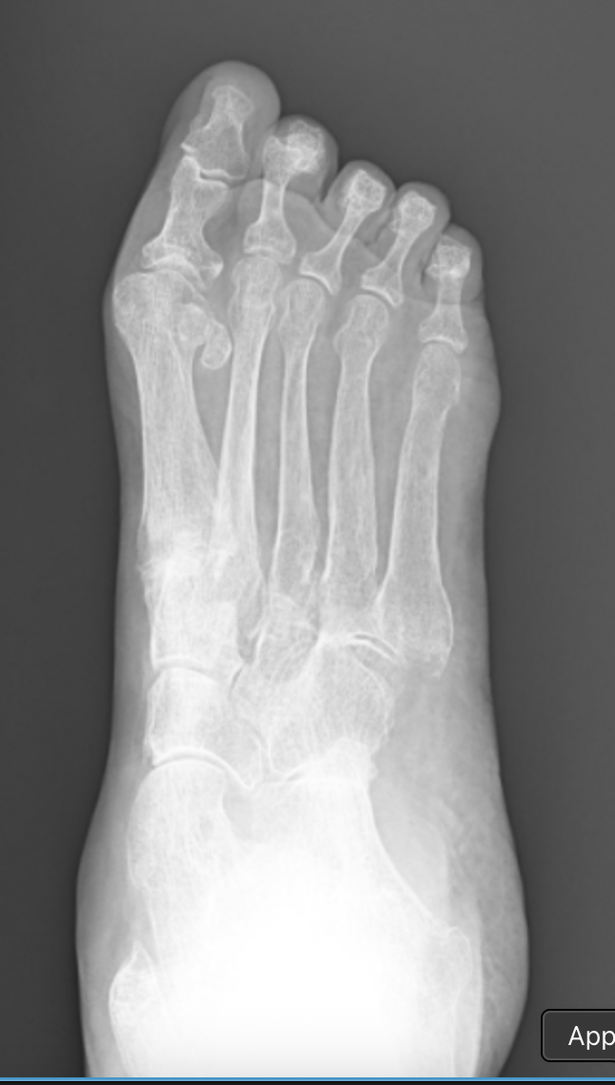
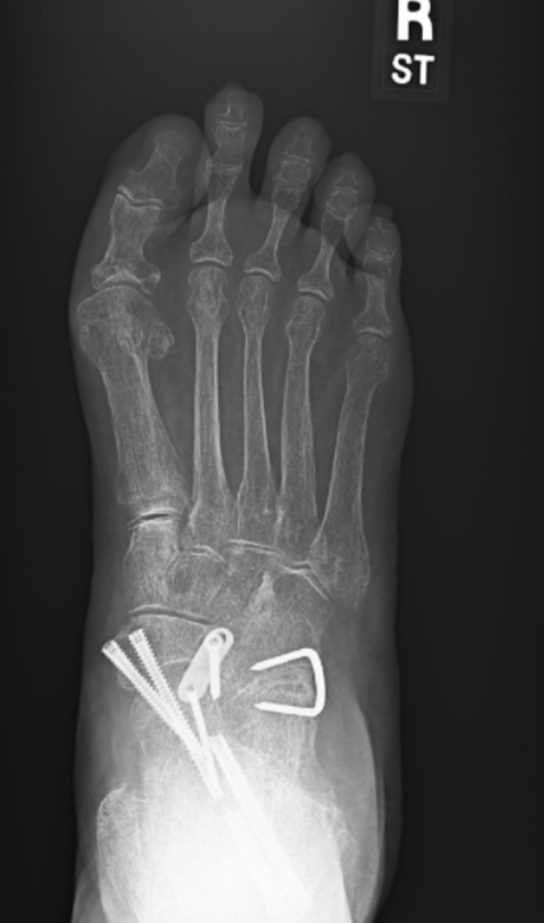
Corrected Talar head
Notice the Severe Talar head
prominence
TRIPLE ARTHRODESIS

Slide 17
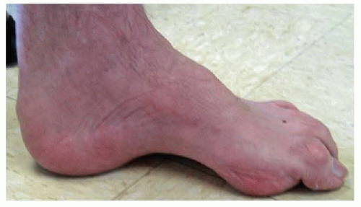
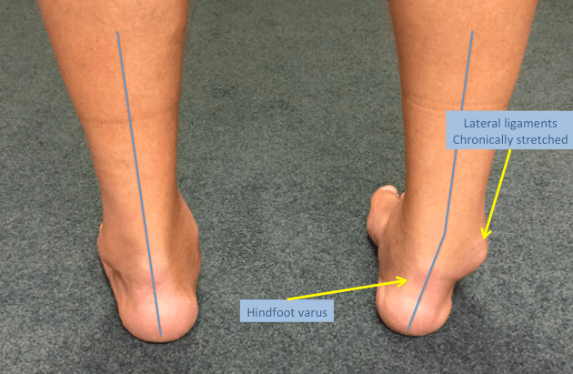
Cavus:
Elevated arch hindfoot varus plantarflexed first ray

Slide 18
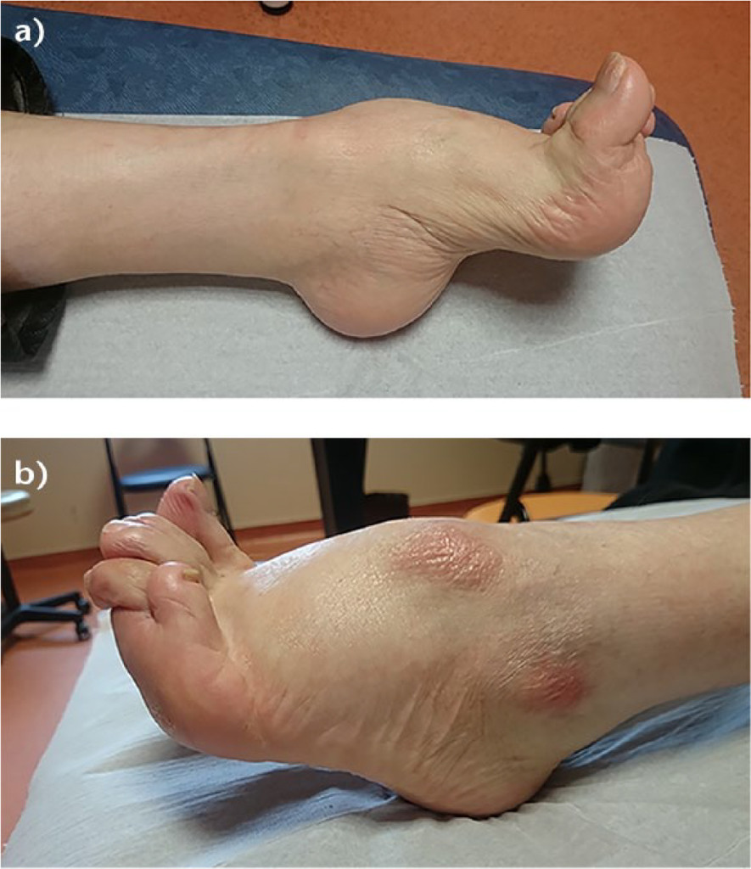
Cavovarus Foot
Symptomatology:
  Recurrent lateral ankle
  sprains
  metatarsalgia
  stress fracture

Slide 19
Clinical Findings
Claw toe deformities, plantar fascia contracture, lateral column overload
Positive Coleman block test/Peekaboo sign/ High arch

Slide 20
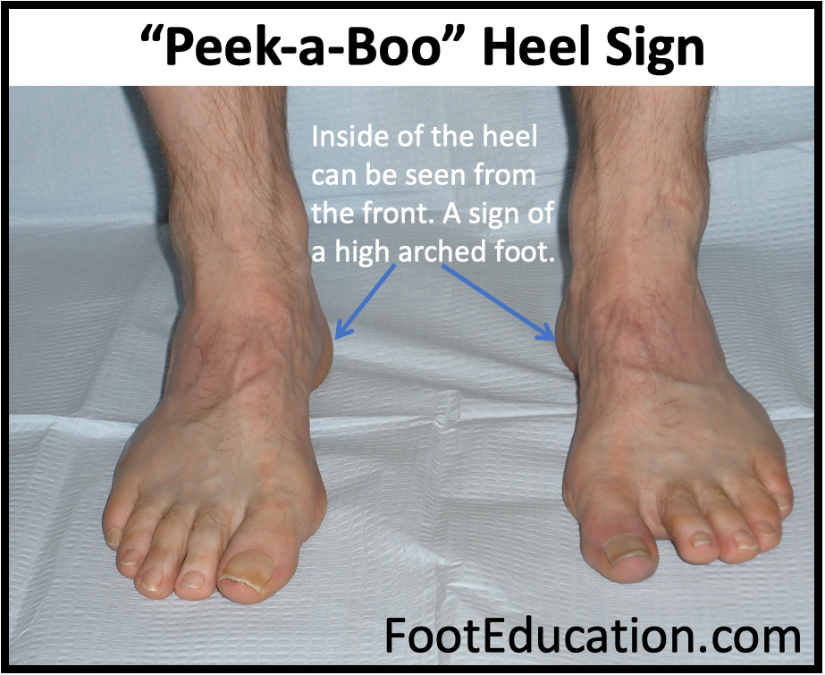

Slide 21
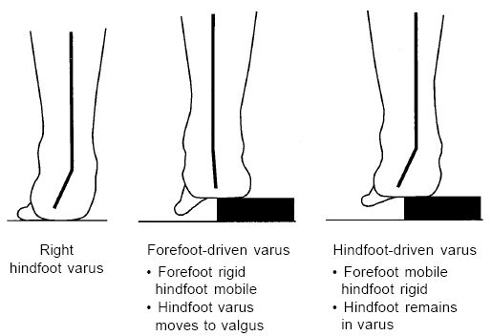
Notes:
This is important because it can distinguish people who need surgery and some who can possible benefit from orthothics. In addition, it can help the surgeon distinguish what to do in surgery.

Slide 22
Conservative Management
Footwear: Enhanced shock absorption and lateral stability
Orthoses: Custom devices incorporating lateral hindfoot posting and 1st ray recess
Bracing: Semi-rigid ankle stabilization for recurrent sprains
PT regimen: Peroneal muscle facilitation, plantar fascial and gastrocnemius elongation, proprioceptive retraining

Slide 23
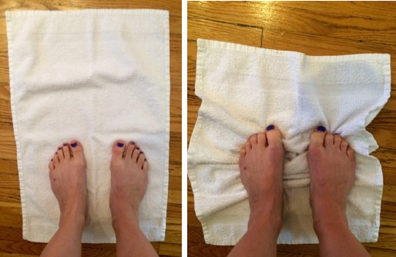
Nonop/
Physical
Therapy
Foot Orthoses + Lateral Posting
Semi-rigid insoles with lateral posting/first-ray relief to redistribute pressure.
Gastrocnemius–Achilles Stretching
Address equinus
Intrinsic Foot Muscle Activation
Towel-scrunch and toe-spreading
Posterior Tibial Muscle Stretching
Resistance-band exercises to enhance medial support(opposite of flat flatfoot)
Proprioception & Balance Training
single-leg stance
improve ankle stability and reduce sprain risk
Notes:
The Effect of Foot Rehabilitation Protocol in
Adults With Congenital Deformity of Foot: An
Analytical Case Series

Slide 24
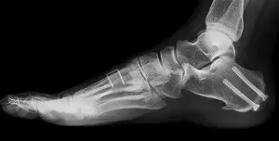
Operative Management
Soft tissue: Plantar fascia release, Gastroc release
Tendon transfers: Peroneus longus to brevis; PTT to dorsolateral foot
Bony: Dorsiflexion 1st metatarsal osteotomy, lateralizing calcaneal osteotomy
Arthrodesis reserved for rigid deformity or degenerative joint disease

Slide 25
Thank You

