Slide 1

Metacarpal Fractures of the Hand: How to Manage
David Chan, MD, PT
Suncoast Orthopaedic Institute
Venice, FL

Slide 2
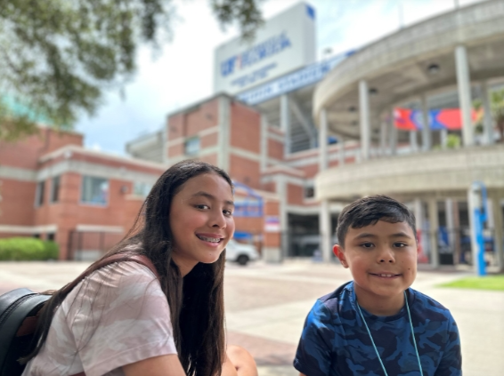

FINANCIAL DISCLOSURES

Slide 3
DISCUSSION GOALS
Epidemiology
Anatomy
Fracture Patterns & Treatment
Rehab Protocol Principles

Slide 4
Incidence
Metacarpal fractures account for 31% of all hand fractures.
Hand fractures represent 19% of all fractures.
Estimated incidence: 8.4 to 13.6 per 100,000 people per year in the U.S.
Notes:
Metacarpal fractures are a significant public health concern due to their high incidence and potential for disability.
This slide introduces the concept of epidemiology and economic burden, emphasizing that these fractures are not just clinical issues
but also have broader societal implications. Highlight how understanding the distribution and impact of these injuries can guide
resource allocation and treatment strategies.

Slide 5
Demographic Patterns
Highest incidence in young males.
Ages 10–19: 38.8 per 100,000/year.
Ages 20–29: 28.4 per 100,000/year.
Men: 23 per 100,000 vs. Women: 4.5 per 100,000.
Notes:
Emphasize that hand fractures make up 19% of all fractures, and metacarpal fractures account for nearly a third of those. Discuss the age and gender disparities, noting that young males are disproportionately affected. Use this data to underscore the need for targeted prevention strategies in high-risk populations.

Slide 6
Socioeconomic Impact
Incidence increases with decreasing socioeconomic status.
69% more fractures in lowest income quartile compared to highest.
Notes:
Point out that individuals in lower income brackets experience significantly higher fracture rates. Discuss how this may relate to occupational hazards, access to protective equipment, and healthcare disparities.
This information is crucial for public health planning and equity in healthcare delivery.

Slide 7
Work-Related Consequences
High societal cost due to lost work time.
Average time off work for finger fractures: 6.3 weeks.
Only 31% return to very heavy demand jobs.
Athletes may require faster return-to-play strategies.
Notes:
This slide addresses the economic consequences of metacarpal fractures. Explain how these injuries often result in time off work,
especially for individuals in physically demanding jobs. Reference the study showing an average of 6.3 weeks off work and the low return rate
to heavy labor roles. Discuss implications for employers, insurance providers, and rehabilitation planning.

Slide 8
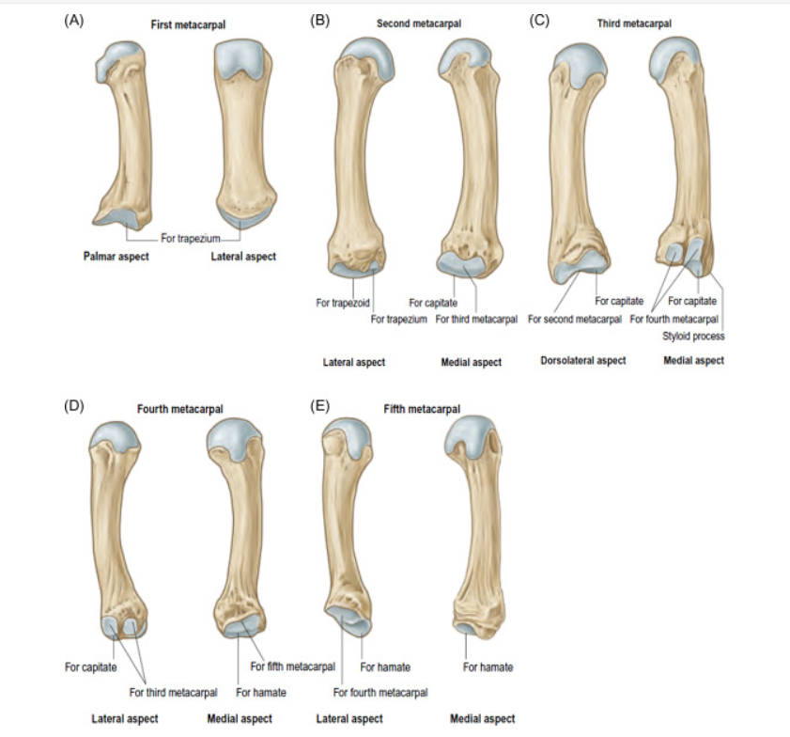
ANATOMY
Notes:
Flat dorsal surface, curved palmar surface. important for surgical fixation, IM threaded screws

Slide 9
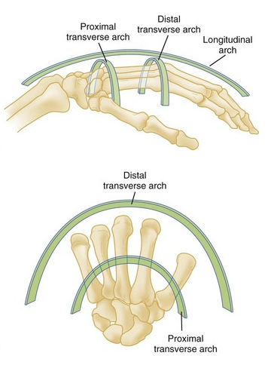
Metacarpal Curvature and Carpal Arch
Palmar aspect of metacarpals is concave.
Metacarpals form a volar transverse carpal arch.
Divergence allows equiangular curves following the Fibonacci sequence.
Balanced joint forces are required to maintain proper motion.
Notes:
Slide 1: Metacarpal Curvature and Carpal Arch
The palmar aspect of the metacarpals is concave, forming a volar transverse carpal arch. This curvature allows the hand to conform to objects and perform complex tasks. The divergence of metacarpals creates equiangular curves that follow the Fibonacci sequence, enhancing adaptability and dexterity. Clinically, this anatomical arrangement must be preserved during fracture treatment to maintain hand function and grip strength.

Slide 10
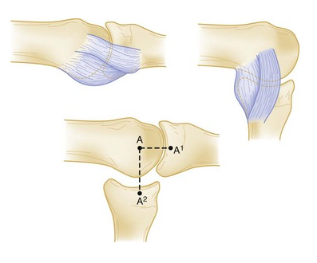
Joint Articulations
Index and middle fingers are fixed relative to the carpus.
Ring and small fingers have a 15°–25° flexion/extension arc.
Metacarpal heads are cam-shaped forming condyloid joints.
Notes:
The index and middle fingers are relatively fixed, providing stability, while the ring and small fingers have a 15°–25° flexion/extension arc, allowing more mobility.
The metacarpal heads are cam-shaped and form condyloid joints with the proximal phalanges, collateral ligaments taut in flexion, loose in extension

Slide 11
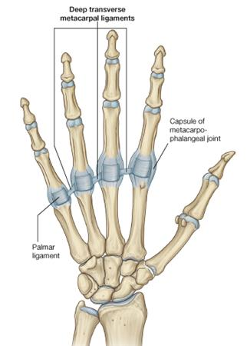
Ligamentous Support
Proper and accessory collateral ligaments stabilize MCP joints.
Ligaments become taut during pinch and grip.
Deep intermetacarpal ligament connects volar plates.
Limits proximal migration and rotation of metacarpal fractures.
Notes:
Slide 3: Ligamentous Support
The proper and accessory collateral ligaments stabilize the MCP joints and become taut during pinch and grip. The deep intermetacarpal ligament connects volar plates and limits proximal migration and rotation of metacarpal fractures, especially in the middle digits. These ligaments are essential for joint stability and must be considered during surgical fixation to prevent deformity and loss of function.

Slide 12
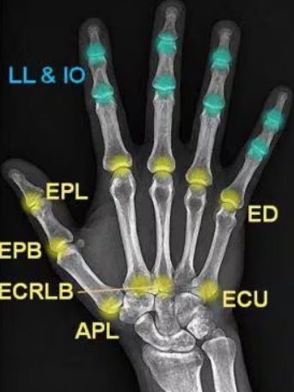
Musculotendinous Attachments
Interossei originate on metacarpal shafts and insert into proximal phalanx and extensor hood.
Dorsal tendons: ECU (5th), ECRL/B (2nd and 3rd).
Volar tendons: FCR (2nd), FCU (5th).
Fourth metacarpal has no proximal tendon attachment.
Notes:
Slide 4: Musculotendinous Attachments
The interossei muscles originate on the metacarpal shafts and insert into the proximal phalanx and extensor hood, contributing to finger movement and grip. Dorsal tendons like the extensor carpi ulnaris and radialis insert on the metacarpals, while volar tendons like the flexor carpi radialis and ulnaris provide flexion. The fourth metacarpal lacks proximal tendon attachment, making it biomechanically unique. These attachments influence fracture displacement and healing.

Slide 13
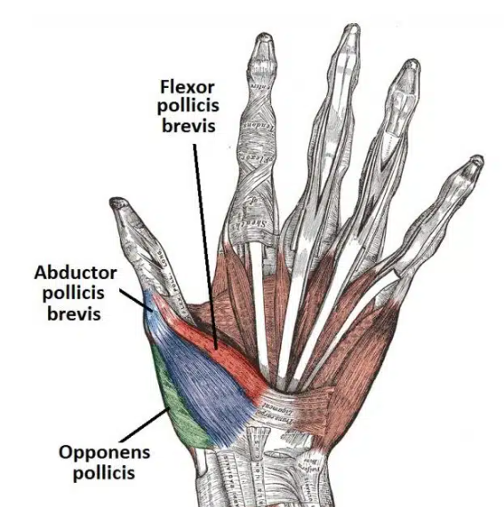
Thumb Anatomy
First metacarpal forms a biconcave-convex saddle joint at the carpometacarpal joint.
Thumb axis is pronated and flexed ~80° for opposition.
Musculotendinous contributions: APL (base), FPB (MCP capsule), opponens (distal shaft).
Notes:
Slide 5: Thumb Anatomy
The first metacarpal forms a biconcave-convex saddle joint with the carpus, allowing a wide range of motion. Its axis is pronated and flexed approximately 80° relative to the fingers, enabling opposition. Musculotendinous contributions include the abductor pollicis longus, flexor pollicis brevis, and opponens pollicis, which facilitate thumb movement. Preserving thumb anatomy is critical for hand function, especially in tasks requiring precision and grip.

Slide 14

Fracture Pathology

Slide 15
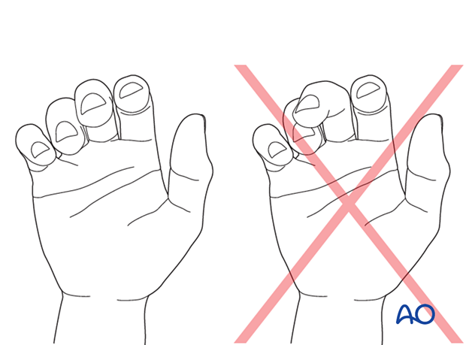
Malrotation
Evaluate nail alignment during finger flexion.
Each degree of metacarpal rotation leads to 5° rotation at the fingertip, causing 1.5 cm of digital overlap.
Notes:
Malrotation is a critical finding in metacarpal fractures. During physical examination, observe the alignment of the fingernails when the fingers are flexed. Even small degrees of rotation at the metacarpal level can result in significant overlap at the fingertip, affecting hand function and grip.

Slide 16
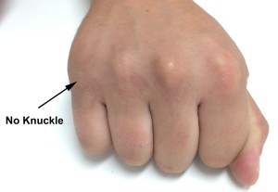
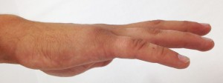
Shortening and Extensor Lag
Loss of MCP joint contour may indicate shortening.
Every 2 mm of shortening results in a 7° extensor lag.
Up to 6 mm shortening may be tolerated due to MCP hyperextension.
Notes:
Shortening of the metacarpal can be assessed by observing the MCP joint contour and confirmed with radiographs. While some shortening is tolerated due to compensatory hyperextension at the MCP joint, excessive shortening can lead to extensor lag and impaired hand function, especially in border digits given their propensity to shorten.

Slide 17
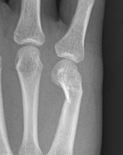
Angulation and Grip Strength
Identified by dorsal bony prominence and radiographs.
Angulation tolerance increases ulnarly.
>30° angulation may reduce grip strength.
Notes:
Angulation is another important parameter in metacarpal fractures. It is often visible as a dorsal bony prominence and should be confirmed radiographically. While the hand can tolerate more angulation on the ulnar side, angulation beyond 30 degrees can compromise grip strength and hand mechanics.

Slide 18
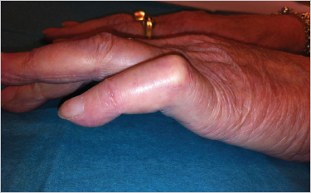
MCP and PIP Joint Compensation
MCP hyperextension may compensate for shortening.
This can lead to PIP extensor lag and pseudoclawing.
Notes:
Compensatory mechanisms such as MCP joint hyperextension can mask the effects of metacarpal shortening. However, this compensation may result in extensor lag at the PIP joint, leading to pseudoclawing. Understanding these dynamics is essential for accurate diagnosis and treatment planning.

Slide 19
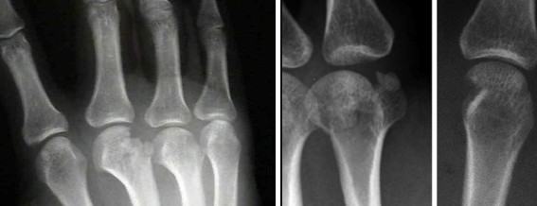
Metacarpal Head Fractures
Notes:
Rare: Metacarpal head fractures account for 4–5% of all metacarpal fractures. Often intra-articular and complex.

Slide 20
Indications
Nonoperative
  nondisplaced fractures or <20% of articular surface
Surgical
  >20% articular involvement or >1 mm step-off.
Notes:
Explain conservative management and criteria for avoiding surgery.

Slide 21
Surgical Techniques
closed reduction percutaneous pinning - Kirschner wires,
mini screws
mini plates
external fixation
Notes:
Review techniques and their indications.

Slide 22
Good Outcomes
Jing et al: 8 patients treated with percutaneous osteotomy and mini external fixator. Good outcomes at 1 year.
Lee et al: No difference in outcomes between K-wires, screws, or combination. All achieved union.
Teoh et al: ORIF with 1.2–2.3 mm screws. All fractures united with minimal complications.
Notes:
Metacarpal head fractures require individualized treatment. Surgical techniques vary with no clear superiority.

Slide 23
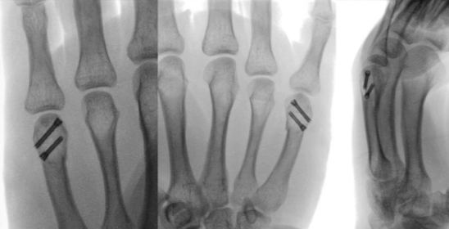
Intramedullary Fixation
Less studied but feasible with sufficient distal bone. May offer stability with minimal dissection.
Notes:
Introduce emerging technique and considerations.

Slide 24
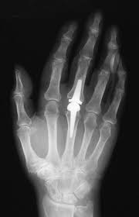
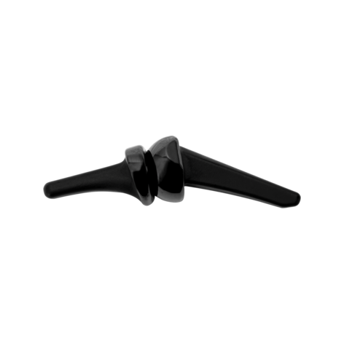
Arthroplasty Option
Houdek et al: Pyrocarbon MCP arthroplasty for unreconstructable fractures. No revisions at 4 years.
Notes:
Present alternative for severe cases.

Slide 25
Rehabilitation Protocols
Varies by fixation type. Options range from immediate ROM to splinting until K-wire removal.
Notes:
Tailor rehab to patient and fixation method.

Slide 26
Complications
Risk of arthritis due to intra-articular nature. Pin site infections, subsidence, stiffness.
Notes:
Counsel patients on long-term risks.

Slide 27
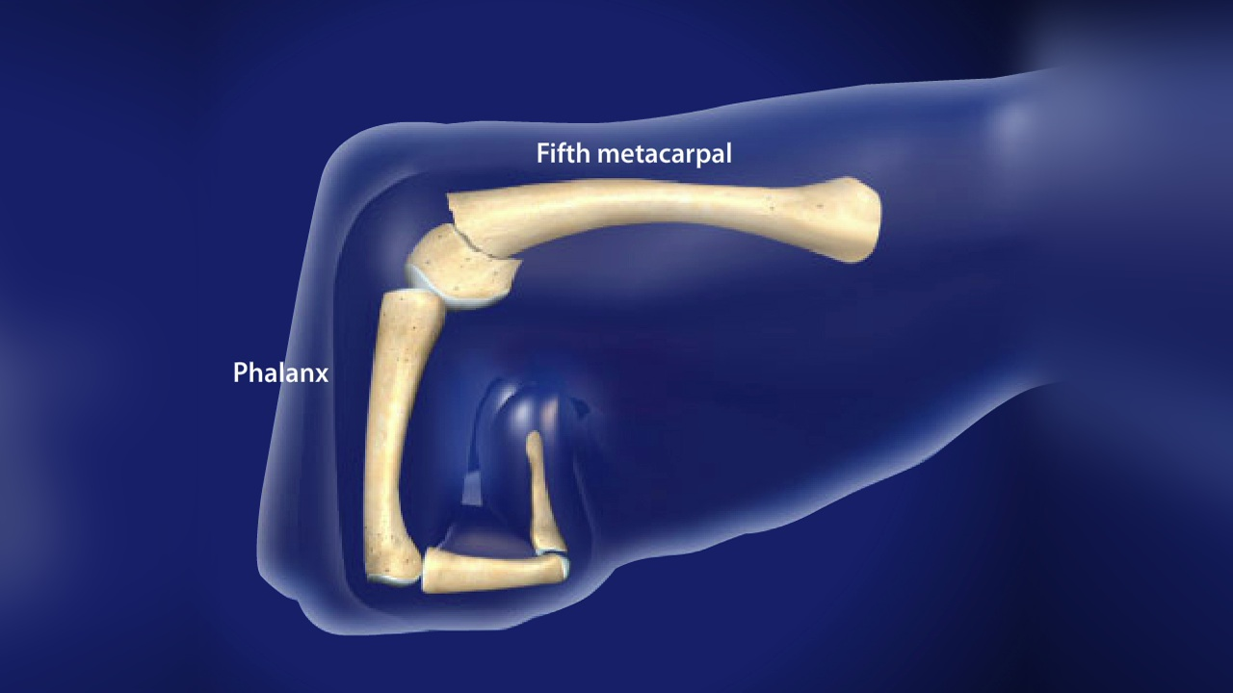
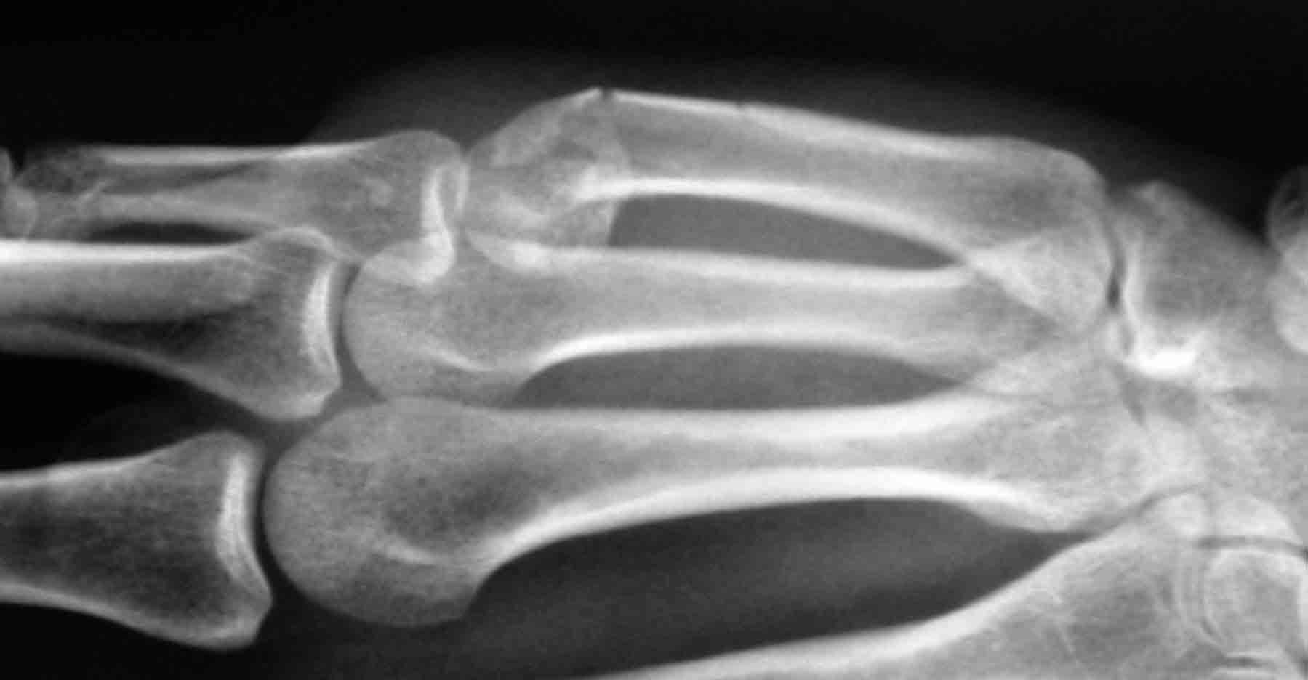
Metacarpal Neck Fractures
Notes:
Welcome to this presentation on Metacarpal Neck Fractures. We'll explore the clinical relevance, treatment options, and recent comparative studies to guide surgical decision-making.

Slide 28
Metacarpal Neck Fractures Overview
Metacarpal neck fractures account for 10% to 40% of hand fractures.
Commonly affect the fifth metacarpal (boxer's fracture) 5MCN
Incidence: 130/100,000.
Treatment is debated: conservative vs. surgical.
Notes:
Metacarpal neck fractures are among the most common hand injuries, accounting for up to 40% of hand fractures. The fifth metacarpal is most frequently affected due to its mobility and exposure to trauma.

Slide 29
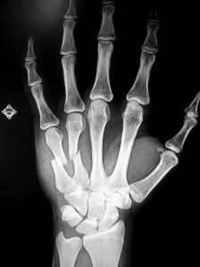
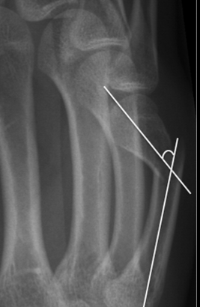
Surgical Indications
- Multiple fractures
- Open fractures
- Clinical malrotation
- Significant angulation
Angulation tolerance:
- Fifth metacarpal: up to 70°
- Index/middle fingers: 10°–15°
Notes:
Treatment options vary based on fracture characteristics. Nonsurgical management is common for fractures without malrotation or significant angulation. Surgical intervention is considered for complex cases.
The fifth metacarpal can tolerate up to 70° of angulation, while the index and middle fingers accommodate only 10°–15°. This anatomical difference influences treatment decisions.

Slide 30
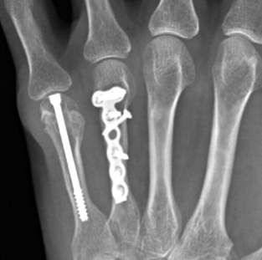
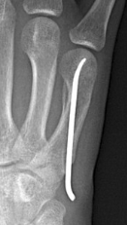
Surgical Techniques
- Kirschner wire (KW) fixation
- Intramedullary fixation (screws, nails)
- Interfragmentary screws
- Plate and screw fixation
Notes:
Surgical options include Kirschner wire fixation, intramedullary screws, interfragmentary screws, and plate fixation. Each has unique biomechanical and clinical implications.

Slide 31
Comparative Studies:
KW vs. Intramedullary
Avery et al: Headless screws > KW in axial load and failure.
Patel et al: Nails > KW in three-point bend strength.
Garcia-Lopez et al: Intramedullary > KW in stiffness and load to failure.
Notes:
Biomechanical studies show intramedullary screws offer superior load to failure and axial stability compared to Kirschner wires, suggesting better early mobilization potential.

Slide 32
Clinical Outcomes
Nelson et al: Plate vs. pin fixation
- High complication rate (48%)
- Stiffness most common
Huang et al: Plates vs. KW
- Plates: earlier return to work
- Similar ROM, union, grip strength, DASH scores
Notes:
Nelson, no difference plate vs pin in complications

Slide 33
Decision-Making Considerations
Factors:
- Fracture pattern
- Bone stock availability
- Surgeon preference
Intramedullary fixation:
- Early motion
- No percutaneous implants
KW fixation:
- Useful for minimal distal bone

Slide 34
Summary
Both KW and intramedullary fixation are effective.
Intramedullary may offer better biomechanics and earlier return.
Future studies needed to refine techniques and outcomes.
Notes:
Clinical studies comparing KW and IS fixation show similar outcomes in terms of motion and healing, but IS fixation may allow earlier return to work and better cosmetic results.
Kwires pin site infections

Slide 35
Metacarpal Shaft Fractures

Slide 36
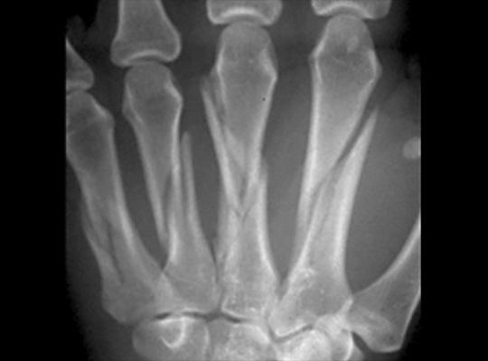
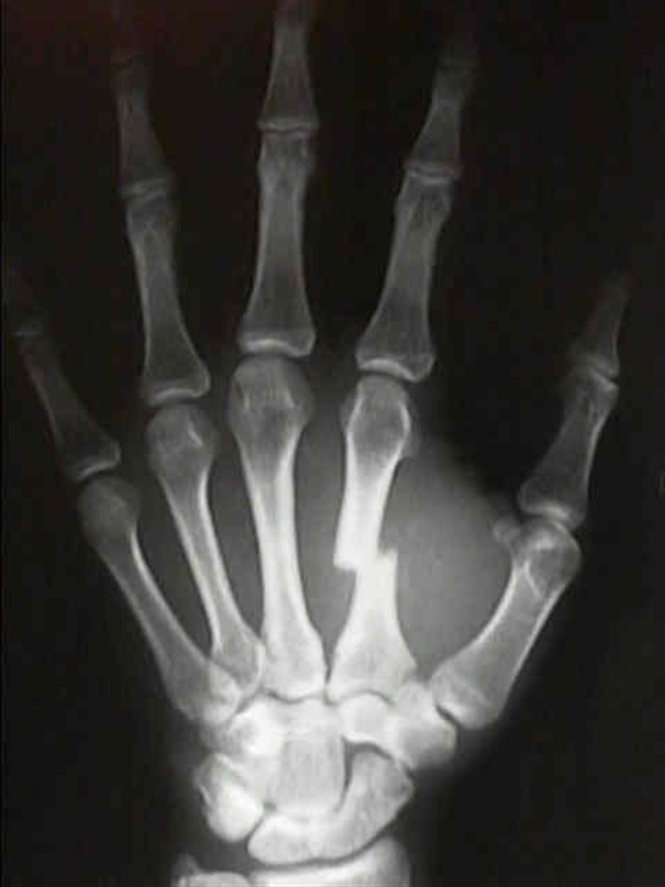
Fracture Patterns
Transverse
Spiral
Oblique
Comminuted
Notes:
This slide introduces the descriptive classification of metacarpal shaft fractures based on their pattern.

Slide 37
Indications
Nonsurgical
  Minimally displaced fractures
  No malangulation or malrotation.
Surgical
  Considered for angulation
  pseudoclawing
  rotational deformity
  dorsal tenting
Notes:
Discuss the criteria for choosing between nonsurgical and surgical treatment. Emphasize the lack of standardized deformity criteria.

Slide 38
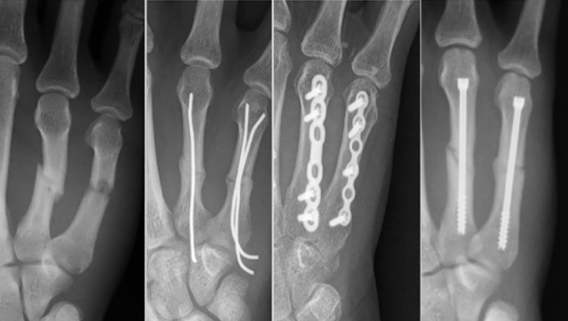
Surgical Fixation Techniques
- Kirschner wires (most common)
- Interfragmentary screws
- Plates and screws
- Intramedullary fixation
- External fixation
- Cerclage wiring (adjuvant)
Notes:
List and briefly describe the various surgical fixation techniques used for metacarpal shaft fractures.

Slide 39
Systematic Review by Taha et al.
Wide variability in management
No clear reporting parameters
No single technique shown to be superior
Notes:
Highlight the findings from Taha et al.'s review, emphasizing the need for standardized outcomes.

Slide 40
Vasilakis et al. (2019)
Compared CRPP vs ORIF
No difference in functional outcomes
Transverse fractures: better ROM with ORIF
Notes:
Discuss the retrospective comparison and its implications for choosing fixation strategies based on fracture type.

Slide 41
Kibar et al. (2022)
Compared intramedullary screws vs plate fixation
Similar outcomes in motion, grip strength, DASH, VAS, union rates
Intramedullary: shorter OR time, fewer complications
Notes:
Explain the advantages of intramedullary screws and their increasing popularity.

Slide 42
External Fixation
Used for open fractures, soft-tissue defects, osteomyelitis
Contraindications: osteoporosis, uncontrolled diabetes
Complications: infection, tendon irritation, nonunion
Notes:
Describe the indications and limitations of external fixator application.

Slide 43
Surgery Summary
No single superior treatment technique
Choice depends on fracture pattern and patient factors
Need for standardized outcomes and further research
Notes:
Wrap up the presentation by emphasizing individualized treatment and the importance of ongoing research.

Slide 44
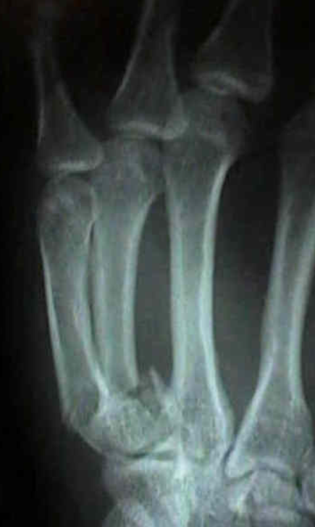
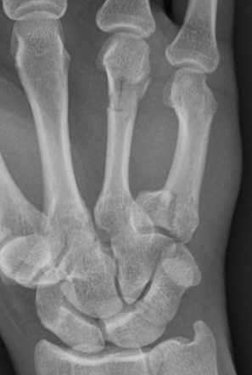
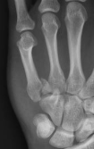
Metacarpal Base Fractures
Notes:
Welcome to this presentation on Metacarpal Base Fractures. Today, we'll explore the unique characteristics, diagnostic challenges, and treatment options for these relatively uncommon injuries.

Slide 45
Rarity and Diagnostic Challenges
• Metacarpal base fractures are relatively uncommon compared to neck and shaft fractures.
• Diagnosis is often difficult, leading to underdiagnosis and under-reporting.
• High index of suspicion is needed for patients with pain at carpometacarpal joints after axial load.
Notes:
Unlike metacarpal neck and shaft fractures, base fractures are less common. This may be due to diagnostic difficulties, leading to underdiagnosis or under-reporting. It's important to maintain a high index of suspicion when evaluating patients with pain at the carpometacarpal joints following axial loading.
Most common at 4th/5th

Slide 46
Anatomical Considerations
• Stability from carpometacarpal ligaments and interossei
• Motion increases ulnarly from second to fifth metacarpals
• Tendon insertions (ECRL, ECRB, ECU) can cause deforming forces and avulsion fractures
Notes:
The carpometacarpal ligaments and interossei provide inherent stability to the metacarpal bases. The second and third bases have minimal motion, while the fourth and fifth allow for grasp. This stability influences fracture displacement. Additionally, tendon insertions from ECRL, ECRB, and ECU can act as deforming forces and may lead to avulsion-type fractures.

Slide 47
Treatment Options
• Based on case reports and small series due to rarity
• Second metacarpal: surgical treatment to restore ECRL function
• Third metacarpal: surgical treatment may restore musculotendinous function
• Fourth and fifth metacarpals: immobilization in 30° wrist extension recommended.
Notes:
Treatment recommendations are based on limited data due to the rarity of these fractures. For the second metacarpal, surgical treatment is often preferred to restore ECRL function. Third metacarpal fractures are rare but may also require surgery. Fourth and fifth metacarpal fractures are initially treated with immobilization in 30° wrist extension to counteract extensor forces.

Slide 48
Outcomes from Studies
• Closed reduction and immobilization showed good results with low-grade arthrosis.
• Surgical treatment improved alignment in displaced fractures.
• Similar rates (~40%) of intermittent pain in both surgical and nonsurgical groups.
• 2023 study: >90% grip strength, 99–100% total active motion, low pain/disability scores.
Notes:
Studies show that both surgical and nonsurgical treatments can yield satisfactory outcomes. For minimally displaced fractures, closed reduction and immobilization have shown good results. For displaced fractures, surgical intervention improves alignment. A 2023 study by Park et al found excellent outcomes with both percutaneous pinning and open locked plating for fifth metacarpal base fractures.

Slide 49
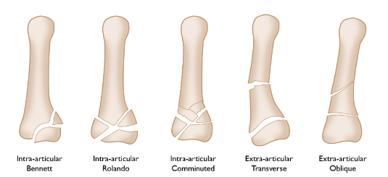
Thumb Metacarpal Fractures
Notes:
Welcome to the presentation on Thumb Metacarpal Fractures. We'll explore the anatomy, common fracture types, treatment options, and outcomes based on recent studies.

Slide 50
Overview
Thumb metacarpal fractures are most common at the base and account for 4% of all hand fractures
They require a different approach due to unique anatomy and function
Notes:
Thumb metacarpal fractures are most commonly seen at the base and account for 4% of all hand fractures. Due to the thumb's unique anatomy and function, these fractures require a different approach compared to finger metacarpals.

Slide 51
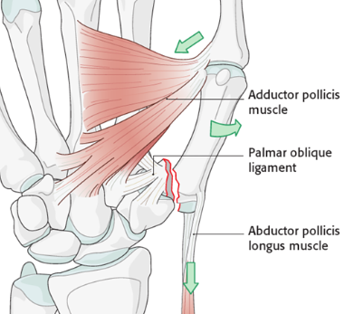
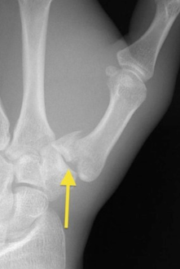
Bennett Fx
Notes:
Bennett fractures are intra-articular fractures at the base of the thumb. The fragment is attached to the anterior oblique ligament, and deforming forces from the abductor pollicis longus and adductor pollicis must be counteracted during reduction. Surgical treatment is preferred due to instability.

Slide 52
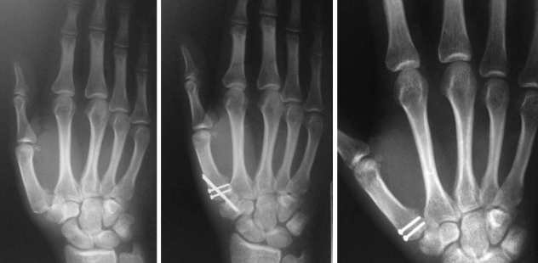
Bennett Fx
Notes:
Sometimes CRPP/pins, combo pins and screws, plate
Depends on subluxation, instability, greater 15-25% articular surface involvement

Slide 53
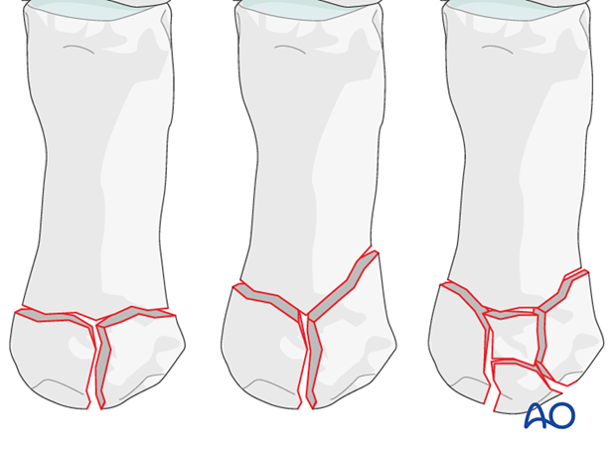
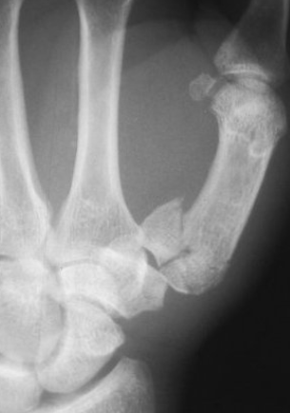
Rolando Fx
Notes:
Rolando fractures involve multiple fragments at the base of the thumb. Closed reduction is often unsuccessful, and open or arthroscopic reduction is recommended

Slide 54
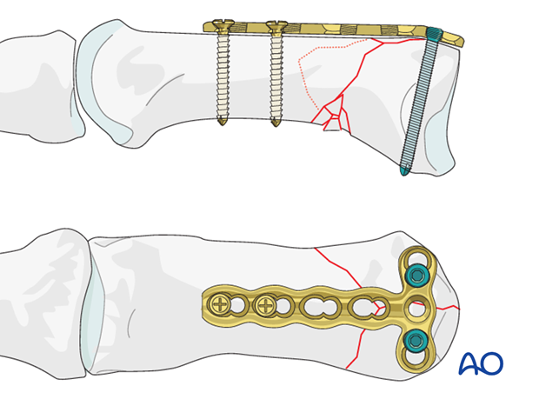
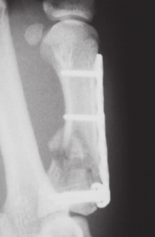
Rolando
Notes:
Usually plate, difficult to just pin or screw due to comminution

Slide 55
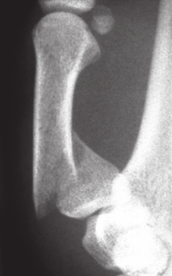
Extraarticular
Notes:
Extra-articular fractures of the first metacarpal base are more tolerant to nonsurgical treatment. However, deformity in adduction can narrow the first web space. Surgical intervention is recommended if displacement exceeds 30 degrees.
Fixation techniques: Percutaneous pinning, interfragmentary screws, plate and screw constructs, intramedullary fixation.

Slide 56
Outcomes from Studies
• Pechlaner et al (2003): Compared closed reduction with Kirschner wire vs open reduction
• No significant differences in motion, grip, or clinical outcome
• Percutaneous group had more adduction deformity, linked to arthritis but not symptoms
Notes:
Treatment options include closed reduction with percutaneous pinning or open reduction with internal fixation using screws, plates, or intramedullary devices. The choice depends on fracture type and displacement.

Slide 57
What are the national treatment trends?

Slide 58
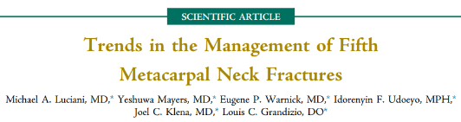
Luciani et al. JHS 2024
• Retrospective review of 611 5MCN Fx cases from 2012–2020 in a large healthcare system
Notes:
• Purpose: To describe management trends of fifth metacarpal neck (5MCN) fractures in a large healthcare system.
• Goals: Identify patient and surgeon factors associated with surgical vs. nonsurgical treatment and ED-only care.

Slide 59
Key Results and Trends
• 5MCN fractures: 90% nonsurgical 10% surgically
• No nonsurgical cases required later surgery for nonunion or malunion
• Use of soft dressings increased over time; >20% by 2020
• Factors increasing likelihood of surgery: higher angulation, associated injuries, workers' compensation, treatment by hand surgeon
• 21% of patients received care only in the ED.

Slide 60
Conclusions and Implications
• Most 5MCN fractures can be managed nonsurgically with good outcomes
• Increasing trend toward soft dressing use reflects evolving practice
• Surgical treatment influenced by clinical and demographic factors
• ED-only care common among patients with mental health conditions
• Findings support reevaluation of surgical indications and follow-up protocols
Notes:
Good data showing neck fractures can be treated nonop, what about shaft?

Slide 61
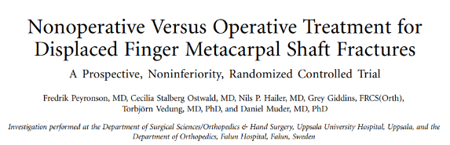
Peyronson et al JBJC 2022
• RCT with 42 patients
• Nonoperative: unrestricted mobilization
• Operative: screw fixation
• Primary outcome: grip strength at 1 year
• Secondary outcomes: DASH score, ROM, complications, sick leave, costs
Notes:
Compared nonoperative vs operative treatment for displaced finger metacarpal shaft fractures

Slide 62
Main Results
• Grip strength: Nonoperative 104%, Operative 96% (vs contralateral hand)
• DASH scores low and similar in both groups
• Metacarpal shortening: greater in nonoperative group
• Complications: 1 minor (nonoperative), 7 total (operative)
• Sick leave: 12 days (nonoperative) vs 35 days (operative)
• Costs: $1,347 (nonoperative) vs $3,834 (operative)
Notes:
Both groups had comparable functional outcomes, but the operative group had more complications, longer sick leave, and higher costs.
No difference in grip strength, motion, DASH scores.
Nonsurgical: shorter sick leave, lower cost.
Surgical: less radiographic shortening, more complications

Slide 63
Conclusions and Implications
• Nonoperative treatment is noninferior to operative treatment
• Comparable outcomes despite metacarpal shortening
• Lower costs and shorter sick leave with nonoperative approach
• Nonoperative treatment should be advocated for single MSFs
Notes:
This slide presents the study's conclusion that nonoperative treatment is effective and preferable for single metacarpal shaft fractures due to similar outcomes and reduced costs.

Slide 64
Daher et al. (2023)
ORIF minimizes fracture shortening.
Nonsurgical: higher DASH scores (mean difference 1.59).
No difference in grip strength.
Notes:
Present the findings from the meta-analysis comparing surgical and nonsurgical treatments.

Slide 65
Nonop Treatment
Closed Reduction or Early Mobilization?
Notes:
Welcome to this presentation summarizing key findings from a study on closed reduction of fifth metacarpal neck fractures. We'll review the study's purpose, methodology, results, conclusions, and clinical implications.

Slide 66
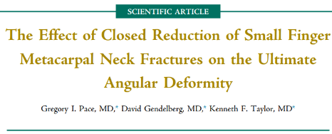
Pace et al 2015 JHS
To assess whether attempted closed reduction of 5MCN Fx results in decreased fracture angulation at final follow-up
Notes:
The study aimed to determine whether attempting closed reduction of fifth metacarpal neck fractures leads to improved fracture angulation at final follow-up.

Slide 67
Methodology
Retrospective chart review of patients aged 18+ treated for isolated fifth metacarpal neck fractures (2004–2014)
Excluded: multiple fractures, open fractures, rotational deformity, surgical treatment
Two groups: attempted reduction vs. no reduction
Fracture angles measured on oblique radiographs
Notes:
This was a retrospective chart review of patients aged 18 and older treated for isolated fifth metacarpal neck fractures between 2004 and 2014. Patients with multiple fractures, open fractures, rotational deformity, or surgical treatment were excluded. Fracture angles were measured using oblique radiographs, and patients were divided into two groups: those who had attempted reduction and those who did not.

Slide 68
Results
66 patients included: 23 with attempted reduction, 43 without
Initial reduction showed statistically significant improvement in angulation
However, no significant difference in final angulation between groups
Reduction often lost during healing
Notes:
Out of 66 patients, 23 underwent attempted reduction and 43 did not. While initial reduction showed a statistically significant improvement in angulation, this improvement was not maintained at final follow-up. Both groups had similar final fracture angles, indicating that reduction was often lost during healing.

Slide 69
Conclusions
Closed reduction and splint immobilization did not maintain improved alignment.
Alternative treatments like pin fixation or ORIF should be considered when reduction maintenance is desired.
Notes:
The study concluded that closed reduction followed by splint immobilization does not effectively maintain improved fracture alignment. Therefore, alternative treatments such as pin fixation or open reduction internal fixation (ORIF) should be considered when maintaining reduction is important.

Slide 70
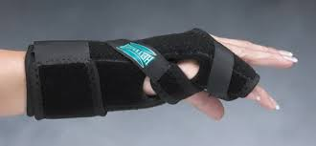
Splint or Not?
Notes:
Clinically, this suggests that routine closed reduction may not be necessary unless there is rotational deformity. Emphasis should be placed on value-based care, focusing on outcomes relative to cost. Conservative management remains appropriate unless specific indications for reduction exist.

Slide 71
Steller et al 2003 5MCN
Indications: No malrotation, acceptable angulation. < 70 degrees 5MCN
Methods:
  - Cast immobilization (3 weeks)
  - Bandage (1 week) followed by mobilization
  - Buddy taping with immediate motion
Outcomes: No significant difference in ROM, satisfaction, or pain.
Notes:
Several studies have shown that nonsurgical treatments like buddy taping or short-term splinting yield satisfactory outcomes for fifth metacarpal fractures without malrotation.

Slide 72
van Aaken et al 2007
prospective review
  5MCN treated with simple buddy taping & immediate ROM
Key Findings:
  Satisfactory outcomes
  No loss of grip strength
  Union of all fractures
  High patient satisfaction

Slide 73
Strub et al 2010
  IM (bouquet osteosynthesis) vs splint and early motion 30-70 degrees
  No difference grip strength or MCP ROM
  Satisfaction high both groups
  Manual laborers
    Disturbance with tool holding
    > 50% dissatisfied cosmesis

Slide 74
Summary
Early ROM is key
Splinting vs soft dressing/buddy taping achieves similar functional outcomes and patient satisfaction

Slide 75
Surgical Rehab
Healing stages
Inflammatory Phase
Early repair Phase
Late Repair Phase
Remodeling Phase
Reintegration Phase
Notes:
Introduce the rehabilitation timeline. Explain that recovery is divided into phases based on healing stages.

Slide 76
Weeks 0–2: Inflammatory Phase
Goals:
- Protect surgical site, reduce swelling, initiate gentle motion
Care:
- Post-op dressing and splint in place
- Hand elevated above heart
- Gentle fist-making exercises (unless pins are placed)
- Light activities (e.g., eating, typing)
Precautions:
- No motion of pinned fingers
- Avoid soaking wounds
Notes:
Discuss the goals of the inflammatory phase: protecting the surgical site and reducing swelling. Emphasize elevation and gentle motion.

Slide 77
Weeks 2–4: Early Repair Phase
Goals:
- Promote tissue healing, begin active motion
Care:
- Sutures removed
- Scar massage and desensitization
- Aggressive active finger ROM
- Self-assisted passive ROM with support under metacarpal heads
- Splint worn full-time except during exercises
Notes:
early repair phase. Highlight the importance of active motion and scar management. Mention splint usage during exercises.

Slide 78
Weeks 4–6: Late Repair Phase
Goals:
- Restore range of motion, begin light functional use
Care:
- Splint may be removed for light activities (up to 2 lbs)
- Continue aggressive active and passive ROM
Precautions:
- Avoid axial loading (e.g., push-ups, lifting)
Notes:
Describe the late repair phase. Focus on restoring range of motion and beginning light functional use. Caution against axial loading.

Slide 79
Weeks 6–10: Remodeling Phase
Goals:
- Strengthening and proprioception
Care:
- Wean off splint completely
- Begin strengthening exercises (only with full, pain-free ROM)
- Introduce resistance exercises and functional tasks
Notes:
Talk about the remodeling phase. Stress the importance of strengthening only after achieving pain-free ROM. Introduce resistance exercises.

Slide 80
Weeks 10–12+: Reintegration Phase
Goals:
- Return to normal function and endurance
Care:
- Resume occupational and personal activities
- Functional bracing only during high-risk tasks
- Continue proprioceptive training and endurance building
Notes:
Summarize the reintegration phase. Encourage return to normal activities with functional bracing during high-risk tasks.

Slide 81
Clinical Considerations
Avoid prolonged immobilization (>4 weeks) to prevent stiffness
Monitor for complications like swelling, extensor lag, or complex regional pain syndrome
Tailor rehab to fracture type, fixation method, and patient needs

Slide 82
Conclusion
Metacarpal Fractures Common Injury
young working males
5MCN & Shaft Fxs majority of injuries
Surgical outcomes are favorable when indicated
Most can be treated nonop with early motion +/- splinting
Notes:
Nonop high patient satisfaction and good functional scores

