Slide 1





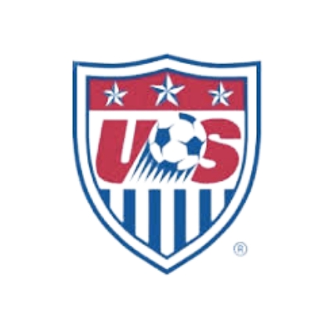
Articular Cartilage Injuries of the Knee
Daniel S. Lamar, M.D.
Notes:
Welcome everyone. Today we’ll discuss articular cartilage and knee injuries, starting with anatomy and moving through treatment options. The focus will be on what’s most relevant for physical therapists.

Slide 2
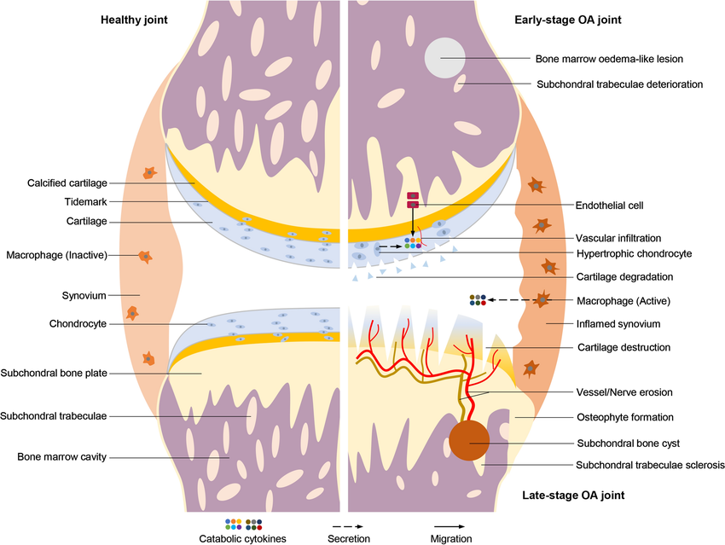

Anatomy of Articular Cartilage
Covers ends of bones in synovial joints
Composed of chondrocytes and extracellular matrix
Avascular and aneural
Provides smooth surface for articulation
Absorbs shock and distributes load
Notes:
Articular cartilage covers the ends of bones in synovial joints. It is unique because it’s avascular and aneural. This allows smooth motion and shock absorption but also means limited healing capacity.

Slide 3
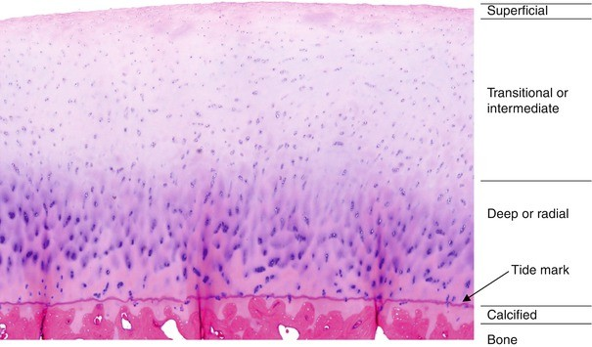
Structure of Articular Cartilage
Superficial zone: collagen fibers aligned parallel
Middle zone: random fiber orientation, shock absorption
Deep zone: fibers perpendicular, resist compression
Calcified zone: anchors cartilage to subchondral bone
Notes:
The cartilage has four zones: superficial, middle, deep, and calcified. Each contributes differently to joint mechanics and durability.

Slide 4
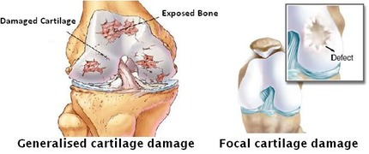
Common Injuries of Knee Cartilage
Discreet- focal injuries
  Trauma/ vascular
Diffuse- degenerative cartilage wear
  Arthritis
Notes:
Cartilage injuries can be chondral, osteochondral, or degenerative. Often, they are associated with ligament or meniscus injuries. This is key for PTs since rehab often involves multiple structures.

Slide 5
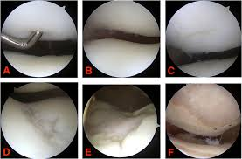
Outerbridge Arthroscopic Grading System
Grade -Normal cartilage
Grade I-Softening and swelling (noted with tactile feedback with probe)
Grade II -Partial-thickness defect with surface fissures (do not reach subchondral bone or exceed 1.5 cm in diameter)
Grade III -Deep fissures at the level of subchondral bone with a diameter more than 1.5 cm
Grade IV -Exposed subchondral bone

Slide 6
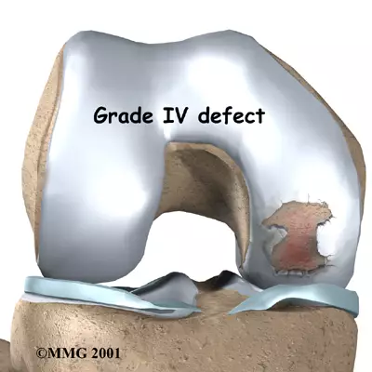
Symptoms of Cartilage Injuries
Pain, especially with activity
Swelling and stiffness
Locking or catching sensation
Decreased range of motion
Instability in advanced cases
Notes:
Patients typically report pain, swelling, stiffness, and sometimes locking. As PTs, recognizing these symptoms helps guide early interventions and referral if needed.

Slide 7
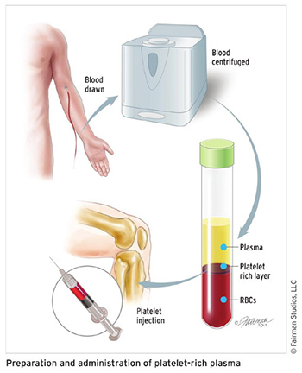
Non-Surgical Treatments
Rest and activity modification
Physical therapy and strengthening
NSAIDs for pain relief
Injections (corticosteroids, hyaluronic acid, PRP)
Bracing or orthotics
Notes:
Non-surgical treatments focus on reducing symptoms and improving function. PT has a major role here, alongside activity modification, medications, and injections.

Slide 8
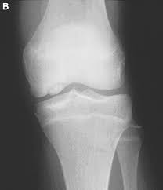
Surgical Options
Arthroscopic debridement and lavage
Microfracture technique- marrow stimulation
OCD repair
Osteochondral autograft/ allograft transfer (OATS)
Matrix-induced autologous chondrocyte implantation (MACI)
Partial or total knee replacement in severe cases
Notes:
Surgical treatments are chosen when conservative measures fail. Techniques like microfracture and grafts aim to restore cartilage, while replacements are last resorts. PT supports recovery in every stage.

Slide 9
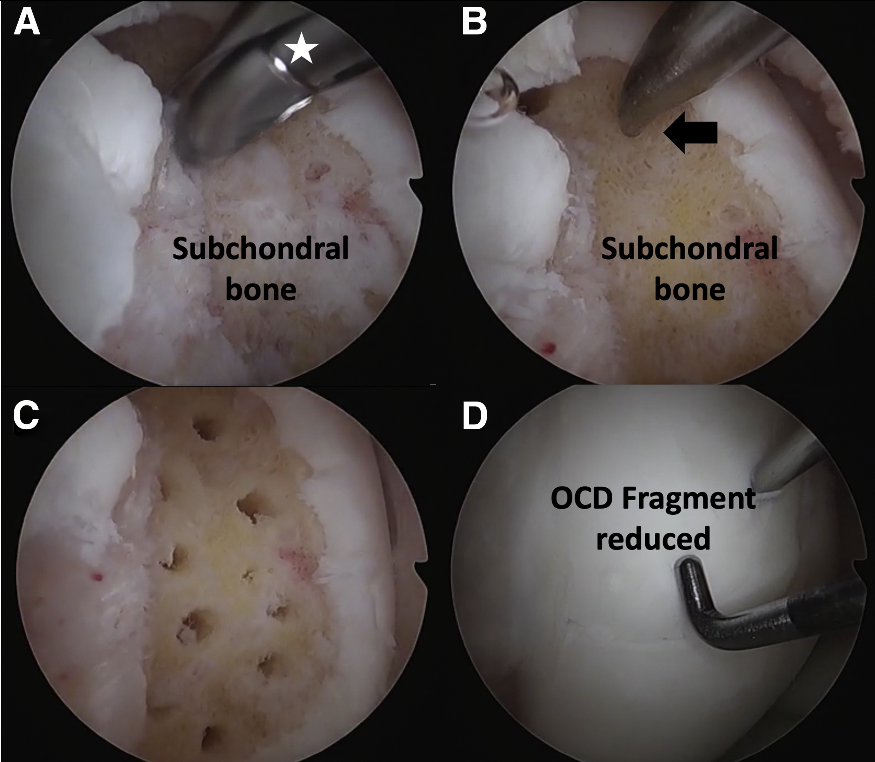
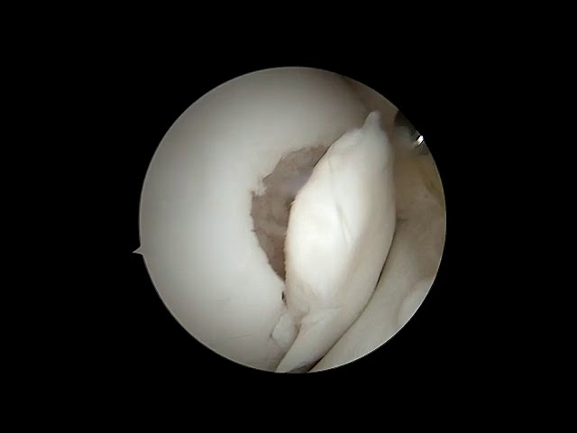
OCD lesions- Pick/abrasion

Slide 10
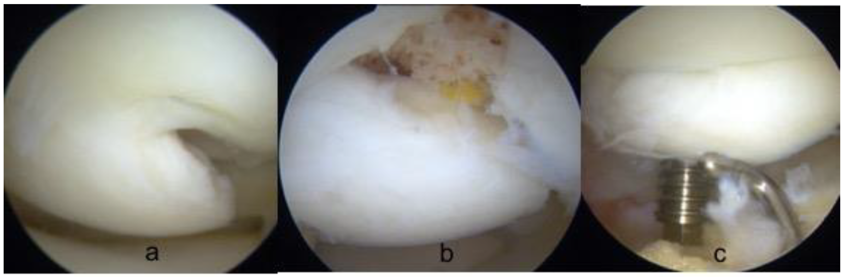
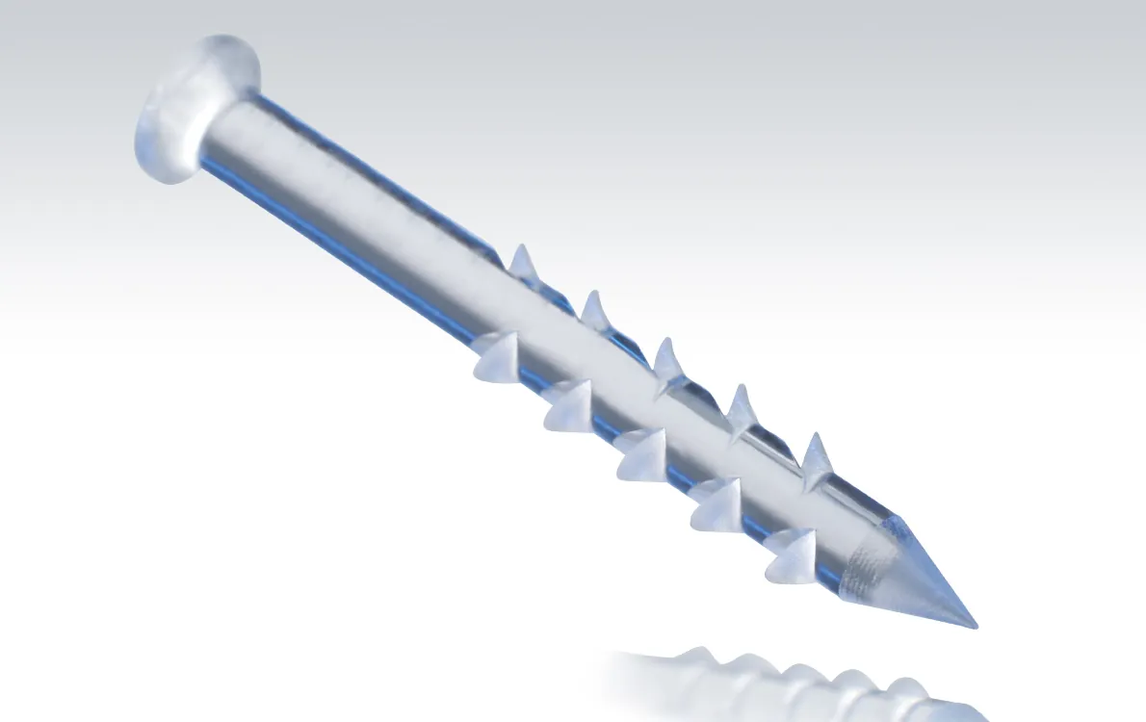
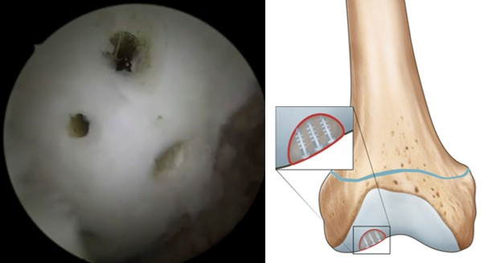
OCD Repair- internal fixation

Slide 11
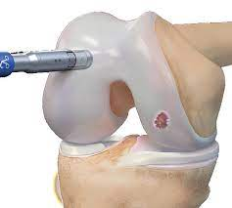
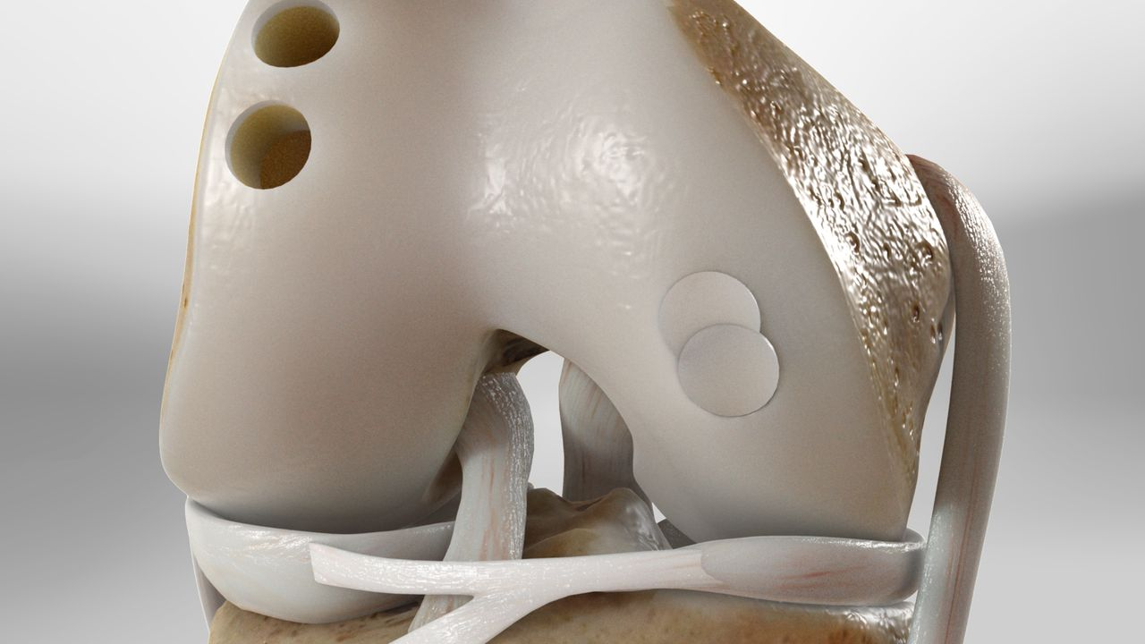
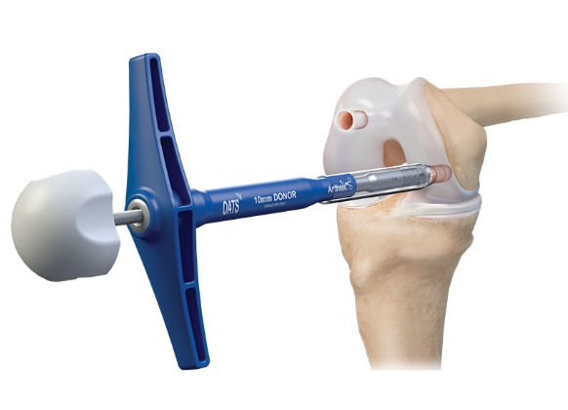
OATS- Auto vs Allo

Slide 12
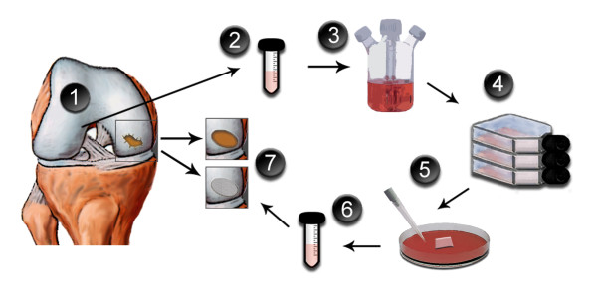
MACI

Slide 13
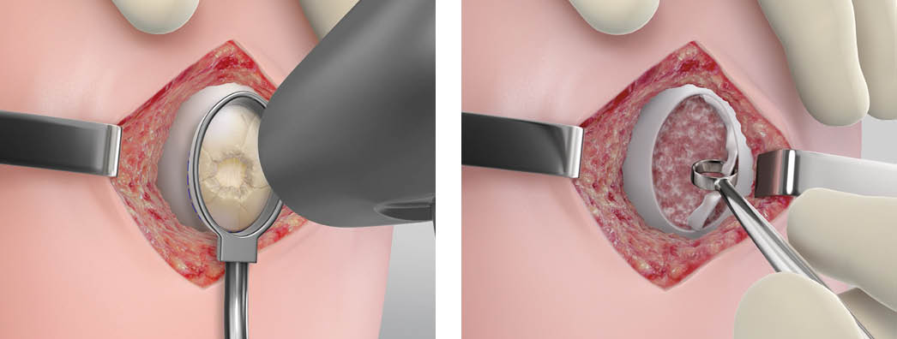
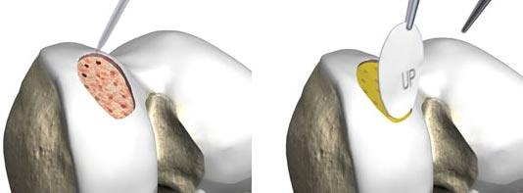
MACI

Slide 14
Role of Physical Therapy in Cartilage Injuries
Early intervention: restore range of motion, reduce swelling
Strengthening: quadriceps, hamstrings, gluteal muscles
Neuromuscular training: balance and proprioception
Gradual weight-bearing progression after surgery
Return-to-sport protocols individualized per patient
Ongoing education to prevent re-injury and manage OA risk
Notes:
Physical therapy is critical post-treatment. Early work focuses on motion and swelling, then progresses to strengthening, neuromuscular training, and sport-specific rehab. PTs also educate patients to prevent reinjury.

Slide 15
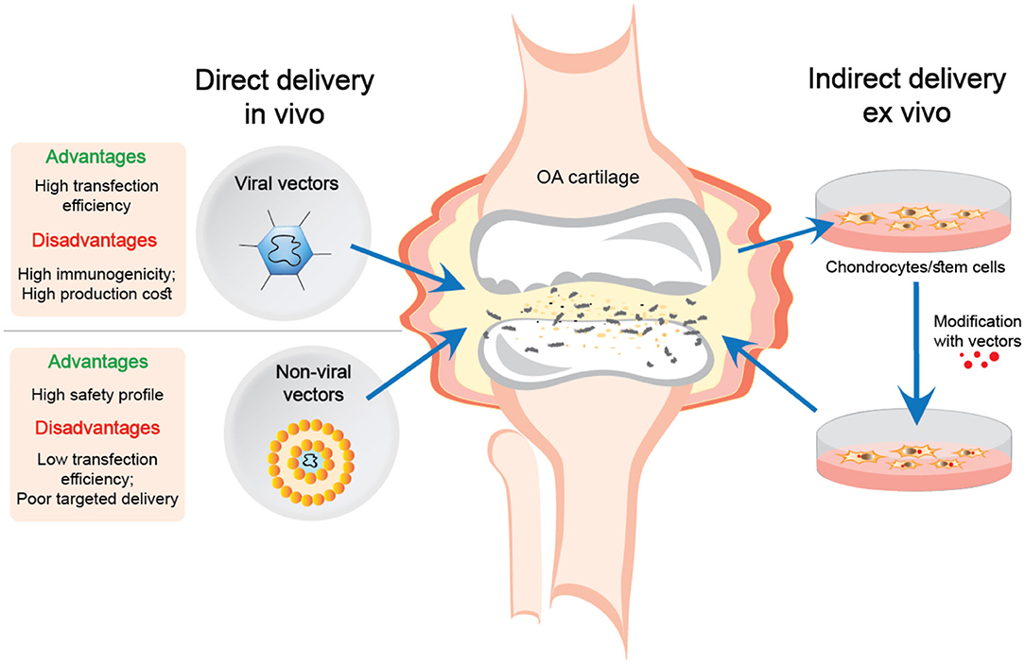
Future Directions in Cartilage Repair
Tissue engineering – Zonal scaffolds
Stem cell–based therapies- improve signaling/targeting
Gene therapy approaches- less vulnerable
Notes:
Research is advancing toward biologics, stem cells, and 3D tissue engineering. These will eventually impact rehab strategies, so it’s important to stay current.

Slide 16
Thank You

