Slide 1
Ankle Sprains 2025
Javier Guzman, MD

Slide 2
Introduction
>3 million ankle sprains will present to the Emergency department. Prevalence likely to be significantly higher
40% of all sports trauma injuries
Basketball (41.1%), American football (9.3%), and soccer (7.9%)
Notes:
Evidence-based clinical practice guidelines
for the management of acute ankle injuries
according to: a PRISMA systematic review
and quality appraisal with AGREE II

Slide 3
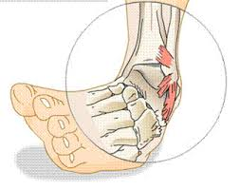
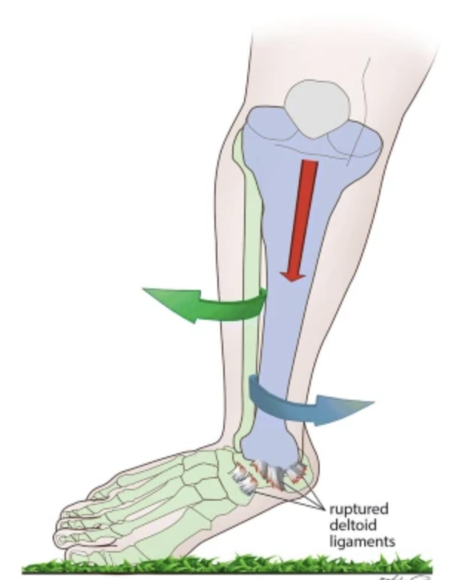
Mechanism
Forced inversion of a plantarflexed foot: anterior talofibular ligament (ATFL) is weakest and most often torn, followed by the calcaneofibular ligament (CFL)
High Ankle (syndesmotic) sprains (dorsiflexion/external rotation injuries) are less common.

Slide 4
Classification
Grade | Hematoma/swelling/pain | Anterior drawer test | Talar tilt test | Anatomic lesion | Stability
I | Positive | Negative | Negative | Incomplete tear of ATFL | Stable
II | Positive | Positive | Negative | Complete tear of ATFL, incomplete tear of CFL | Unstable
III | Positive | Positive | Positive | Complete tear of ATFL, complete tear of CFL | Unstable

Slide 5
Acute Treatment 24-72 hours
RICE therapy (rest, ice, compression, and elevation)
REST reduces the metabolic rate of tissue, which decreases the amount of blood circulating in the damaged area.
ICE: induces vasoconstriction, brings down the temperature, and diminishes the metabolic rate of cells. Ice provides analgesic
COMPRESSION: limits the swelling and stops hemorrhaging
ELEVATION: improves lymph drainage and venous circulation
Notes:
Acute Ankle Sprain Management: An Umbrella Review of Systematic Reviews

Slide 6
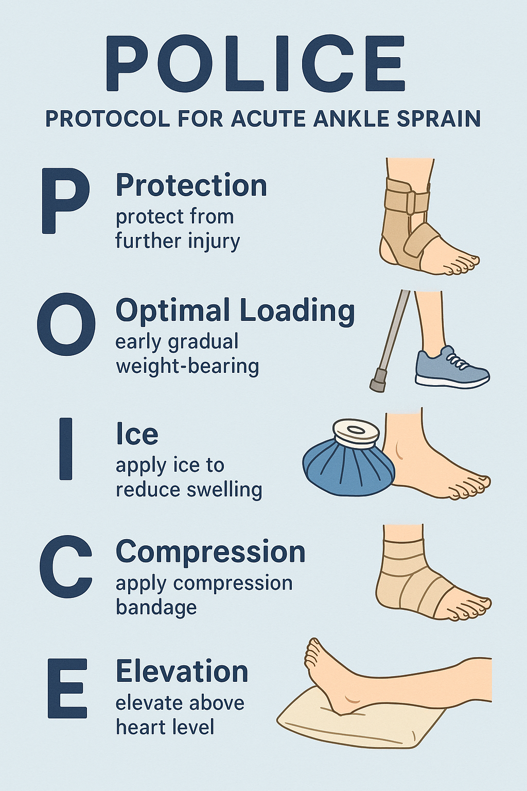
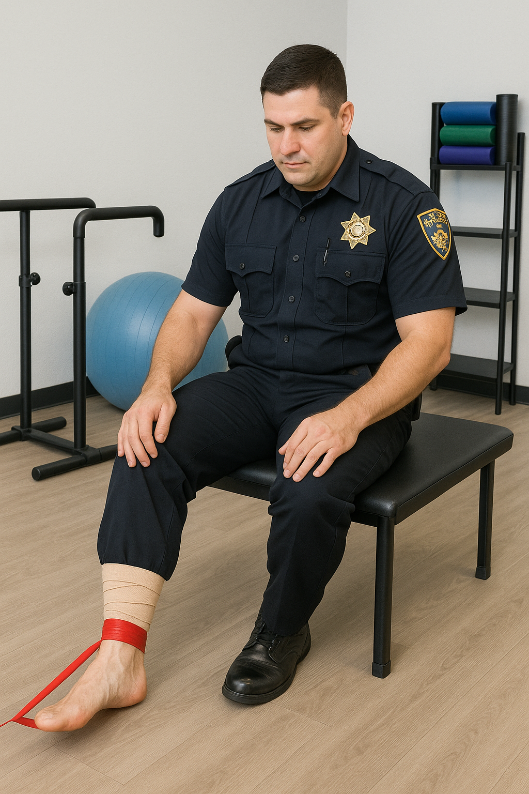

Slide 7
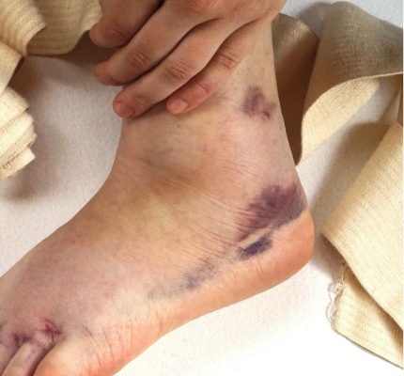
NSAIDS? YAY or NAY
NSAIDs are usually prescribed in an oral or topical form, which are both more eﬀective than a placebo.
Side eﬀects: NSAIDs and opioids would be equivalent
My recommendation:
  Consider Celebrex (Short term)
  If younger, OTC NSAIDS short term such as ibuprofen may be effective
  Opioids reserved for patients unable to tolerate NSAIDS
  ALLOWS FASTER TIME TO OPTIMAL LOAD

Slide 8
Functional ReHab
Functional treatment represents a better choice than immobilization.
Key Goals: Restore ANKLE DORSIFLEXION and prevent joint stiﬀness
risk factors for recurrent sprains and chronic joint instability.
Work on Decreasing swelling, ROM limitations, joint stiﬀness, and joint instability.
Return earlier to their pre-injury work and sports activities
Notes:
8. Jones MH, Amendola AS. Acute treatment of inversion ankle sprains:
immobilization versus functional treatment. Clin Orthop Relat Res. (2007)
455:169–72. doi: 10.1097/BLO.0b013e31802f5468
19. Kemler E, van de Port I, Backx F, van Dijk CN. A systematic review on the
treatment of acute ankle sprain: brace versus other functional treatment types.
SportsMed.(2011) 41:185–97. doi: 10.2165/11584370-000000000-00000
20. Kerkhoﬀs GM, Rowe BH, Assendelft WJ, Kelly KD, Struijs PA, van Dijk
CN. Immobilisation for acute ankle sprain. A systematic review.ArchOrthop
TraumaSurg.(2001) 121:462–71. doi: 10.1007/s004020100283
21. Ortega-Avila AB, Cervera-Garvi P, Marchena-Rodriguez A, Chicharro-Luna
E, Nester CJ, Starbuck C, et al. Conservative treatment for acute ankle sprain:

Slide 9
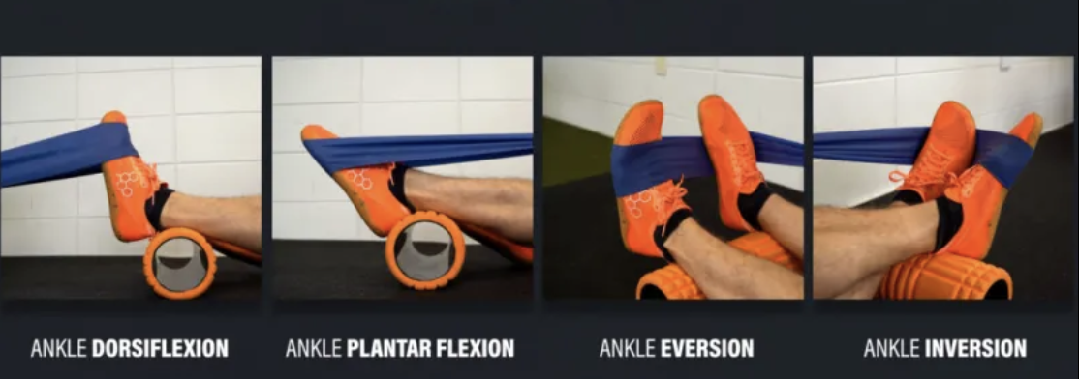
Rehab Exercises
Active circumduction mobility
Active PF / DF mobility
Static Muscle strengthening: EV / IN / PF / DF
Calf
Stretching

Slide 10
Chronic Ankle INstability
Persistent ankle instability, “giving way (generally ≥6 months post-injury)
01
Objective
Subjective
10-30% of ankle sprains can go on to Chronic Ankle Instability
02
Increased risk of arthritis, osteochondral lesions, and falls
03

Slide 11
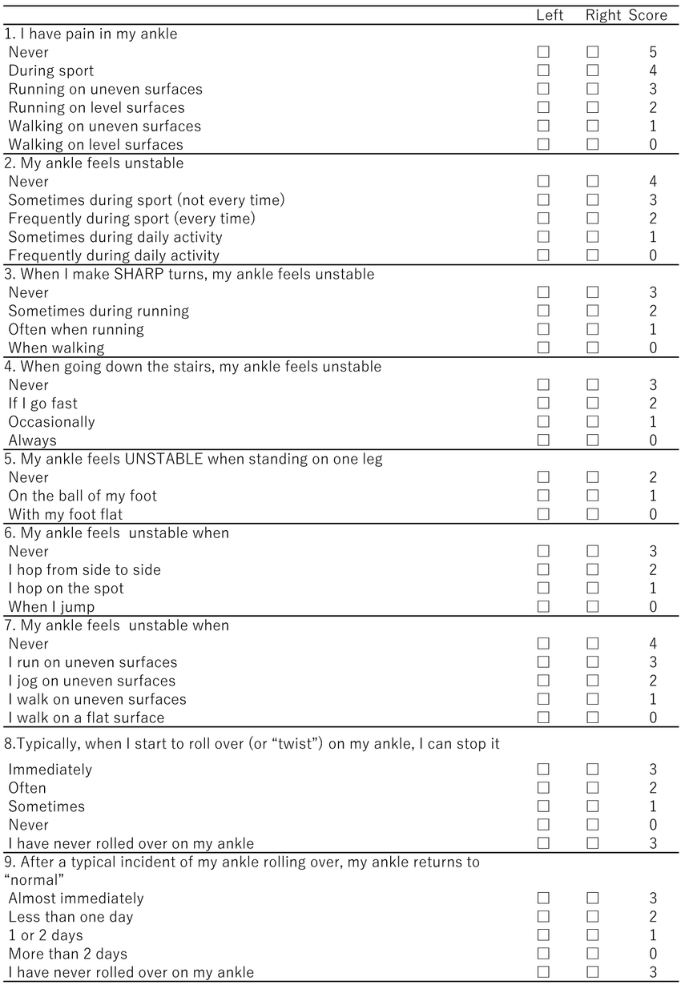
Cumberland
Ankle
Instability Tool (CAIT)
≤ 25 can indicated chronic ankle instability
Notes:
Just repeat the questions for them in the presentation

Slide 12
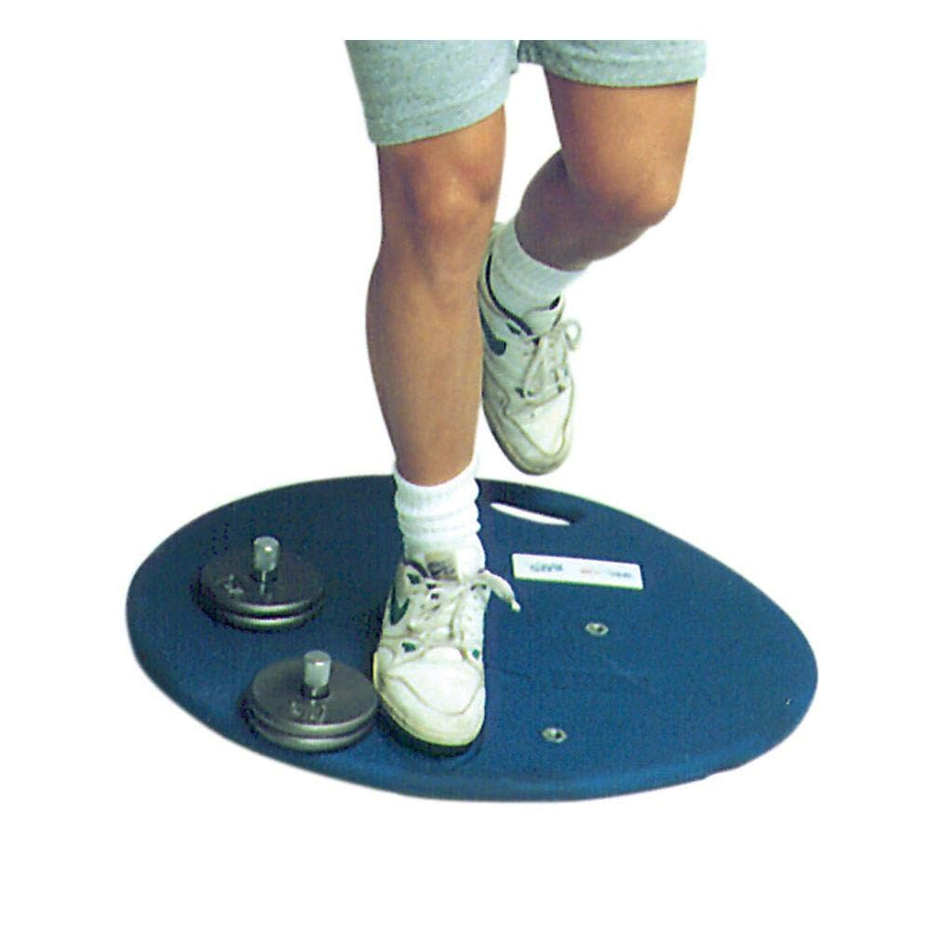
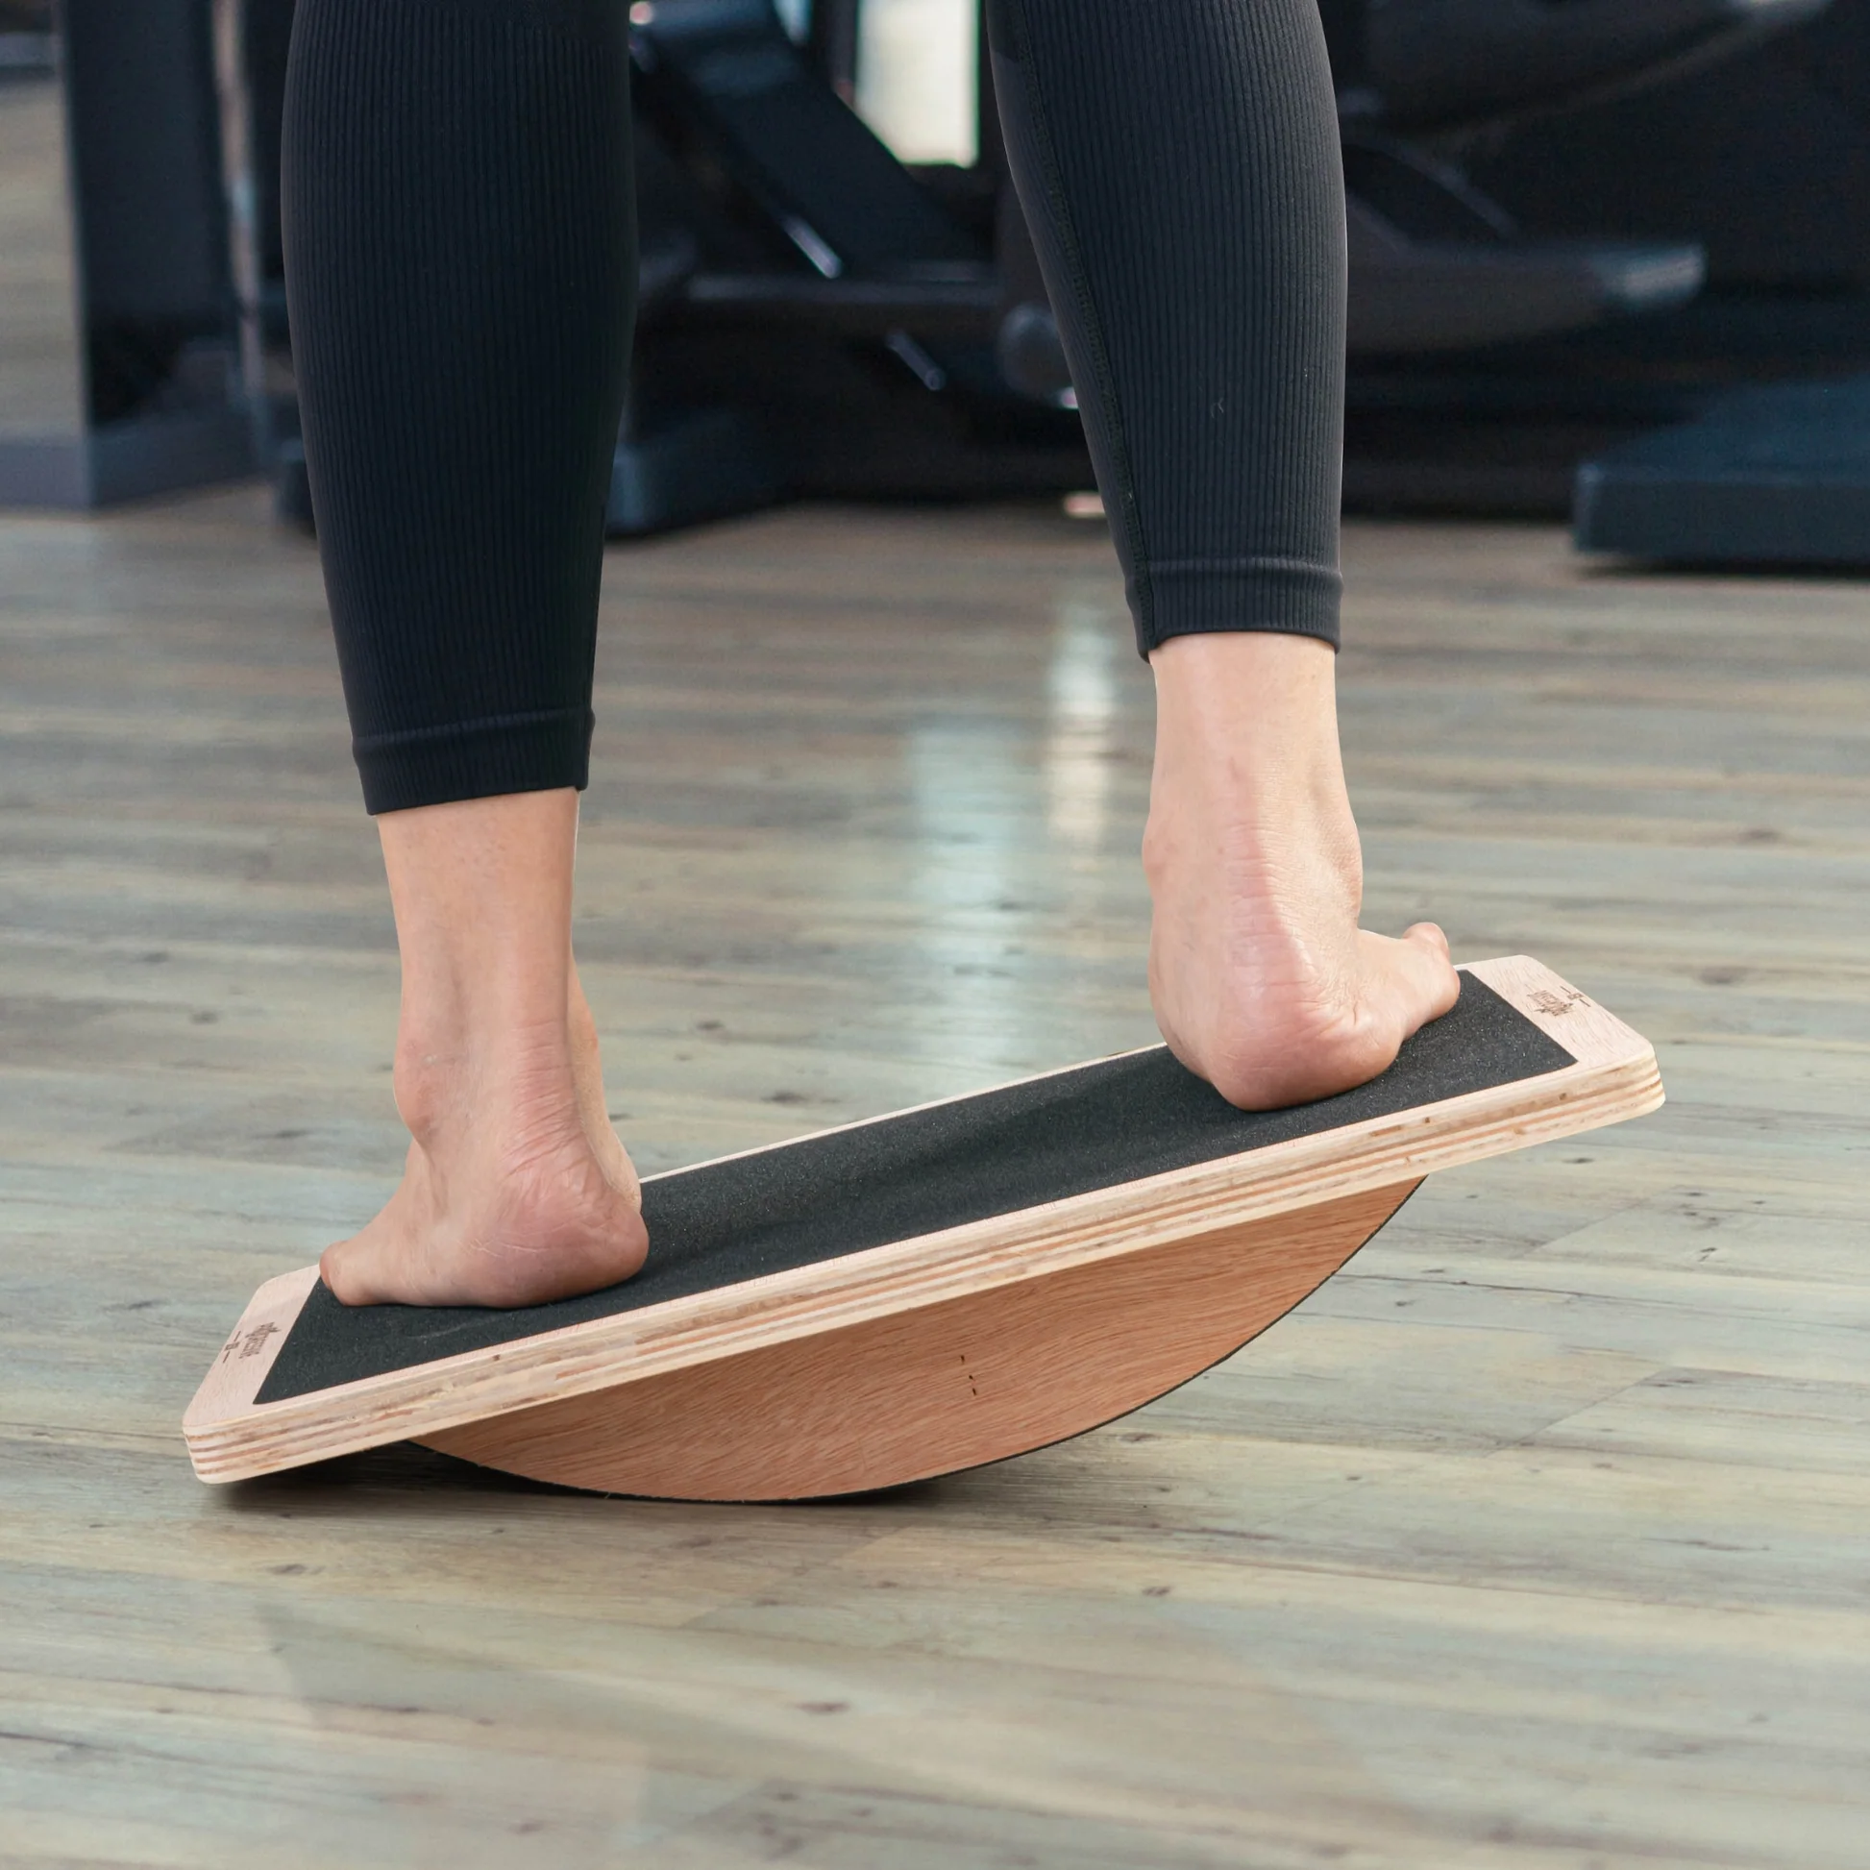
Treatment for Chronic Ankle Instability
REHAB IS FIRST LINE TREATMENT
  Traditional balance and strength training(COMBINE BOTH, BUT PROPRIOCEPTION IS MORE IMPORTANT)
  Wobble boards and (Biomechanical Ankle Platform System(BAPS) systems
  Stroboscopic vision training (sensory deprivation to enhance proprioception)

Slide 13
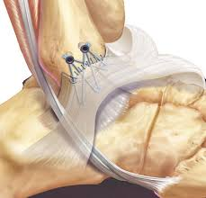
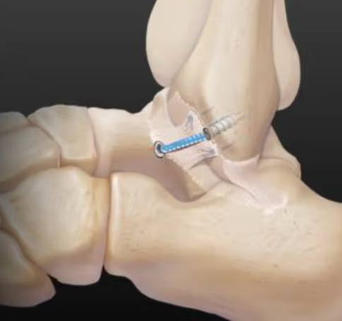
Surgical Treatment
Lateral ligament reconstruction +/- Arthroscopy
Can be performed arthroscopically
Augmented repair(internal brace)

Slide 14
Return to preinjury level
90 + percent will return to play
Augmented repair may be able to come back at 12 weeks
Nonaugmented Repair 6 months
Notes:
Outcomes and Return to Sports Following the Ankle Lateral Ligament Reconstruction in Professional Athletes: A Systematic Review of the Literature
Is Internal brace augmentation a gold standard treatment compared to isolated Modified Brostrom Gould repair for chronic lateral ligament ankle instability? Effect on functional outcome and Return to preinjury activity: A retrospective analysis

Slide 15
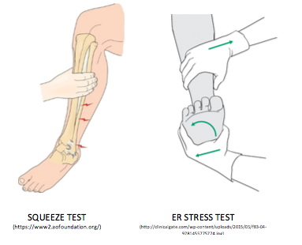
What about High Ankle Sprains?
When to suspect?
  Patient has pain
  and difficulty with WB
  Pain is above the ankle
Notes:
Go over test briefly here

Slide 16
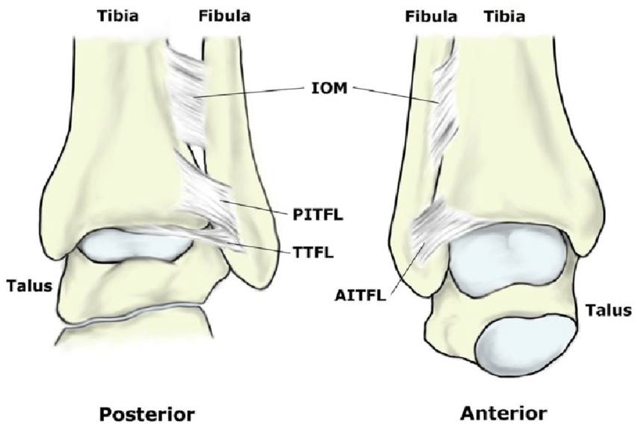
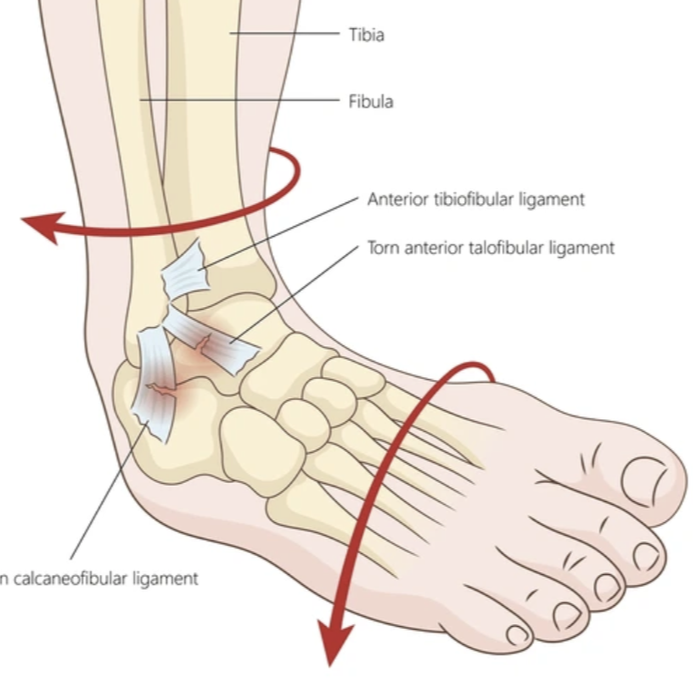
High ankle Vs Traditional SPrain
Notes:
AITFL/PITFL, TTFL/ IOM/interosseous ligament

Slide 17
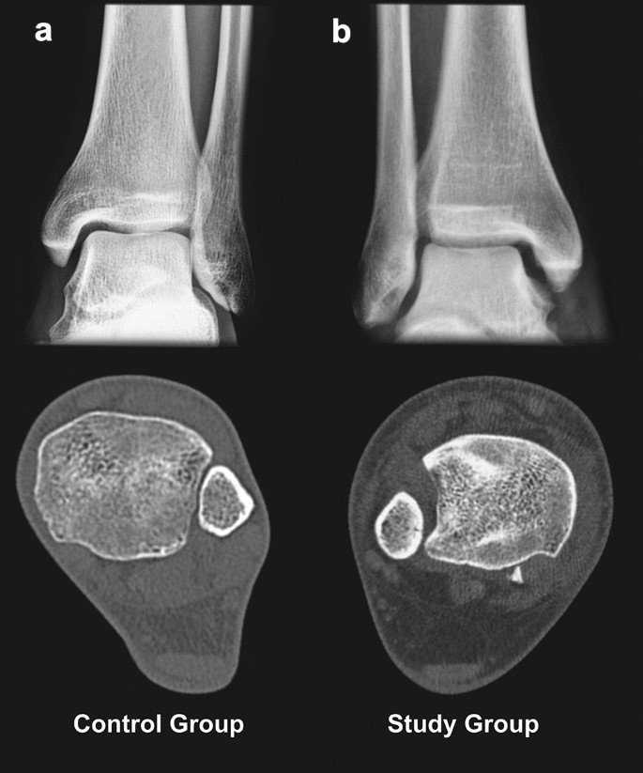
Why does it matter?
High ankle sprain recovery may be longer
Will not get better if not treated correctly
If suspect, obtain an MRI/CT to evaluate
  A. Syndesmosis injury
  B. Cartilage lesions in the ankle

Slide 18
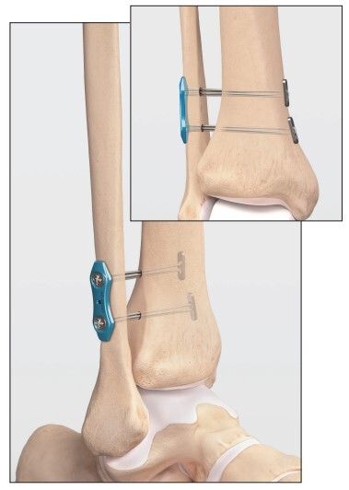
Treatment of high ankle sprains
Evaluate for syndemosis injury
  If stable, protect WB in boot for 4 weeks
  If unstable-consider surgical fixation
Surgical Fixation
-Flexible Fixation
-Rigid if older/poor bone
-Return to sport 2 months

Slide 19

THANK YOU

