Slide 1
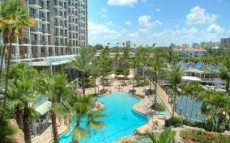
5th Annual Gulfcoast Orthopaedic Rehabilitation Conference
Hyatt Regency, Sarasota, FL
August 24, 2018

Slide 2
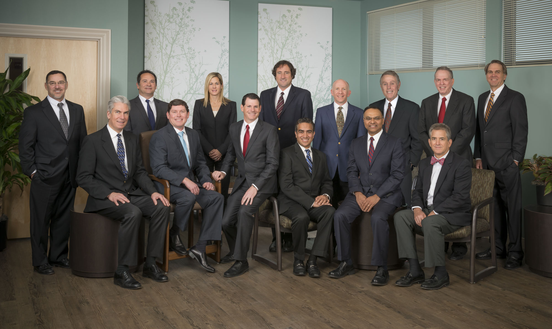
Pain after a total knee, why do I have it?
Edward Stolarski, M.D
Adult Reconstruction
Kennedy White Orthopedic Center

Slide 3
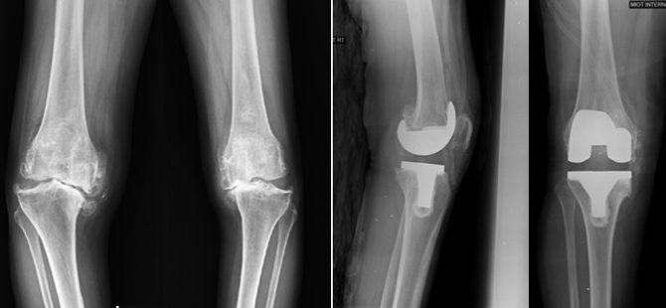
The Painful Total Knee

Slide 4
I had my knee replaced, why am I still in pain?
Facts about total knees
20% of total knee patients not satisfied
chronic pain can be the cause
TKA is certainly not “back to God’s knee”
Expectations need to be appropriate
Many many reasons for persistent pain
Xrays often look fine
“my doctor said my xrays look great”

Slide 5
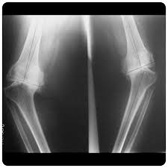
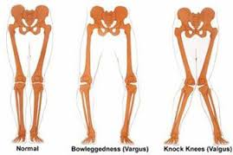
All total knees are not created equal!!

Slide 6
All total knees are not created equal!!
So many variables…
Age
Medical issues
Trauma
Prior surgery
Narcotic usage
ROM pre-op
So many more
Pre-op variables play a role in post op outcomes

Slide 7
All total knees are not created equal!!
Yet they leave (or should leave) the OR with very similar results
ROM
Alignment
Stability
Some knees take more work to get there!

Slide 8
Acute pain after surgery
Expected…
Trauma of surgery
Tourniquet
Swelling
Inadequate pain meds
Overaggressive post op exercise
Not enough exercise
Not narcotic naive

Slide 9
Outpatient therapist will be seeing patients earlier…
Outpatient total joints routinely performed
Significant reduction in SNF admissions
Decreased home health visits prior to transfer to outpatient
Therefore, will see patients with more pain then when then present later

Slide 10
Subacute pain after surgery
How long will my knee hurt…
Different for everyone
Bell curve
some do insanely well
others incredibly poorly
most in between
Feel better when inflammatory cascade subsides
SAME OPERATION, different patients

Slide 11
Subacute pain after surgery
First couple weeks are rough
Linear reduction in pain and swelling for months
Won’t really know what baseline will be for 12-15 months post op.
Most people feel great somewhere between 3 and 12 weeks and never
Lot of second opinions 3-9 months post op

Slide 12
Atypical causes of post op pain
Infection
Arthrofibrosis (excessive scar tissue)
Ligamentous instability
Component malposition
Patellofemoral maltracking
Overstuffed patellofemoral joint
Component sizing
Metal allergy
hip pathology
Back pathology

Slide 13
Infection
May just present with increasing pain and loss of function, or post op pain that just never resolved
Don’t have to have fever, chills or drainage
Acute post op issues
persistent drainage, hematoma, or return to OR should be red flags
Comorbidities
Diabetes, RA, on steroids

Slide 14
Arthrofibrosis (excessive scar tissue)
Usually has a root cause
Can lead to loss of flexion and or extension
Poor pain control
High anxiety personality
Hyperintense inflammatory response
Metal allergy
infection

Slide 15
Etiology of pain and stiffness after TKA
Preoperatively
Postraumatic OA
Prior high tibial osteotomy
Limited preop ROM
Obesity is debatable factor
Stiff contralateral TKA
Preoperative ROM is strong predictor of postop ROM

Slide 16
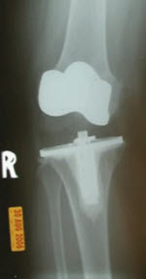
Ligamentous balancing
Flexion and extension gaps and ligamentous tension need to be balanced
Midflexion instability can be subtle
Full extension has posterior capsular structures providing false sense of stability on exam. Must evaluate in midflexion
Complain of weightbearing pain and not trusting the leg

Slide 17
Ligamentous balancing

Slide 18
Component malposition
Knee just not put in right
Creates poor and painful kinematics
Xrays can look normal
Major culprit is internal rotation of femur or tibial components
Raised joint line (taking too much distal femur)
Varus or valgus malignment

Slide 19
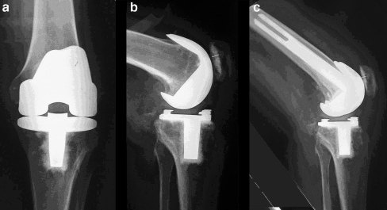
Component malalignment
Femur flexed or extended
Tibial slope

Slide 20
Patellofemoral causes
Patellofemoral maltracking
Poorly balanced
Internally rotated components
Overstuffed patellofemoral joint
Tight flexion space
Femur too big
Too little patellar resection
Tight PCL
Component sizing
Need of lateral release

Slide 21
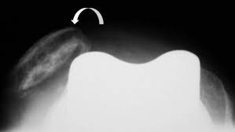
Innacurate patellofemoral joint reconstruction
Patellar maltracking
Malrotation of the femoral or tibial implant

Slide 22
Poor component sizing causes pain
Femur too big
Femur too wide (overhang)
Too big front to back
Tight in flexion
PF pain
Poor flexion
Tibial overhang
Painful
Irritate popliteus, MCL etc

Slide 23
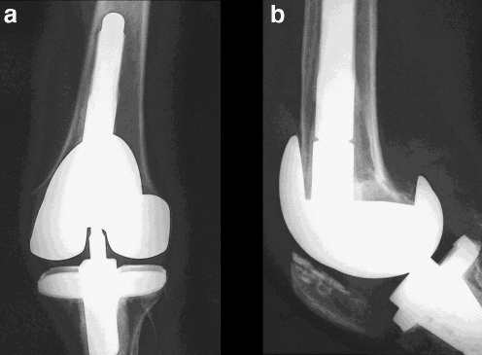
Causes of tight flexion gap (knee won’t bend)
Oversized femoral component

Slide 24
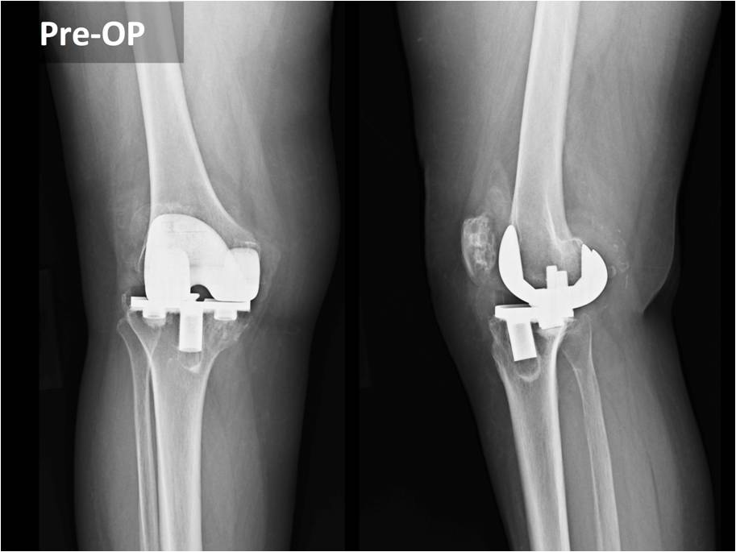
Poly wear and osteolysis (bone loss)
Body’s response to plastic wear debri
Change in ligamentous tension causing instability
Bone loss

Slide 25
Aseptic loosening
Interface between the implants and cement or cement and bone has broken down
Knee has usually been in for awhile
Patient had done well for long period of time

Slide 26
Metal sensitivity
Cobalt Chromium femur
Nickel
Cobalt
Chromium
Everything else ruled out
Blood tests
Revise?
Long shot but sometimes it’s a miracle

Slide 27
Extraarticular causes of knee pain
Lumbar pathology
L4 nerve root impingement can cause knee pain
Check motor and sensation
Most of these older people have back issues
Neuropathy
Hip pathology
Not uncommon to have pain referred from hip to knee
Supratentorial (in their head)
Was their knee really that bad preop and radiographically
Preop you want bad pain AND bad xrays
Unrealistic expectations
Don’t assume this too early

Slide 28
Poorly balanced flexion and extension gaps and improperly sized components often overlap

Slide 29
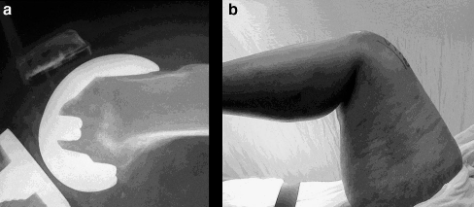
Causes of tight flexion gap (knee won’t bend)
Posteriorly translated femoral component

Slide 30
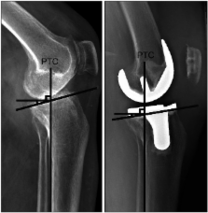
Causes of tight flexion gap (knee won’t bend)
PCL too tight
Not enough tibial slope

Slide 31
Causes of tight flexion gap (knee won’t bend)
Inadequate patellar resection (left knee cap too thick)

Slide 32
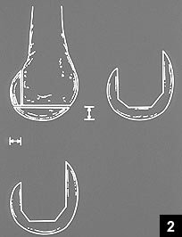
Causes of tight extension gap (knee won’t straighten)
Insufficient distal femoral resection

Slide 33
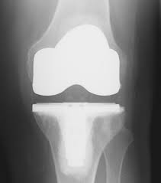
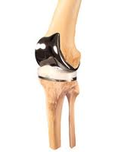
Causes of tight flexion and extension gap
Insufficient tibial resection
Poly too thick

Slide 34
When to go back to OR..
Infection
Hematoma
Mechanical issues described above
Best results are obtained when there is a diagnosis for the pain not just going in and looking around
Not usually due to “poor” therapy

Slide 35
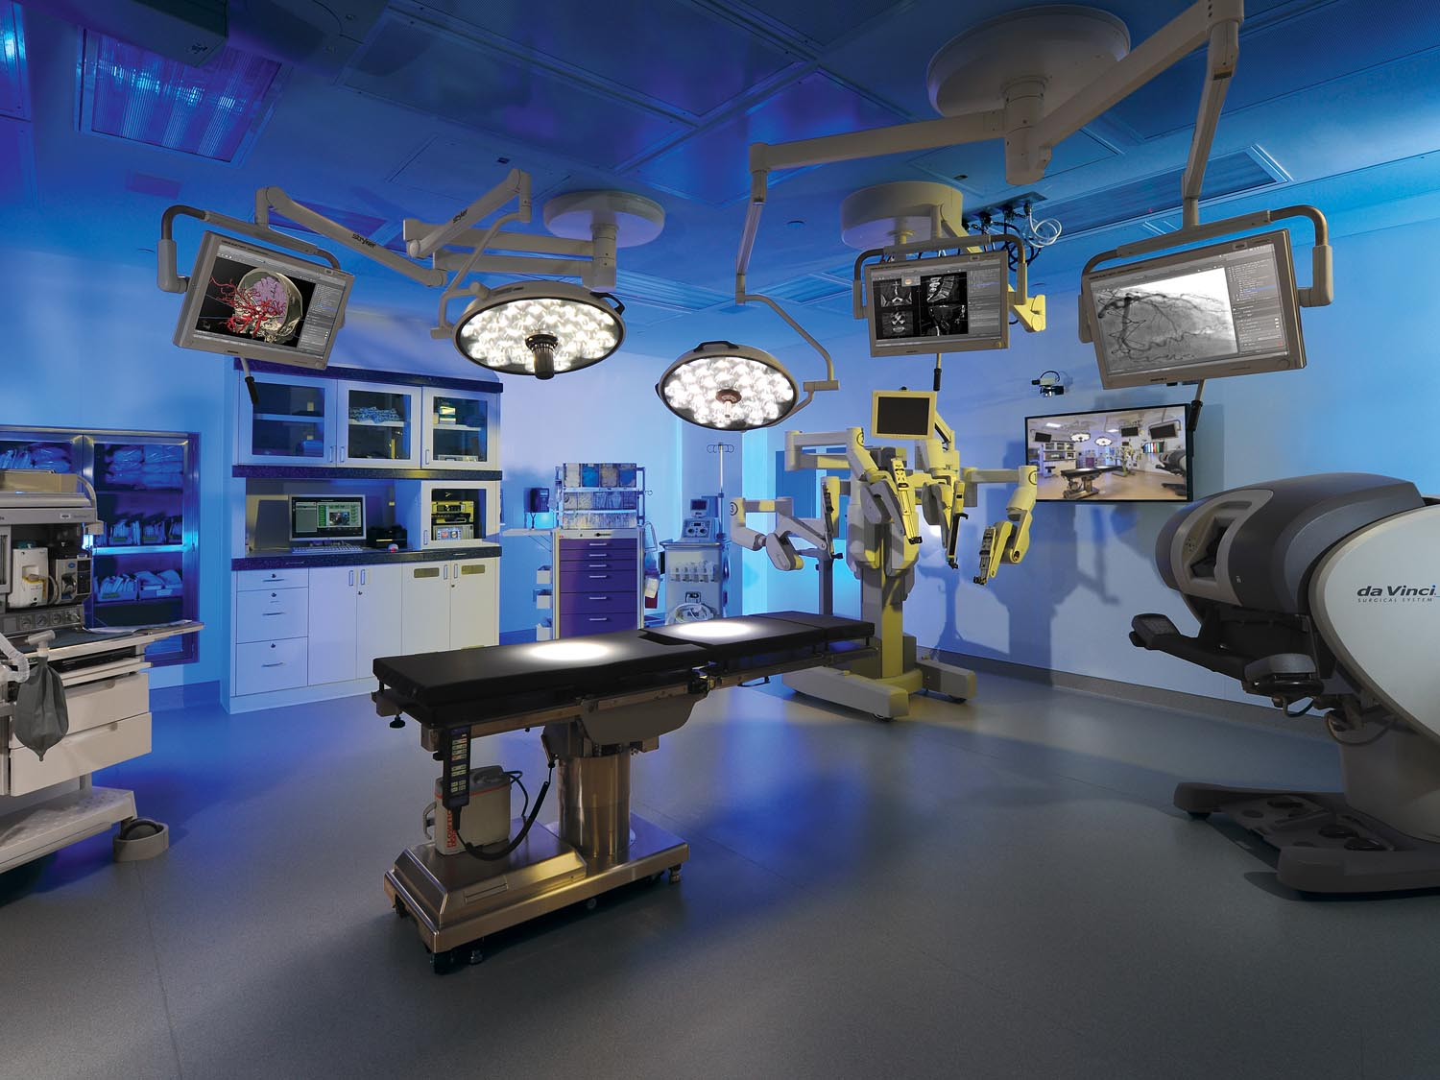
Outpatient Joint Replacement
Who is not…
Poor support network
Multiple medical problems
Fearful of going home
Anesthesia concerns
Want more traditional post op care
You still will heal faster

Slide 36
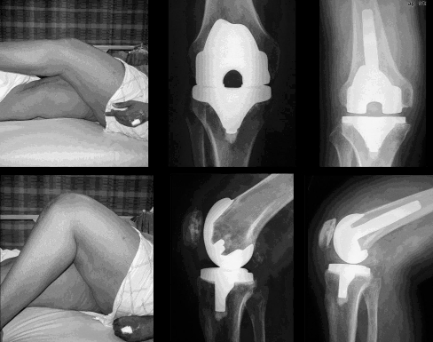
Revision TKA – Get it right!
Best way to address the root cause of the problem

Slide 37
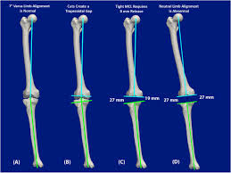
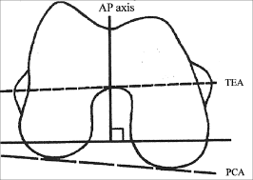
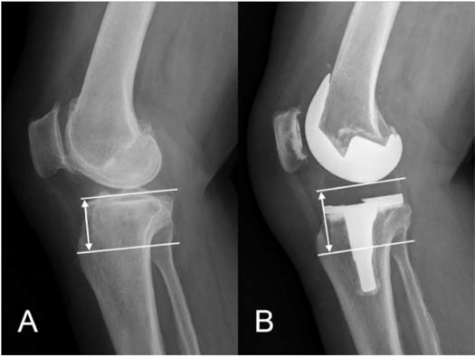

Slide 38
All total knees are not created equal!!

Slide 39
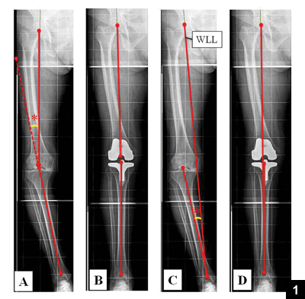
TKA attempts to return knee to normal anatomy

Slide 40
How is technology helping improve outcomes?
By getting it right the first time

Slide 41
Changes in primary total knee replacement
Quad Sparing TKA
Specialized instrumentation
No cutting of muscle or tendon
Much quicker rehab
Less pain
Shorter hospital stay
No tourniquet
Great hemostasis possible now
Less thigh pain

Slide 42
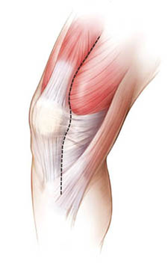
Quad Sparing Total Knee
Traditional
Quad-Sparing

Slide 43
How is technology helping? Navigational choices for knee arthroplasty
Computer aided navigation
Patient specific cutting blocks
Accelerometer technology
Orthosensor technology – “after the cuts”
Robotics assisted tka

Slide 44
Why do we need these technologies?
20% of TKA patients are unsatisfied
Will being more accurate lead to better outcomes
3 deg of inaccuracy increased revision rate
24% developed loosening eight years post op
Improves bone cut accuracy and implant positioning
Does it matter?
Is there a difference in accuracy?
Inadequate manual techniques (too much guess work)

Slide 45
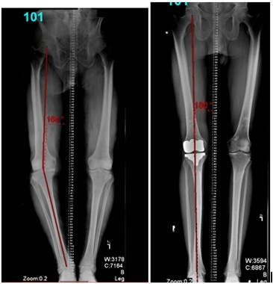
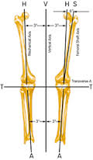
Navigational choices for knee arthroplasty

Slide 46
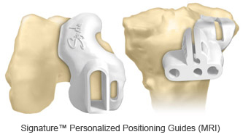
Patient Specific Cutting Guides for UKA and TKA
More ACCURATE sizing, rotation and bone cuts
Utilizes MRI technology to determine the cutting block specifications
less invasive
less guess work

Slide 47
UKA - Patient Specific Cutting Blocks
Signature UKA Oxford
MRI and HKA films to engineer
Adjust parameters with engineer
Cutting blocks generated

Slide 48
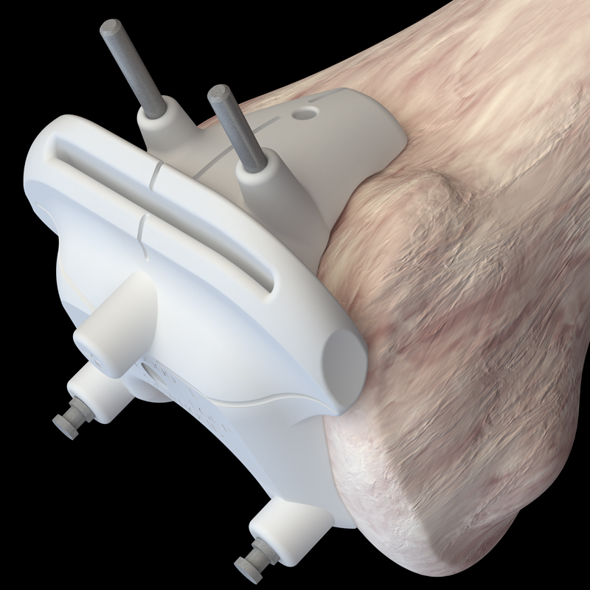
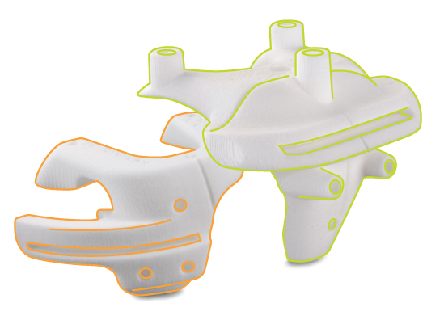
Design features
Improves
Alignment
Rotation
sizing
Compatible with standard instrumentation for intraoperative adjustments
™Trademark of Smith & Nephew.

Slide 49
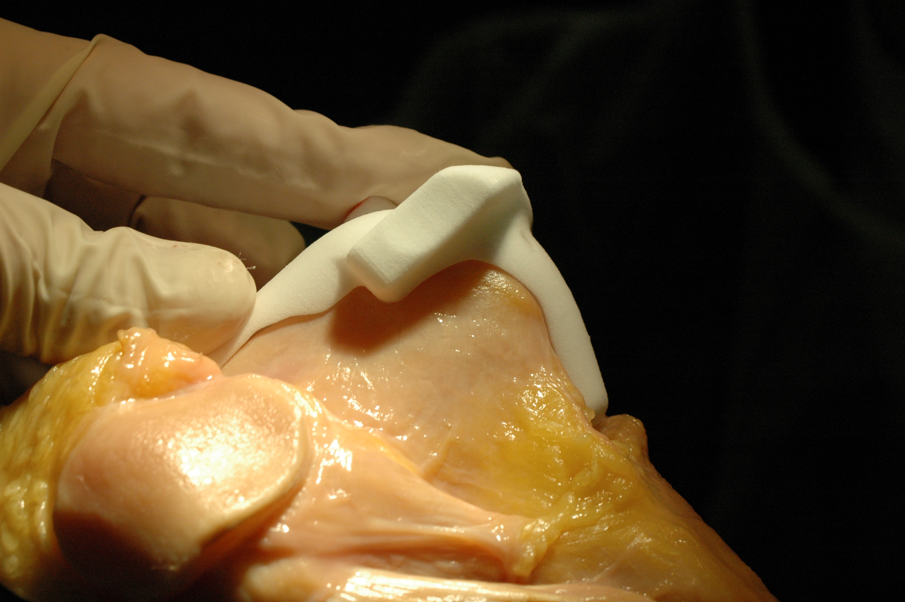
™Trademark of Smith & Nephew.

Slide 50
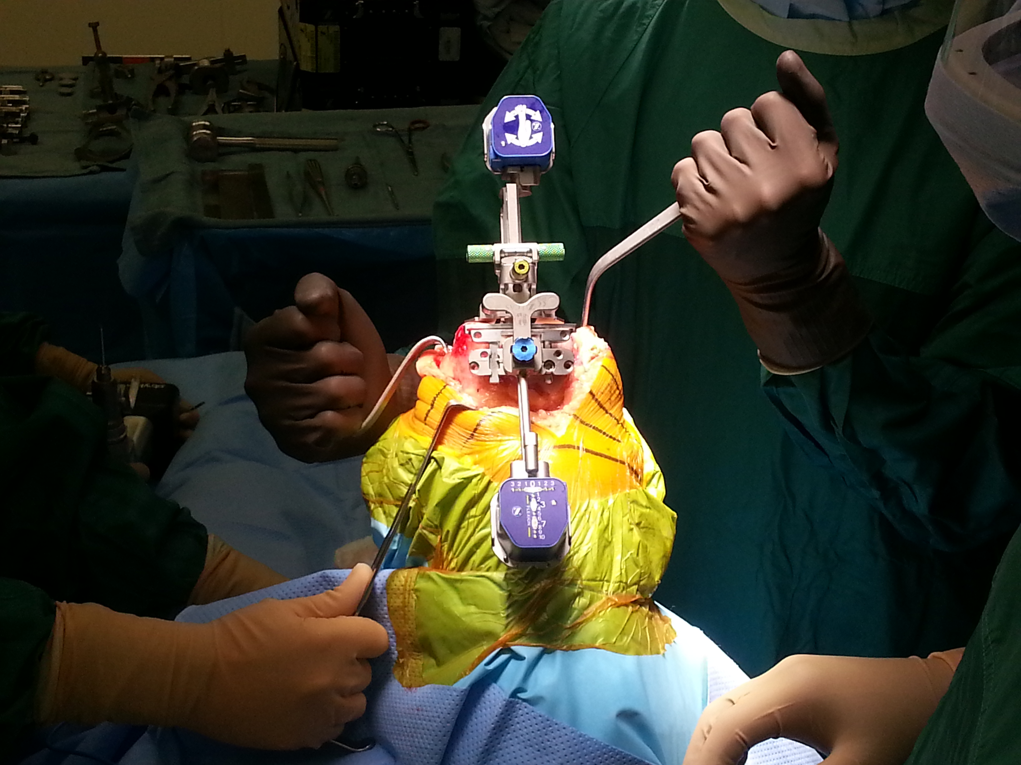
Iassist Knee Navigation

Slide 52
Iassist Knee Navigation
￼Accerlerometer Based Navigation￼Nam et al.
100 total knee patients
traditional extramedullary tibial alignment guide does not require a large computer console or infrared camera
Standard intramedullary femoral navigation
Long standing radiographs
95.7% of accelerometer-based tibial navigation
2degrees of the mechanical axis com
68.1% in the extramedullary group
accelerometer-based tibial navigation unit, 89.4% had a mechanical axis within 3 of the plan
74.5% in the conventional group
difference was attributed not to errors in tibial preparation but to variability of the in- tramedullary femoral guide, for which a similar technique was used in both groups.

Slide 53
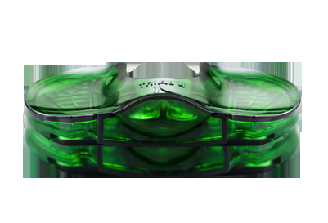
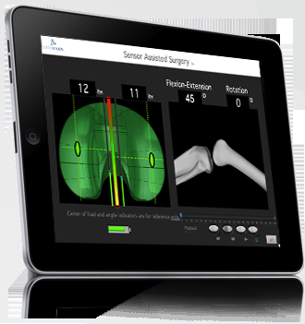
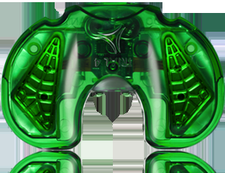
Smart Knee Technology

Slide 54
Thank You!
Can you see the end of this talk yet…?

Slide 55
Summary
If you treat TKA, there will be chronic pain cases
It is not necessarily a failure of the patient or the therapist (although we will blame you both)
Surgeons are not perfect
Surgery may need to be performed to correct the underlying problem
Use technology to avoid errors in the first place

Slide 56
Thank You!

Slide 57
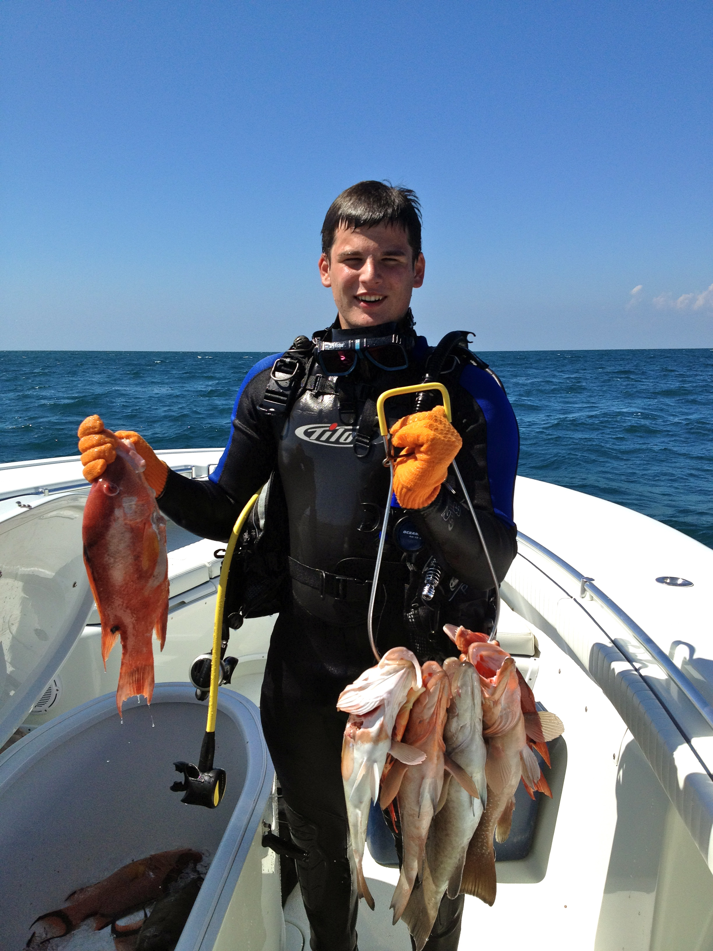
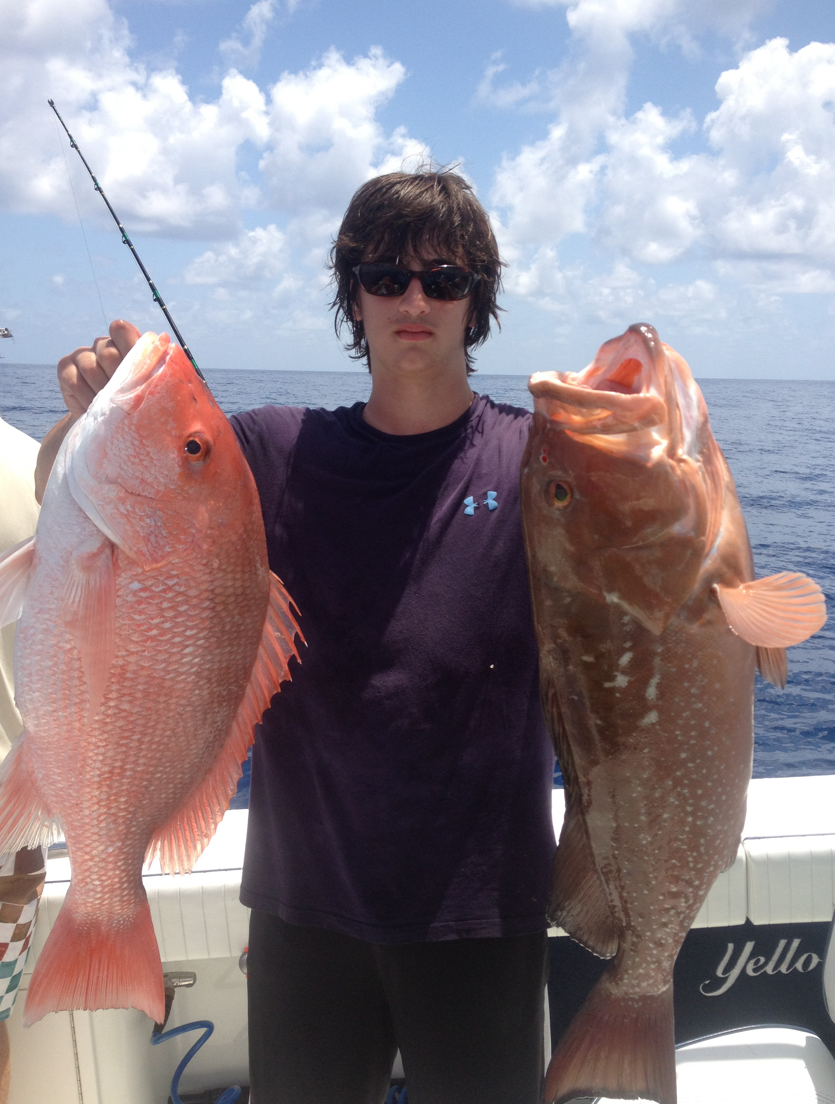
Thank You!

Slide 58
Breakdown of the Phases of TKA Rehab
Phase I – Immediate Post Surgical Phase (Day 0-3)
Goals
decrease swelling
increase range of motion
enhance muscle control and strength

Slide 59
Phase I – Immediate Post Surgical Phase (Day 0-3)
Goals: bed mobility and transfers with the least amount of assistance Ambulate 25-100 feet
ascend/descend stairs
Regain at least 80 degrees of passive and active range of motion
Gain knee extension less than or equal to -10 degrees.
Independently perform Straight Leg Raise (SLR)

Slide 60
Continuous Passive Motion (CPM) machine
not part of the standard of care for patient
may be indicated according to surgeon preference
cases where post-operative knee range-of-motion (ROM) is severely restricted
revision or reconstructive surgery,
severe post-operative pain
limb girth and/or edema, or
impaired ability to participate in ROM exercises.

Slide 61
Observation and Assessment: • deep vein thrombosis (DVT)
increased swelling
erthymia
calf pain.
Drainage blistering or frail skin
Assess patients’ pain using the visual analogue scale
premedicate with oral/IV pain medication 30-60 minutes prior to treatment.

Slide 62
Therapeutic exercise and functional mobility:
Active/active assisted/passive exercises
Patella femoral and tibial femoral joint mobilization
Soft tissue massage
Isometric quadriceps, hamstring, and gluteal isometric exercises.
Straight leg raises (SLR)
Lower extremity range of motion
Closed chain exercises
Gait training on flat surfaces and on stairs. Transfer training.

Slide 63
Modalities:
Continuous Cryotherapy for 72 hours after surgery, or at least 5 times/day.
20 minutes before and after their independent exercise program.
Precautions:
WBAT with assistive device
Monitor wound
Monitor for signs of DVT, pulmonary embolism (PE), and/or loss of peripheral nerve integrity

Slide 64
Phase II – Motion Phase (Day 3 – Week 6)
Goals:
Improve knee active ROM 0-110 degrees
Muscle strengthening
knee extensor and flexor muscle groups.
operative extremity
any generalized weakness in the upper extremities, trunk or contralateral lower extremity.
Proprioceptive training
Endurance training cardiovascular fitness.
Functional training
Gait training: Assistive devices are discontinued when the patient demonstrates adequate lower extremity strength and balance during functional activities (usually
1-4 weeks)

Slide 65
Weeks 1-4
AA/A/PROM, stretching for flexion (>90 degrees) and extension
Stationary Bicycle for ROMto full revolutions (no resistance).
Patella femoral and tibial femoral joint Continue isometric quadriceps, hamstring, and gluteal isometric exercises
Supine heel slides and seated Long Arc Quad (LAQ)
SLR in 4 planes (flexion, abduction, adduction, extension)
Neuromuscular electrical stimulation (NMES) for quads if poor quad contraction
wean off their assistive device
Postural cues/ reeducation during all functional activities as indicated.

Slide 66
Weeks 4-6
Continue above exercises
Continue patella femoral and tibial femoral joint mobilization as indicated.
Continue NMES of quads if poor muscular performance of quad is present.
Front and lateral step up and step down.
1/4 front lunge
Use sit to stand and chair exercises to increase knee flexion
Continue stationary bicycle for ROM
Begin pool program if incision is completely healed

Slide 67
Modalities:
Cryotherapy 1-3x/
Other modalities at the discretion of the therapist based on clinical findings
Precautions:
WBAT with assistive device as needed to minimize compensatory gait.
straight cane within one week of surgery if he/she is WBAT to FWB
weaned from assistive device by 2 weeks if they did not use an assistive device preoperatively and post-operative muscle performance is adequate for weight acceptance.
Criteria for progression to the next phase:
AROM 0-110’
Good voluntary quadriceps control

Slide 68
Phase III – Intermediate phase (week 7-12): Goals:
Maximize ROM (0-115 degrees plus)
Good patella femoral mobility
Good strength all lower extremity musculature. Return to most functional activities
light recreational activities (i.e. walking, pool program)

Slide 69
Phase III – Intermediate phase (week 7-12):
Therapeutic Exercises
Continue exercises listed in Phase II with progression including resistance and repetitions
assess hip/knee and trunk stability at this time and provide patients with open/closed chain activities .
Initiate endurance program, walking and/or pool. Initiate and progress age-appropriate balance and proprioception exercises. .

Slide 70
Phase III – Intermediate phase (week 7-12):
Criteria for progression to next phase: AROM without pain, or plateaued AROM based on preoperative ROM status. 4+/5 muscular performance based on MMT of all lower extremity musculature. Minimal to no pain or swelling.

Slide 71
Phase IV – Advanced strengthening and higher level function stage (week 12-16):
Goals:
Return to appropriate recreational sports / activities as indicated
Enhance strength, endurance and proprioception
Therapeutic Exercises:
Continue previous exercises with progression of resistance and repetitions.
Increased duration of endurance activities.
Initiate return to specific recreational activity: golf, doubles tennis, progressive
walking or biking program.
.

Slide 72
Phase IV – Advanced strengthening and higher level function stage (week 12-16):
Criteria for Discharge:
(These are general guidelines as patients may progress differently depending on previous level of function and individual goals.)
Non-antalgic, independent gait
Independent step over step stair climbing
Pain-free AROM
At least 4+/5 muscular performance based on MMT of all lower extremity
musculature.
Normal, age appropriate balance and proprioception.
Patient is independent with home exercise program.

