Slide 1
ACL Injuries Risk Factors, Prevention Strategies, and Surgical Techniques
Arthur Valadie, MD
Coastal Orthopedics & Sports Medicine

Slide 2
Goals
Understand demographics of ACL injuries
Understand risk factors for ACL injury
Discuss prevention strategies
Surgical current concepts

Slide 3
Demographics
>200,000 ACL injuries in US annually
Greater than 50% in young athletes
100,000 ACL reconstructions annually
Approximately $1 billion expenditures

Slide 4
Consequences of ACL injuries
Economic cost of care
Missed work/school/sports/scholarships
Post-traumatic arthritis

Slide 5
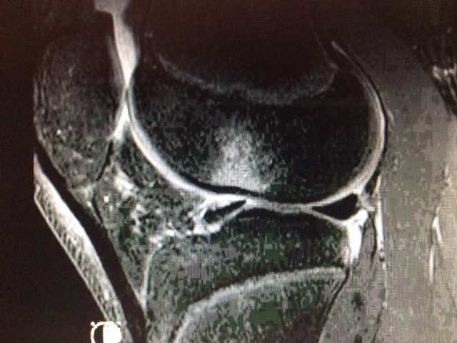
Post-traumatic arthritis

Slide 6
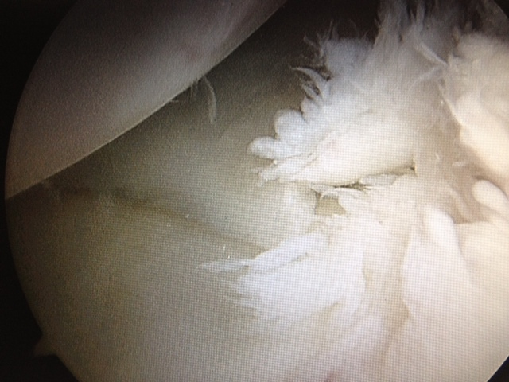
Post-traumatic arthritis

Slide 7
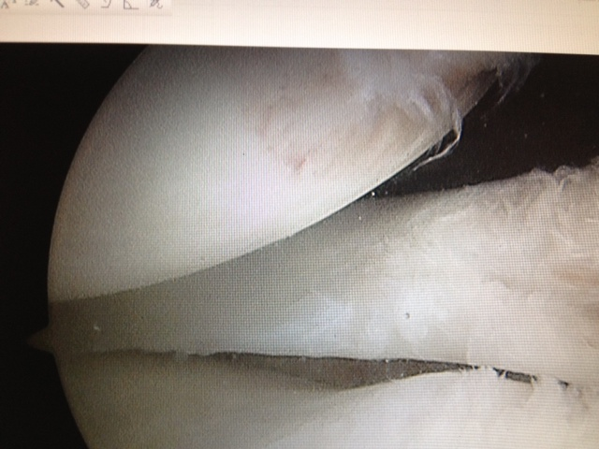
Post-traumatic arthritis

Slide 8
Male vs. Female
Female athletes more likely than males to have an ACL injury
3.5 X more likely in basketball
2.7 X more likely in soccer
2-8 X more likely overall
Annual incidence of ACL injury in year-round collegiate soccer players is 4.7% in females and 1.7 % in males
Prodromos et al, Arthroscopy, 2007

Slide 9
Risk Factors
Extrinsic
Intrinsic

Slide 10
Extrinsic Risk Factors
Weather
Dry conditions increased risk (rugby study)
Playing surface
New turf may be better
Footwear
High traction may increase risk
Braces (knee)
controversial

Slide 11
Prophylactic Braces
Teitz (1987), Rovere (1987)
College football players
Increased incidence of knee injuries
Sitler (1990)
Intramural tackle football at US military academy
Randomized, prospective study
1396 athletes
Decreased incidence of injury (4 vs. 12)

Slide 12
Post-operative bracing
McDevitt (2004)
100 ACL reconstructions
No difference in risk of re-injury
Data is mixed
Lowe (JAAOS-2017)
Bottom line: we don’t know

Slide 13
Anatomic Risk Factors
Q angle
Basketball players with knee injuries had higher Q-angles
Females have a Q-angle 2-6 degrees greater than males
Shambaugh 1991
Posthumus, 2009

Slide 14
Anatomic Risk Factors
Notch width
Mixed data but multiple studies suggest an association between narrow notch width and ACL injury
Arent (2001), Souryal (1993), LaPrade (1994)
Notch width may predict size of ACL
You can’t pick your parents!

Slide 15
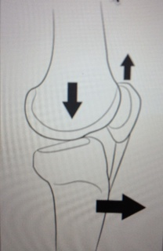
Anatomic Risk Factors
Tibial Slope
Some evidence that increased tibial slope may increase ACL injury risk
Solution?

Slide 16
Anatomic Risk Factors
Generalized ligamentous laxity
Knee hyperextension
(Myer 2008, Ramesh 2005)

Slide 17
Hormonal Risk Factors
Animal studies show hormonal influence on ligament strength
Human study suggests hormonal influence on ACL fibroblast metabolism and collagen synthesis
Several studies demonstrate increased AP knee laxity during certain phases of the menstrual cycle
Clinical implications yet to be determined

Slide 18
Familial Risk Factors
Harner (1994), Flynn (2005)
There appears to be a familial tendency toward ACL tears
Family members of patients with a history of ACL tears (esp. bilateral) had increased risk of ACL injury

Slide 19
Neuromuscular Risk Factors
Altered movement patterns may increase risk
These appears to be more common in females
Landing with:
Less hip/knee flexion
More knee valgus
More IR of hip
More ER of tibia
Less knee joint stiffness

Slide 20
Neuromuscular Risk Factors
Altered muscle activation patterns
Quad dominant pattern with loading
Fatigue may increase ACL loading
Females appear to be more quad dominant than males after puberty

Slide 21
Injury Biomechanics
Negative factors on dynamic muscle control
Fatigue
Muscle imbalance
Unanticipated cutting
Straight landing posture

Slide 22
Injury Biomechanics
Positive factors on dynamic muscle control
Anticipation of cutting
Maximal muscle co-contraction
Deceased time to peak torque for voluntary muscle contraction
May be enhanced by training!

Slide 23
Prevention Strategies
12 prevention programs have published data
Combinations of
Strengthening
Flexibility
Agility
Plyometrics
Conditioning
Risk awareness

Slide 24
Prevention Strategies
Variable quality of studies
Most report a decreased rate of knee injury
None had an increased risk of injury
Most studies involved females

Slide 25
Prevention Strategies
Studies:
Hewitt (1999): 72% decrease in ACL injuries
Gilchrist (2008): 3.3X fewer non-contact ACL injuries
Mandelbaum (2005): 74%-88% reduction in ACL tears
Hewitt (2006): meta-analysis of prevention programs
3 of 6 studies showed significant decrease in ACL tears with neuromuscular prevention programs

Slide 26
Prevention Strategies
Components of a successful prevention program
At least 10 minutes 3 times/week for 8 wks
Start during pre-season
Perform during warm-up
Maintain over long term

Slide 27
Surgical Management
Graft choice
Autograft
Bone-patellar tendon-bone (BTB)
Quadrupled hamstring
Quadriceps tendon
Allograft
BTB
Tibialis anterior
Achilles tendon

Slide 28
Autograft
Advantages
Lower re-tear rate
Gold standard
More stability
No risk of disease transmission
Low cost
Fast graft incorporation
Disadvantages
Donor site morbidity
Cosmesis
Post-op pain
Harvest time

Slide 29
Allograft
Advantages
No donor site morbidity
Better cosmesis
Less post-op pain
Disadvantages
Higher failure rate
Cost
Availability
Risk of disease transmission

Slide 30
Graft selection
Individualized graft selection
Based on:
Age
Activity level
Male vs female?
Previous surgery
Anatomy (patella alta, Osgood-Schlatters, etc)

Slide 31
Tunnel Position
“Anatomic” tunnel placement
Shift away from trans-tibial femoral tunnel drilling to independent tunnel drilling
Accessory anteromedial portal
Retro-drilling
Curved reamers

Slide 32
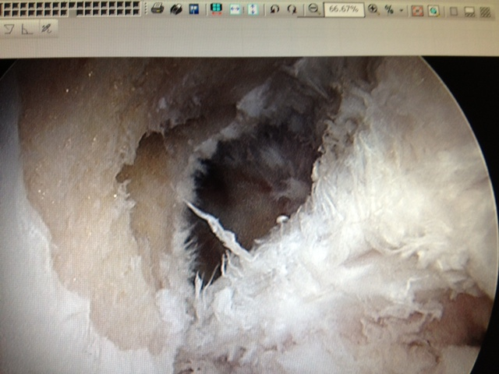
Anatomic femoral tunnel

Slide 33
Surgical Management
Single vs. Double bundle
Attempts to duplicate the 2 bundles of native ACL
Laboratory studies show better rotational stability with double bundle
No clear clinical advantage proven yet
Still controversial

Slide 34
Summary
ACL tears are a significant health problem with high cost to society
Females at higher risk for a variety of reasons
Prevention strategies do appear to make a difference
Reconstructions trending toward anatomic techniques with autograft

Slide 35
Questions?
Thank You!

