Slide 1
Achilles Tendon Tears
Patrick J. O’Neill, M.D.
Orthopaedic Surgeon Specializing in Foot/Ankle
4th Annual Gulfcoast Orthopaedic Rehabilitation Conference
8/26/17

Slide 2
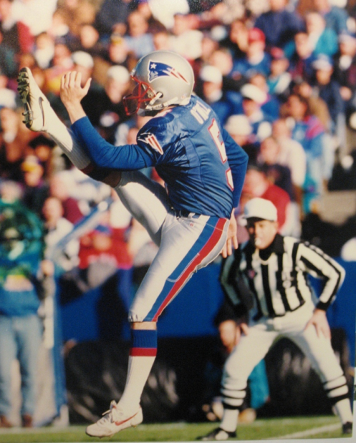
My Background
Medical training (Johns Hopkins)
Medical School (4 years)
Orthopaedic Residency (5 years)
Foot & Ankle Fellowship (1 year)
Sarasota
10 years
Pat O’Neill-Drafted 5th Round NFL 1994

Slide 3
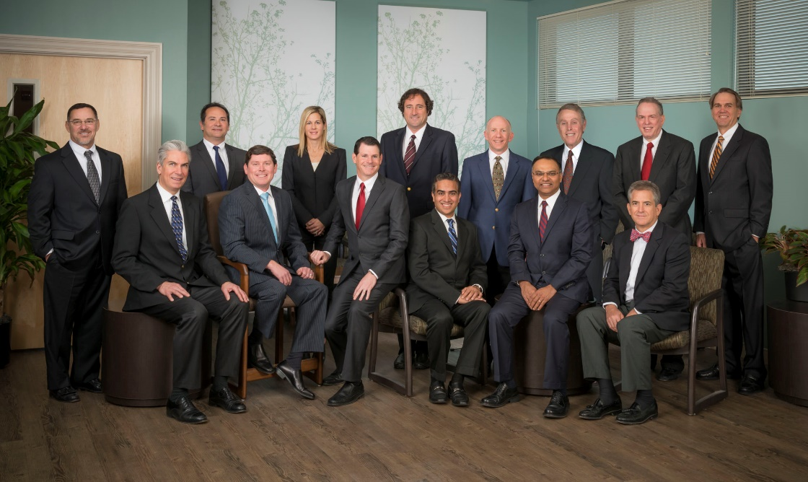
Kennedy-White Orthopaedic Center
Spine – Patel, Feiertag, Nguyen
Joints – White, Dingle, Stolarski, Rush
Sports – Shapiro
Hand/Upper – Klein, Moustoukas
Pain – Erb, Satia
PMR - Herman
Foot/Ankle – O’Neill

Slide 4
Achilles Tendon Tears
Tendonitis/Tendinosis (chronic)
Ruptures (acute)

Slide 5
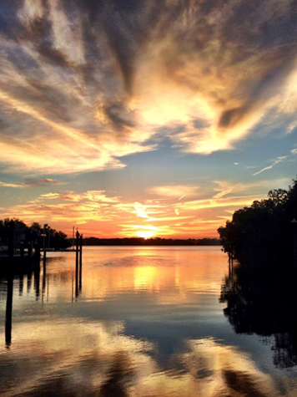
Achilles Tendonitis/Tendinosis
Very common (top 3)
Overused, inflamed, unhappy tendon
Can be very painful
Often long duration
Insertional or Non-insertional

Slide 6
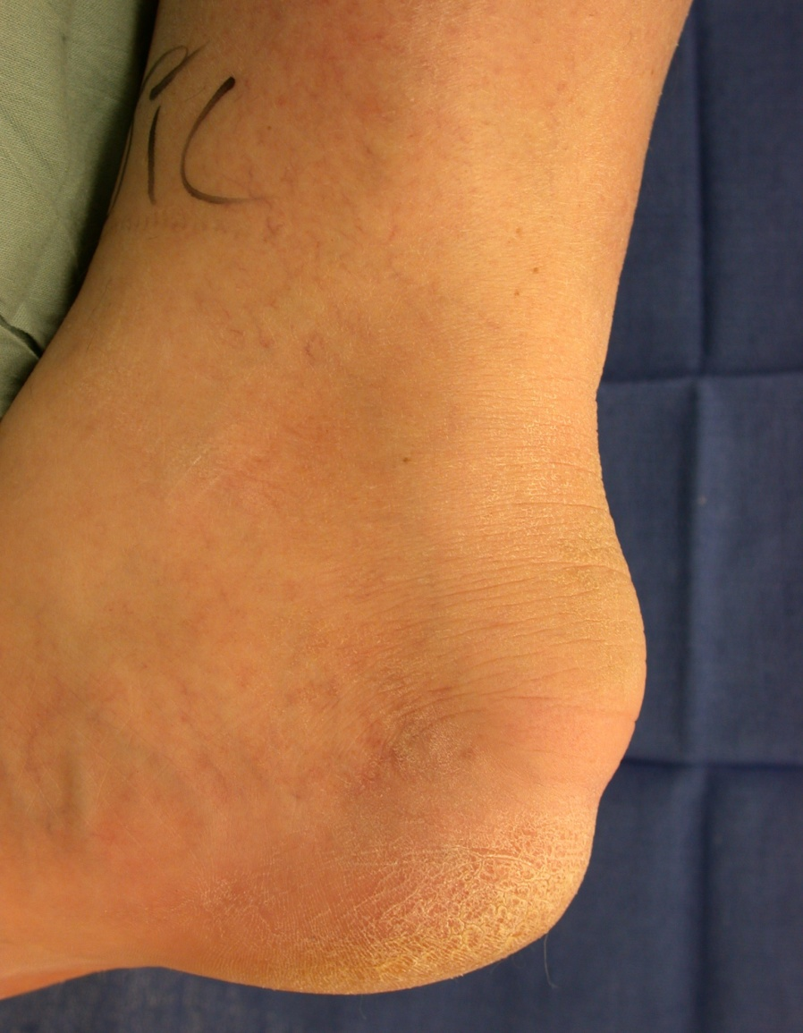
Insertional Achilles Tendonitis
Tendinosis
Very tender
Lump (later finding)

Slide 7
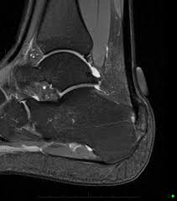
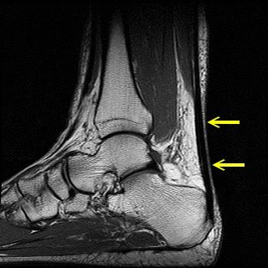
Insertional Tendonitis
Normal Tendon
Abnormal Tendon
Not really a “tear”

Slide 8
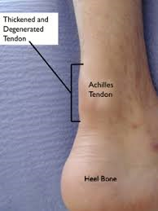
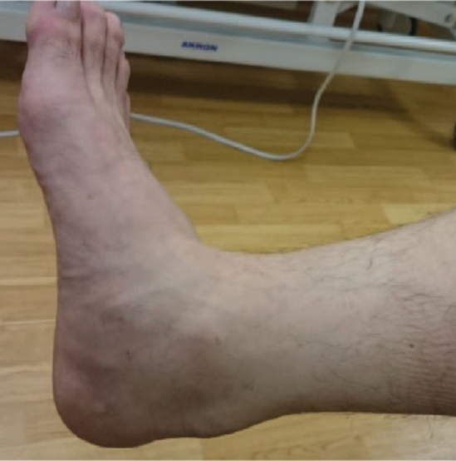
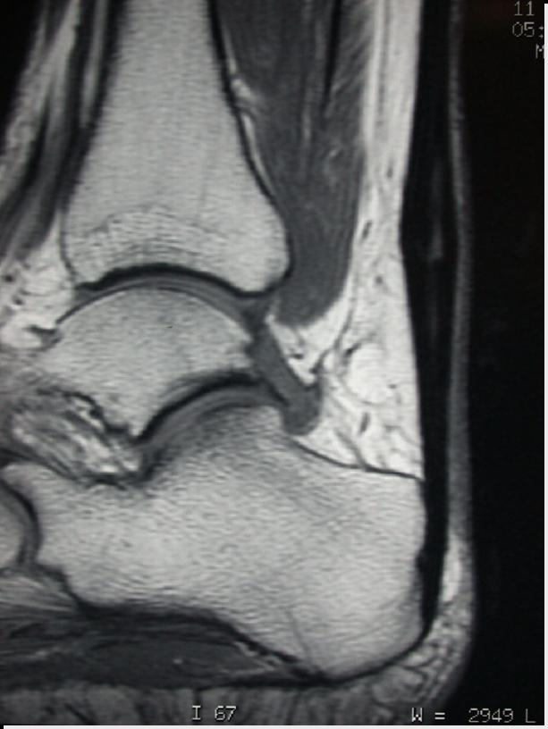
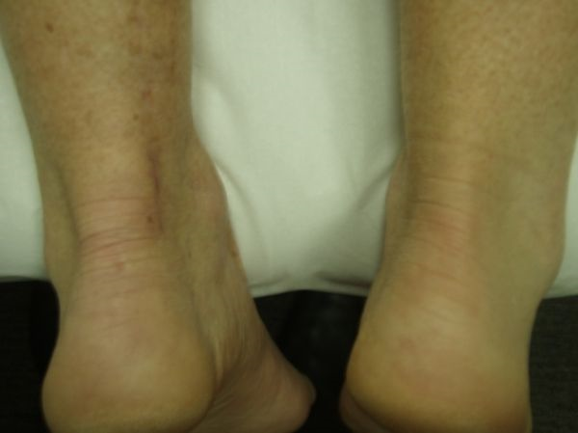
Non-insertional Achilles Tendonitis
Abnormal Tendon

Slide 9
Non-Op Treatment
>90% successful
Ice (30 min bid)
Rest (don’t make it hurt)
Heel lift
Boot
Nsaids (Ibuprofen, etc)
Physical Therapy

Slide 10
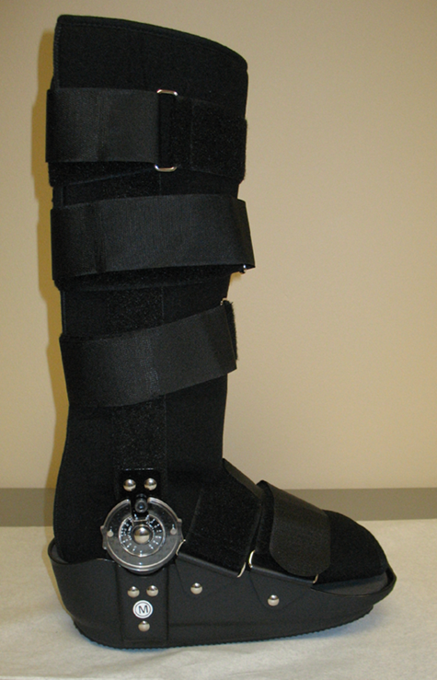
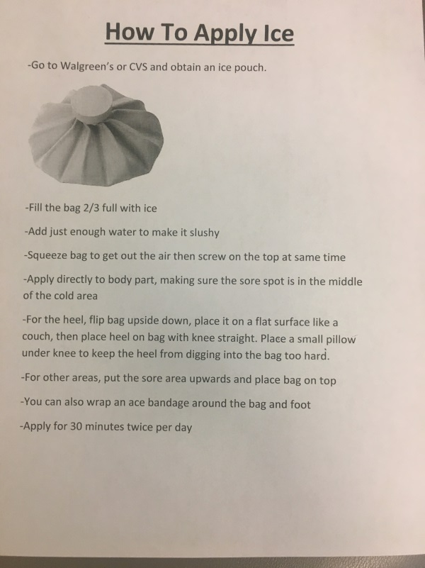
Achilles Tendonitis
Ice is your friend!

Slide 11
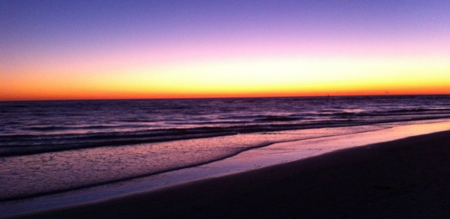
Achilles Rehab/Therapy
Boot 2-3 months, then wean
Need to see at least 50% healed
Then Ok to Start Therapy
Eccentric strengthening, U/S, ionto
Don’t make it hurt!
Pain=No gain
Wait longer if still hurts

Slide 12
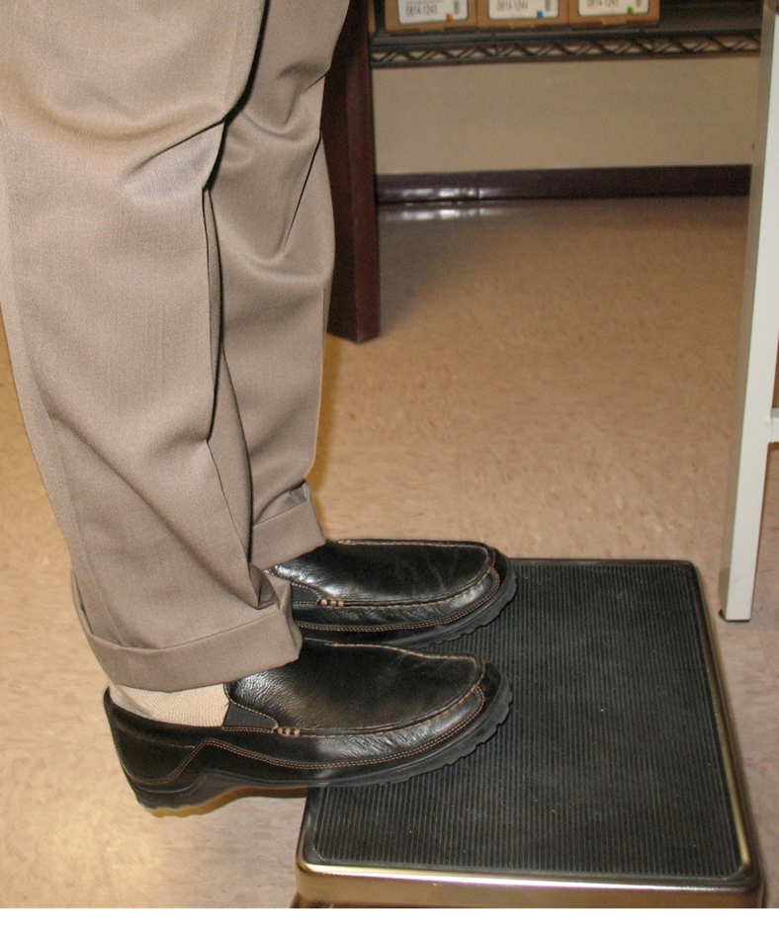
Tendonitis Prevention
After it’s mostly healed
Warm up well
ICE and Nsaids for flares
Heel lift
Stretch!
Hold for at least 30 sec

Slide 13
Surgery for Chronic Tendonitis
@ 5% of cases (almost all insertional)
Live with it vs fixing it
Excise abnormal tendon, bone
Reconstruct tendon
Lengthen, re-attach, FHL
Recovery
Wound (Do nothing for 2 weeks)
NWB 4-6 weeks
WBAT in boot (6-10 weeks)

Slide 14
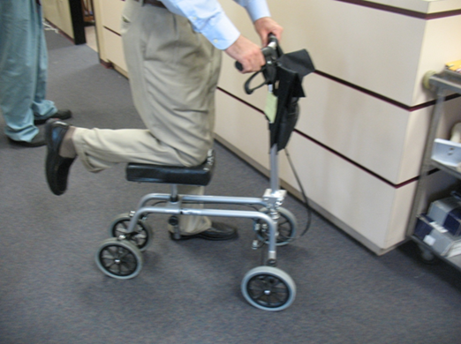
Post-op Rehab
Therapy starts 8-10 weeks post op
Sooner if need home therapy (older patients)
Wean boot @10 weeks
Progress as tolerated
No restrictions
3 months
6-9 months full activity

Slide 15
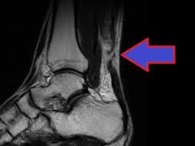
Achilles Ruptures
Occurs mostly in men over age 40
Sudden, eccentric load (curb, etc)
“I got hit in the back of the heel!”

Slide 16
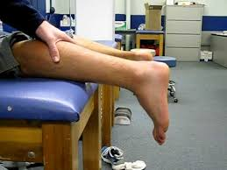
Clinical Findings
Pain
Swelling, tenderness, bruising
Palpable “divot” at achilles
Positive Thompson’s test
MRI not usually needed

Slide 17
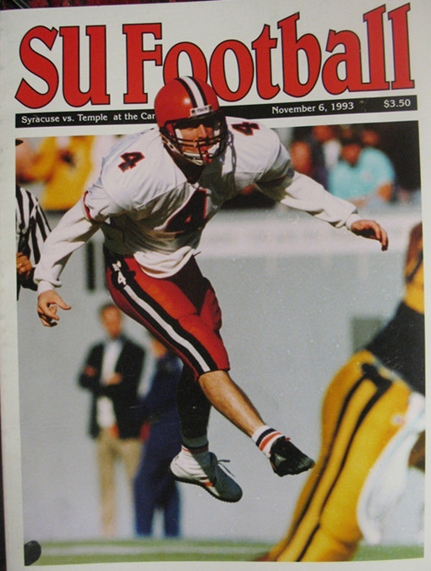
Achilles Rupture Treatment
Surgery vs Non-operative treatment
Nonsurgical?
Less active/older/medical issues
Increased re-rupture rate, decreased strength
Surgery
Most get fixed
Avoid Surgical complications

Slide 18
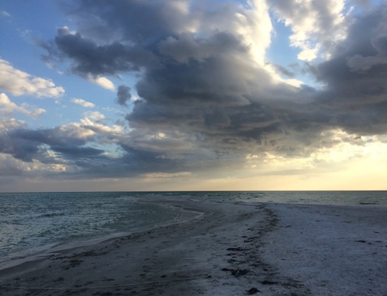
Non-operative Treatment
Older/less active patients
Try to get end-to-end healing
Immobilize in plantarflexion 4 weeks
Boot with a wedge
Progress to WBAT starting @ 4 weeks
Physical therapy @6 weeks
Progress as tolerated
Some may need AFO

Slide 19
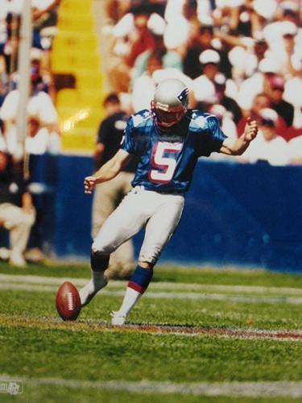
Surgery
Treatment of choice for most
End to end repair
Prevent wound issues and re-rupture
Surgical Technique
Patient compliance
Careful observation
Need wound healing first
Then ok to WB and therapy

Slide 20
Post-op Rehab
NWB 4-6 weeks
Progress to WBAT in boot @6 weeks
Start physical therapy @8 weeks
Wean boot @10 weeks
No restrictions @ 3 months
One year for full recovery
High “success” rates

Slide 21
Summary Important Points
Tendonitis
Most heal non-op if do right stuff
Patience, dilligence
Don’t make it hurt during therapy
Send back to MD if lack progress
Ruptures
Surgery best for most
Avoid complications
Progress slowly with therapy

Slide 22
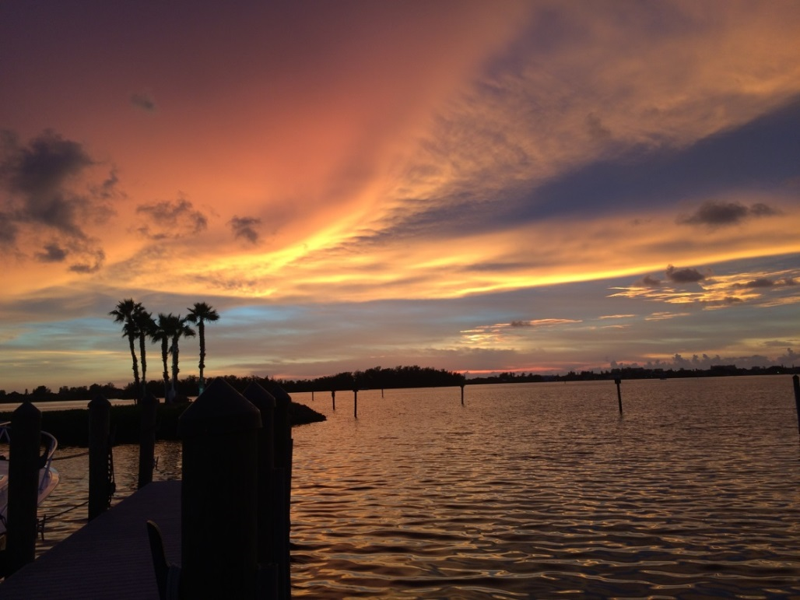
Thank YOU!!
Kennedy-White Orthopaedic Center
366-FEET (3338)

Slide 24
Why See Me?
I take care of my patients!
The only board certified Ortho foot/ankle guy between St. Pete and Fort Myers
vs podiatrist/general ortho
95% Foot/Ankle
I see everything big and
small (except toenails)

Slide 25
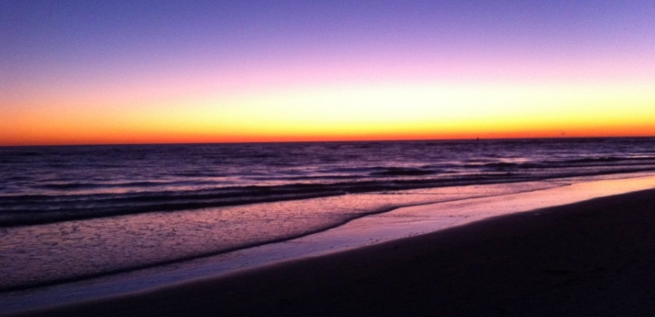
Treatment Rules
Be nice to your feet
It if hurts don’t do it
If it ain’t broke don’t fix it
There’s no magic pill!

