Slide 1
Ankle Sprains
Patrick J. O’Neill, M.D.
Foot and Ankle Fellowship Trained Orthopaedic Surgeon
5th Annual Gulfcoast Orthopaedic Rehabilitation Conference
8/25/18

Slide 2
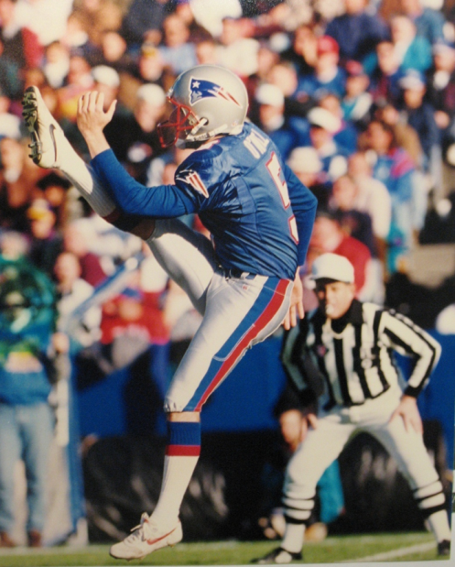
My Background
Medical training in Baltimore, MD
Medical School (Johns Hopkins 4 years)
Orthopaedic Residency (5 years)
Foot & Ankle Fellowship
Sarasota
10 years
Pat O’Neill-Drafted 5th Round NFL 1994

Slide 3
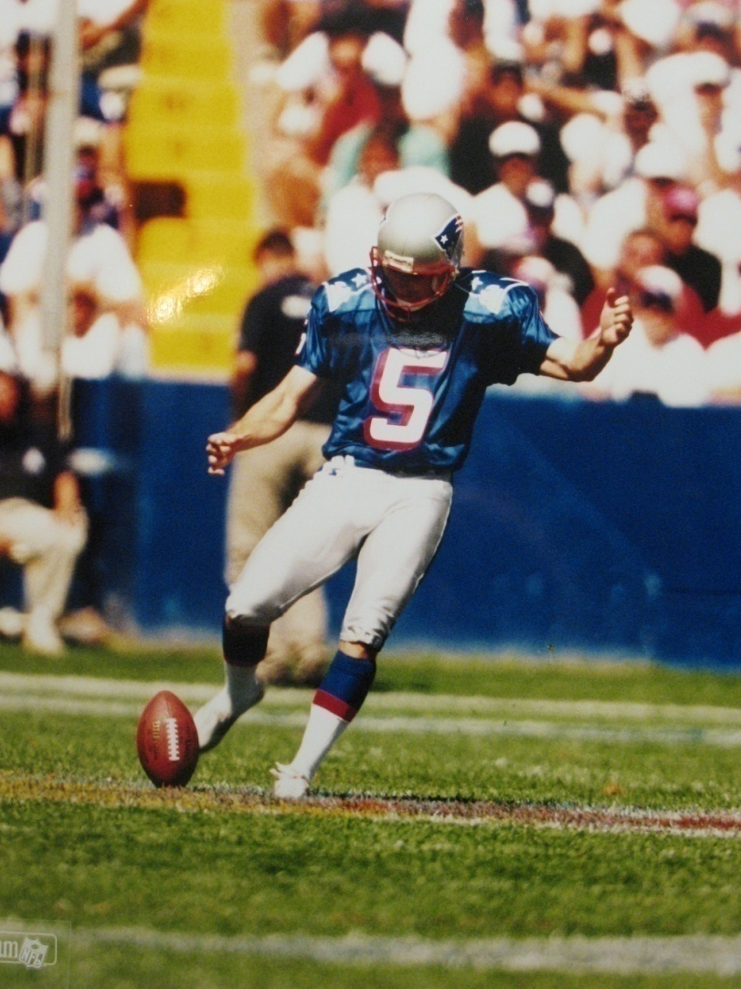
Why See Me?
I take care of my patients!
The only board certified Ortho foot/ankle in Sarasota
vs podiatrist/general ortho
95% Foot/Ankle
I see everything big and
small (except toenails)

Slide 4
Kennedy-White Orthopaedic Center
-Bill Kennedy – Joints
-Ron White – Joints
-Ash Patel – Spine
-Chuck Rush – Joints/Sports
-Gary Shapiro – Joints/Sports
-David Klein – Upper Extremity
-Mike Feiertag – Spine
-Sean Dingle – Joints
-Ed Stolarski – Joints
-Lam Nguyen – Spine
-Mike Moustoukas – Upper Extremity
-Daryl Miller – Sports/General
-Erik Herman – PMR/EMG/Non-surgical mgmt
-Don Erb – Pain Management
-Paul Satia – Pain Management

Slide 5
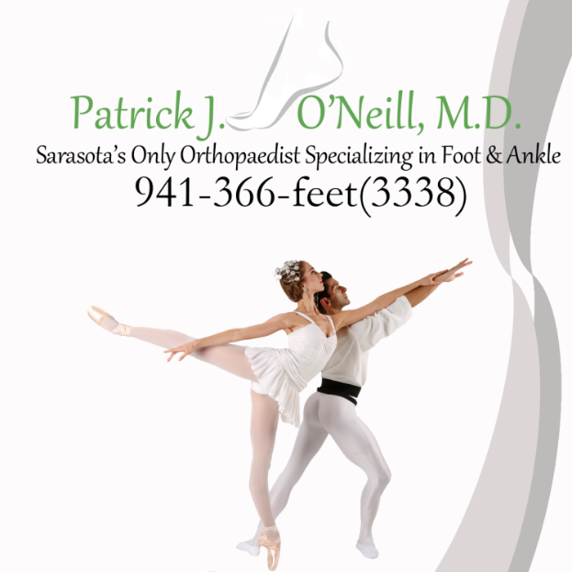
Ankle Sprains
Common
Most common athletic injury
Basketball, soccer
Can occur in all ages

Slide 6
What’s a Sprainf?
Mechanism=
Traumatic Inversion or Twist/Ankle “rolls” during plantarflexion

Slide 7
1:29, 2:17, 3:27, 4:00, 4:30

Slide 8
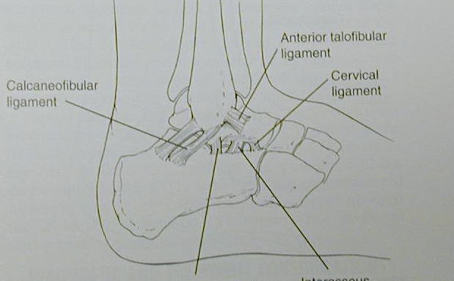
What’s Injured?
Lateral Ankle Ligaments -
ATFL and CFL
ATFL
CFL

Slide 9
High Ankle Sprain = rare, ankle ligament
Lateral Ankle Sprain=common, ATFL/CFL

Slide 10
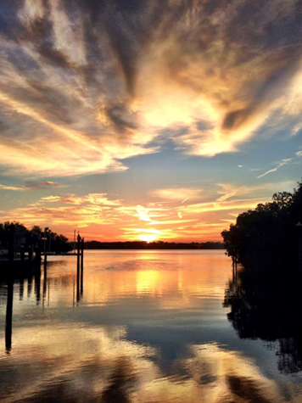
Clinical Findings
Symptoms
Pain, Difficulty Walking, Swelling, Bruising
Severity-Based on Severity of Sprain
Ligaments
Exam
Tenderness on ATFL +/- CFL, Deltoid
Ligament testing
Anterior Drawer

Slide 11
Imaging
X-rays
Usually negative but could have small fractures
MRI will show “tear” of ATFL/CFL
Definition of sprain
Will Always be positive for every sprain

Slide 12
aaaaaaaa
aaaaaa

Slide 13
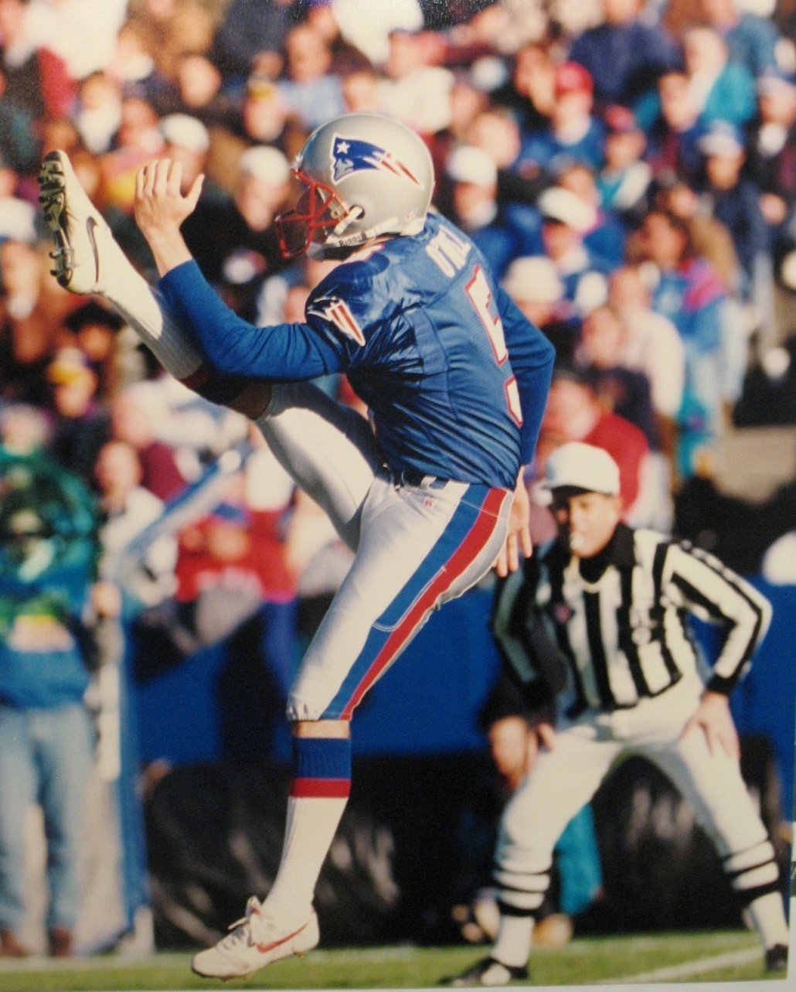
Treatment Goals
Heal ASAP
Treat the injured tissues
Return to ADL’s/sports quickly
Prevent Further Injury Instability
Functional Instability
Inability of ankle to protect itself
from further injury
Structures + Neuro components
Avoid any more sprains

Slide 14
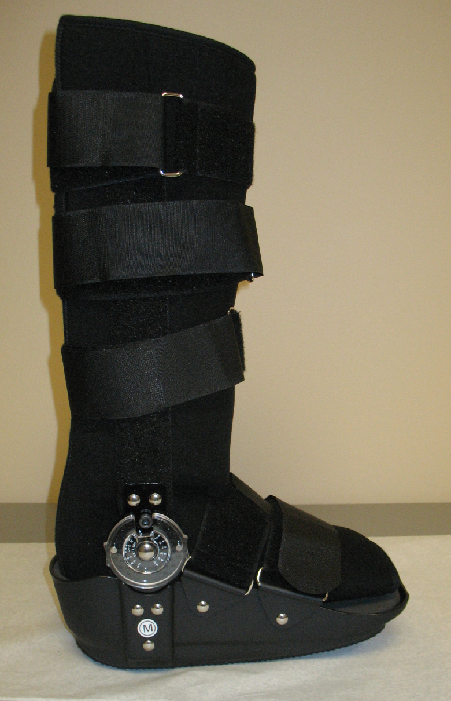
Treatment – Non-Op
Successful most of the time
Rest is key
2-4 weeks based on severity
ICE, Nsaids, rest, boot
Transition to brace
Therapy
Time
Can be 3-4 months for severe
Most improve and heal

Slide 15
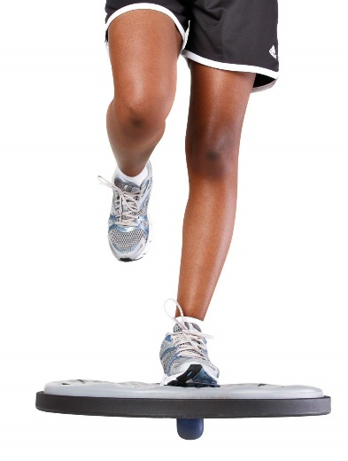
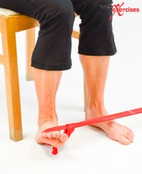
Treatment – Non-Op
Instability
Prevent any more sprains!
Let ligaments/muscles/proprioception heal
Avoid risky activities
Brace/tape if going back early
Physical Therapy
Peroneal strengthening
Proprioceptive training
Teach ankle to be
An ankle again!

Slide 16
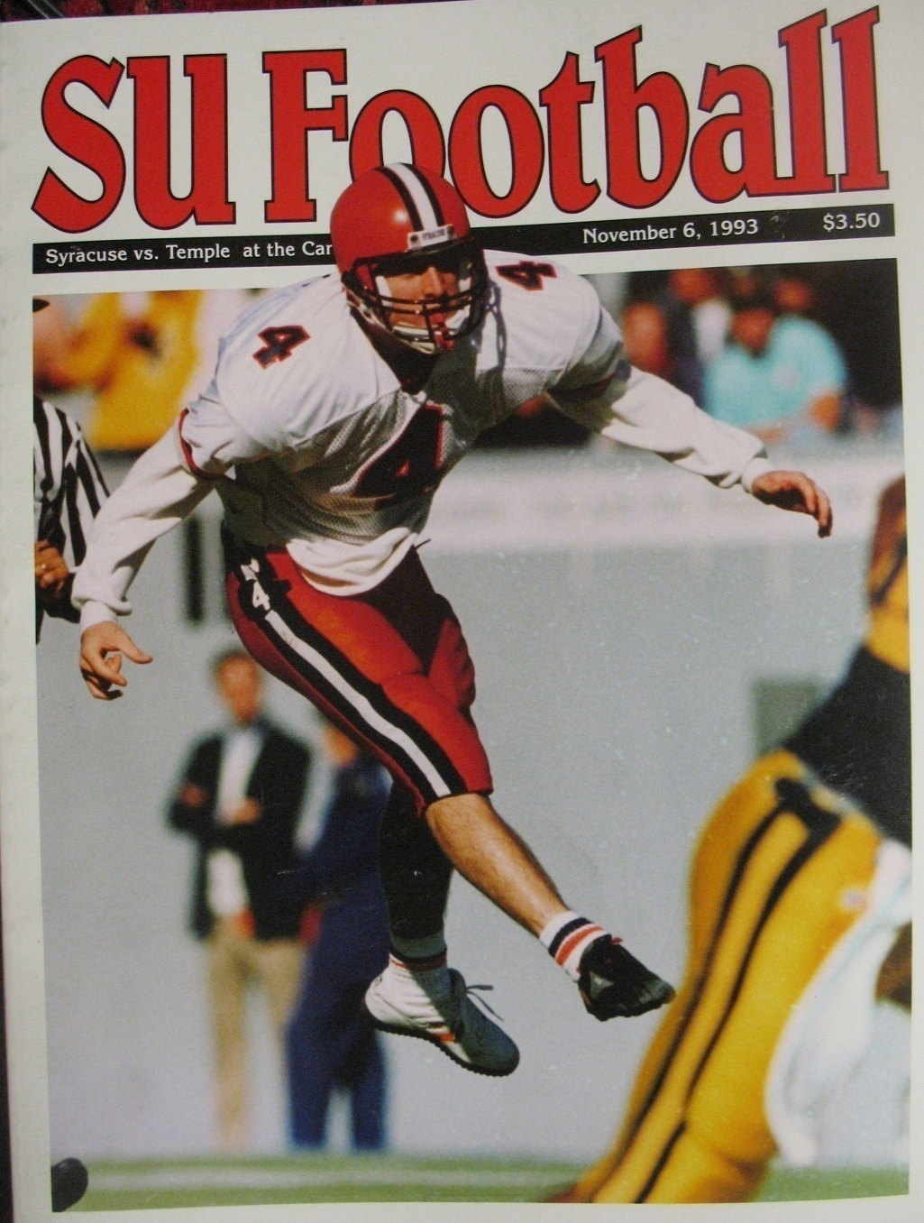
Surgery?
Surgery is rarely needed
Not due to pain
Patients with continued pain have other issue
Patients with recurrent ankle sprain (functional instability)
Failed brace, therapy, etc
Associated injuries

Slide 17
Treatment - Surgery
Repair ATFL and CFL
Ligament to bone (fibula)
Most techniques work well
Anchors, bone tunnels, etc
Roughen the bone surface, then attach
Very successful

Slide 18
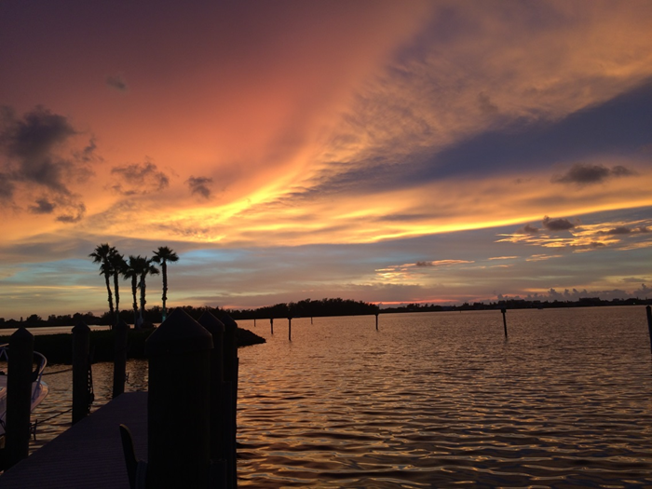
Surgery
Recovery
4 weeks NWB
4 weeks WBAT in boot
Start therapy @6 weeks
No inversion for 3 months
Progress with sports/activities
Protect ankle for 6 months
Very successful
“Reset” the system”
Ligaments and Neuro

Slide 19
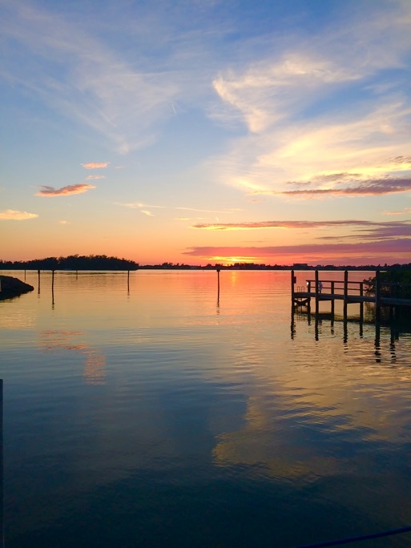
Associated Injuries?
Bones
Tendons
Cartilage
Nerves
High Ankle Sprain

Slide 20
Associated Injuries
Bones
Tender on bone!
Medial, lateral
Xrays show any fractures

Slide 21
Associated Injuries
High Ankle Sprain
Above the ankle
Tender across/above front of ankle
Displaced mortise
Rare isolated injury
Usually has fractures

Slide 22
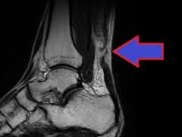
Associated Injuries
Tendons
Peroneal
Posterior tibial
Achilles Rupture
Anterior tibial
Tender on the tendon
MRI

Slide 23
Associated Injuries
Ankle joint cartilage injury
Talus osteochondral lesion (OLT)
Tender across front of ankle
Various patterns of pain
Could hurt right away, in future, or never
CT or MRI

Slide 24
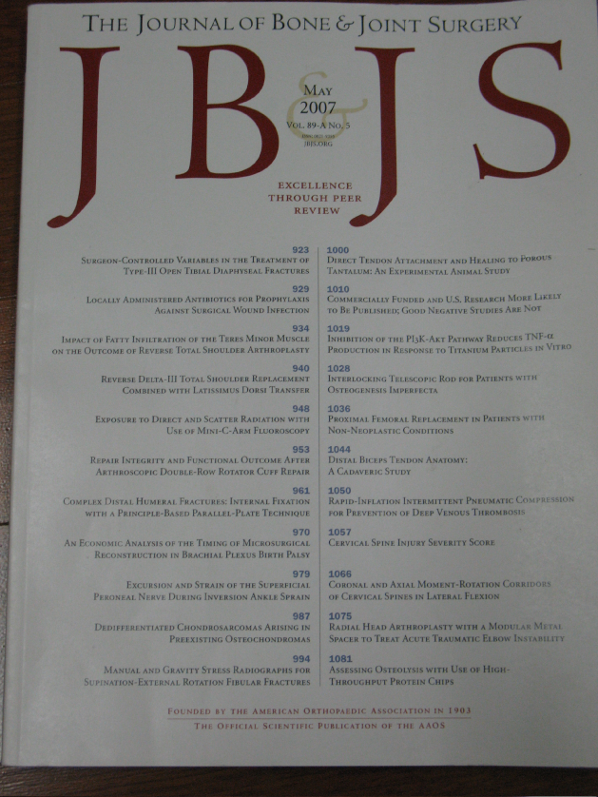
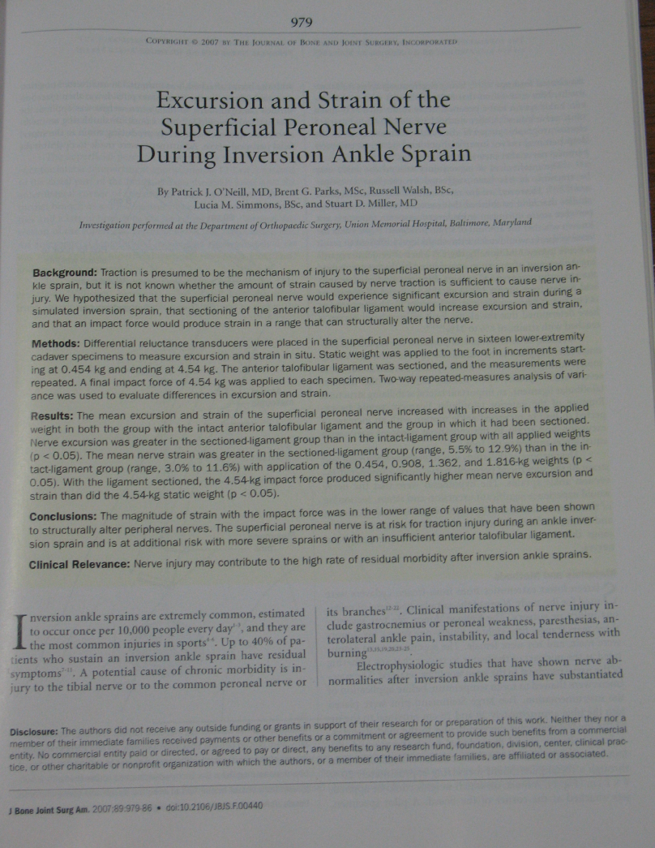
Associated Injuries
Nerve
Sural, SPN
Tingly, Numb,
Radiating pain

Slide 25
Associated Problems
Careful exam
Sprains hurt only on the ATFL/CFL
Follow the severe sprains closely
Continued pain after sprain and time?
Exam
Image

Slide 26
Important Points to Remember
Sprain = Ligament Tear!
Give the sprain time to heal
Can be up to 4-6 weeks initially
Surgery rarely needed, but successful
Therapy can improve most sprains
If not improving, back off/send back to me!
Watch out for other injuries

Slide 27
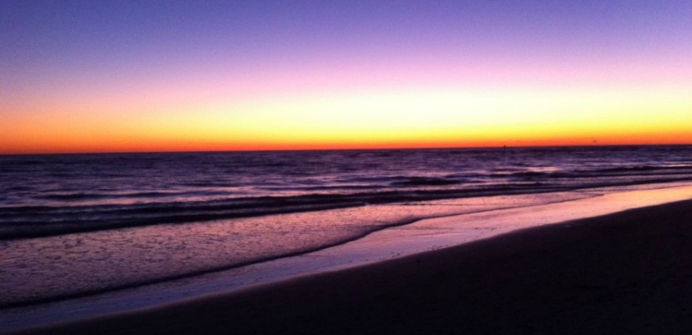
Dr. O’Neill’s Daily Rules
Be nice to your feet
There’s no magic pill
If you’re gonna be dumb, you better be tough
Can’t fix stupid

Slide 28
THANK YOU!

