Slide 1
Wrist Denervation: When, Why, and How
David Chan, MD, PT
Suncoast Orthopaedic Surgery & Sports Medicine
Venice, FL

Slide 2
Wrist Denervation: When, Why, and How
David Chan, MD, PT
Suncoast Orthopaedic Surgery & Sports Medicine
Venice, FL

Slide 3
FINANCIAL DISCLOSURES
NONE
ZERO
ZIP
ZILCH
NADA
Notes:
I’m also a PT
Acknowledge therapists and their good works

Slide 4
DISCUSSION GOALS
REVIEW INDICATIONS FOR DENERVATION
REVIEW SURGICAL TECHNIQUES
REVIEW GOALS

Slide 5
WHEN?
INDICATIONS
WRIST ARTHRITIS (RC, MC, DRUJ, CMC)
POSTTRAUMATIC
SLAC
SNAC
DEGENERATIVE
OA, RA

Slide 6
WHEN?
INDICATIONS
AVASCULAR
PREISER’S
KIENBOCK’S
DYNAMIC INSTABILITY
CONTROVERSIAL
CONSENSUS
ANYTHING REQUIRING ARTHRODESIS

Slide 7
SCAPHOIDECTOMY & PARTIAL INTERCARPAL ARTHRODESIS

Slide 8
PROXIMAL ROW CARPECTOMY

Slide 9
TOTAL WRIST ARTHRODESIS

Slide 10
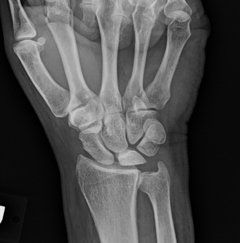
KIENBOCK’S DISEASE

Slide 11
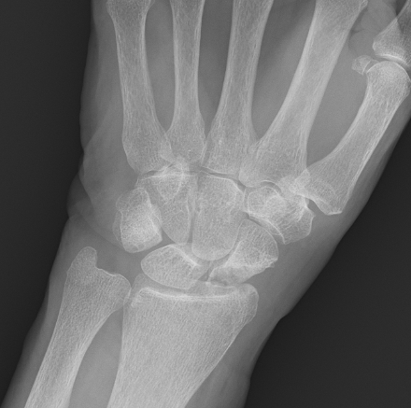
PREISER’S DISEASE

Slide 12
WRIST ARTHROPLASTY

Slide 13
DARRACH

Slide 14
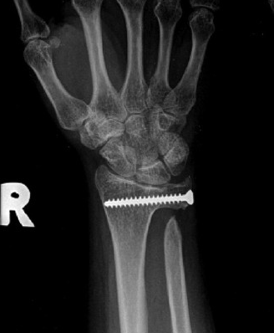
SAUVE-KAPANDJI
Notes:
LONG TRACK RECORD GOOD SUCCESS
ULNAR IMPINGEMENT
OSSIFICATION PSEUDOARTHROSIS
EXTENSOR TENDON RUPTURE

Slide 15
THUMC CMC

Slide 16
COMMONALITY
PERIOPERATIVE MORBIDITY
PROLONGED RECOVERY

Slide 17
DENERVATION - WHY?
AVOID (OR DELAY) DEFINITIVE SALVAGE OPERATIONS

Slide 18
DENERVATION - WHY?
DECREASE PAIN
MINIMIZE MORBIDITY & COMPLICATIONS
MAINTAIN MOTION
EXPEDITE RECOVERY

Slide 19
DENERVATION – HOW?
Notes:
PIN – dorsal RC, intercarpal, 2-4 CMC
DRSN – RC, 1st CMC
Articular branch 1st IO space – 1-2 CMC
DUCN – UC, 4-5 CMC
Deep ulnar perforators – 2-5 CMC, intercarpal
AIN – volar RC & volar DRUJ
PCBMN – 1st CMC
LABC – RC, 1st CMC
MABC - UC

Slide 20
COMPLETE
1ST DESCRIPTION 1959
ALBRECHT WILHELM
TOTAL WRIST DENERVATION

Slide 21
CONTINENTAL DIVIDE
TOTAL DENERVATION
EUROPE
PARTIAL DENERVATION
USA

Slide 22
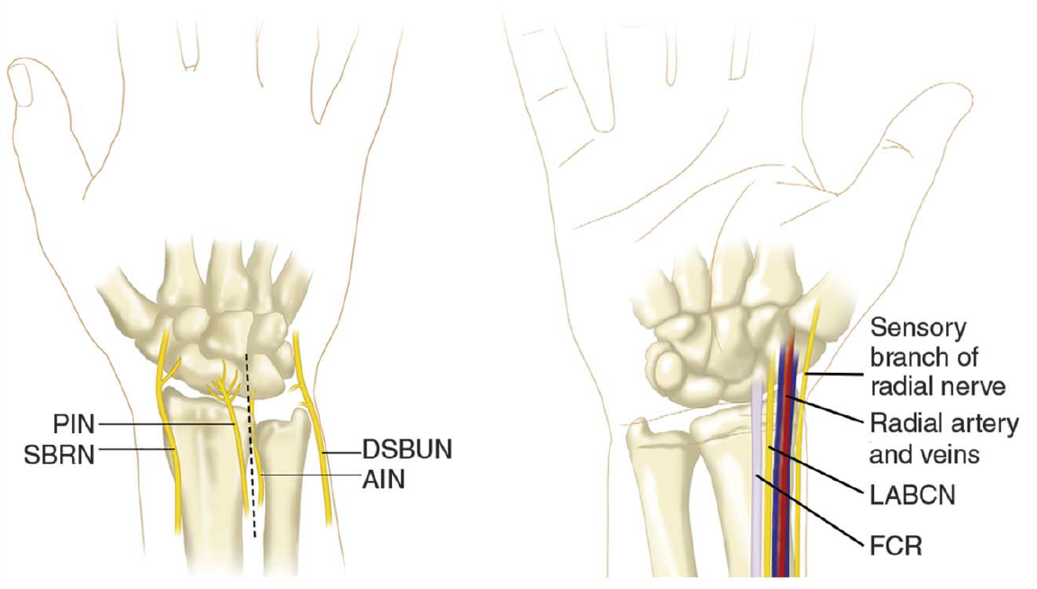
PARTIAL
Single dorsal 3 cm inicision
PIN – floor 4th compartment
Incise IOM
AIN - between IOM & pronator

Slide 23
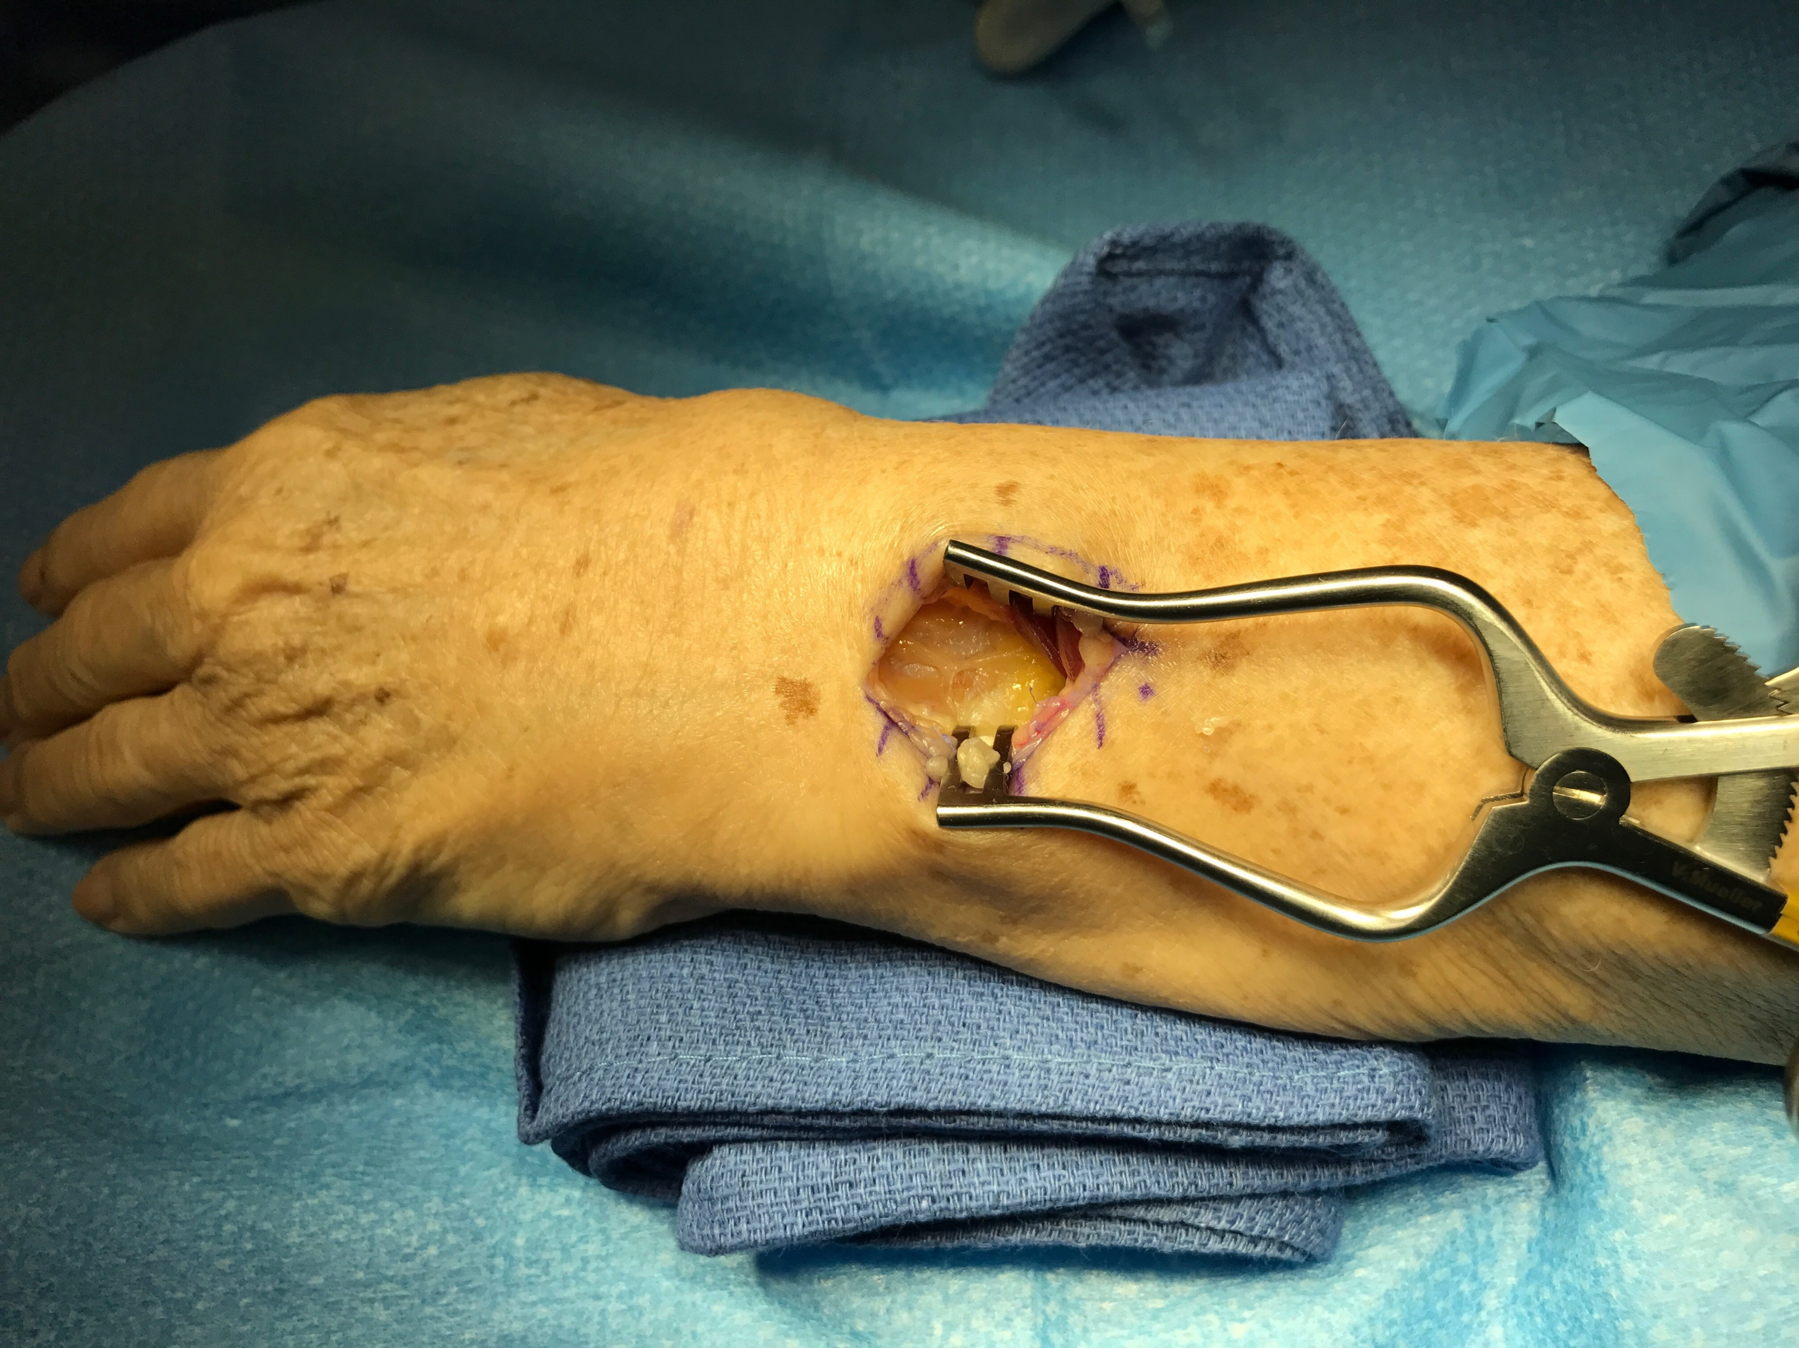
POSTERIOR INTEROSSEOUS NERVE

Slide 24
ANTERIOR INTEROSSEOUS NERVE

Slide 25
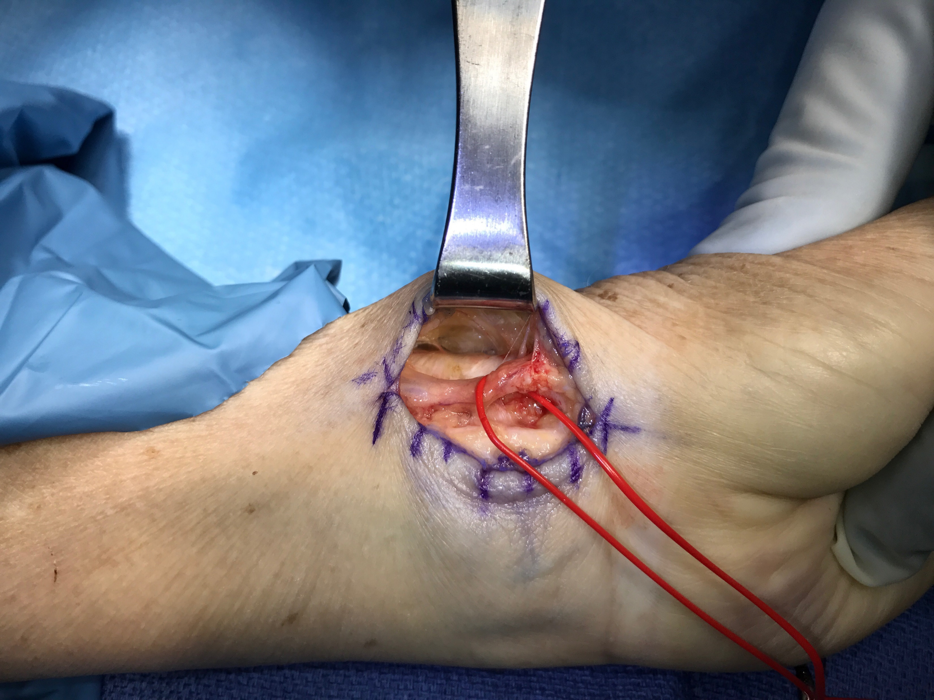
LABC & DRSN PERFORATORS

Slide 26
IS IT SAFE?
Notes:
NO DEVELOPMENT OF CHARCOT JOINTS IN LIT

Slide 27
RESULTS TOTAL DENERVATION
Long-term follow-up evaluation of denervation of the wrist. Schweizer et al. JHS 2006
n = 71, avg age 45
10 year 67% good results
69% would do again
14% second surgery (5 mo – 6 yr)
Notes:
Switzerland
TOTAL denervation
Age 45 yo @ surgery, 55 yo @ f/u
61/70 pt returned to occupation
Best result SLAC
Worst results old DR FX
Results did deteriorate over time in successful pts

Slide 28
RESULTS PARTIAL DENERVATION
Buying time: long-term results of wrist denervation and time to repeat surgery. Berger et al. Hand 2018
20 year retrospective
n=100, age = 54 yo
6.75 yr avg f/u
69% avoided secondary surgery
31% revision surgery @ avg 26 months
Notes:
MAYO study
Mayo wrist score improved 48 → 77
Primary outcome was need for revision surgery

Slide 29
THUMB CMC OA
Thumb CMC joint denervation for primary OA: prospective study 31 thumbs. Giesen et al. Hand Surgery & Rehabilitation June 2017.
1 year improvement
pain reduction
key pinch strength
6 failures – Stage IV OA in 4/6 failed pts
Notes:
European study, ? technique

Slide 30
THUMB CMC OA
Selective thumb CMC joint denervation for painful arthritis: clinical outcomes and cadaveric study. Lifchez et al. Journal of Hand Surgery 2018.
n=12, 15 mo f/u
7/12 Eaton grade III or IV
11/12 complete or near complete resolution of pain
Notes:
Curtis Hand Center Baltimore retro case series
ASSH presentation 2017
Branches PCBMN, DRSN, LABC
Light activites @ 1wk, no restrictions @ 6 wks

Slide 31
PERSONAL RESULTS
14 MONTHS, n = 6
#1 – 73 yoF Preiser’s (golfing at 3 mo)
#2 – 77 yoM SLAC 3 (aerodyne trainer & bicycling @ 2 mo)
#3 – 72 yoM Kienbocks Stage 4 (golfing @ 2.5 mo)
#4 – 58 yoF SLAC 2 (pain relief 1st postop, moved out FL)
#5 – 64yoM SLAC 3 (excellent 1st postop, did not f/u)
#6 – 71 yoM DRUJ & RC PsGout (pain better 40% @ 2mo)

Slide 32
THERAPY CONSIDERATIONS
QUICK RETURN TO FULL FUNCTION
MAINTENANCE PROGRAM
EXACERBATION MITIGATION & PREVENTION

Slide 33
THANK YOU

