Slide 1
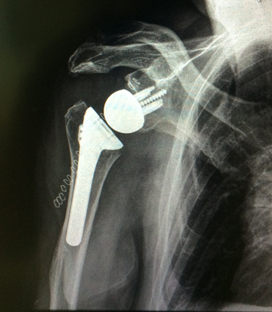
Expanding Indications of Reverse Shoulder Arthroplasty
Derek Cuff, M.D.
Suncoast Orthopaedic Surgery and Sports Medicine
5th Annual Gulfcoast Rehab Conference

Slide 2
Disclosures
DJO Surgical
Consultant
Implant design

Slide 3
Expanding Use of RSA
Goals
Discuss mechanics of RSA
Discuss why its use is growing
Discuss how this affects PT/OT practice

Slide 4
Expanding Use of RSA

Slide 5
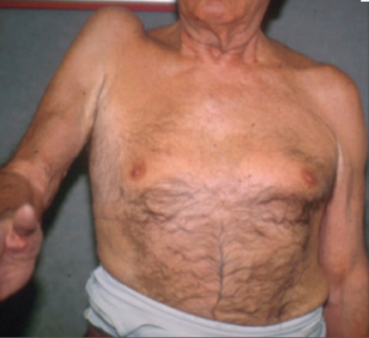
Expanding Use of RSA
FDA approved for use in 2003
Used since the early 1990’s in Europe
Initially approved for treatment of cuff tear arthropathy

Slide 6
Expanding Use of RSA

Slide 7
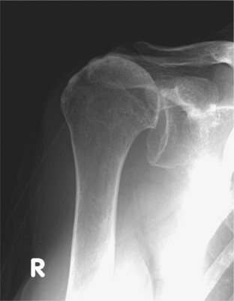

Slide 8
Expanding Use of RSA

Slide 10
Expanding Use of RSA
2008 JBJS publication- Cuff et al.
112 patients (114 shoulders)
94% satisfaction rating
Dramatic improvements in ROM

Slide 11
Expanding Use of RSA
Cuff et al 2017
Same cohort now with minimum 10 year f/u
42 patients left, avg f/u 11 years
Maintained excellent outcomes
91% survivorship for implant

Slide 12
Expanding Use of RSA
Good results = search for new indications
Severe fractures in the elderly

Slide 13
Expanding Use of RSA

Slide 14
Expanding Use of RSA
High failure rate of healing of tuberosities in elderly
55-60% success rate
Many patients do not regain overhead use

Slide 15
Expanding Use of RSA

Slide 16
Expanding Use of RSA
JBJS 2013 Cuff et al.
91% success rate RSA vs 61% of hemi
Avg. forward elevation 140⁰

Slide 17
Expanding Use of RSA
What we have learned:
Great implant for any potential rotator cuff deficiency
Great for any instability issues
Rigid reliable fixation of implant even in bad bone or bone loss cases
This has led to an explosion of indications and use

Slide 18
LAST 12 Months
12 different indications

Slide 19
Expanding Use of RSA
What does this mean for therapist?
Going to see a lot more of these patients
Not a surgery just for shoulder specialists anymore
All surgeons go through a learn curve

Slide 20
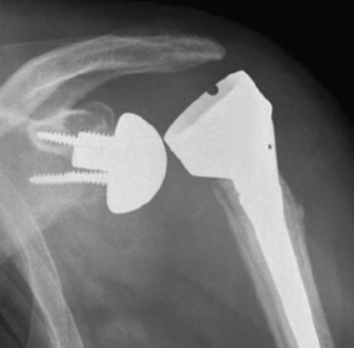
Expanding Use of RSA
What am I seeing?

Slide 21
Expanding Use of RSA
What to watch out for?
Understand the indication
Different diagnosis = different results/concerns
Fully understand the surgeons rehab protocol
Wide variation in how these are rehab

Slide 22
Expanding Use of RSA
Mistakes to avoid
Overaggressive PT
Dislocation IS a risk

Slide 23
Expanding Use of RSA
Acromial fractures
Now the most common complication after RSA
3% incidence nationally
Typically occur 3-4 months post op

Slide 24
Expanding Use of RSA
Acute pain posterior-lateral aspect of shoulder
Cant raise arm at all
Stop all PT/OT
Notify MD ASAP

Slide 25
Expanding Use of RSA

Slide 26
Expanding Use of RSA
What causes these fx’s??
No one knows
Some have concerns about PT

Slide 27
Expanding Use of RSA
My PT protocol:
Weeks 0-6 weeks immobilizer- Pendulums only and elbow/wrist/hand ROM
Weeks 6-8 passive ROM
Weeks 8-10 passive and AA ROM
Weeks 10-12 advancing AROM
Week 12 start light deltoid strengthening

Slide 28
Summary
Use of RSA has skyrocketed
Used to treat a myriad of pathology
PT/OT going to be involved in post-op
Beware of pitfalls (instability and acromial fx)

Slide 29
Thank You

