Slide 1
ACHILLES TENDON INJURIES AND TREATMENT
Joseph Noah, MD
Suncoast Orthopaedic Surgery and Sports Medicine

Slide 2
Lower extremity Anatomy
Achilles tendon is made up of the muscles of the soleus and medial and lateral gastrocnemius and insert on the calcaneus.
Muscles originate from the back of the tibia. The gastrocnemius also has attachment on the posterior femur.
Plantaris tendon

Slide 3
Lower extremity Anatomy
Blood supply to tendon is primarily from the posterior tibial artery
Musculotendinous
Osseotendinous
The paratenon (lining over the tendon)
Watershed area is subject to injury and has poor healing. Also site of tendinopathy

Slide 4
Mechanism of Injury
Injury most common in men
Can be associated with previous Achilles tendinopathy
Forceful plantarflexion with the knee in extension
Forceful dorsiflexion in a plantar flex foot
Flouroquinolone use (cipro or levaquin)

Slide 5
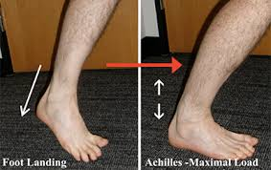
Mechanism of Injury

Slide 6
VIDEO

Slide 7
Clinical History of Injury
Sports related injury (unless associated with meds)
Usually associated with loud “pop”
“Felt like someone hit me over the back of my leg”
May have had previous pain from tendonitis
Swelling and bruising

Slide 8
Diagnosis Achilles tendon injury
History
Exam reveals bruising and swelling
May have a palpable defect over the injured area
Thompson test (lack of plantarflexion with calf squeeze)
Radiographs
MRI

Slide 9
Diagnosis Achilles tendon injury
Radiographs required to rule out fracture and evaluate for a insertional Achilles avulsion

Slide 10
Diagnosis Achilles tendon injury
MRI is helpful in confirming diagnosis and extent of retraction. Not always required in the acute setting.

Slide 11
Achilles tendon tear treatment
Surgical repair usually recommended in the younger athletic patient
Allows for restoration of the anatomy by directly suturing the ends together
Can be done through minimal incisions
Recommended in more chronic injuries

Slide 12
Achilles tendon tear treatment: surgical
Tendon often
appears shredded
Ends are debrided
and then sutured
together.

Slide 13
Achilles tendon tear treatment
Avulsion injuries are usually treated surgically with reinsertion of the tendon down to calcaneus
Anchors often used to secure the tendon and allow for early motion

Slide 14
Achilles tendon tear treatment: surgical
Postop splint in slight plantar flexion. Use crutches/walker.
Placed in walking cast at 1st postop visit (if ankle can be brought to neutral), allow WBAT. Wean off crutches/walker.
Keep in cast until 4 weeks postop. Consider walking boot at that time.

Slide 15
Achilles tendon tear treatment: surgical
After 6-8 weeks allow weaning out of boot using heel wedge in sneaker/shoe
Start formal PT
Regain normal gait and motion
Strengthening by 12 weeks
No sports until 5-6 months postop

Slide 16
Achilles tendon tear treatment: nonsurgical
Nonsurgical treatment has gained recent popularity
Avoids surgery and surgical complications (wound infections)
Maybe great option in less athletic patient or those with medical issues
Re-rupture rates were slightly higher than surgical treatment
Small but statistically significant decrease in plantar flexion strength
Longer time to return to work

Slide 17
Achilles tendon tear treatment: nonsurgical
Acute injury
Patient compliance needed
Short leg cast in plantar flexion (can also use boot with 3 heel wedges). Use Crutches/walker
Start weight bearing in boot with wedges. Continue with crutches/walker
Plantar flexion exercises from position in boot to full plantar flexion. Dorsiflexion back to position in boot
0-2 WEEKS
2-4 WEEKS

Slide 18
Achilles tendon tear treatment: nonsurgical
Gradually remove wedges (one per week) until foot plantigrade in boot. Wean off crutches/walker.
Allow dorsiflexion to neutral. Can start resisted plantar flexion exercises
Aim to remove boot by 12 weeks
Allow dorsiflexion to return normally. No forced dorsiflexion.
Inversion/eversion exercises
Normalize gait
4-8 WEEKS
8-12 WEEKS

Slide 19
Achilles tendon tear treatment: nonsurgical
Proprioceptive exercises
Closed chain exercises
Gradual return to normal activities
12-24 Weeks

Slide 20
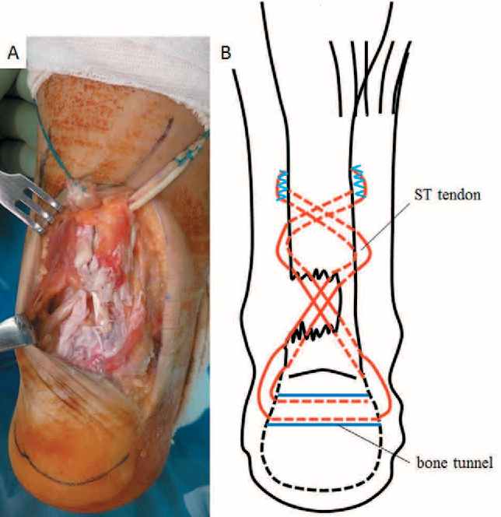
Achilles tendon tear treatment
Successful outcome can be achieved with both surgical or nonsurgical treatments
High level athletes probably best treated with surgery
Surgery also required in bony avulsion
Chronic injuries or neglected tears (late diagnosis) often require surgery

Slide 21
Thank You

